Slide 1


Implementing Anti-racist Practices and Engaging Special Populations, and Underrepresented or Marginalized Groups In Community-based Settings
Marianna Horowitz

Slide 2
Purpose
Identify community settings that provide drug and alcohol recovery supportive services
Identify programs that provide services to vulnerable populations
Identify culturally relevant practices

Slide 3


Evidence-Based Practice Question
What culturally-based practices best support recovery from substance and alcohol use disorders among marginalized, underserved, and underrepresented populations?

Slide 4

Research Methods
Search tools:
Google Scholar
Shippensburg University library resources
Research Parameters
Peer-Reviewed
2015 to 2020
Research terms:
Drug and alcohol use, substance use, and/or addiction recovery
Race, ethnicity, and/or minority
Underserved or Underrepresented
Recovery Community Organizations, Recovery Community Centers, Peer Recovery Support Services

Slide 5
Terms & Definitions
Peer Professional: A person in recovery, from a substance or alcohol use disorder, who has completed education to become certified to operate as a professional to support and enhance substance or alcohol use recovery for others.
Peer Recovery Support Services: Various services offered by a peer professional. These services may include recovery planning, resource brokering, and telephone support services.
Recovery Capital: The resources available to an individual to support their recovery. Recovery capital domains consist of socio-enviro-economic factors.
Recovery Community Centers (rccs): Physical locations that offer non-clinical, community-based, substance use and/or mental health recovery supportive services.
Recovery Community Organizations (rcos): These organizations may have physical spaces, mobile units, or operate without a physical location that can be visited by service recipients. Services may include peer services, mutual-aid meeting space, advocacy, training, outreach, social events, or any combination of these service.

Slide 6
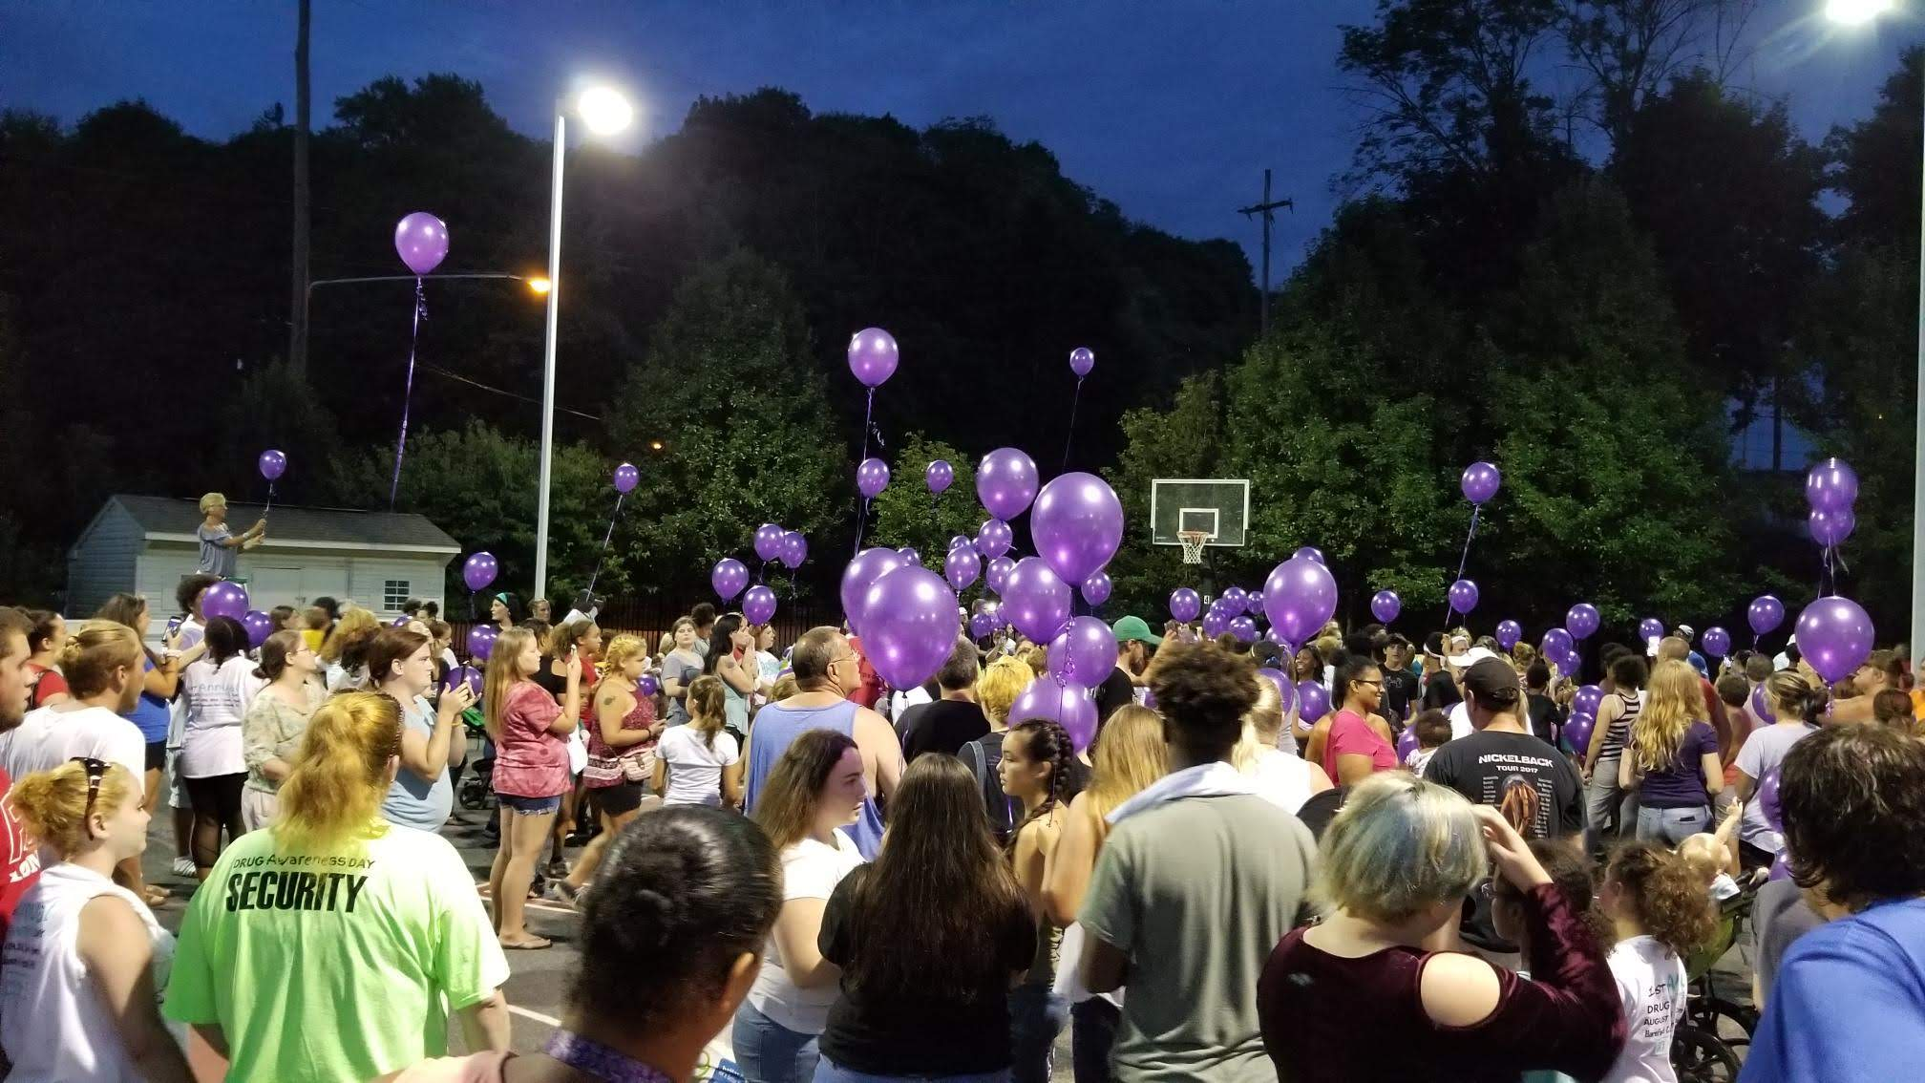
Vulnerable Populations
Adolescents
Criminal justice impacted
Hard to reach
Low income
Medically Underserved
Persons using drugs intravenously
Persons experiencing homelessness
Race and Ethnicity
Native Hawaiian
American Indian
Native Alaskan
Black, African American
LatinX, Latino, Hispanic
LGBTQI+
Mixed Race
Rural Communities
Underrepresented
Public Insured/Uninsured/Underinsured
Urban communities
Veterans

Slide 7
Theme: Community-Based Settings
Peer Recovery Support Services Outreach Programs, and RCOs
Recovery Community Centers (rccs)
Peer recovery support services (PRSS), outreach programs, and rcos are viable for engagement and harm reduction programs for persons currently using substances intravenously. Vulnerable characteristics of participants in this research included persons experiencing homelessness, individuals impacted by criminal justice, LatinX, and LGBTQI+ populations (Ashford, et al., 2018).
This study points to the potential to provide community-based services, in areas where medical services are under available, to vulnerable populations. Vulnerable characteristics of participants in this research included African American, low income, and non-traditional service recipient populations in urban communities (Damian, et al., 2017).

Slide 8

Theme: Adolescents
Research showed that there are five classes of recovery capital. These classes were identified as resource-wealthy recovery capital class; strong social, weak community recovery capital class; religious, resource-poor recovery capital class; strong community recovery capital class; and secular, weak community recovery capital class.
Individuals in the religious, resource poor class, were most likely to have close family relationships, to identify with a race or ethnicity minority population, and more likely to have the least of each recovery capital domains, the lowest health scores, increased financial instability, and to have more peers who did not view marijuana or alcohol use in a disapproving manner (Hennessy, 2018).
American Indian (AI) and Alaska Native (AN) youth indicated community stressors, safety concerns, and a lack of resources. These youth experienced cultural identity issues and encountered incorrect labeling and stereotyping (Dickerson, et al. 2016).
Treatment models are needed to support young people (Damian, et al. 2017).
Social media is the most effective form of recruitment to reach young people in recovery. This method of outreach produced nearly twice as many young people responses in comparison to other methods (Subbaraman, et al., 2015).
This Photo by Unknown Author is licensed under CC BY-SA
Adolescent recovery capital and recovery supportive services should be appropriate to culture and cultural identify, religious belief systems, family structure. Effective outreach and engagement is appropriate for the age range.

Slide 9
Theme: Integrated Care
Medical Setting
Behavioral Health Setting
Research targeted a rural community; medically underserved community members, many of which meet qualifying factors for public insurance; and a substantial minority population.
Utilizing an integrated care model, in a medical setting, for buprenorphine programs is a suitable alternative for rural communities. Offering care in an integrated system circumvents many obstacles faced by rural community members in need of addiction medicine services (Logan, et al., 2019) .
Research targeted community members of a race or ethnicity minority, in an urban community with rates of low-income, homelessness, and community members experiencing accessibility barriers to care. Individuals in this community were also identified as being medically underserved, experiencing vulnerabilities, and being difficult to reach.
Research showed that integrating peer recovery support services into the existing behavioral health system to supplement the behavioral health component of treatment would be beneficial, and seen as favorable, to service recipients (Satinsky, et al., 2020).

Slide 10
Theme: Veterans
Brief interventions for alcohol use received among the veteran population varies across race, ethnicity, and gender domains. These characteristics intersect and form disparities in the rate of which these interventions are received.
In the VA system, research shows race/ethnicity and gender disparities in the rate in which individuals receive brief interventions.
Black women, Black men, and Asian/Pacific Islander women were least likely to receive brief intervention services.
The VA heathcare system utilizes a standardized alcohol screening tool. Research suggests that targeted interventions, rather than a standardized tool, may be more appropriate.
(Chen, et al., 2020)

Slide 11
Theme: Race & Ethnicity
Race and ethnicity factors significantly correlate to quantity of peer engagements with LatinX participants having a decreased likelihood of multiple peer engagements and multiracial participants having an increased likelihood of multiple episodes of peer engagements. Future work is needed to identify vulnerability factors for developing services and implementing them in community-based service settings (Ashford, et al., 2018).
Research shows that mindfulness-based relapse prevention, as a relapse prevention modality, is more effective in Caucasian populations for minimizing an alcohol relapse and more effective in race or ethnic minorities for minimizing a drug relapse. Future work is needed to identify culturally relevant modalities to prevent relapse across different populations (Greenfield, et al., 2018).

Slide 12
Areas of Need: Future Research
Future research is needed to support program delivery and funding to better enable rcos and PRSS community-based service settings in identifying and addressing the needs of vulnerable populations (Ashford, et al., 2018).
Future research is needed to understand various forms of peer service delivery, types of services, quantity and frequency in which services are received, the context of service delivery, and the role of cultural context in peer support service settings (Bassuk, et al. 2016).
Future research is needed on correlating factors of alcohol use and medical conditions worsened by alcohol use among African American women. Additional future research topics may include alcohol and drug use studies on gender and race/ethnicity among Asian American, Pacific Islander, American Indian, and Alaskan Native populations to better understand culturally relevant treatment needs (Chen, et al., 2020).
Future research is needed on the impact of housing and homelessness on treatment and recovery (Damian, et al., 2017).

Slide 13
Areas of Need: Future Research Continued
Future research is needed to more fully understand factors of recurrence of use. Additional future research suggestions include factors related to race and ethnicity and treatment outcomes, treatment modalities, and geographical factors (Greenfield, et al., 2018).
Future research is needed on youth supports and vulnerabilities in youth-based recovery supportive services. Additional research is also needed to better understand recovery capital and vulnerabilities (Hennessy, 2018).
Future research is needed to understand a broader geographical catchment area, to further explore community demographics, and to provide reliability of rcc domains (Kelly, et al., 2020).

Slide 14
Areas of Need: Future Research Continued
Future research is needed to expand evidence-based services and integrated care into rural communities. Additional research is needed to understand the difficulties for, and needs of, practitioners serving rural communities to identify their barriers to practice and continuing education. Researchers cited several barriers impacting practitioners as they pertain to those living off the mainland U.S. (Logan, et al., 2019).
Future follow up research may target other geographic locations, size and type of communities, and incorporate women into the sample (Manuel, et al., 2017).
Further research is needed to understand barriers specific to substance use disorder treatment in comparison to behavioral health treatment (Satinsky, et al., 2020).
Research on recovery is needed to drive best practices, good policy, and adequate funding for recovery supportive services. Multifaceted approaches for recruiting recovery-based research samples is needed (Subbaraman, et al., 2015).

Slide 15
Targeting & Engagement for Future Research
Research showed that online platforms and mutual aid groups yielded underrepresented minority and treatment naïve populations.
Rco’s are more likely to reach African American and rural populations.
Social media is the most effective form of recruitment to reach young people in recovery. This method of outreach produced nearly twice as many young people responses in comparison to other methods.
Individuals who have less education, those who are in earlier recovery, individuals in natural recovery, and those not exercising complete abstinence were more likely to be reached through social media outlets.
The most effective methods for reaching underrepresented race groups; populations who had no previous episodes of treatment; individuals who were not exposed to 12-step mutual aid groups; and non-abstaining individuals were identified as other sources, family and friends, craigslist, social media, and non-12-step self-help groups.
Treatment samples had less female and less individuals who were 65 years of age and older.
Web-based surveys may yield less respondents who identify as Hispanic and other racial minorities.
(Subbaraman, et al., 2015)

Slide 16
Conclusion
All studies indicated a need for intersectional framework in designing and implementing culturally appropriate services (Ashford, et al., 2018; Bassuk, et al., 2016; Chen, et al., 2020; Damian, et al., 2017; Dickerson, et al., 2016; Greenfield, et al., 2018; Hennessy, 2018; Kelly, et al., 2020; Logan, et al., 2019; Manuel, et al., 2017; Satinsky, et al., 2020; Subbaraman, et al., 2015)
Of research conducted:
5 studies included age data sets to indicate the need for age-appropriate and cultural appropriate services for youth populations (Damian, et al., 2017; Dickerson, et al., 2016; Hennessy, 2018; Subbaraman, et al., 2015).
3 studies included criminal justice data sets to indicate the need to consider impacts of criminal justice system involvement in designing and implementing appropriate services (Ashford, et al., 2018; Kelly, et al., 2020; Manuel, et al., 2017).
3 studies included housing risk data sets to indicate the need for housing supportive services to individuals with intersecting vulnerable identity markers (Ashford, et al., 2018; Damian, et al., 2017; Manuel, et al., 2017; Satinsky, et al., 2020).
4 studies included public, underinsured, or uninsured data sets that indicate policy needs for appropriate funding to increase accessibility to non-traditional services for vulnerable populations (Damian, et al., 2017; 2018 Hennessy, 2018; Logan, et al., 2019; Manuel, et al., 2017).

Slide 17
References
Ashford, R.D., Curtis, B. & Brown, A.M. (2018). Peer-delivered harm reduction and recovery support services: Initial evaluation from a hybrid recovery community drop-in center and syringe exchange program. Harm Reduction Journal, 15(1). https://doi.org/10.1186/s12954-018-0258-2
Bassuk, E. L., Hanson, J., Greene, R. N., Richard, M., & Laudet, A. (2016). Peer-delivered recovery support services for addictions in the united states: A systematic review. Journal of substance abuse treatment, 63, 1–9. https://doi.org/10.1016/j.jsat.2016.01.003
Chen, J. A., Glass, J. E., Bensley, K. M. K., Goldberg, S. B., Lehavot, K., & Williams, E. C. (2020). Racial/ethnic and gender differences in receipt of brief intervention among patients with unhealthy alcohol use in the U.S. Veterans Health Administration. Journal of Substance Abuse Treatment, 119. https://doi.org/10.1016/j.jsat.2020.108078
Damian, A. J., Mendelson, T., & Agus, D. (2017). Predictors of buprenorphine treatment success of opioid dependence in two Baltimore city grassroots recovery programs. Addictive behaviors, 73, 129–132. https://doi.org/10.1016/j.addbeh.2017.05.010
Dickerson, D. L., Brown, R. A., Johnson, C. L., Schweigman, K., & D'Amico, E. J. (2016). Integrating motivational interviewing and traditional practices to address alcohol and drug use among urban American Indian/Alaska Native youth. Journal of substance abuse treatment, 65, 26–35. https://doi.org/10.1016/j.jsat.2015.06.023
Greenfield, B. L., Roos, C., Hagler, K. J., Stein, E., Bowen, S., & Witkiewitz, K. A. (2018). Race/ethnicity and racial group composition moderate the effectiveness of mindfulness-based relapse prevention for substance use disorder. Addictive Behaviors, 81, 96–103. https://doi.org/10.1016/j.addbeh.2018.02.010
Hennessy, E. A. (2018). A latent class exploration of adolescent recovery capital. Journal of Community Psychology, 46(4), 442–456. https://doi.org/10.1002/jcop.21950
Kelly, J. F., Fallah-Sohy, N., Vilsaint, C., Hoffman, L. A., Jason, L. A., Stout, R. L., Cristello, J. V., & Hoeppner, B. B. (2020). New kid on the block: An investigation of the physical, operational, personnel, and service characteristics of recovery community centers in the United States. Journal of Substance Abuse Treatment, 111, 1–10. https://doi.org/10.1016/j.jsat.2019.12.009
Logan D.E., Lavoie A.M., Zwick W.R., Kunz K., Bumgardner M.A., Molina Y., (2019) Integrating addiction medicine into rural primary care: Strategies and initial outcomes. Journal of Consulting and Clinical Psychology, 87(10):952-961. doi:10.1037/ccp0000410
Manuel, J. I., Yuan, Y., Herman, D. B., Svikis, D. S., Nichols, O., Palmer, E., & Deren, S. (2017). Barriers and facilitators to successful transition from long-term residential substance abuse treatment. Journal of Substance Abuse Treatment, 74, 16–22. https://doi.org/10.1016/j.jsat.2016.12.001
Satinsky, E. N., Doran, K., Felton, J. W., Kleinman, M., Dean, D., Magidson, J. F., & Myers, B. (2020). Adapting a peer recovery coach-delivered behavioral activation intervention for problematic substance use in a medically underserved community in Baltimore city. PLoS ONE, 1, 15(1), e0228084. https://doi.org/10.1371/journal.pone.0228084
Subbaraman, M. S., Laudet, A. B., Ritter, L. A., Stunz, A., & Kaskutas, L. A. (2015). Multi-source recruitment strategies for advancing addiction recovery research beyond treated samples. Journal of community psychology, 43(5), 560–575. https://doi.org/10.1002/jcop.21702

