Slide 1
WELCOME
Peer Recovery Support Services

Slide 2
Building A Family
Recovery Community Organization
Recovery Leadership Summit 2023
Presented by
Pam Lanhart, Founder
Co-Executive Director of Programs
Thrive Family Recovery Resources

Slide 3
THRIVE FAMILY RECOVERY RESOURCES
Founded in 2016 as Thrive Family Support under fiscal sponsor
2021 became Thrive Family Recovery Resources
Family Recovery Community Organization
October 2022, MN DHS Grant Awardee to provide One-on-One Peer Support Evidence-Based Family Psychosocial Educational Workshop CRAFT and Invitation to Change Family Recovery Groups Resource Navigation

Slide 4
Learning Objectives
Explain Recovery Oriented Family Systems using Evidence Based Practices
Define holistic family recovery using multiple pathways
Discuss the importance of the family system in the process of recovery and the data that supports the outcomes when families are involved in the recovery process
Discuss the differences between a regular recovery community organization and a family recovery community organization

Slide 5

ADDICTION AND THE FAMILY
23 million people in active addiction
For every 1 person with a substance use disorder, 4 loved ones are negatively impacted
Just 1 person can start to change the entire family eco-system

Slide 6

Why Do Families Matter?
When families are educated, supported and equipped they can become one of the most valuable resources in the recovery process.

Slide 7
Why Do Families Matter?
Families are a valuable source of support for the management of illness
Families provide a more accurate picture of the individual’s symptoms
Families are the primary source of many health-related beliefs and behaviors
Families care the most
Stand to gain the most in recovery
Have the most regular contact with their loved one

Slide 8
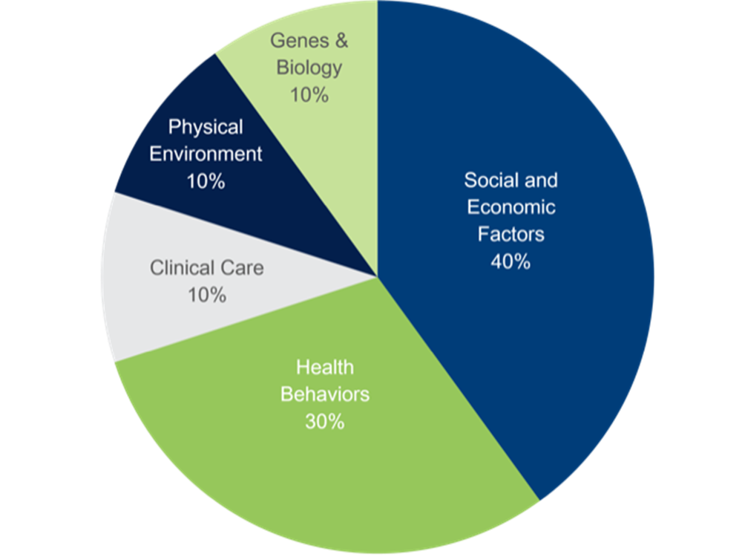
Determinants of Health
Social determinants of health (SDOH) are the non-medical factors that influence health outcomes. They are the conditions in which people are born, grow, work, live, and age, and the wider set of forces and systems shaping the conditions of daily life.

Slide 9
Grass-Roots
Robust programs and services
Holistic
Supports Multiple Pathways
Notes:
Up to 80% of Adults with a sud live with their parents in the US
64% of people with an opioid use disorder have daily contact with their families
Using the Arise model 96% of subjects using a comprehensive family care model engaged in treatment within 6 months and when the entire family was involved 71% were either sober or had reduced use at the 1 year mark
ARISE data citation

Slide 10
Family Peer Services are not just support
Notes:
Up to 80% of Adults with a sud live with their parents in the US
64% of people with an opioid use disorder have daily contact with their families
Using the Arise model 96% of subjects using a comprehensive family care model engaged in treatment within 6 months and when the entire family was involved 71% were either sober or had reduced use at the 1 year mark
ARISE data citation

Slide 11
Person Centered One-on-One Peer Support
Psycho-social Education
Group Support
Connection to Resources
Advocacy
Notes:
Up to 80% of Adults with a sud live with their parents in the US
64% of people with an opioid use disorder have daily contact with their families
Using the Arise model 96% of subjects using a comprehensive family care model engaged in treatment within 6 months and when the entire family was involved 71% were either sober or had reduced use at the 1 year mark
ARISE data citation

Slide 12
What is recovery?
re·cov·er·y
1. A return to a normal state of health, mind, or strength
2. The action or process of regaining a possession or control of something that was stolen or lost
Notes:
Up to 80% of Adults with a sud live with their parents in the US
64% of people with an opioid use disorder have daily contact with their families
Using the Arise model 96% of subjects using a comprehensive family care model engaged in treatment within 6 months and when the entire family was involved 71% were either sober or had reduced use at the 1 year mark
ARISE data citation

Slide 13
Creating Holistic Support for the Family using a person-centered approach
Notes:
Up to 80% of Adults with a sud live with their parents in the US
64% of people with an opioid use disorder have daily contact with their families
Using the Arise model 96% of subjects using a comprehensive family care model engaged in treatment within 6 months and when the entire family was involved 71% were either sober or had reduced use at the 1 year mark
ARISE data citation

Slide 14
Training for our Family Peer Specialists
Identify areas the the family members need to reclaim
Create SMART goals for creating health and well-being in critical areas
Identifying potential boundaries that need to be set
Engaging the entire family in the process of working together towards healthy goals

Slide 15
One-on-One Peer Support
Notes:
Up to 80% of Adults with a sud live with their parents in the US
64% of people with an opioid use disorder have daily contact with their families
Using the Arise model 96% of subjects using a comprehensive family care model engaged in treatment within 6 months and when the entire family was involved 71% were either sober or had reduced use at the 1 year mark
ARISE data citation

Slide 16
8
Dimensions
of
Wellness
Emotional
Environmental
Financial
Social
Intellectual
Physical
Spiritual
Occupational
Notes:
Up to 80% of Adults with a sud live with their parents in the US
64% of people with an opioid use disorder have daily contact with their families
Using the Arise model 96% of subjects using a comprehensive family care model engaged in treatment within 6 months and when the entire family was involved 71% were either sober or had reduced use at the 1 year mark
ARISE data citation

Slide 17
Using the 8 Demensions to:
Identify areas the the family members need to reclaim
Create SMART goals for creating health and well-being in critical areas
Identifying potential boundaries that need to be set
Engaging the entire family in the process of working together towards healthy goals

Slide 18
Identifing Values
What matters to me?
How do I want to show up for the world around me?
Am I aligned with those values and making decisions with intention?
Do I have the ability to self-regulate and self-reflect?

Slide 19
Evidence Based Actional Solutions
CRAFT, Motivational Interviewing and
Acceptance and Commitment Therapy
Functional Analysis
Communications skills using OARS, LOVE and SURF
Reinforcing and rewarding positive behaviors
Allowing for natural consequences (does this action support continued use or recovery)

Slide 20
Bonding before Boundaries
Am I in relationship or do I need to work on connection first?
Does the boundary I am setting align with my values?
Can I effectively follow through on the boundary I’m setting?
Am I communicating boundaries while still honoring the person I’m in front of?

Slide 21
HARM REDUCTION AS A FAMILY STRATEGY
Harm reduction saves lives
Meeting someone where they are at
Self-efficacy
Agency in decisions
Naloxone availability and training
Access to syringe service programs
Notes:
First do no harm

Slide 22
Group Support
Notes:
Up to 80% of Adults with a sud live with their parents in the US
64% of people with an opioid use disorder have daily contact with their families
Using the Arise model 96% of subjects using a comprehensive family care model engaged in treatment within 6 months and when the entire family was involved 71% were either sober or had reduced use at the 1 year mark
ARISE data citation

Slide 23
Why Invitation to Change and CRAFT?
Invidual person centered approach
Combination of “way of being” work, practices of acceptance and skills
No one-size-fits all. Supports harm reduction and any pathway their loved one chooses
Robust materials (that I didn’t have to write myself)
Data driven, evidence based

Slide 24
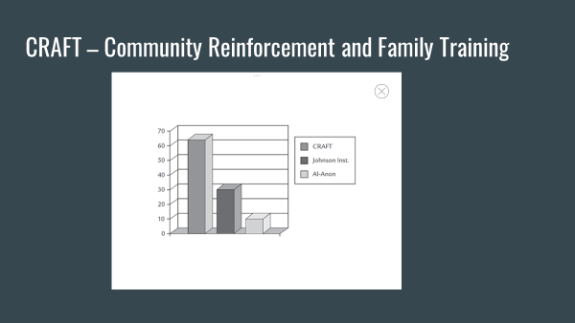

Slide 25
Educational Workshops
Notes:
Up to 80% of Adults with a sud live with their parents in the US
64% of people with an opioid use disorder have daily contact with their families
Using the Arise model 96% of subjects using a comprehensive family care model engaged in treatment within 6 months and when the entire family was involved 71% were either sober or had reduced use at the 1 year mark
ARISE data citation

Slide 26
Community Needs Assessment
One hour, 3 hour and 6 hour workshops
Informed by CRAFT, Motivational Interviewing and other evidence-based practices
Helping families and community members understand the science and behaviors of substance use
Challenging stigma, language and stereo types associated with substance use
Opportunity to engage families to determine interest in local support groups

Slide 27
Resource Navigation
Notes:
Up to 80% of Adults with a sud live with their parents in the US
64% of people with an opioid use disorder have daily contact with their families
Using the Arise model 96% of subjects using a comprehensive family care model engaged in treatment within 6 months and when the entire family was involved 71% were either sober or had reduced use at the 1 year mark
ARISE data citation

Slide 28
When a person is ready, there is a small window
Understanding systems of care, particularly in the individuals state
Developing a network of all types of treatment programs, levels of care and funding sources
Understanding the steps to withdrawal management
Supporting medications for opioid use disorder
Partnering with recovery community organizations throughout the state and nationally

Slide 29
Advocacy
Notes:
Up to 80% of Adults with a sud live with their parents in the US
64% of people with an opioid use disorder have daily contact with their families
Using the Arise model 96% of subjects using a comprehensive family care model engaged in treatment within 6 months and when the entire family was involved 71% were either sober or had reduced use at the 1 year mark
ARISE data citation

Slide 30
Family Voices Matter
Discovery – find out what your state policies are regarding funding for family run organization
Advocate for legislation that supports funding for family run organizations
Discover the process of certification for family peer services
Billable services

Slide 31
Strategic Planning
Do it well, before you do more
Data management, deliverables and outcomes (numbers and improvements)
Needs assessments. What next?
Engaging and training volunteers

Slide 32
Funding
Fee for services
Foundation Grants
State grants – rewarded as an emerging recovery community organization
Memorandums of understand in partnership with recovery community organizations

Slide 33
Partnering with RCO’s
Guidance from long-standing members
Referrals from RCO’s
Referrals to RCO’s (warm handoffs)
Ongoing back-end support from current RCO’s

Slide 34
Partnering with Community Members
Every family has been impacted by substance use
Intetifying community partners such as county chemical health, county social workers, faith-communities, schools, first responders, medical facilities
Show up
Participate in other organizations events (you don’t have to be the headliner

Slide 35
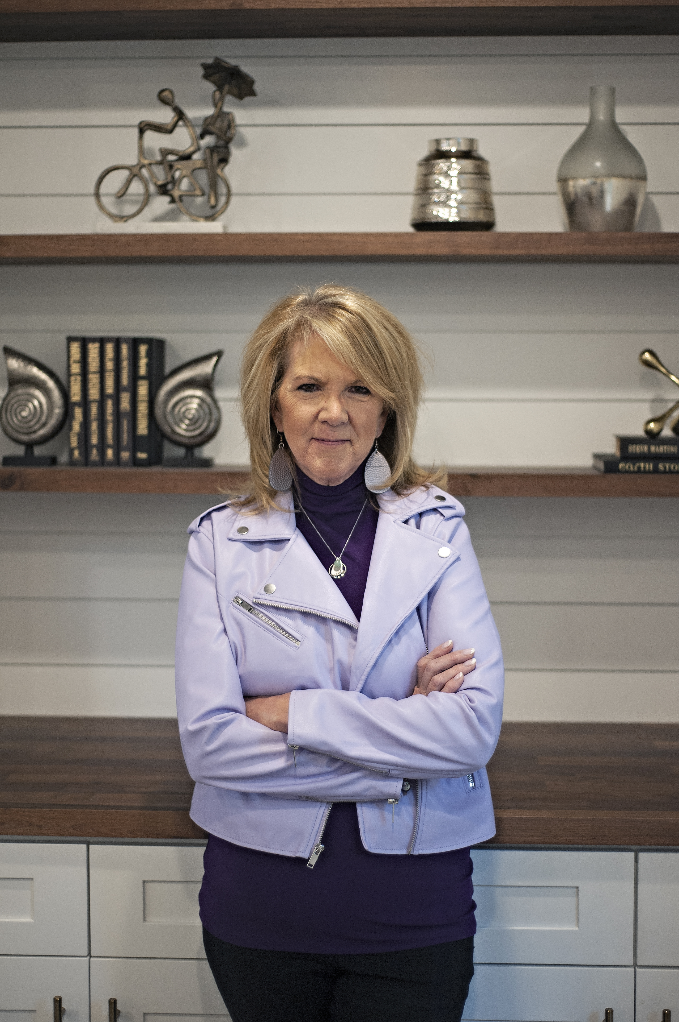
THANK YOU!
Pam Lanhart
Thrive Family Recovery Resources
Pam.lanhart@thrivefamilyrecoveryresources.org
www.thrivefamilyrecoveryresources.org
www.pamlanhart.com
Notes:
Thrive logo and website

Slide 36
Reference Slide
Robert Meyers - CRAFT
Jeff Foote - Beyond Addiction: How Science and Kindness Help People Change
Jeff Foote - Invitation to Change
Judith Landou - Arise Intervention
William R. Miller - Motivational Interviewing
Prochaska and DiClemente 1983 - Stages of Change
Bill Hettler - 8 Dimensions of Wellness
Notes:
Links to go to for these actionable solutions

Slide 37
