Slide 1
WELCOME
Advocacy and Outreach

Slide 2

Peggy Bonneau, NYS OASAS
The Intersectionality of Advocacy and Public Health in New York State
Office of the NYS Behavioral Health Ombudsman Program - CHAMP
Faces & Voices
June 2023
Stephanie Campbell, Director, NYS Office of the Behavioral Health Ombudsman Program (CHAMP)

Slide 3
Need for CHAMP
Latest provisional data from the Centers for Disease Control and Prevention (CDC) estimates that almost 109,680 people died of a drug overdose in 2022
Suicide is now the 2nd leading cause of death for 1-44 age group, and numbers of suicides continue to rise.
CDC study documents rise in adolescent suicide attempts during pandemic. The increase started in May 2020 with a particularly alarming spike among girls aged 12–17 from February to March 2021.
Former Congressman Patrick J. Kennedy (D-R.I.), the co-author of the Mental Health Parity and Addiction Equity Act (MHPAEA), noted that “access restrictions fan the flames of the opioid crisis and suicide deaths, two of the most urgent public health challenges we face as a nation.”
Access to insurance benefits and SUD/MH care continue to be a primary problem.
Source: https://www.cdc.gov/nchs/nvss/vsrr/drug-overdose-data.htm
Source: Emergency Department Visits for Suspected Suicide Attempts Among Persons Aged 12–25 Years Before and During the COVID-19 Pandemic — United States, January 2019–May 2021 | MMWR (cdc.gov)

Slide 4
Need for Statewide Ombudsman Office
According to the 2020 National Survey on Drug Use and Health, among the 41.1 million people who needed treatment for substance use disorders (SUD), only 2.7 million (6.5-percent) of them received treatment at a specialty treatment facility over the previous year. One reason for this gap is that people with addiction and those who care for them face too many barriers to treatment.
Health inequities impacted by social determinants of health and exacerbated by COVID-19, have disproportionately impacted BIPOC communities, resulting in a sharp increased number of recorded overdose deaths.
The spike in overdose deaths and social determinants of health disparities require a targeted response to the increase demand for addiction and mental healthcare services.
States are finding new ways, to reach communities hardest hit by the pandemic, to reduce barriers that prevent vulnerable populations from accessing care that addresses their health needs.

Slide 5
CHAMP Accomplishments
Since launching, CHAMP:
Handled 6,534 (CHAMP: CBOs, Specialists, Helpline) + Ombudsman Director (1,671) = 8,205 total cases
Reached over 315,000 people through outreach and education

Slide 6
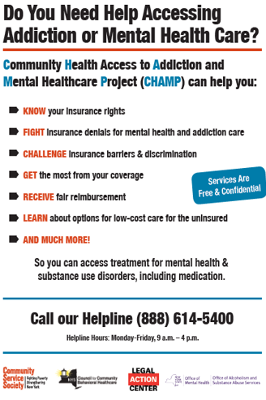
CHAMP
The 2018 Executive Budget established the first-in-the-nation Office of the Independent Substance Use Disorder and Mental Health Ombudsman program, Section 33.27 of the Mental Hygiene Law.
The program, also known as the Community Health Access to Addiction & Mental Healthcare Project (CHAMP), assists individuals with an SUD/MH condition with using their health insurance coverage and to identify, investigate, refer and resolve complaints made by, or on behalf of, consumers regarding their coverage.
CHAMP also helps SUD/MH providers resolve their patients’ insurance problems and assists New Yorkers with accessing SUD/MH treatment, including medication, as well as other related social determinant of health needs including transportation, housing, and peer services.

Slide 7
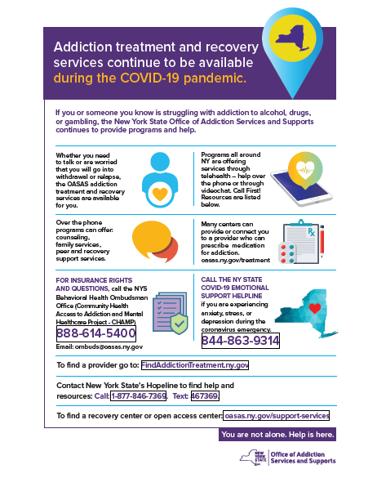
What CHAMP Does
Insurance coverage
Training & Technical Assistance
Appeals
complaints
Outreach/engagement
Community education
Complex cases
Casework (access to care)

Slide 8
CHAMP Structure
CSS:
-Helpline
-Learning community
-Contracts, Budgets, Invoices
-Quality Assurance
-Reporting to State
-Sentinel function
CBOs:
-Outreach in their communities
-Client services in their communities
Specialists:
-TA
-Training
-Complex Cases (MRC)
CHAMP CBOs:
Adirondack Health Institute
Community Health Action for Staten Island
Family & Children’s Association
Family & Children’s Counseling Services
Save the Michaels of the World
AIM Independence
Andreus
Phoenix House
Second Chance Opportunities
CHAMP Specialists:
Legal Action Center
Medicare Rights Center
NYS Council for Community Behavioral Healthcare
Notes:
New CBOs (as of Dec. 2022)
AIM Independence will provide education and services in the Southern Tier, with an emphasis on Chemung, Schuyler, and Steuben counties. AIM offers a diverse range of support services, focusing on people with disabilities, the uninsured and underinsured, and those with substance use and/or mental health conditions.
Andreus will provide education and services in Westchester County. Andreus has a proven record of providing a full continuum of care for expectant mothers, children and young adults with mental health and substance use issues, with a focus on health equity.
Phoenix House will provide education and services in New York City for low-income and uninsured individuals with a substance use or mental health condition, or in recovery. Phoenix House has a robust peer-outreach infrastructure of professionals with lived experience that has been leveraged for community outreach and engagement.
Second Chance Opportunities (SCO) will provide education and services in the Capital District region. SCO employs individuals with lived experience who work collaboratively with local communities to help individuals and families access many services, including treatment, and recovery supports, for individuals with mental health and substance use conditions.

Slide 9
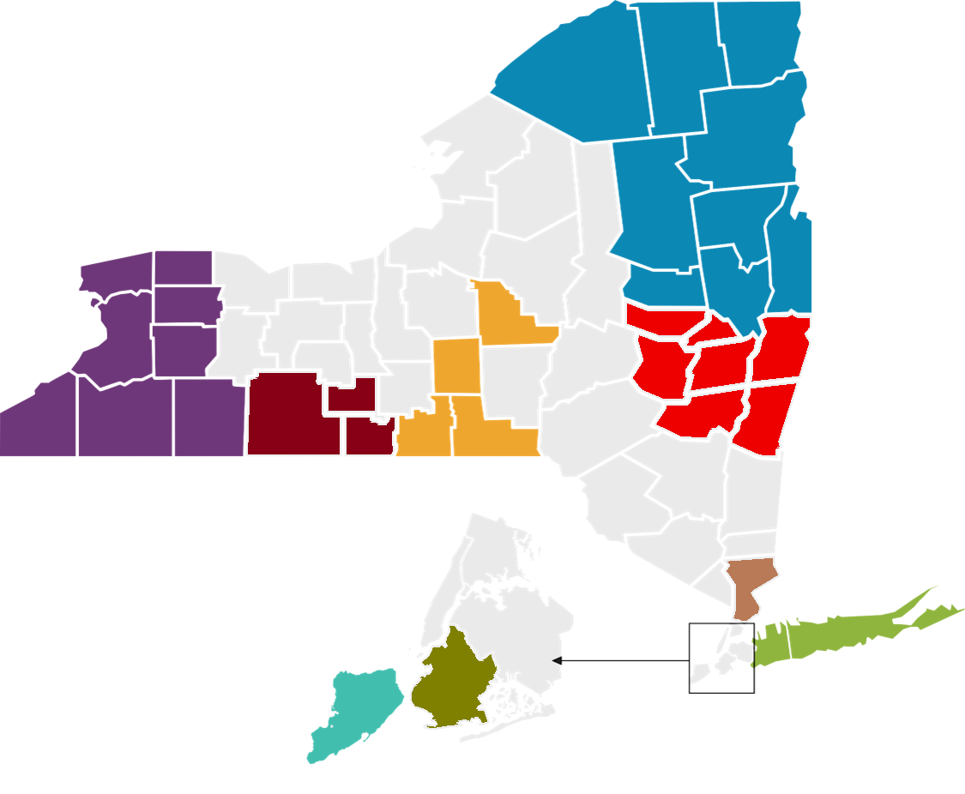

CHAMP
Franklin
Clinton
Community Health Access to Addiction & Mental Healthcare Project)
(
Essex
Lewis
St. Lawrance
Herkimer
Hamilton
Jefferson
Warren
Network Map
Oswego
Orleans
Monroe
Oneida
Saratoga
CHAMP Helpline
888.614.5400
Niagara
Wayne
Cayuga
Onondaga
Fulton
Erie
Genesee
Ontario
Madison
Washington
Senec a
Montgomery
Wyoming
Livingston
Yates
Otsego
Schenectady
Chenango
Albany
Rensselaer
Cortland
Schoharie
Steuben
Schuyler
Tompkins
Chautauqua
Cattaraugus
Allegany
Chemung
Delaware
Greene
Columbia
Tioga
Broome
AGENCY | COUNTIES | PHONE NUMBER
Adirondack Health Institute | Clinton, Essex, Franklin, Fulton, Hamilton Northern Saratoga, St. Lawrence, Warren, and Washington | 518.480.0111
Community Health Action of Staten Island | Staten Island | 718.808.1840
Family and Children’s Association | Nassau and Suffolk | 516.746.0350
Family Counseling Services of Cortland County | Broome, Cortland, Madison, and Tioga | 607.753.0234
Save the Michaels of the World | Allegany, Cattaraugus, Chautauqua, Eerie, Genesee, Niagara, Orleans, and Wyoming | 716.984.8375
AIM | Chemung, Schuyler, Steuben | 607.962.8225 Ext 233
Andrus | Parts of Westchester County | 914-965-1109
Phoenix House | Brooklyn | 631.235.6673
Second Chance Opportunities | Albany, Schenectady, Rensselaer, Columbia, Greene, Montgomery, Schoharie, Saratoga | 518.489.1929
Legal Action Center* | New York State | 212.243.1313
Medicare Rights Center* | New York State | 800.333.4114
NYS Council for Community Behavioral Healthcare* | New York State | 518.445.2642
Community Service Society of New York* | New York State | 888.614.5400
Sullivan
Dutchess
Ulster
Bronx
Orange
Putnam
Westchester
Manhattan
Rockland
Queens
Kings
Nassau
Suffolk
Staten Island
* Serves all of New York State

Slide 10
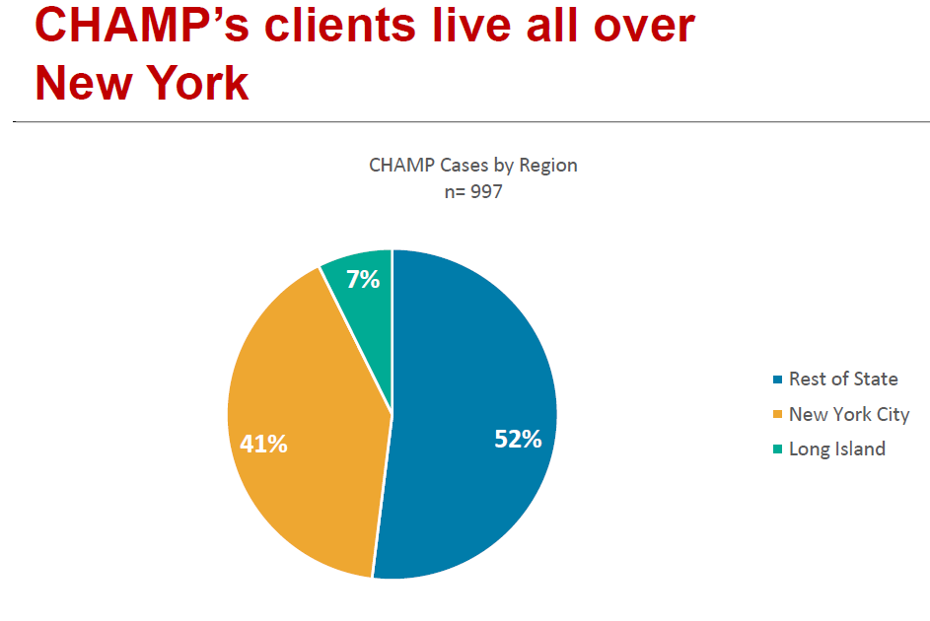
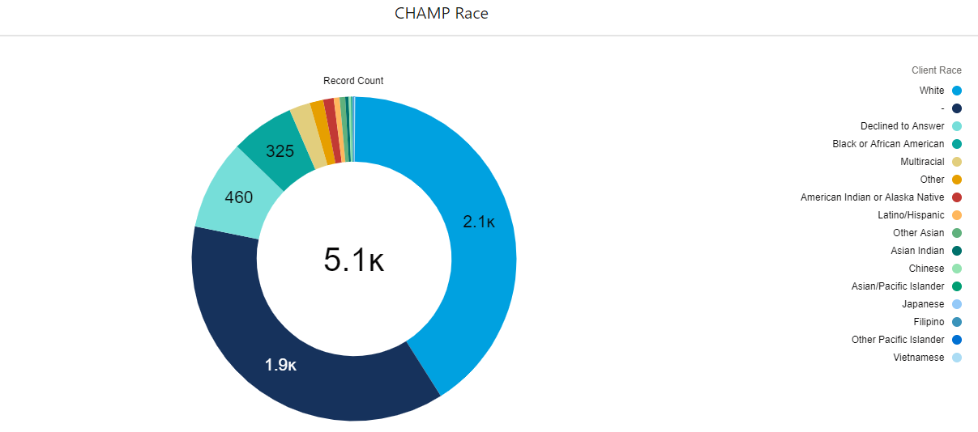
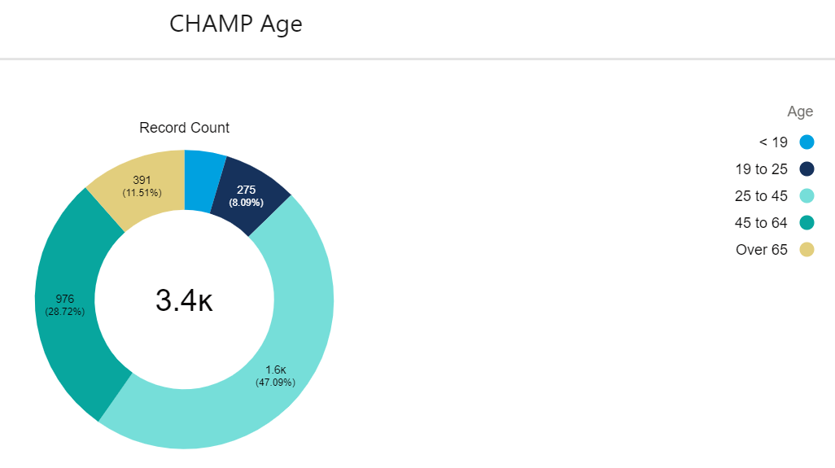
CHAMP Clients – Who and Where

Slide 11
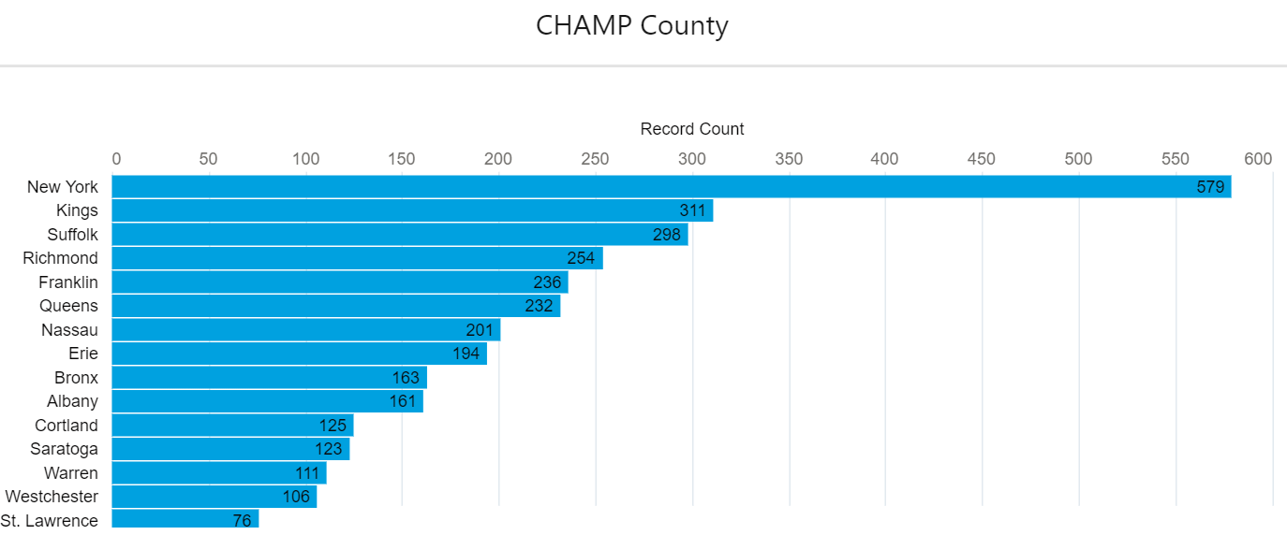
CHAMP Top Counties

Slide 12
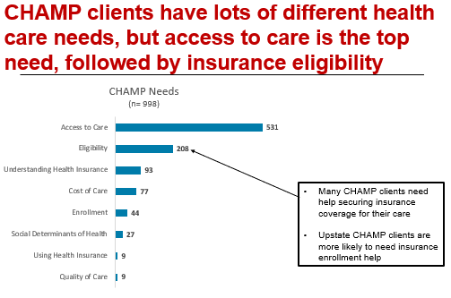
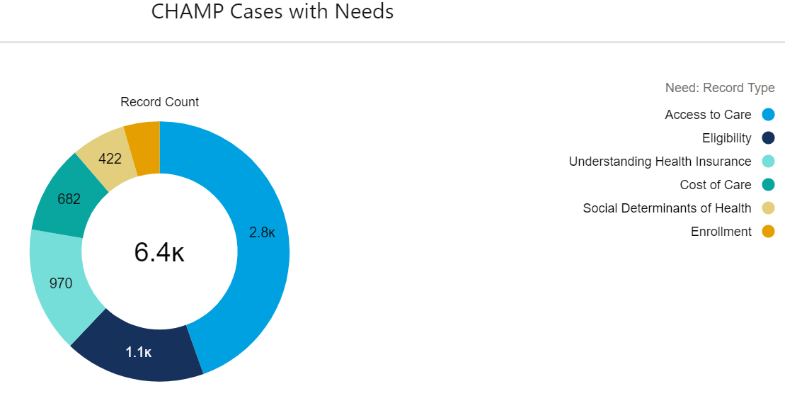
CHAMP Needs – what our clients contact us for

Slide 13
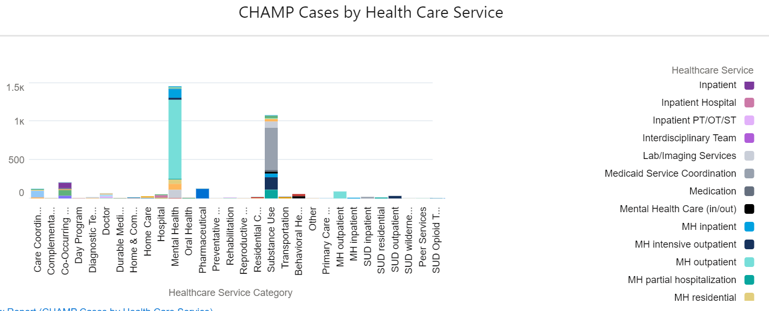
CHAMP Healthcare Services - How we connect clients throughout the system

Slide 14
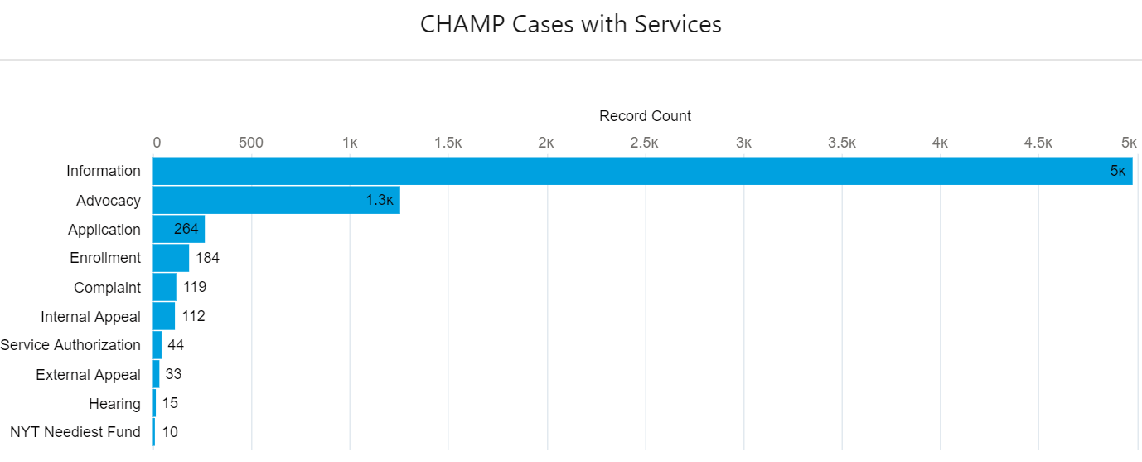
CHAMP Insurance Services – How we can help our clients

Slide 15
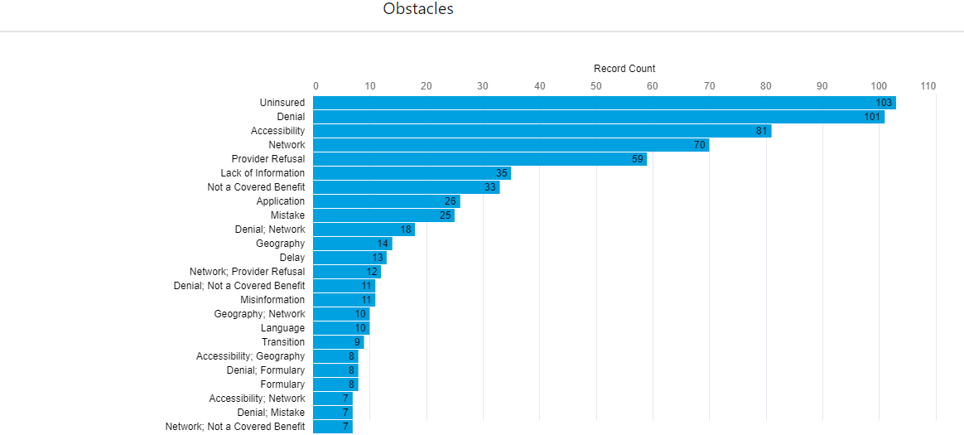
CHAMP Insurance Barriers – the obstacles our clients face

Slide 16
CHAMP’s Technical Assistance – how we educate and empower clients
Technical Assistance (TA)
CBOs contact CSS and the Specialists for assistance with complex cases, like:
Researching whether an insurance plan is subject to parity laws
Asking whether secondary Medicaid can pay for services that Medicare excludes, like residential SUD treatment in a non-hospital setting
Seeking assistance in serving a client in crisis which includes access to treatment
CSS, Specialists, and CBOs also work closely with the Ombudsman Project Director
Trainings
Trainings are provided each month at the CHAMP monthly meeting, and at the annual 2-day Intensive Training
Topics include; Commercial Insurance; Medicaid; Medicare; Parity; Appeals; IMD Exclusion; Confidentiality; Case Handling; Working with Suicidal Clients

Slide 17
CHAMP – Strategies for Success
Ted’s Story
A provider contacted CHAMP for help finding inpatient alcohol use disorder treatment (AUD) for her patient, Ted, who was also living with schizophrenia. CHAMP reached out to Ted’s local hospital, which confirmed that it accepts Ted’s insurance (Medicare and Medicaid), and that to access inpatient AUD treatment Ted should present at the hospital’s emergency department for stabilization, after which he would be transferred to inpatient AUD treatment.
When Ted went to this hospital’s emergency department, they told him they could not detox him there, and they could not transfer him to their detox facility because it had no available beds; he was discharged home. CHAMP contacted Ted’s local treatment program, but it had no available beds.
Unable to access AUD treatment for Ted, CHAMP reached out to the State Ombudsman Project Director for help. The Ombudsman Project Director was able to gain admission for Ted to treatment at a state Addiction Treatment Center (ATC). CHAMP Specialist MRC also assisted with the case, helping Ted to resolve a complex issue with his Medicare.

Slide 18
CHAMP – Strategies for Success
Felicia’s Story
Felicia called CHAMP because her Medicaid managed care (MMC) plan, Fidelis, was denying a formulary exception for her Zubsolv. Felicia had switched her MMC plan a month earlier so that she could see her primary care physician.
Felicia’s Zubsolv provider filed an expedited appeal of the plan’s formulary exception denial, but the plan upheld its denial. CHAMP helped Felicia change her MMC plan back to the previous plan and connected her with an outpatient program to bridge her medication until the plan switch became effective and her Zubsolv was once again covered by her insurance.

Slide 19
CHAMP – Strategies for Success
Rosie’s Story
In 2018, Rosie , who had health coverage through Medicaid, received outpatient SUD treatment through a facility that assured her it accepted Medicaid. After completing treatment, Rosie learned that the facility did not, in fact, accept Medicaid, and she was billed over $8,000 for her treatment. Rosie contacted CHAMP for help, and CHAMP negotiated with the facility to have Rosie’s bill reduced to $2,500.
CHAMP then applied to the New York Times Neediest (NYTN) fund for assistance with Rosie’s remaining balance. NYTN awarded Rosie a $2,500 grant. As a result of CHAMP’s debt negotiation and the NYTN grant, Rosie’s entire bill was resolved, and she did not need to pay any out-of-pocket costs for her treatment.

Slide 20
CHAMP’s Outreach Work
Outreach and Engagement
The Specialists conduct outreach statewide, such as tabling at conferences, setting up outreach sessions at organizations serving communities with MH/SUD needs, and sharing information through social media and other communication channels.
The CBOs conduct outreach in their communities, such as local hospitals and recovery organizations, local food pantries, mobile treatment vans, billboards, newspaper ads, etc.

Slide 21
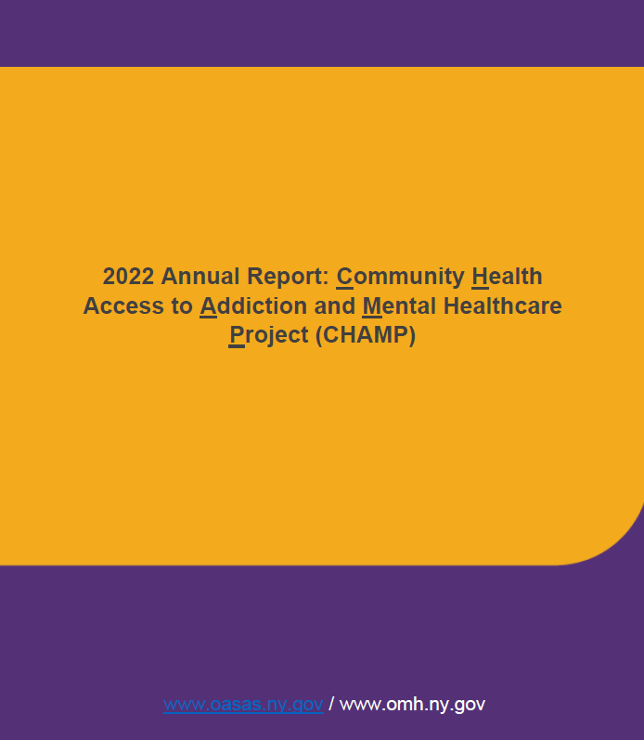
CHAMP 1st Annual Report
The New York State Office of Addiction Services and Supports (OASAS), and the Office of Mental Health (OMH) released of the first annual report by the Independent Behavioral Health Ombudsman program (CHAMP).
The report summarized the work of the first-in-the-nation program and made recommendations to inform decision makers on challenges New Yorkers have with accessing their insurance coverage for behavioral health issues.

Slide 22
CHAMP Report Recommendations
Expanding outreach and engagement for communities experiencing inequities in accessing care
Providing network adequacy standards that are geographically accessible; adopting appointment wait time metrics; establishing patient-to-provider ratios, with ongoing compliance monitoring
Increasing access to evidence-based treatment for children and adolescents
Integrating screening and treatment for individuals with co-occurring mental health and substance use disorders
Monitoring parity compliance and enforcement
Applying parity standards to Medicare
Aiding consumer transparency

Slide 23
Thank You!
Call or email:
Stephanie Campbell
Director, NYS Behavioral Health Ombudsman Office
518-788-3018
Stephanie.campbell@oasas.ny.gov

Slide 24
