Slide 1
WELCOME
Harm Reduction

Slide 2

OVERDOSE REVERSAL, DRUG TRENDS, HARM REDUCTION

Slide 3

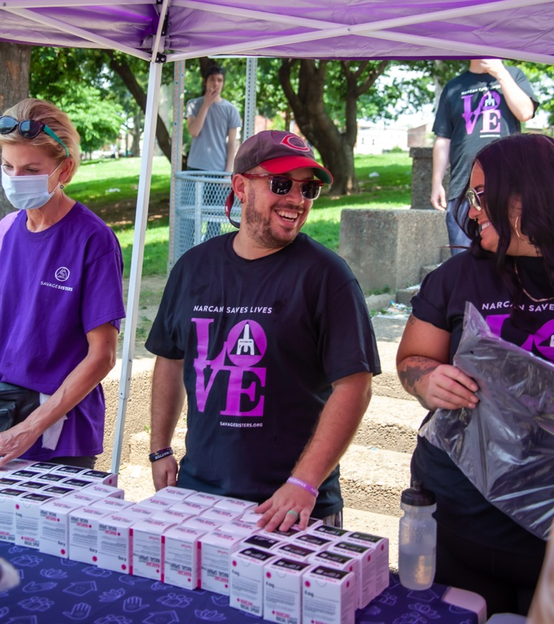
Getting Started
_
Our story & harm reduction
Our mission
The opioid epidemic? PUBLIC HEALTH CRISIS
Nationwide/statewide statistics
Updates on current drug supply
Reversal training
I encourage you to ASK QUESTIONS!
Just shout them out!

Slide 4
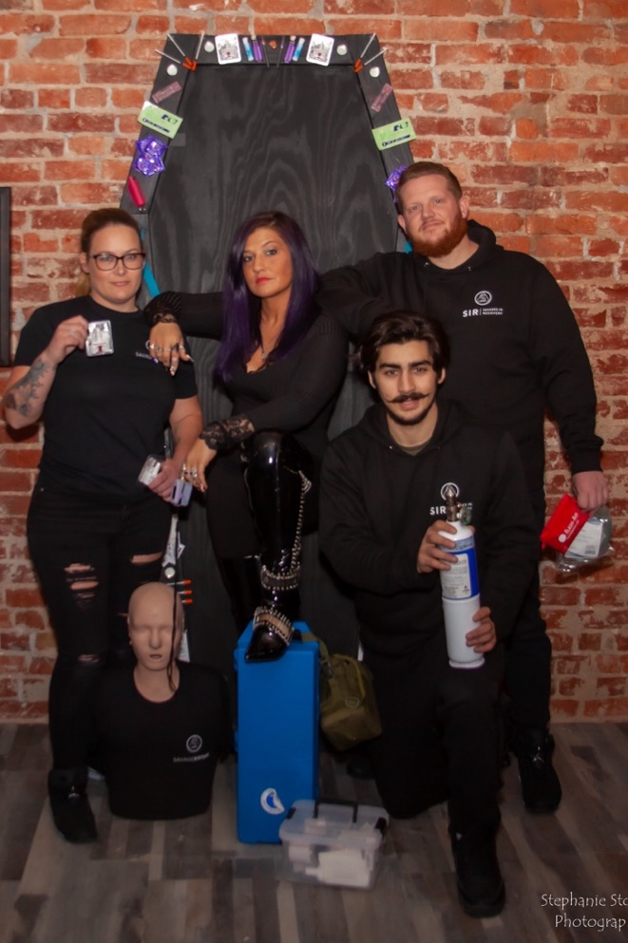
Harm Reduction
_
Harm reduction refers to policies, programs and practices that aim to minimize the negative health, social and legal impacts associated with drug use, drug policies/laws and other potentially dangerous behaviors.
Harm reduction is grounded in justice and human rights. It focuses on positive change and on working with people without judgement, coercion, discrimination, or requiring that people stop using drugs or engaging in certain practices as a precondition of support.
Harm reduction services save lives by being available and accessible in a matter that emphasizes the need for humility and compassion toward people who use drugs. Harm reduction plays a significant role in preventing drug-related deaths and offering access to healthcare, social services, and treatment. These services decrease overdose fatalities, acute life-threatening infections related to unsterile drug injection, and chronic diseases such as HIV/HCV.
***Harm Reduction | SAMHSA

Slide 5

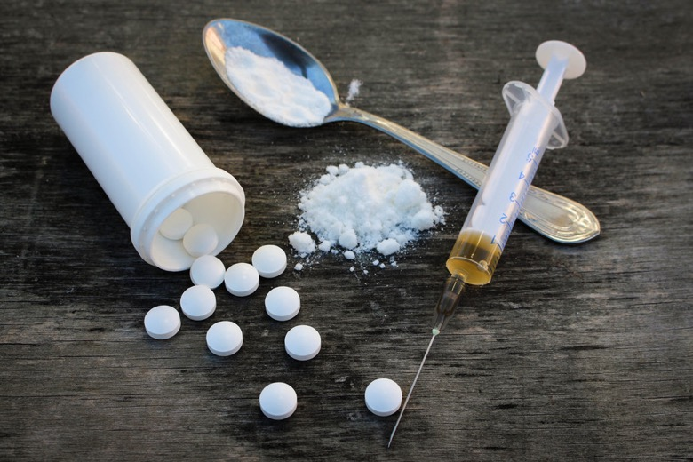
What is an Opioid?
_
Opioids are a class of drugs that include the illegal drug heroin, synthetic opioids such as fentanyl, and pain relievers available legally by prescription, such as oxycodone (OxyContin®), hydrocodone (Vicodin®), codeine, morphine, and many others.
Opium is a highly addictive non-synthetic narcotic that is extracted from the poppy plant, Papaver somniferum. The opium poppy is the key source for many narcotics, including morphine, codeine, and heroin.

Slide 6
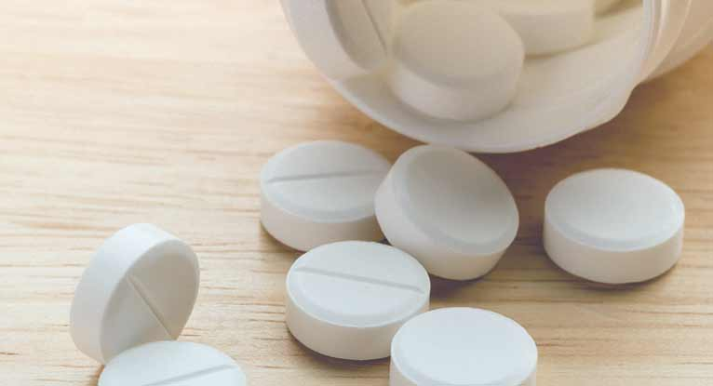
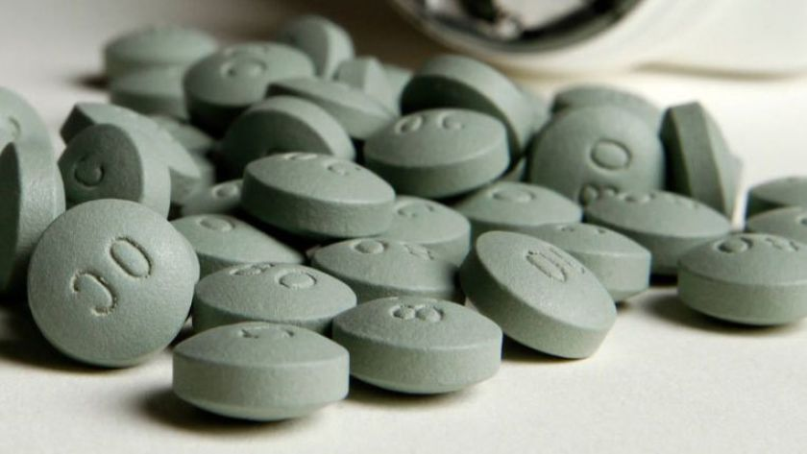
The Most Common Types of
Prescription Opioids
_
Hydrocodone (Vicodin, Lortab)
Oxycodone (OxyContin, Roxicodone, Percodan, Percocet)
Hydromorphone (Dilaudid)
Morphine
Codeine
Fentanyl (Duragesic, Antiq, Sublimaze)
Tramadol (Ultram, ConZip, Ryzolt)
Methadone (Dolophine)
Buprenorphine (Buprenex, Suboxone)

Slide 7

MAT Medication Assisted Treatment for Opiate Use Disorder, OUD
BUPRENORPHINE
  daily medication as a film or tablet
  curbs opioid craving
VIVITROL
  Monthly injection
  Binds and blocks opioid receptors to reduce cravings
  Daily pill form (Naltrexone)
METHADONE
  Daily medication as pill or liquid
  Curbs opioid cravings & manages withdrawal
_
Prescribed to those who are physically dependent on opioids as well as chronic pain patients
Language matters!
*Always use person first language* PWUD, OUD, SUD

Slide 8
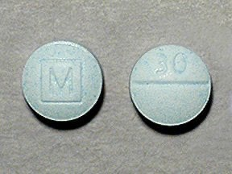
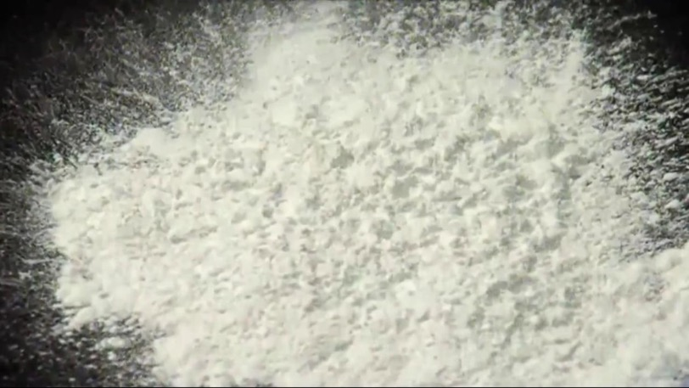
Why Heroin or Fentanyl
_
People who have misused opioid pain relievers are 19x more likely than others to start using heroin.
For someone who uses opioids from the street, heroin/Fentanyl may be the most economic choice.

Slide 9
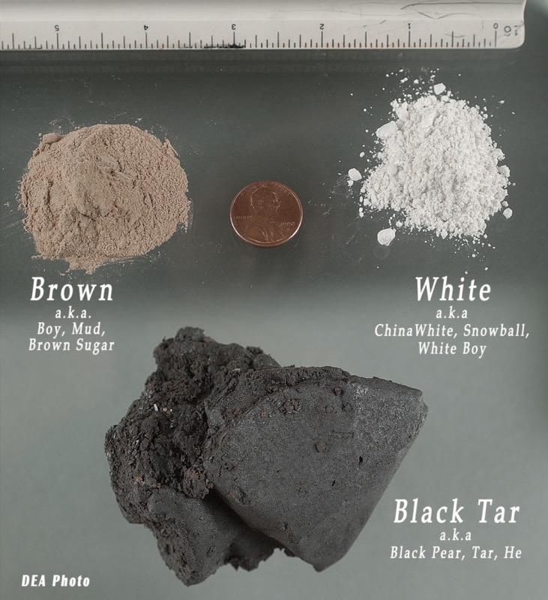
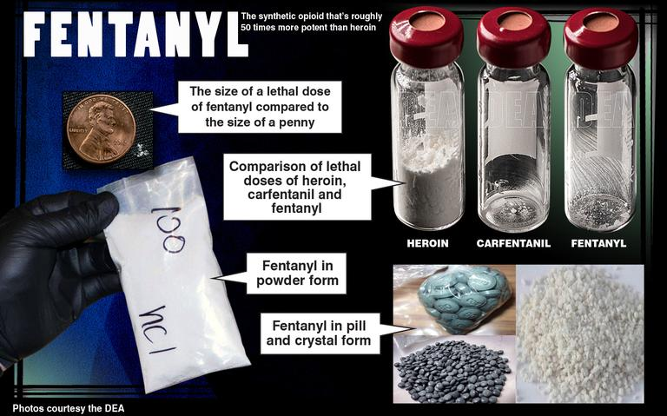
Illicit Opioids: Heroin & Fentanyl
HEROIN
FENTANYL

Slide 10

Myth about Fentanyl
_
Fentanyl powder can NOT be absorbed through the skin
It would take large amounts over a long period of time to have any impact & is highly unlikely
Narcan can reverse any opioid overdose including fentanyl
You can overdose by touching fentanyl
Fentanyl powder in the air can be inhaled and cause an overdose
Narcan cannot reverse a fentanyl overdose

Slide 11
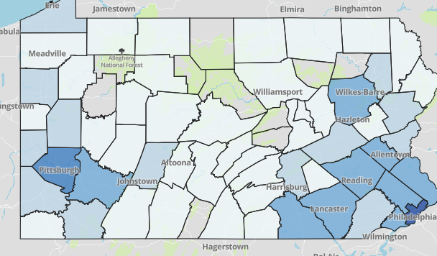
_
Overdose Deaths Per County in Pennsylvania 2021 – 5,224 total
  Philadelphia 1240
  Allegheny 700
Luzerne 189
Montco 185
Lehigh 183
Delco 174
Bucks 160
West Moreland 160
York 139
Lancaster 138
Berks 134
Dauphin 106
Chester 105
Washington 101

Slide 12
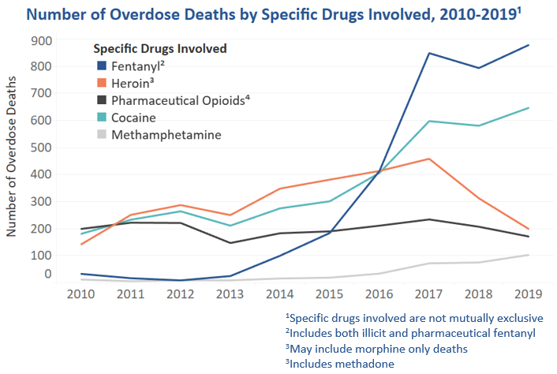
Number of Overdose Deaths by Specific Drugs Involved
2019-2019¹
_

Slide 13
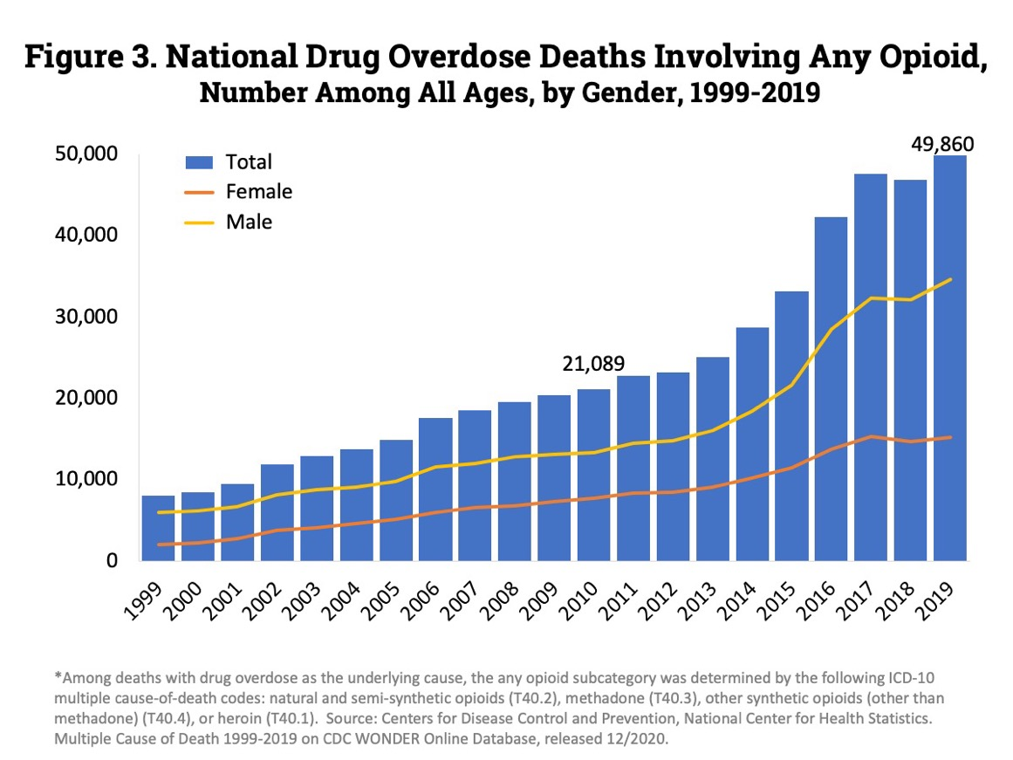

National Drug Overdose Deaths
Involving any Opioid
Number among all ages
By gender
1999-2019
_

Slide 14
Xylazine
Sarah Laurel, Executive Director, Savage Sisters

Slide 15
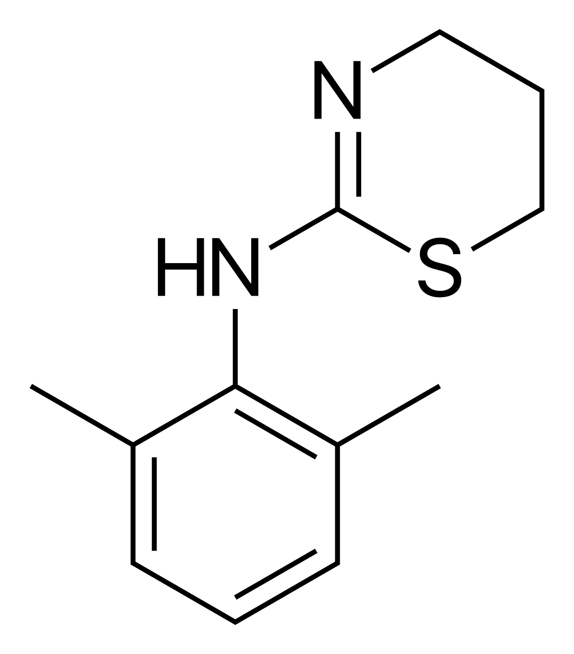
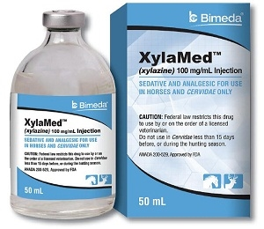
Xylazine – History
_
veterinary drug used as a sedative, analgesic and muscle relaxant.
Xylazine is NOT a controlled substance, only NY state passed legislation in 2017 making it a controlled substance
Commonly used to adulterate heroin, fentanyl and cocaine
In humans, it can cause central nervous system depression, respiratory depression, bradycardia, hypotension, and even death.
Illicit use of xylazine as an additive has been well documented in Puerto Rico since the early 2000s
Been found in 91% of the ‘dope supply’ in Philadelphia

Slide 16
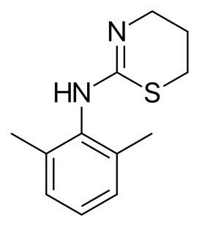
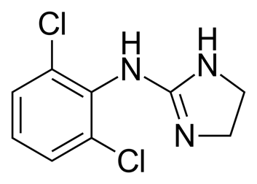
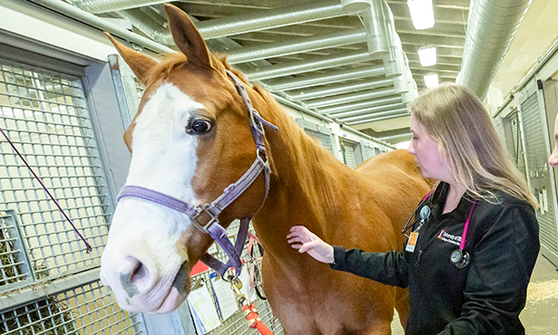
Pharmacology of Xylazine
_
Xylazine Clonidine
Xylazine is an α2-adrenergic agonist that acts via stimulation of central α2-receptors.
Exerts sedative effects by acting as an alpha-2 receptor agonist, similar to clonidine and dexmedetomidine. It is given IV, IM, or orally either alone or in combination with ketamine or barbiturates.
Its chemical configuration is similar to tricyclic antidepressants, phenothiazines, and clonidine. Xylazine inhibits neurotransmitter release of both dopamine and norepinephrine at the neuronal synapse, resulting in depression of the central nervous system (7).
In animals, it has been studied to provide analgesia for 15-30 minutes and sedation for 1-4 hours.
Due to the drug’s secondary site of action, xylazine use as an adulterant may potentiate the effects of heroin, leading to increased risk of overdose. The dose of xylazine required to produce toxicity in humans is between 40 to 2400 mg. Serum concentrations of xylazine in fatal overdose cases were seen from trace to 16 mg/L. This significant overlap between fatal and non-fatal doses indicates that there may be no defined “safe” blood concentration of xylazine. (7)

Slide 17
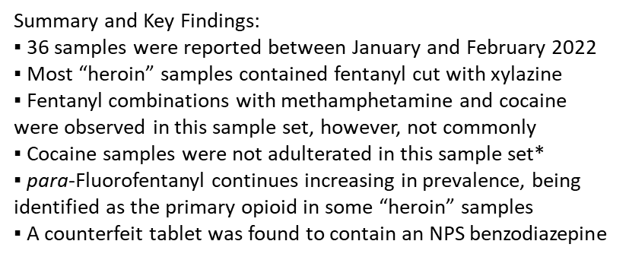
_

Slide 18
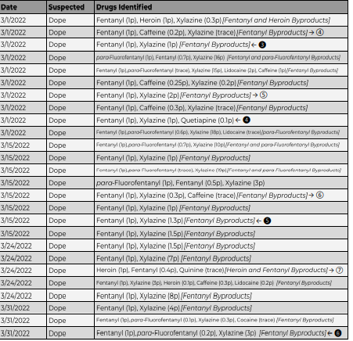
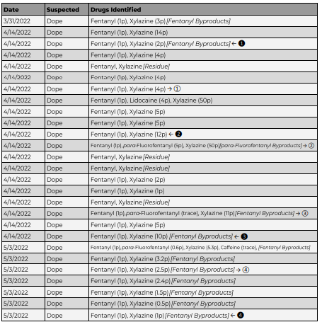

Slide 19
Xylazine Wounds
The following footage and images may be disturbing

Slide 20
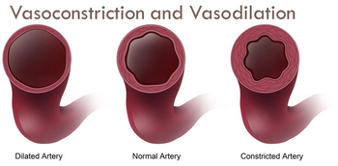
Why wounds show up
_
In the areas with a high prevalence of the use of xylazine mixed with fentanyl or heroin, abscesses, and painful skin ulcers are very often reported. The mechanism is thought to be due to its direct vasoconstricting effect on local blood vessels and the resultant decreased skin perfusion. Prolonged use can lead to decreased perfusion and impaired wound healing, leading to higher chances of infection of these ulcers. In addition to the topical effect of vasoconstriction, xylazine also leads to hypotension, bradycardia, and respiratory depression. A skin ulcer in a PWID, similar to the ones reported in our case, should raise clinical suspicion for the presence of xylazine in opiates and other substances.

Slide 22
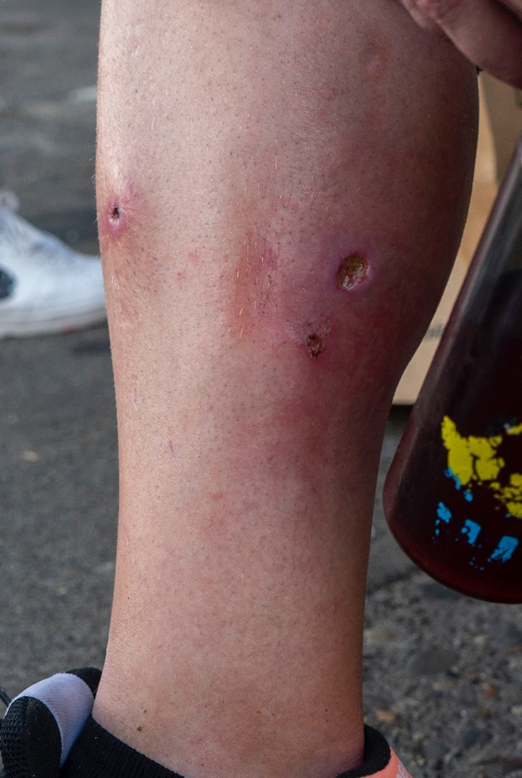
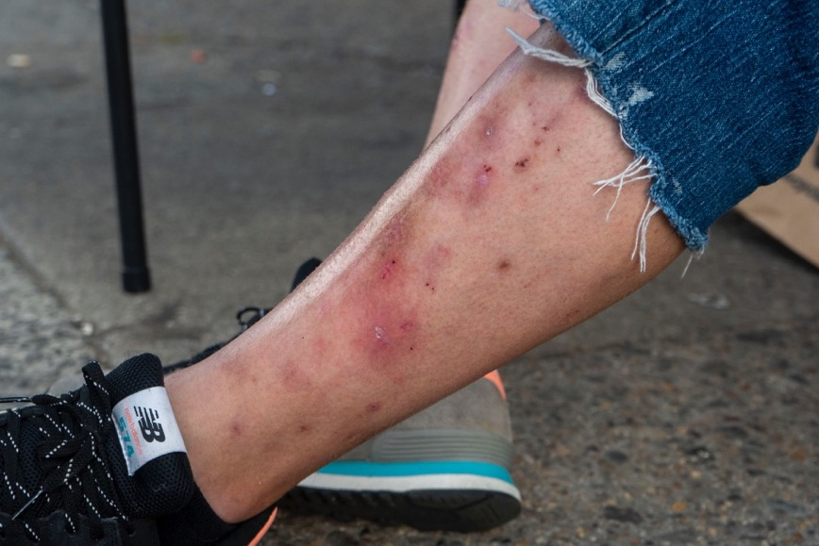
_Photos from street based outreach in Kensington

Slide 23
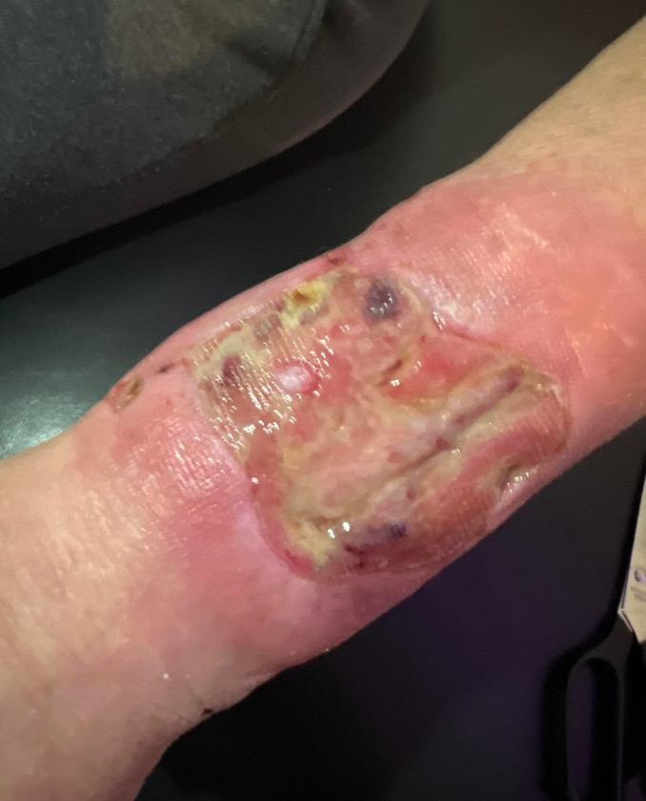
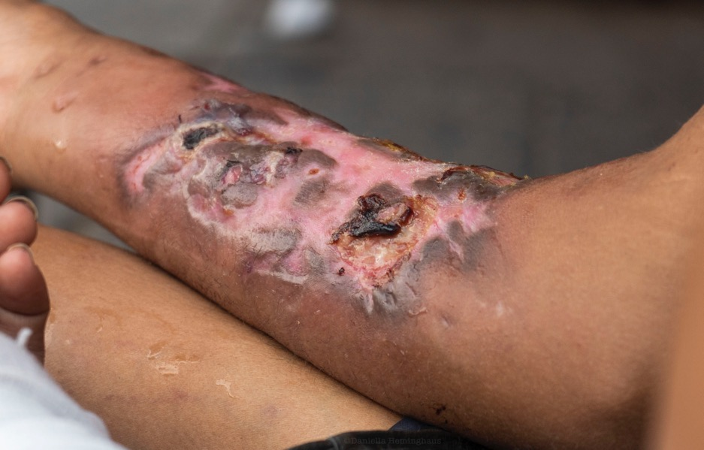
_Photos from street based outreach in Kensington

Slide 24
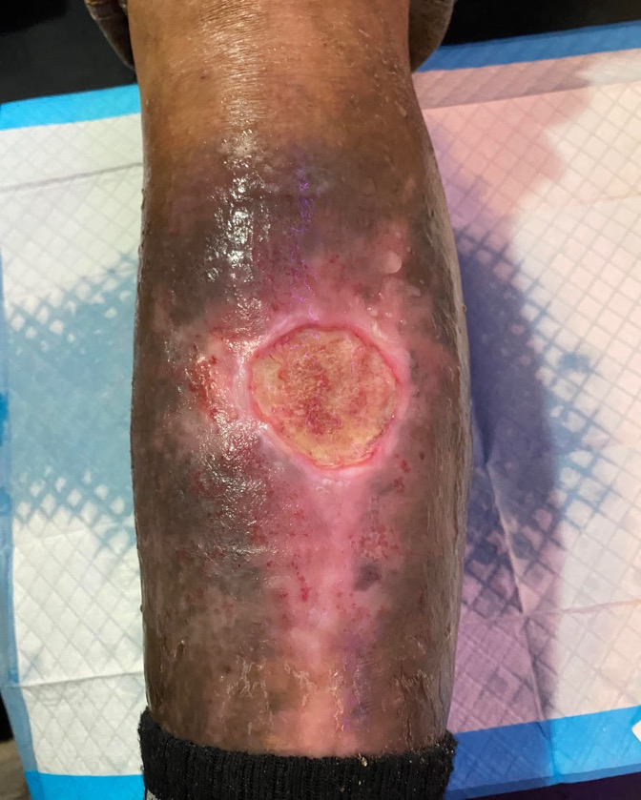
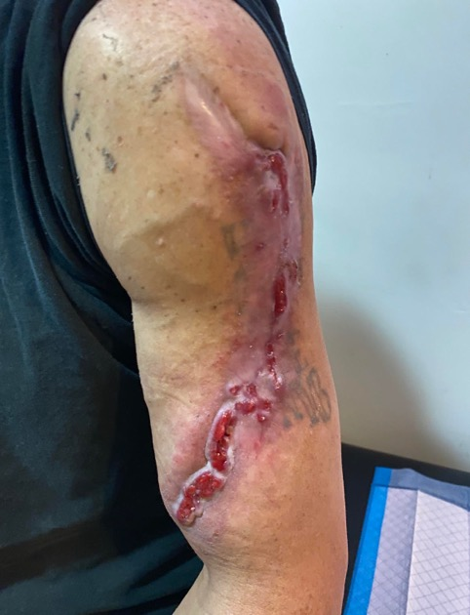
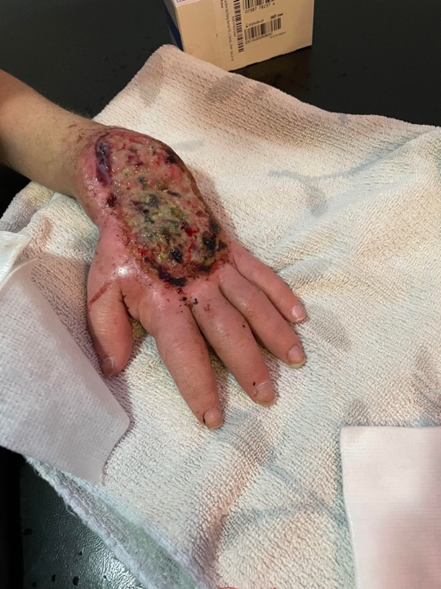
_Photos from street based outreach in Kensington

Slide 25
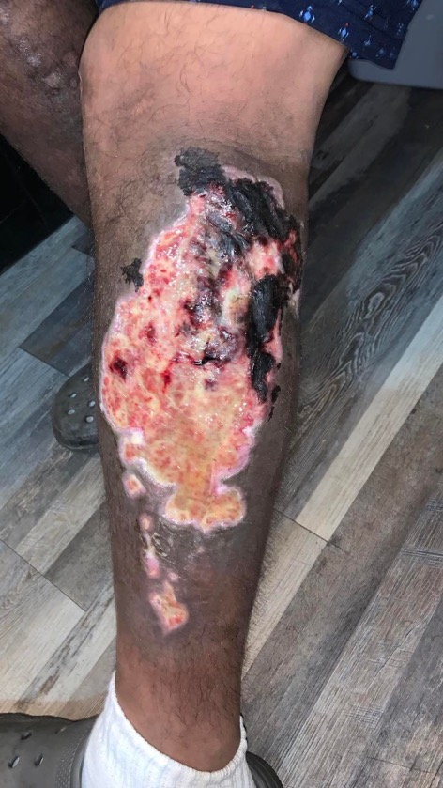
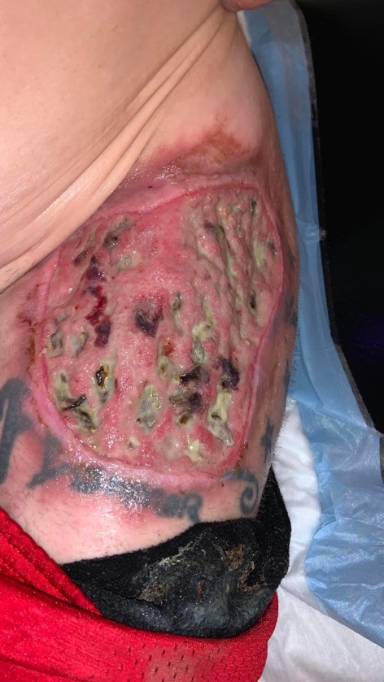
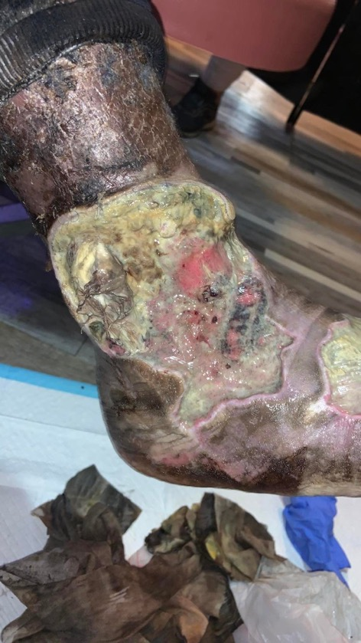
_Photos from friends at the Drop In

Slide 26
Wound Care Best Practices
_
DOs
Wash hands with water+soap or sanitizer
Wash the wound with water+soap or saline, gently remove dried drainage from skin
Keep it moist but not wet: Keep it covered, soak up drainage with gauze, change dressing when soaked if possible
Use ointment (A&D, Hexagen etc – avoid triple antibiotic) or nonstick gauze to avoid sticking, or soak the dressing to take it off
DONTs
Try not to pick or scratch: it can re-open the wound and set your healing back
Don't rip anything off the wound: let tissue soften, dissolve, fall off by itself
Don't press too much on abscesses: it can make them go deeper, or into a joint or your bloodstream
Don't use alcohol, hydrogen peroxide, or iodine on open skin

Slide 27
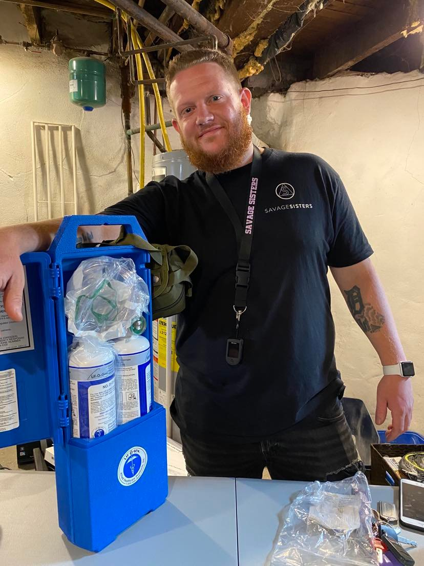
Overdose Reversal Updates
_
Xylazine or Tranqdope is NOT an opioid – reversing overdoses has been more difficult. ALWAYS administer Narcan for the opioid present.
We are dealing with a supply that is heavily cut with tranquilizer, which is a sedative.
We have updated overdose reversal methods to include rescue breathing with a key alert regarding the extended time it takes to be revived.
Savage Sisters now carries Oxygen tanks covered by the Good Samaritan Act to assist in reversing overdoses.

Slide 28
Inpatient treatment for opioid withdrawal may be more difficult than standard opioid withdrawal protocols and require additional pharmacologic treatments if the patient is also withdrawing from xylazine. While the literature on treatment protocols is still emerging, local addiction medicine and toxicology experts recommend the following medications be considered for inpatient management of xylazine withdrawal:
• Dexmedetomidine
• Tizanidine
• Clonidine
• Guanfacine
• Ketamine
• Gabapentin
• Pentobarbital
• Benzodiazepines (with caution)

Slide 29
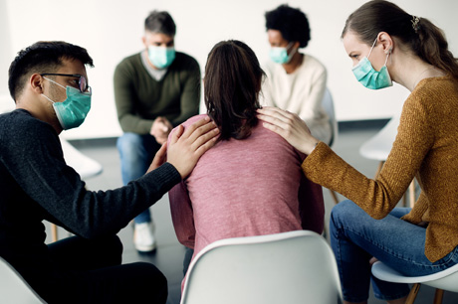
What does this mean for people seeking treatment?
_
Treatment facilities and emergency rooms are NOT currently testing for the presence of Xylazine
The detox from xylazine is different from opioids
People are not comfortable during the acute withdrawal stages due to the symptoms not being treated
People we engage with are less than willing to enter into a medical setting/detox due to the lack of comfort meds

Slide 30
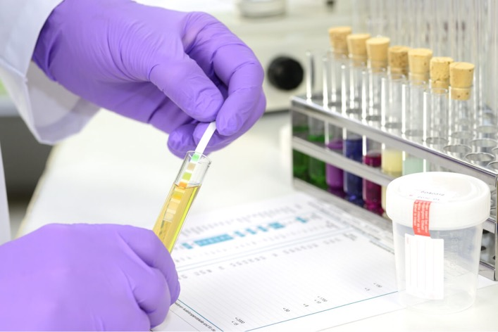
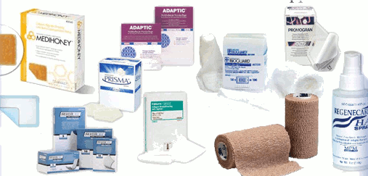
What NEEDS to happen?
_
Treatment facilities need to begin testing for the presence of Xylazine
Case studies needed for acute withdrawal treatment
Update withdrawal protocols
Increase wound care preparedness
Increased availability for medical rehab beds
Increased street side clinicians and wound debridement accessibility

Slide 31
OVERDOSE 101
RISK | SIGNS OF OVERDOSE | USING NARCAN | AFTER-CARE

Slide 32
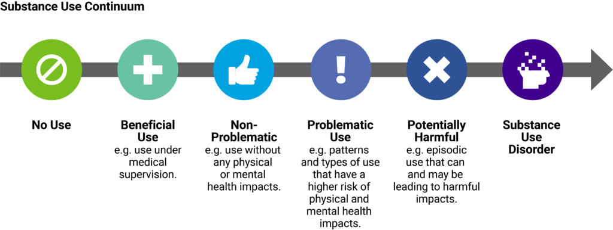
Who is at risk of an Overdose? Anyone
_
TYPES OF USE
  Experimental
  Situational
  Abuse
  Severely & Chemically Dependent
  Binge-Use
  Social & Ritual Use Dependence

Slide 33
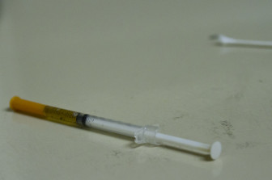
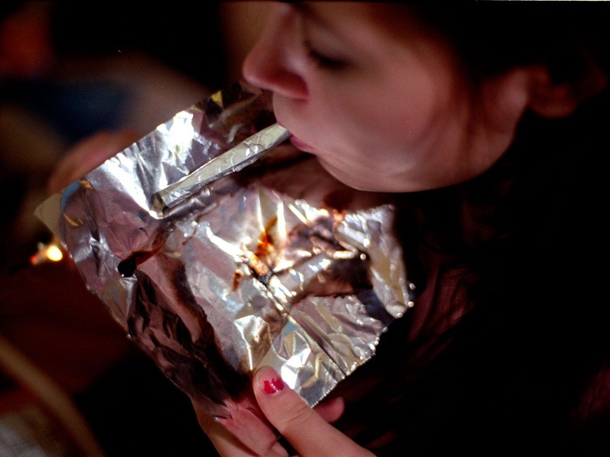
What puts people at risk for overdose?
_
Mixing drugs
Variations in strength , content
Mode of administration oral, smoking, injection
Previous overdose
Tolerance changes 24-48 hours without use, people recently released from jails/institutions
Using alone 8 out of 10 OD’s happen in the home, people outside the city are not provided the correct resources
Physical health (dehydration, breathing conditions, liver/kidney function, weight loss, immune system )

Slide 34
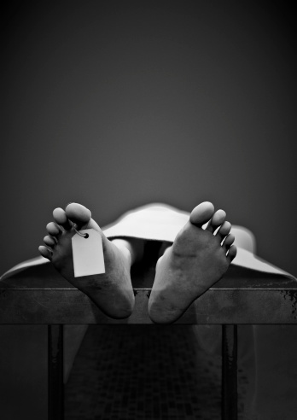
Progression of an Opioid Overdose
_
Breath is suppressed
Respiratory rate slows
Brain not getting enough oxygen
Heart stops
Death

Slide 35
High vs Overdose
Be aware many people do not want to be ”Narcanned.” Paying attention and knowing when to act is very important
_
HIGH
Relaxed muscles
normal skin tone
Slowed/slurred speech
Drowsy appearance
Responsive to stimuli
Normal heartbeat
I will show you the rescue position so you can help with blood flow & clearing the airways
OVERDOSE
Unresponsive or unconscious
Shallow or no detectable breathing
Skin, especially fingertips/lips, appear pale blueish purple, or gray/ashy
Snoring/gurgling
Slow or irregular heartbeat
Stiffened body/seizure like activity
Strange behavior prior to becoming unconscious

Slide 36
Any person who renders emergency care, first aid or rescue at the scene of an emergency, or moves the person receiving such care, first aid and rescue to a hospital or other place of medical care, shall not be liable to such person for any civil damages as a result of any acts or omissions in rendering the emergency care, first aid or rescue, or moving the person receiving the same to a hospital or other place of medical care, except any acts or omissions intentionally designed to harm or any grossly negligent acts or omissions which result in harm to the person receiving the emergency care, first aid or rescue or being moved to a hospital or other place of medical care.
Good Samaritan Law
Always RESPOND!
They cannot prosecute you!
You cannot be prosecuted by the law and you are also covered by college review

Slide 37
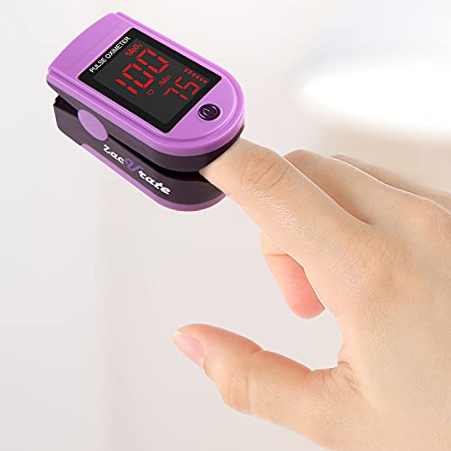
Pulse Oximeter
_
Used to measure the oxygen level (oxygen saturation) of the blood
A tool to help you determine if someone is overdosing or just heavily sedated
%Sp0² normal oxygen saturation levels are in the 90s
Respond when lower than 90 or steadily decreasing
At 70 – oxygen is not getting to the brain

Slide 38
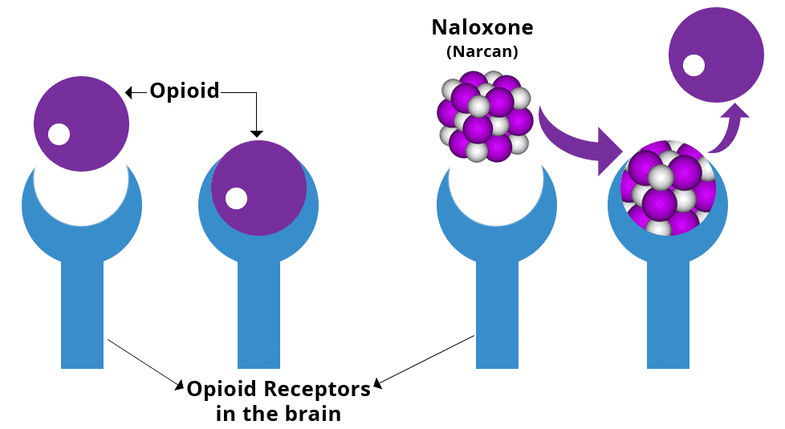
How does Naloxone work?
_
Naloxone is used to temporarily reverse the affects of an opioid overdose
Naloxone only has an effect if there is an opioid in the body
Works for 20-90 minutes

Slide 39
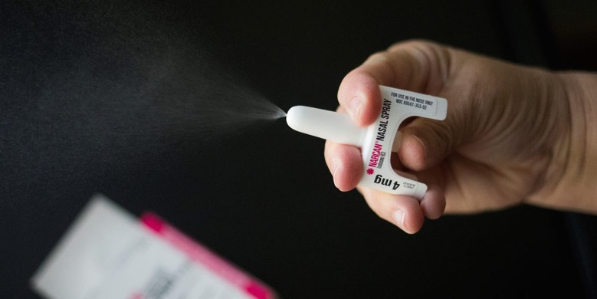
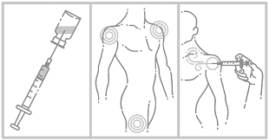
Types of Naloxone
NASAL NARCAN
This nasal spray needs no assembly & can be sprayed up one nostril by pushing the plunger. One time use.
INTERMUSCULAR NARCAN
The most rapid onset of action is achieved by intravenous administration, which is recommended in emergency situations.

Slide 40
First Steps in Reversing an Overdose
TRY TO WAKE THE PERSON
Ask if the person is ok
Offer help
Introduce yourself – have good bedside manner
Apply pressure/slight pain
If they reply, offer to put them in the rescue position
If no response – continue.
CONSENT
Ask for consent before attempting to help
Even if they appear to be unconscious, they still may be able to hear you
The person may refuse, that is ok!
Implied Consent
If the person is unresponsive
CALL 911
Put the phone on speaker on the floor
Give the location
Describe the symptoms
Clear the area – be aware of uncapped syringes, broken pipes or other items that may interfere while you work on the person overdosing

Slide 41
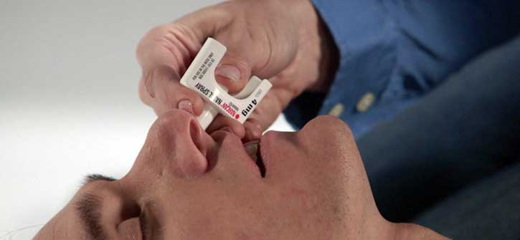
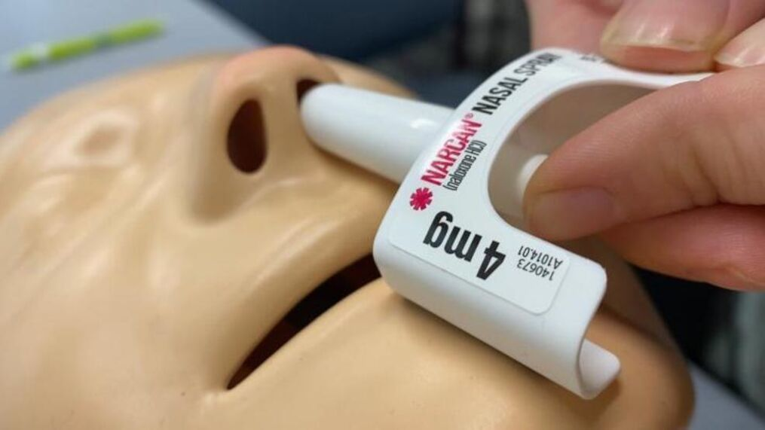
Administer Narcan
_
Check the time when you first administer
  Use your 911 call as a timer***
It takes 2-3 minutes to kick in, check your time and administer a 2nd dose after 3 minutes.
Rescue breaths are KEY after administering naloxone, as they have a high percentage of having tranq dope
Works for 20-90 minutes

Slide 42
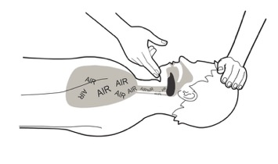
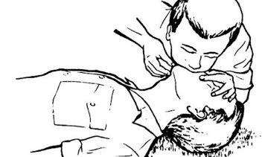
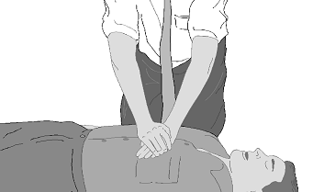
Even if you do not have naloxone, this can save a life.
Take precaution due to Covid19 and use mask if present or get creative!
If you aren’t comfortable immediately put them into the rescue position
Due to the presence of Tranq, please continue rescue breathing until EMS arrives!!!
Rescue breaths
are very Crucial!
STEP 1
Clear the airway
Tilt head back & lift chin
STEP 2
Pinch nose & give 2 strong breaths
Wait 5 seconds, then give
1 breath every 5 seconds
Ensure the chest is rising NOT the belly
STEP 3
Do not give chest compressions unless the heart has stopped
No pulse, no breathing

Slide 43
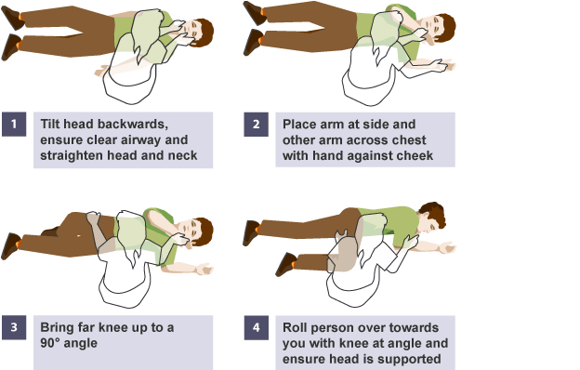
The Recovery Position
If a person starts breathing but has not become conscious yet, put them in the Recovery Position
_

Slide 44
After-steps of an Overdose
PRECAUTIONS
If anyone is starting to get up on their own, give them some space
Introduce yourself and inform them of what happened in a gentle voice
Be mindful that they may be confused, afraid or angry
OVERDOSE PREVENTION
If the individual doesn’t want to go with EMS, ensure they are monitored or remain in public space
Encourage individual not to use again until naloxone wears off (2 hour minimum)
SUGGESTIONS
If the person is willing to speak with you, make some self care suggestions.
Stretch, hydrate sleep safely, connection, boundaries, ask for help

Slide 45
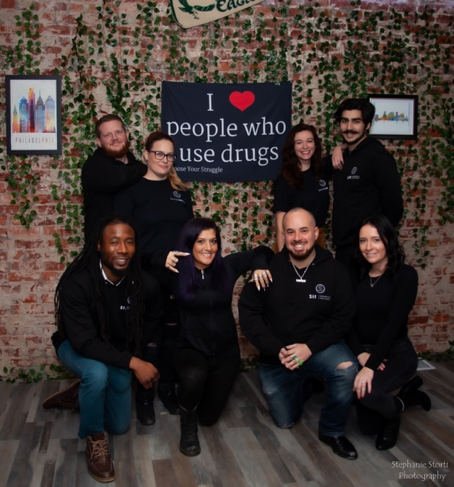
Review & Questions
_
To get involved, donate or volunteer visit:
www.savagesisters.org
Stay Safe & always, Stay Savage!
Thank you for taking the time out to learn about this public health crisis
If you are an outreach worker or in the field I recommend sharing this info with those you encounter – both professionally and with our friends who use substances
Testing the local drug supply is crucial to staying up to date on trends and possible public health consequences
If you need further information or want to schedule a training contact info@savagesisters.org
SavageSistersRecovery | Instagram, Facebook, TikTok | Linktree

Slide 46


Slide 47


