Slide 1
WELCOME
Justice, Diversity, Equity, Inclusion

Slide 2

STRENGTH AND RESILIENCE IN DIVERSITY, CULTURAL
RESPONSIVENESS AND INTEGRATION IN THE PEER MODEL
Javier Alegre, CPSS, Executive Director (he/him/el)
Jules Martinez, LCSW,CPSS, Clinical Director (they/them/elle)

Slide 3
Learning Objectives:
Understand health disparities in diverse and BIPOC communities through a historical, structural lens, as well as how COVID 19 impacted disparities.
Understand the strengths and protective factors in diverse and BIPOC communities.
Historical and communal approaches by indigenous pops in US and
Central/South America to health, wellness, & connection - Javi
The Peer Model - Jules
Integrating the Peer Model into your work - Jules & Javi

Slide 4
Disparities in the Latinx Community
In a 2021 CDC study, it was found that
Rates of Mental Illness
  Depression
  Suicide
Rates of Substance Use
Access to Care
  Insurance
  Geography
  Language
  Stigma, Stereotypes, & Cultural Practices

Slide 5
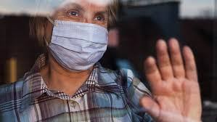
The COVID-19 Pandemic

Slide 6
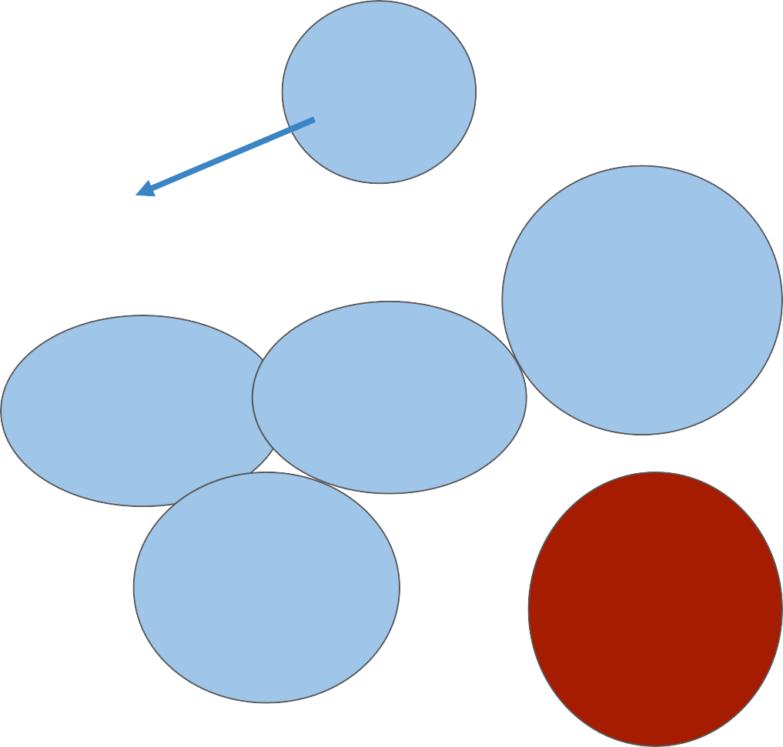
Disparities in Access to Care
Transport- ation & Childcare
Poverty
Insurance & Cost of Care
Provider Availability
Unequal Access to Education and Employment
Stereotypes & Stigma
Residential Segregation
Incarceration
Stigma in minority populations
Racism, Discrimination, Bias
Historical and Current Institutional Racism
Immigration Policy
non-
Language barriers
minority values and cultural norms

Slide 7
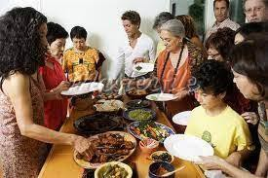
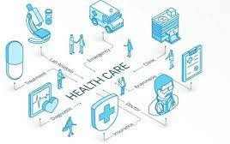
Resiliency in BIPOC Communities: Strengths and Protective Factors
In the community In the system:
Social Connectedness
Religion
Indigenous & Cultural Practices
Strength of Families
Cultural Pride
The clinical model is well supported by research and financially.
Increasingly imbedded within the health care system.
Well connected to other resources in the
community.

Slide 8
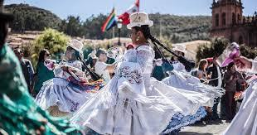
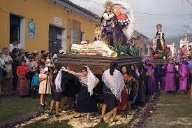
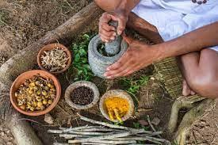
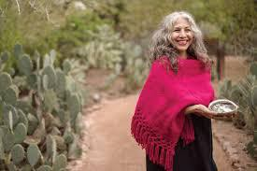
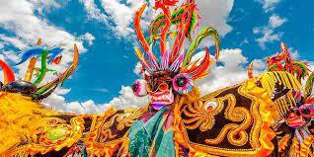
Historical and communal approaches by indigenous pops in US and
Central/South America to health, wellness, & connection

Slide 9
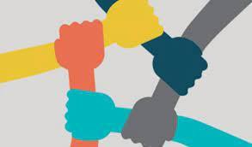
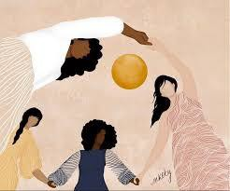
The Peer Recovery Model
How does the peer model work?
How does the peer model work for marginalized populations like the Latinx community?

Slide 10
Integrating the Peer Model (with the clinical model & Social connectedness) for Health Equity
Clinical Services
Community Services
Peer Services

Slide 11
For me, recovery has involved development and “movement” toward new meaning and purpose in my life as I grow beyond the catastrophic effects of immigration, discrimination, oppression, mental illness, abuse of substances and poverty. It is a voluntary maintained lifestyle characterized by sobriety, personal health, spiritual growth, and citizenship.
- Jacqueline Gomez-Arias
LBHS Cofounder

Slide 12
Contacts
Executive Director. Javier Alegre. javier.alegre@latinobehavioral.org
Clinical Director. Jules Martinez. jules.martinez@latinobehavioral.org

Slide 13
