Slide 1


Slide 2
Nothing About Us Without Us Integrating Peers In Research Flo Hilliard University of Wisconsin-Madison

Slide 3

WELCOME!
INTRODUCTIONS

Slide 4
Peer Support in Research
Objectives:
Peer Support Areas of Growth
Why Peer Support in Research is Important
Role of Peer Support in Research
Unconscious and Implicit Bias in the Research World
Intro To Research Basics

Slide 5
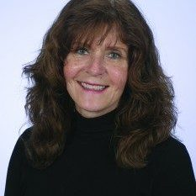
My Story

Slide 6
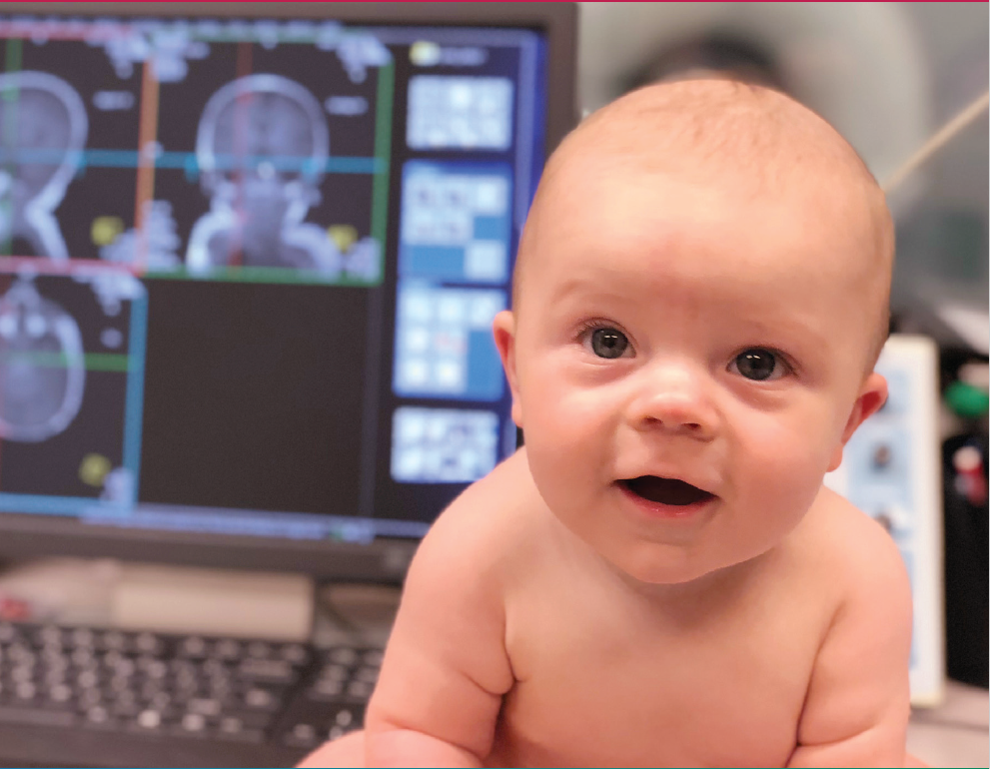

The Healthy Brain and Child Development (HBCD) Study
Doug Dean
Julie Poehlman
Florence Hilliard

Slide 7
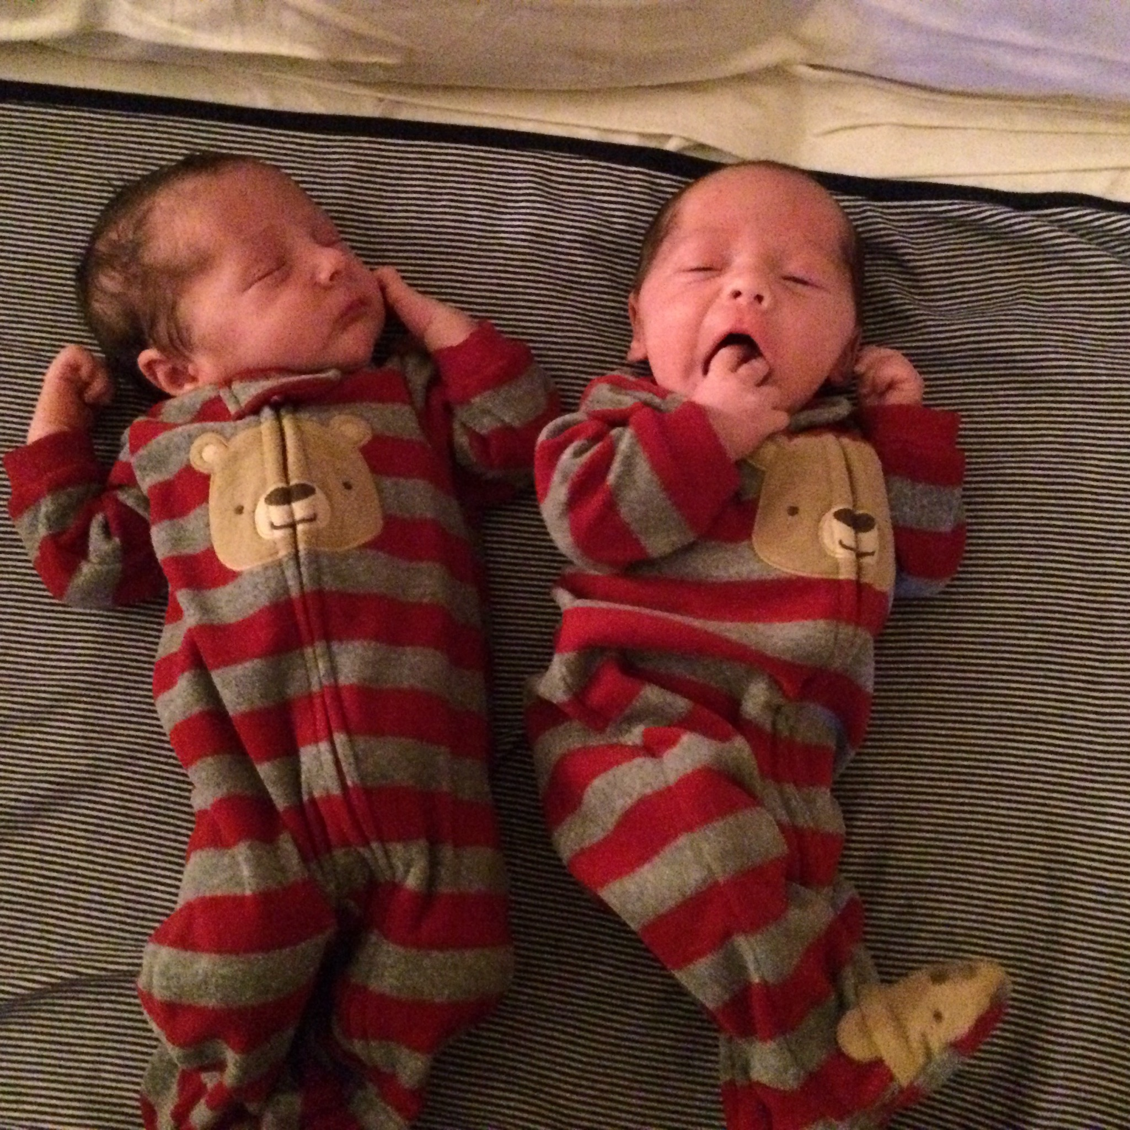
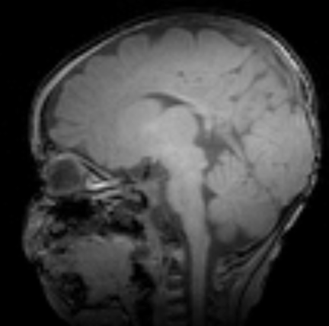
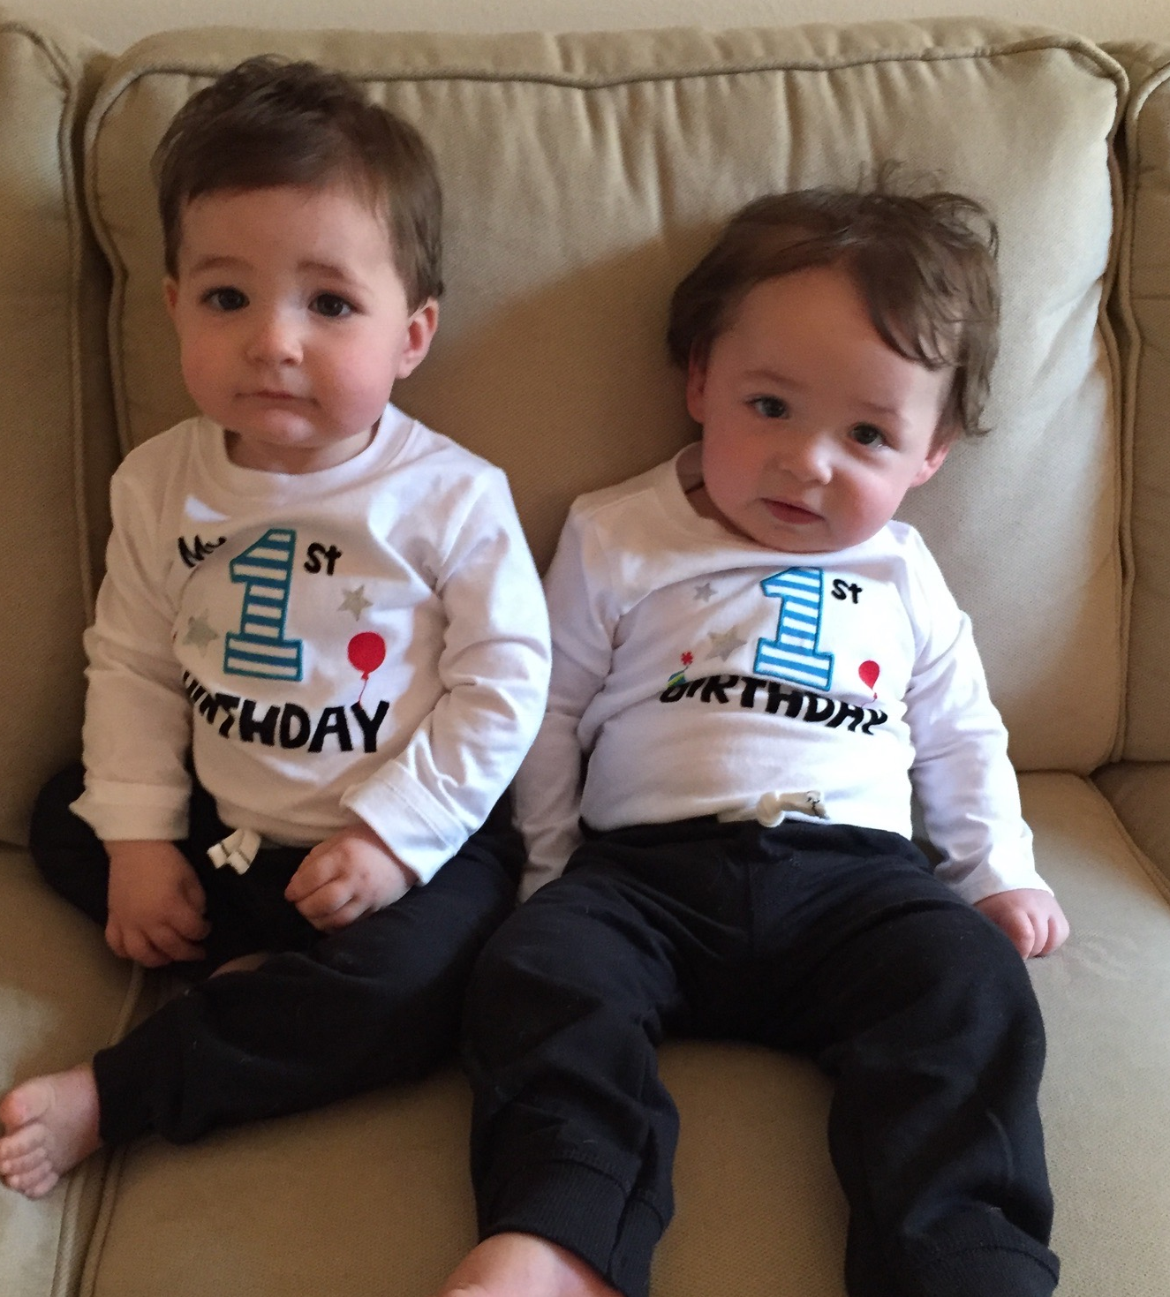
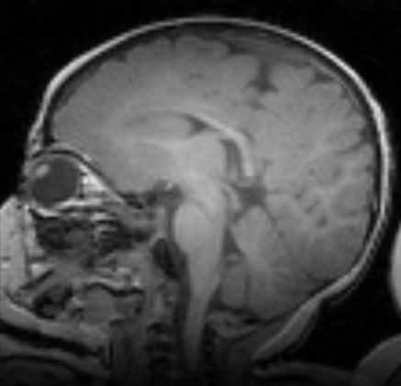
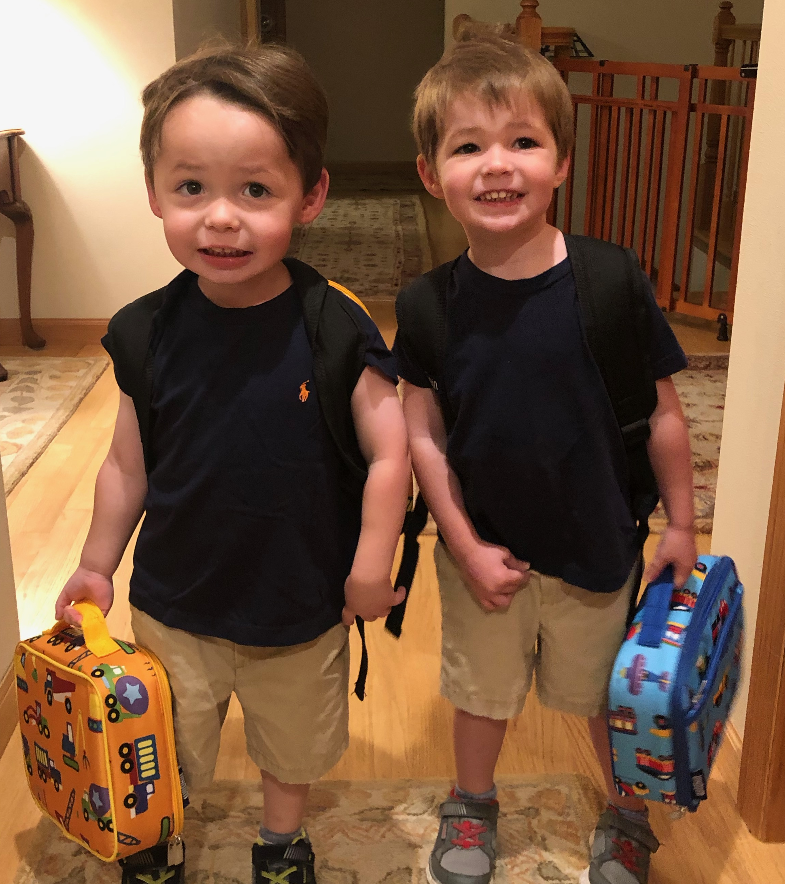
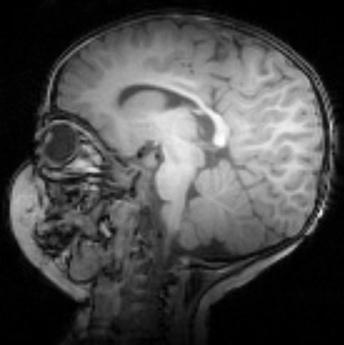
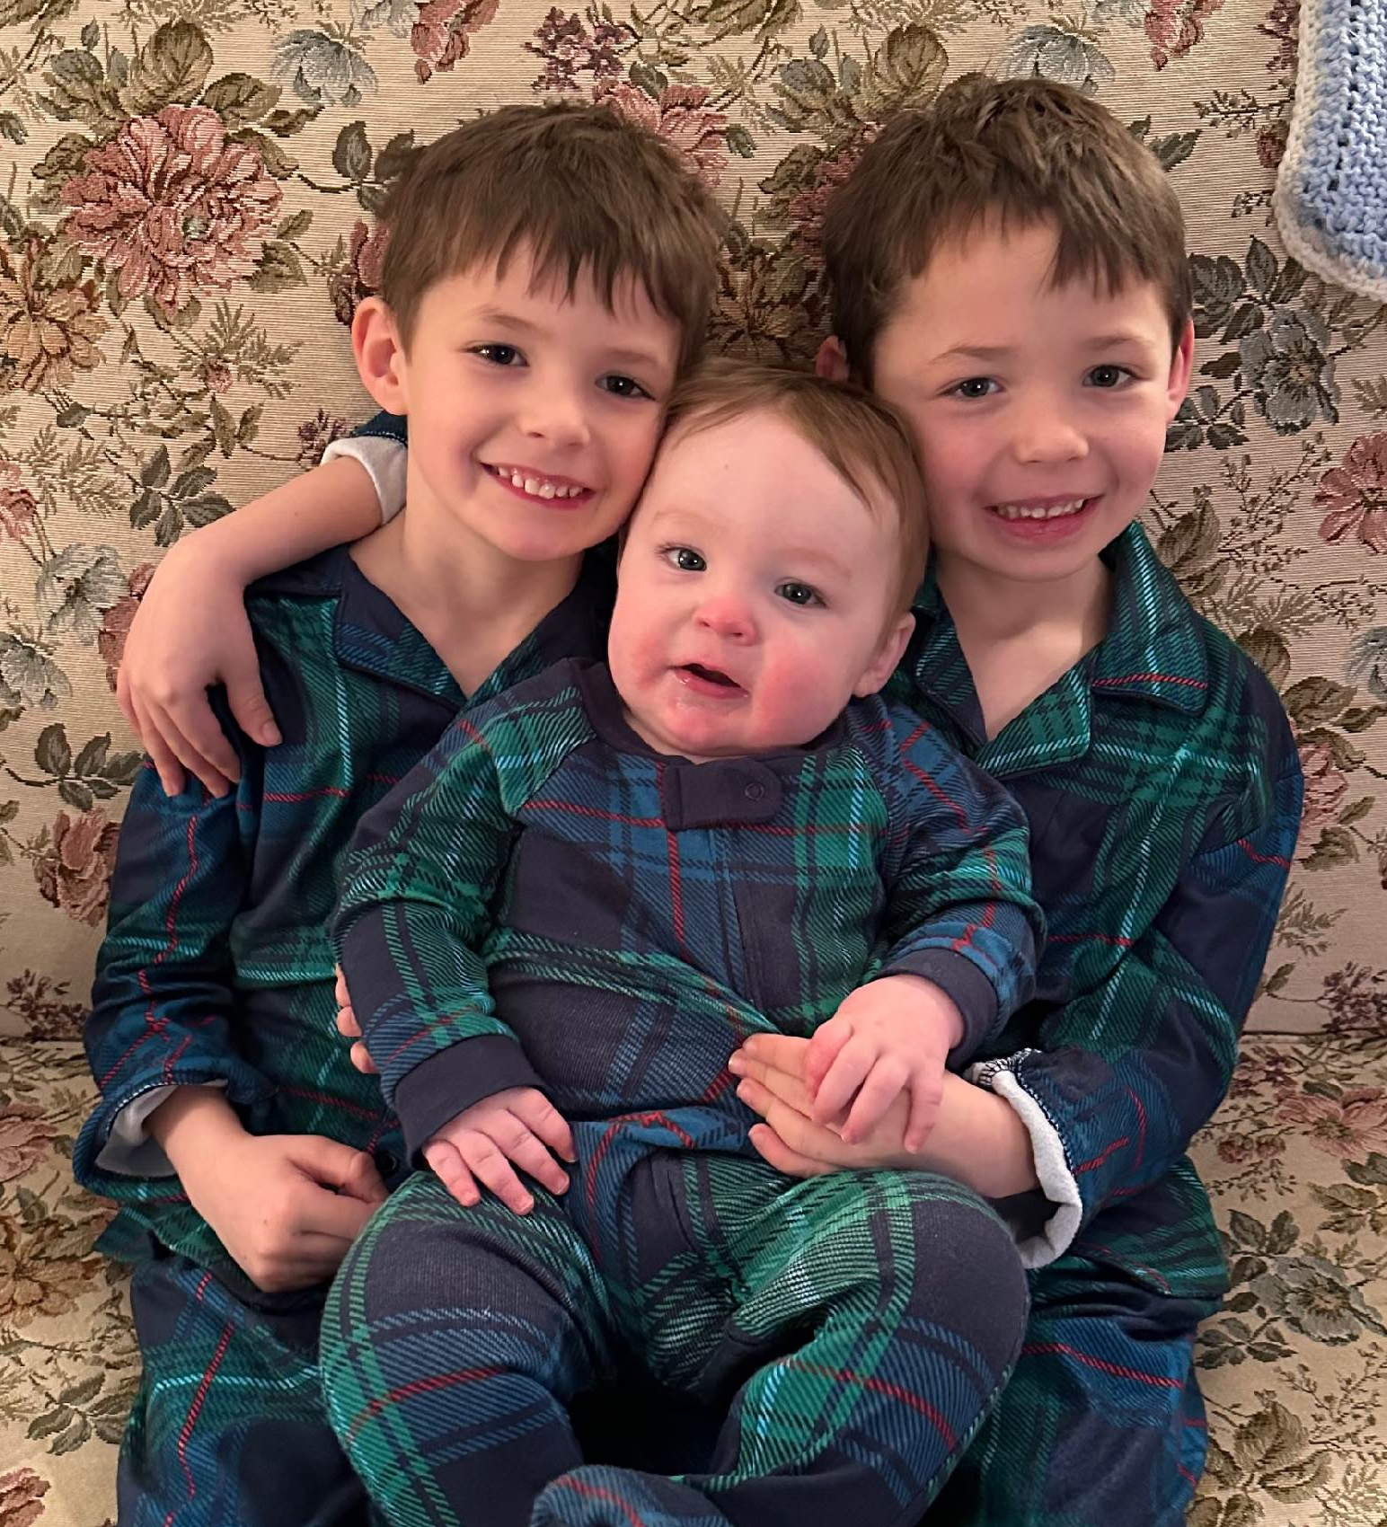
“Our First Years Last the Rest of our Lives”
Stages of Behavioral Development
Age (Years)
0 | 1 | 2 | 3 | 4 | 5 | 6 | 7
Vision Development
Speech Development
Emotional Development
Math / Logic
Social Attachment and Skills
Motor Development
Peer Social Skills
Language

Slide 8
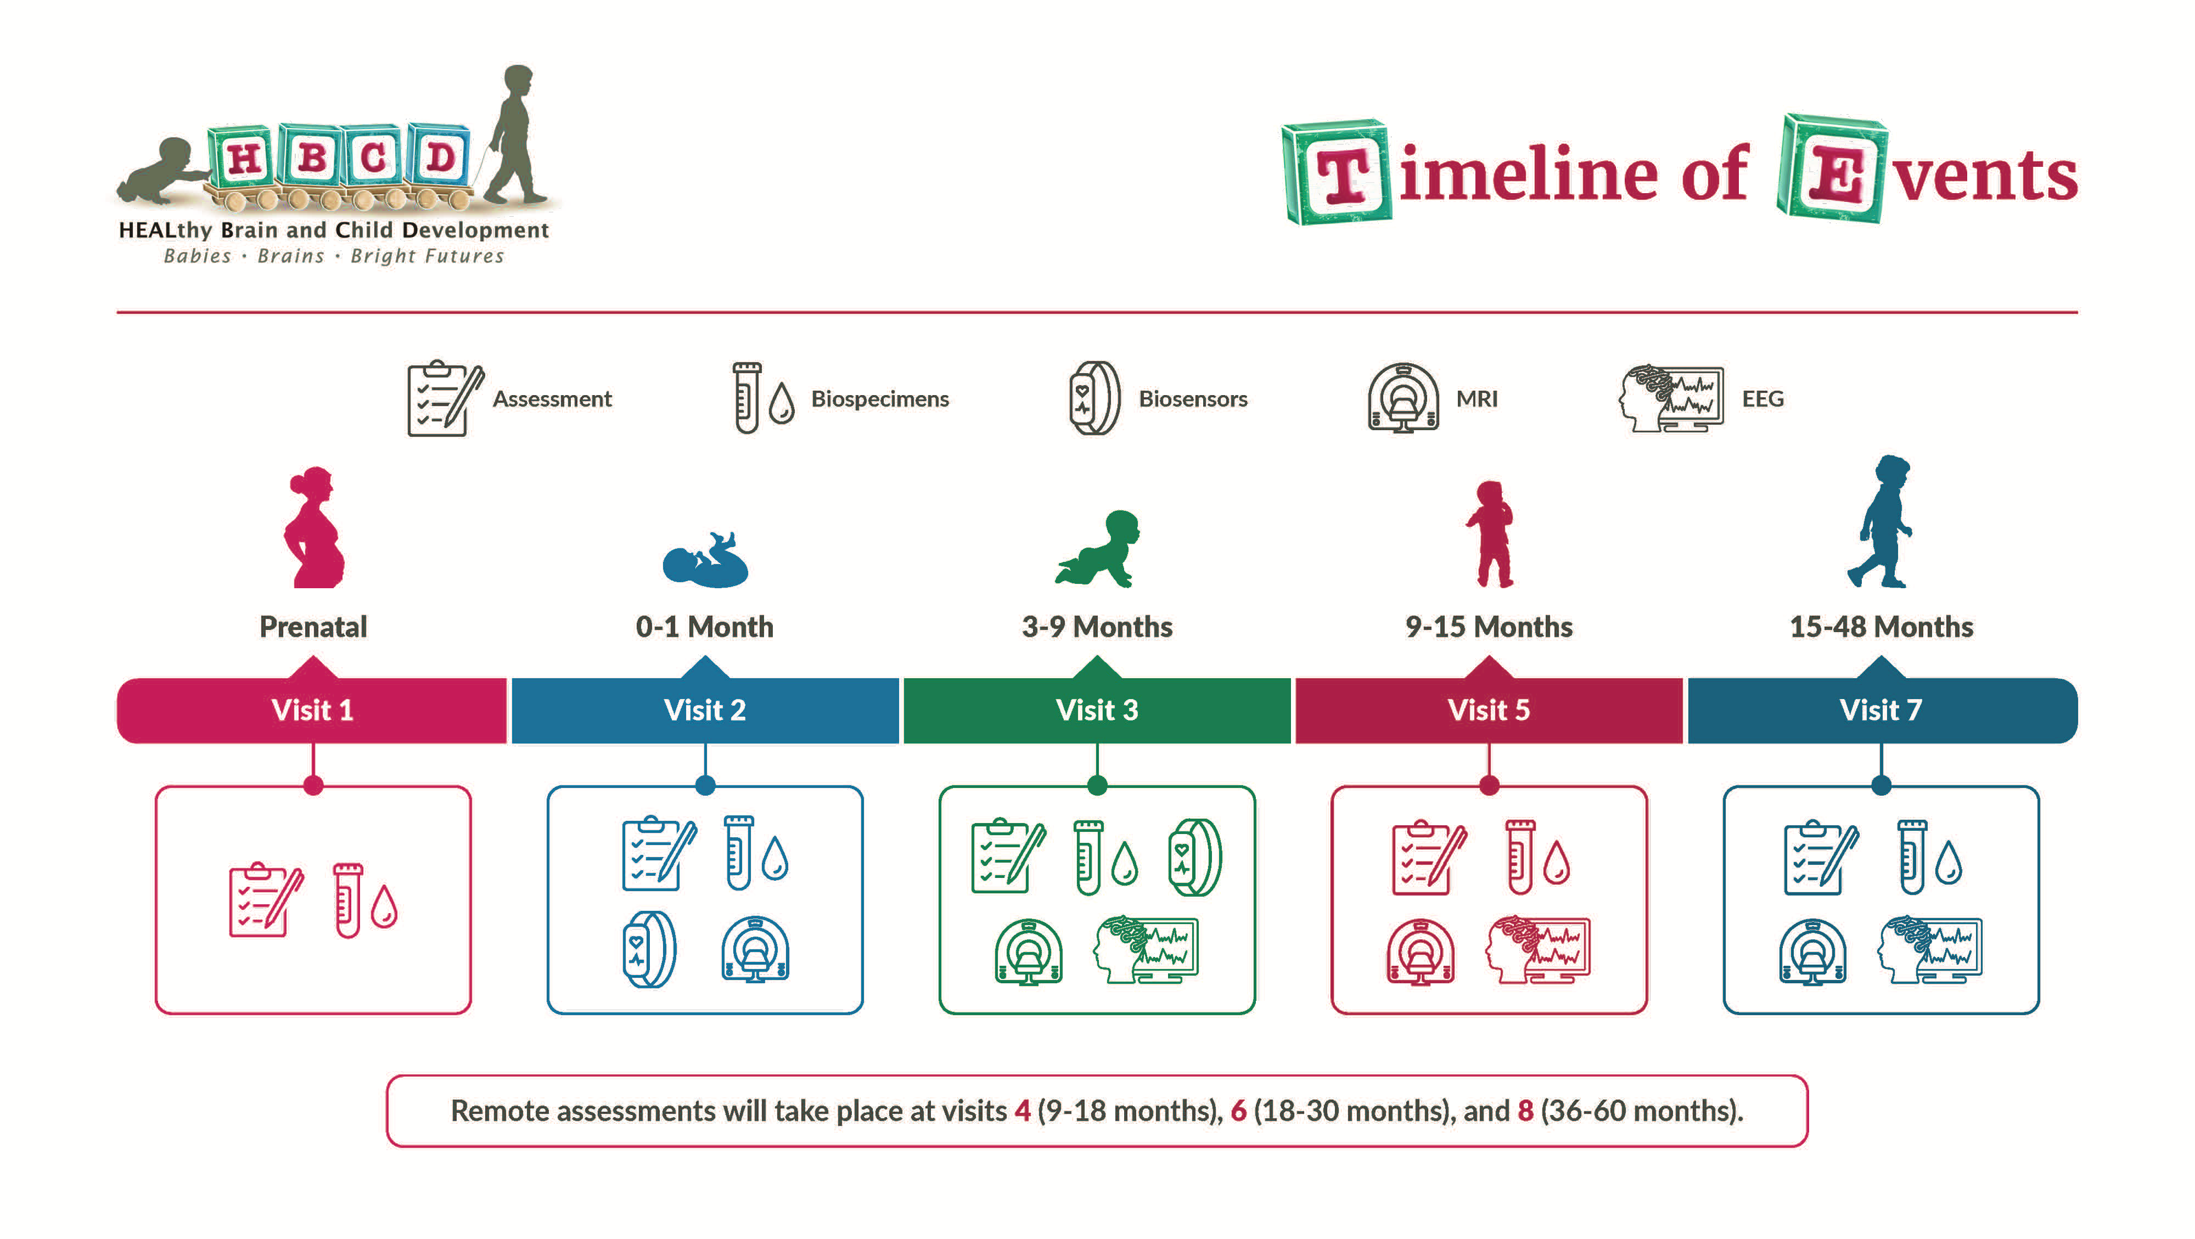

Slide 9
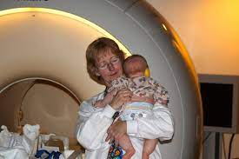
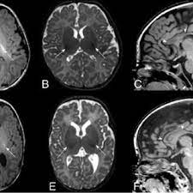
MRI
Structural MRI T1/T2
Diffusion MRI
MR Spectroscopy

Slide 10
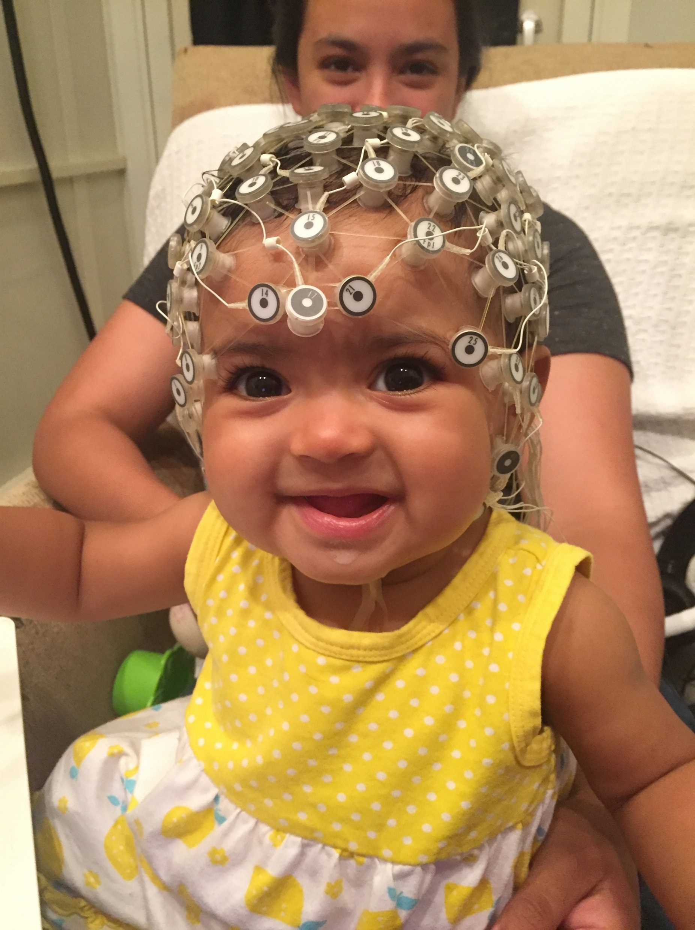
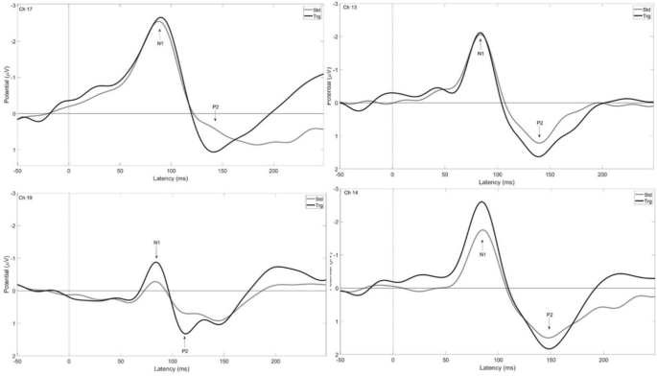
EEG
Baseline
Auditory Oddball
Visual Evoked Potentials
Response to Faces
Notes:
EEG is a direct measure of neuronal activity, provides millisecond time precision

Slide 11
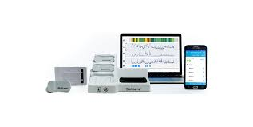
Wearable Biosensors
Measurement of heart rate, heart rate variability, sleep/wake cycles, and physical activity
Devices are sent home with the caregiver
Data are collected from the infant for 72 hours
Caregiver completes a very short survey once a day
Notes:
Wearable biosensors for heart rate (HR), HR variability, sleep/wake cycles, and physical activity

Slide 12

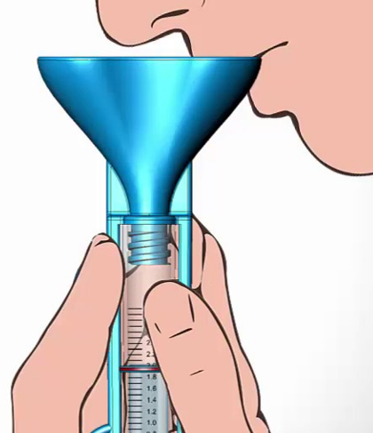
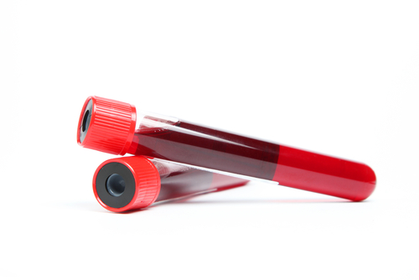
Biospecimens
Birth Parent saliva, blood, and urine (V1)
Birth Parent nails (V2)
Birth Parent saliva (V2, V3, V5, V7)
Child saliva, urine, and stool (V2, V3, V5, V7)
Child height, weight, head circumference
(V2, V3, V5, V7)
Notes:
substance use, genomic, epigenomics, nutrition, toxins, and COVID-19

Slide 13
Questionnaires
Annual EHR Review

Slide 14
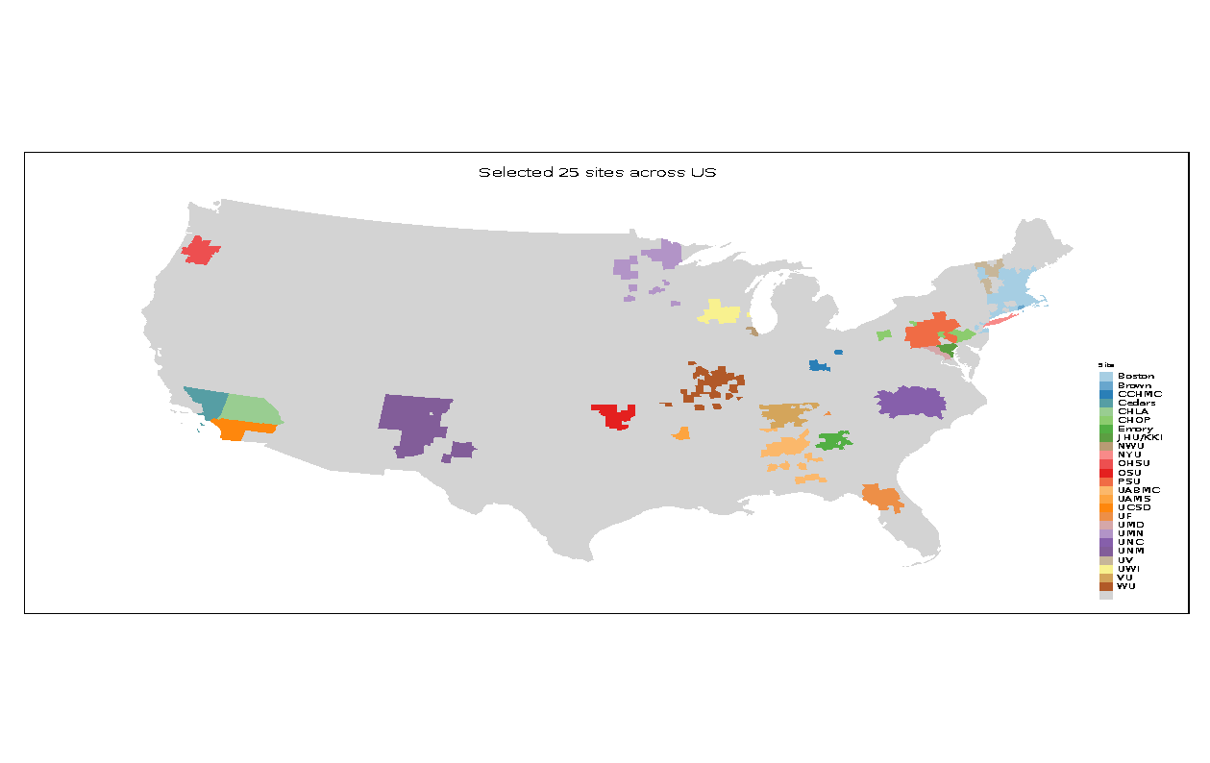
Nationwide multi-modal study
Characterize brain, cognitive, behavioral, physiological, and social emotional development from 0-10 years in a population-based sample
7,500 sample size in first 5-years
Some babies are substance-exposed (e.g. opioids, marijuana, tobacco, alcohol, etc…)
Some babies are non-exposed, share some risks
Some babies have fewer risks
How environments affect brain and behavior development
Longitudinal data collection: MRI, EEG, behavioral/cognitive assessments, biospecimens, questionnaires, wearables
Emphasis on more frequent assessments in first two years of life

Slide 15
What is a Peer Support Navigator?
A PSN is a person who has been successful in their own recovery process and helps others experiencing addiction to stay safe and progress toward remission and recovery. Through shared lived experience, understanding, respect, and mutual empowerment, the PSN helps their clients (‘peers’) become and/or stay engaged in the recovery process, reducing the likelihood of returning to use, and preventing accidental overdose.
(adapted from the SAMSHA’s definition, “Who Are Peer Workers,” at https://www.samhsa.gov/brss-tacs/recovery-support-tools/peers)

Slide 16
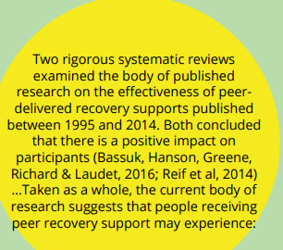
Areas of Growth

Slide 17

Improved relationship with treatment providers
Increased treatment retention
Improved access to social supports Decreased criminal justice involvement
Reduced relapse rates Reduced re-hospitalization rates
Reduced substance use
Greater housing stability

Slide 18
Peer Support & Peer-supported Services:
Can be found across the world
More than 30,000 peer support specialists (peer providers, peers, peer specialists, peer supporters, peer mentors, peer navigators, certified peer support specialists) in the United States offer Medicaid reimbursable services in 43 states
Psychiatr Q. 2022; 93(2): 571–586.
Published online 2022 Feb 18. doi: 10.1007/s11126-022-09971-w PUB Med Central
Psychiatr Q. 2022; 93(2): 571–586.
Published online 2022 Feb 18. doi: 10.1007/s11126-022-09971-w

Slide 19
Biggest Research Challenges
Recruiting participants to sign up!
Retaining them once they start!
This is Where Peer Support Can Be Invaluable!
But NIDA, NIH has never hired Peer Support Navigators for their studies!

Slide 20

Voices of women with lived experience of substance use during pregnancy: A qualitative study of motivators and barriers to recruitment and retention in research Florence Hilliard, MS,ª Ellen Goldstein, MFT, PhD,ª Kendra Nervik, PhD(c),^{b} Kenneth Croes, PhD,^{c} Pilar N. Ossorio,^{de} Aleksandra E. Zgierska, MD, PhD, DFASAM^{f}

Slide 21
Breaking Ground
Promoting Research Engagement Among Women with Addiction: Impact of Recovery Peer Support in a Pilot Randomized Mixed-Methods Study
Aleksandra E. Zgierska, MD, PhD¹, Florence Hilliard², Shelbey Hagen², Alyssa Turnquist², Ellen Goldstein, PhD, MFT³
Pilot Project using a Certified Peer Support Navigator and Research Assistants

Slide 22
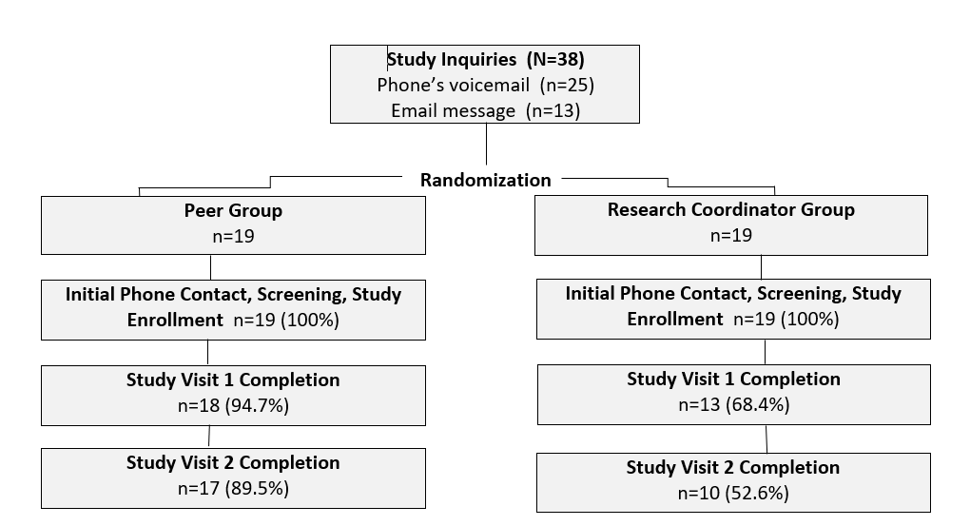

Slide 23
What Is Overarching Role/Goal As A Study Navigator?
Overall Role: Recruiting and Retaining Participants for the HBCD study
Bridge the participants needs with the study requirements.
Build a trusting and ongoing relationship with your participants.
Be a voice for the participant when needed.
Help participants feel comfortable with the different elements of the study.
.

Slide 24
Help participants feel safe putting their babies in the study.
Help participants not feel intimidated.
Being a reliable and consistent support.
Helping motivate them to “stay the course”.
Small Group Activity – Trusting Ourselves

Slide 25
Building Relationships
Similarities to certified peer support role:
Share lived experiences with SUD and recovery
Role model hope and reality of long-term recovery
Provide resources to stabilize/further long-term recovery
Come from “person first” position
Be available to the participant in between “office hours”
Give them resources to help challenges they may be experiencing

Slide 26
Building Relationships
Differences from traditional peer support role:
Getting participants into treatment
Ex: Can help them talk through the decision making process
Setting up recovery goals
Ex. “Here are some things other recovering people have done”
Finding housing for participants if they lose theirs
How could you support?
Visiting participant in the Emergency Room
How could you support?
Taking participant to self-help recovery meetings
How could you support?

Slide 27
SCIENCE AND RESEARCH IS REALLY COOL…….
And Peer Support will become an integral part of it

Slide 28
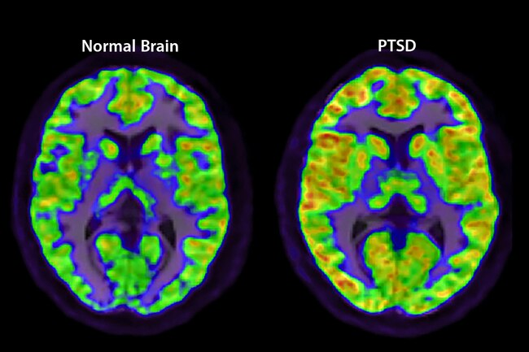
Trauma’s Effect on the Brain
Notes:
When you go through something traumatic, your brain triggers a “flight-or-fight” response. but some get posttraumatic stress disorder. PTSD causes your amygdala -- the part of the brain that controls emotions -- to be overactive. And it lowers activity in your prefrontal cortex, a decision-making area. It can also shrink your hippocampus, which forms memories.

Slide 29
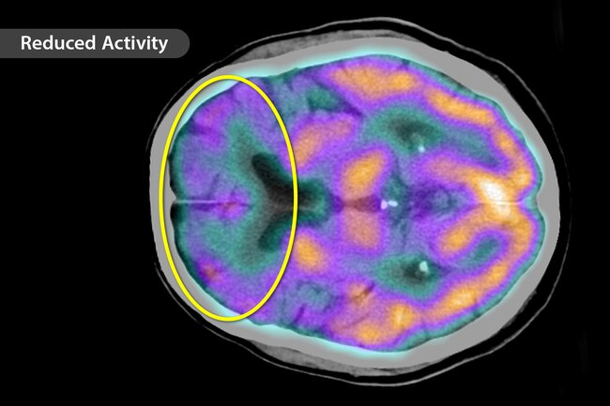
The Brain and Depression
Notes:
Depression doesn’t affect just your mood. The disorder can change your brain. Experts say it lessens activity in some brain areas, including your prefrontal lobes, which are involved with things like reasoning, personality, and judgment. One study found that people who were depressed for more than a decade had about 30% more brain inflammation. This may lead to brain cell loss, which would make memory problems and dementia more likely.

Slide 30
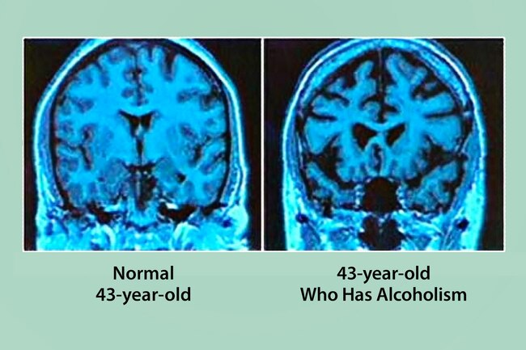
Alcohol Use Disorder
Notes:
Some experts say that people with alcoholism have a smaller hippocampus -- the area important for learning and memory -- than those who don’t drink often.

Slide 31
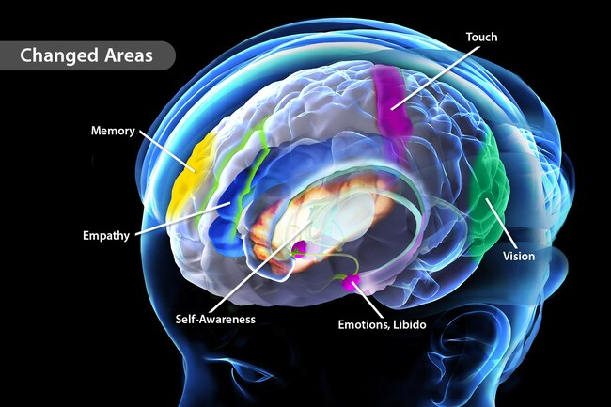
Meditation
Notes:
This mind-body practice eases stress and boosts mental health. Now, research reveals that it may actually change your brain. One study found that meditating for 2 months increased gray matter in parts of the brain that control emotions and learning. Meditation also strengthens the connection between brain cells. It may also ease inflammation in the brain and protect against Alzheimer’s disease.

Slide 32
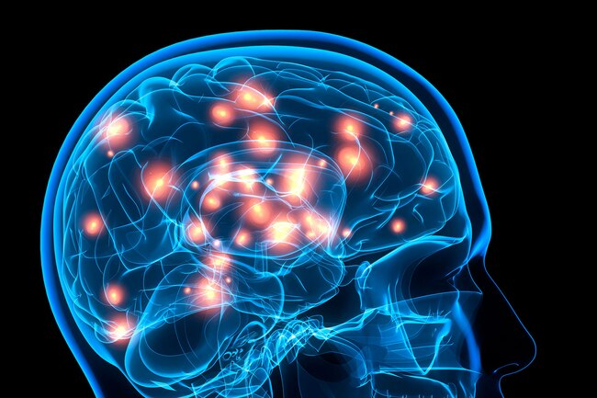
Exercise
Notes:
Getting moving is good for the body and brain. Exercise pumps blood to the brain, which delivers oxygen and nutrients. It also stimulates the release of proteins that keep brain cells healthy and help grow new ones. Research shows that exercise may grow the areas of your brain that control thinking and memory.

Slide 33


