Slide 1
WELCOME
Organizational Wellness & Sustainability

Slide 2


Cost-Effectiveness of PRSS and Bystander Naloxone:
Analysis and a Pilot Calculator
Recovery Leadership Summit - June 2023
Sierra Castedo de Martell, PhD, MPH, Postdoctoral Fellow, JEAP Initiative & Lighthouse Institute, SJCastedo@gmail.com
Margaret Brannon Moore, JD, LLM, MPH, Doctoral Candidate, Margaret.B.Moore@uth.tmc.edu
Hannah Wang, PhD, Programmer Analyst IV, Information Technology
H. Shelton Brown, III, PhD, Associate Professor and PI,
The University of Texas Health Science Center at Houston, School of Public Health
Funding from NIDA R24DA051988 Recovery Research Institute Pilot Grant

Slide 3

Outline for Today
Background and goals for the future
Learn about cost-effectiveness analysis
PRSS cost-effectiveness analysis results
Bystander naloxone distribution
Using the calculator

Slide 4
Background
Our ultimate goal:
  A free, web-based multi-faceted cost-effectiveness calculator that:
    Empowers stakeholders (RCOs, advocates, community decision-makers) to use cost-effectiveness information
    Increases support for existing programs, build support for the adoption of programs
Bonus goal:
  Fill in the knowledge gaps – very little economic evaluation research on peer-driven SUD interventions
Notes:
Our ultimate goal is a free, web-based cost-effectiveness calculator that is multifaceted in that it can look at many interventions at the same time. We want to focus on interventions that are peer-driven and in the substance use realm. We envision a calculator that would empower various stakeholders in that space to use cost-effectiveness information to increase the support of existing programs or to help build support for adopting such programs in areas where they don’t already exist. There’s not much work in this area at all – very few cost-effectiveness evaluations of peer-driven substance use interventions – so as a bonus, we would be helping to fill in this big knowledge gap, as well.

Slide 5
Background
Lots of work to do!
Unfunded collegiate recovery program calculator here
Pilot funding to make today’s calculator (NIDA R24DA051988 Recovery Research Institute Pilot Grant):
  Evaluate cost-effectiveness of long-term PRSS
  Long-term PRSS + Bystander Naloxone Distribution (Coffin & Sullivan, 2013) cost-effectiveness calculator
  Free, web-based, more accessible
+ Future funding to build out more pieces of the calculator, publication.
Notes:
But reaching that goal requires a lot of work, so we’ve taken the approach of tackling just a piece of this calculator at a time. I made a collegiate recovery program cost-effectiveness calculator as part of my master’s thesis work. It’s just based in Excel, but you can take a look at it by following the link. We have had the great fortune of getting some pilot funding to make the calculator we’ll be showing you today through the Recovery Research Institute’s Pilot Grant program through NIDA.
For this pilot, we built out two components of the calculator: we did the full underlying cost-effectiveness analysis of peer recovery support services and made that into a calculator component. We looked specifically at long-term peer recovery support services. So that involves someone with lived experience of addiction recovery – a peer – who is trained and credentialed to support others with substance use disorder, and we looked at the form of services where people are meeting long-term and at a lower intensity, as is often the case as part of a recovery community center’s activities. We also took an existing cost-effectiveness analysis of bystander naloxone distribution from 2013, updated it, and turned it into another calculator component. Bystander naloxone distribution is when recovery community centers or other organizations give naloxone out to people who might be present at an overdose – members of the public, people who work with people who use opioids, and so on.
We’ll also briefly touch on some future planned work to build out more pieces of the calculator, plans to publish and disseminate, and work toward testing potential impacts of the calculator.

Slide 6
THANK YOU to Communities for Recovery and RecoveryATX for providing critical feedback!
Funding from Recovery Research Institute Pilot Grant Program
Pilot funded
Background research
RCOs review model
Calculator prototype
RCOs test calculator
Finalize pilot calculator
Presented at NAPS (launch)
Gathering feedback on pilot
Future improvements + expansion
Notes:
Here’s a brief timeline of what we did to get here today, and where we’re going. So we got that funding, and then we did the background research to figure out how to do the cost-effectiveness analysis for PRSS. For bystander naloxone distribution, there’s actually already a cost-effectiveness study, so my colleague, Marnie, updated all those numbers. Once we figured out how we were planning to build the calculator, we met with staff at two local RCOs, Communities for Recovery and RecoveryATX to make sure we were thinking about things the way they really work. From that feedback, we built out a prototype calculator, and tested that calculator with the same two RCOs. Our IT partner, Hannah, then finalized the pilot calculator with that feedback. We launched the calculator at the National Association of Peer Supporters conference in October 2022, and we’ve put up a survey alongside the calculator to keep gathering feedback. We’d like to eventually work toward expanding the tool and continuing to improve it.

Slide 7
Outline for Today
Background and goals for the future
Learn about cost-effectiveness analysis
PRSS cost-effectiveness analysis results
Bystander naloxone distribution
Using the calculator
Notes:
So that takes care of the background. Next we’ll talk about what cost-effectiveness analysis is.

Slide 8
What is Cost-Effectiveness Analysis?
Moving quickly, but you have these slides and a longer version of this presentation is available on the calculator website!
Notes:
Now we’re going to move quickly through this section, but I wanted to let you know that you’ll have access to these slides, and a longer, slower version of this presentation is up on the calculator website, so you can always refer back to that.

Slide 9
What is Cost-Effectiveness Analysis?
Notes:
Cost-effectiveness analysis is a type of economic evaluation, which might also be called efficiency evaluation.

Slide 10
What is Cost-Effectiveness Analysis?
The intervention (program, activity)
Notes:
For any intervention, or program, or activity we want to do for the benefit of society, we need to think about….

Slide 11
What is Cost-Effectiveness Analysis?
The intervention (program, activity)
Resources that make an intervention happen
Notes:
….the resources that go in to making that intervention happen, and…

Slide 12
What is Cost-Effectiveness Analysis?
Resources that make an intervention happen
The intervention (program, activity)
The good stuff that our intervention produces
Notes:
….the good stuff that comes out of that intervention.

Slide 13


What is Cost-Effectiveness Analysis?
Resources that make an intervention happen
The intervention (program, activity)
The good stuff that our intervention produces
How balanced are resources to good stuff?
Notes:
Cost-effectiveness analysis, and other types of economic evaluation, tell us about the balance between resources put into and the good stuff that comes out of an intervention.

Slide 14
What is Cost-Effectiveness Analysis?
Cost-Effectiveness
Cost-Benefit Analysis
Return on Investment
How balanced are resources to good stuff?
Notes:
You may have heard of other types of economic evaluation – things like cost-benefit analysis, or return on investment.

Slide 15
What is Cost-Effectiveness Analysis?
Cost-Effectiveness
Cost-Benefit Analysis
Return on Investment
Both resources and good stuff have $$$
Resources have $$$, but good stuff doesn’t
How balanced are resources to good stuff?
Notes:
Both cost-benefit analysis and return on investment involve some degree of putting a dollar value onto the good stuff that comes out of an intervention. That can be tricky, especially in an area like substance use disorder recovery, because there’s a ton of evolution happening around what it means to be in recovery, and translating that to a dollar value can be tricky, and can – frankly – feel icky.

Slide 16

What is Cost-Effectiveness Analysis?
Cost-Effectiveness
Cost-Benefit Analysis
Return on Investment
Both resources and good stuff have $$$
Resources have $$$, but good stuff doesn’t
How balanced are resources to good stuff?
Notes:
So that’s one of the reasons I like cost-effectiveness analysis. We don’t have to assign a dollar value to the good stuff in our intervention.

Slide 17
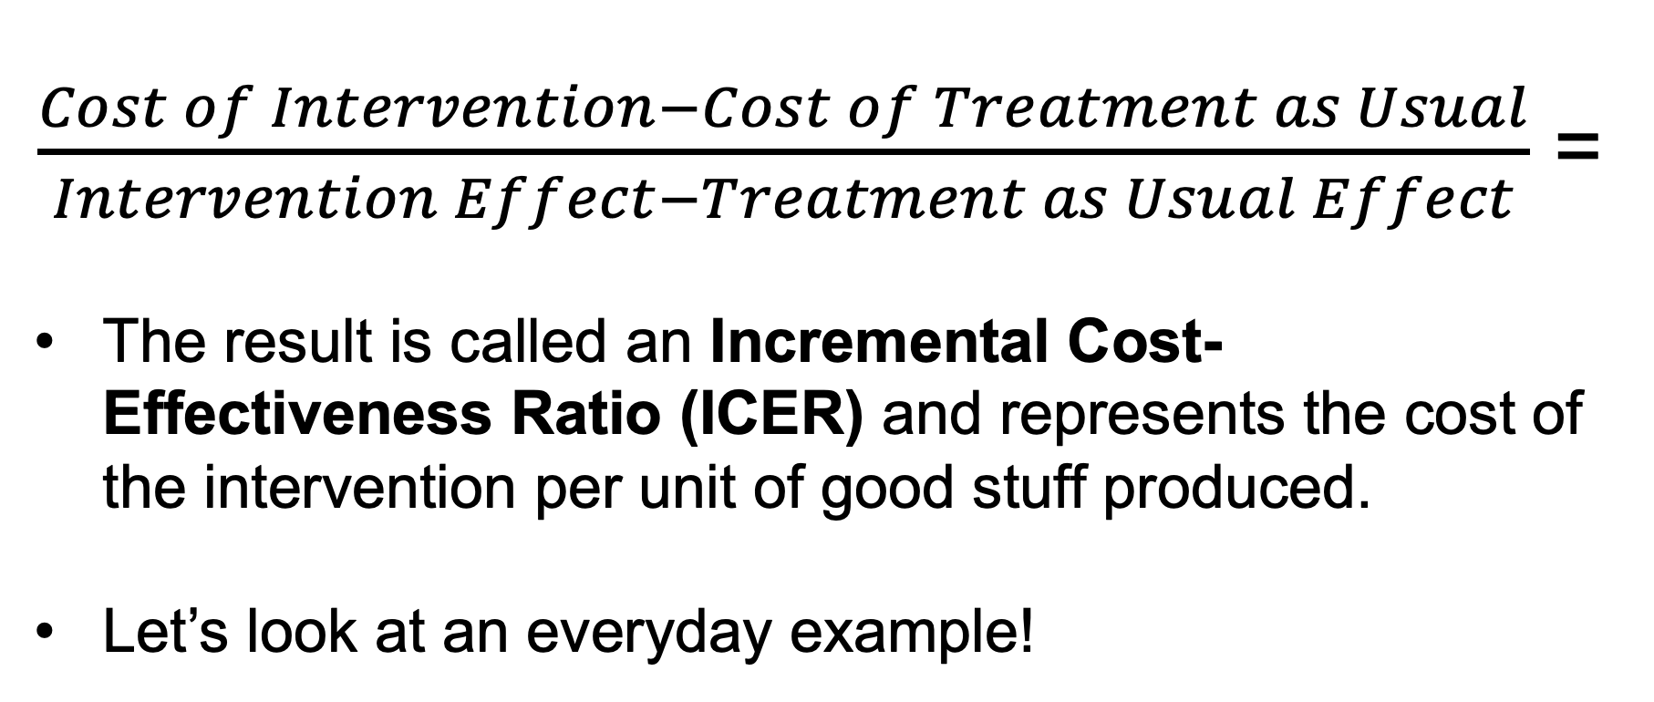
$\frac{Cost of Intervention−Cost of Treatment as Usual}{Intervention Effect−Treatment as Usual Effect}$ =
The result is called an Incremental Cost-Effectiveness Ratio (ICER) and represents the cost of the intervention per unit of good stuff produced.
Let’s look at an everyday example!
Notes:
In cost-effectiveness we get an end result called an incremental cost-effectiveness ratio or ICER. That’s telling us the price of the intervention per unit of good stuff the intervention produces.
That sounds a little funky but here’s an everyday example that may help you think about it:

Slide 18
Grocery store metaphor:
  Compare sticker prices, but packaging or product is not identical, so we can compare price per ounce (or other unit), instead.
Notes:
One of the best ways to explain what cost-effectiveness does, is to think about the supermarket. When you go to the supermarket, and you head to the cereal aisle, there’s a ton of cereals to choose from. There are different kinds of cereals – wheat based, rice based, oats, chocolate, fruity – there are different brands of cereal, and there are different sizes and different packaging. It can be tough to compare different cereals, especially if they come in different packages.

Slide 19
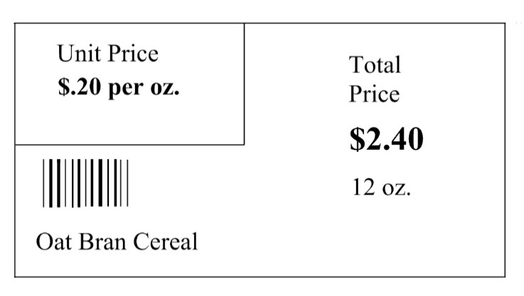
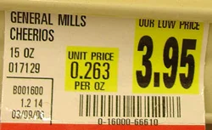
Grocery store metaphor:
  Compare sticker prices, but packaging or product is not identical, so we can compare price per ounce (or other unit), instead.
  For different types of cereal.
Notes:
Let’s say I’m trying to decide between name brand Cheerios in a 15 oz box, and generic oat bran cereal in a 12 oz box. Well the generic is cheaper, but it’s also smaller. So how do I know which one is a better deal – which one is getting me more breakfast for my money?

Slide 20
Grocery store metaphor:
  Compare sticker prices, but packaging or product is not identical, so we can compare price per ounce (or other unit), instead.
  For different types of cereal.
Notes:
We might want to look for the price per ounce, instead of just looking at the sticker price.
The price per ounce lets me compare different kinds of cereal that come in different sized packages.

Slide 21
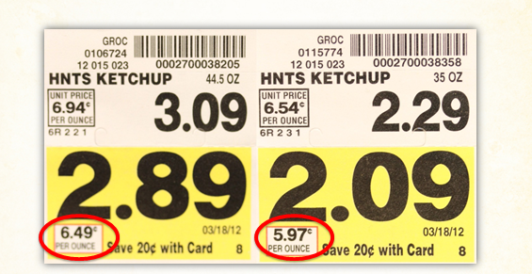
Grocery store metaphor:
  Compare sticker prices, but packaging or product is not identical, so we can compare price per ounce (or other unit), instead.
  Or for the exact same product and brand, but different sizes (economies of scale)
Notes:
And it also lets me compare different sizes of the same product. Do I get a better deal if I buy the bigger size? Actually in this case, I don’t! Similarly, programs for people’s health don’t always work more efficiently when they’re bigger – so cost-effectiveness analysis can help us take a look at that question.

Slide 22
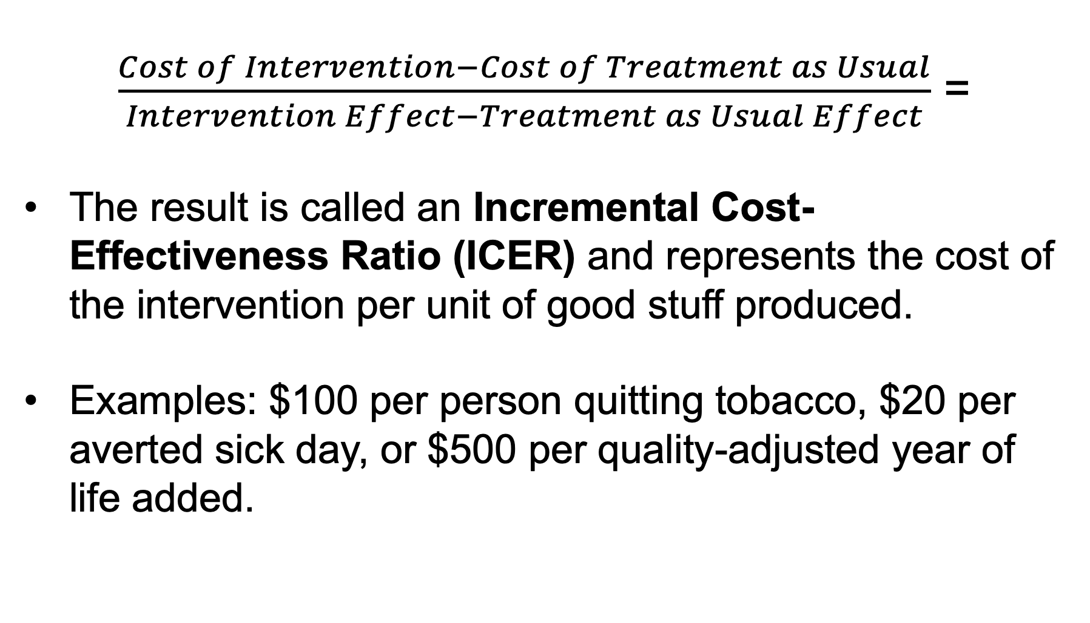
$\frac{Cost of Intervention−Cost of Treatment as Usual}{Intervention Effect−Treatment as Usual Effect}$ =
The result is called an Incremental Cost-Effectiveness Ratio (ICER) and represents the cost of the intervention per unit of good stuff produced.
Examples: $100 per person quitting tobacco, $20 per averted sick day, or $500 per quality-adjusted year of life added.
Notes:
So let’s go back to that slide we were on before the cereal example. That ICER is doing pretty much the same thing, except instead of a price per ounce, it’s a price per unit of good stuff. Now that good stuff might be additional years of life I get to live because of that intervention, or it might be days that I spend healthy instead of days I spend ill.

Slide 23
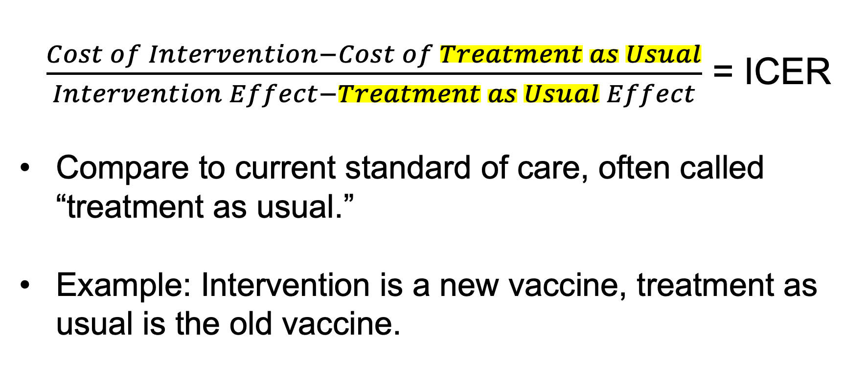
$\frac{Cost of Intervention−Cost of Treatment as Usual}{Intervention Effect−Treatment as Usual Effect}$ = ICER
Compare to current standard of care, often called “treatment as usual.”
Example: Intervention is a new vaccine, treatment as usual is the old vaccine.
Notes:
And we’re looking for the difference between the new intervention I’m looking at, and an old standard way of doing things, which we usually call “treatment as usual.”
Treatment as usual could be doing nothing, if that’s what people usually get. Or it could be doing something that’s working pretty well, but just could be better, like comparing a new vaccine to an old vaccine.

Slide 24
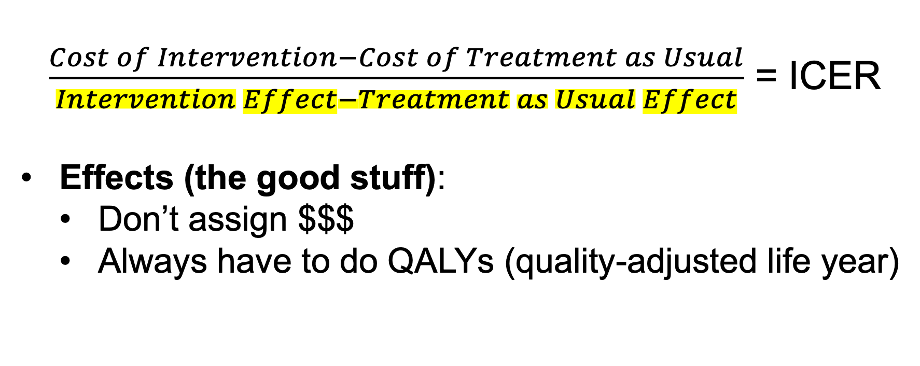
$\frac{Cost of Intervention−Cost of Treatment as Usual}{Intervention Effect−Treatment as Usual Effect}$ = ICER
Effects (the good stuff):
  Don’t assign $$$
  Always have to do QALYs (quality-adjusted life year)
Notes:
Let’s talk about how we figure out the good stuff. To publish, and to compare to other studies that have4 already been done, we have to always start with something called a quality-adjusted life year or QALY. A QALY captures the idea of quality of life and life expectancy at the same time

Slide 25
$\frac{Cost of Intervention−Cost of Treatment as Usual}{Intervention Effect−Treatment as Usual Effect}$ = ICER
Effects (the good stuff):
  Don’t assign $$$
  Always have to do QALYs (quality-adjusted life year)
4 years perfect health
QOL weight = 1
4 x 1 = 4
= 4 QALYs added
4 years at half of perfect health
QOL weight = 0.5
4 x 0.5 = 2
= 2 QALYs added
Notes:
. Let’s say my intervention adds four years of life expectancy per person. Awesome. But it also is really tough and lowers quality of life by about half. So those four years actually become 2 years, because we reduce that number by half – the quality of life adjustment. Let’s say my intervention doesn’t change quality of life at all, or it improves it, to perfect health. Well then in perfect health I’ve got 4 full years, so we’d just use 4.

Slide 26
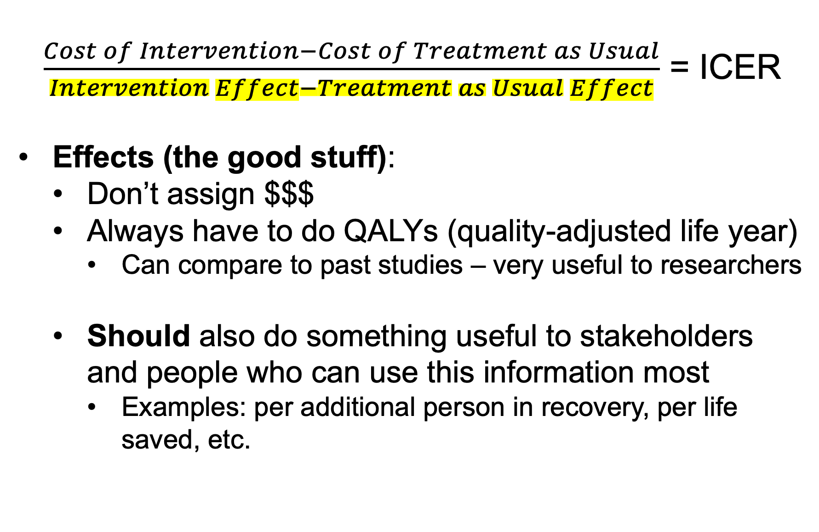
$\frac{Cost of Intervention−Cost of Treatment as Usual}{Intervention Effect−Treatment as Usual Effect}$ = ICER
Effects (the good stuff):
  Don’t assign $$$
  Always have to do QALYs (quality-adjusted life year)
    Can compare to past studies – very useful to researchers
  Should also do something useful to stakeholders and people who can use this information most
    Examples: per additional person in recovery, per life saved, etc.
Notes:
QALYs let us compare across studies that have already been done, which is super helpful. But QALYs aren’t that intuitive to a lot of people, and our field might be way more interested in a different kind of outcome. Often, we think about lives saved or sustained healthy recovery (however that is defined), and in the past abstinence was a big measure, but that definition has broadened to one that is more recovery-focused. So we also always want to do something that is meaningful to the audience for this analysis.

Slide 27









$\frac{Cost of Intervention−Cost of Treatment as Usual}{Intervention Effect−Treatment as Usual Effect}$ = ICER
Costs: Two perspectives (at least)
    Societal
Notes:
So that covers the bottom part – the per ounce part in our grocery store metaphor. Then the top part is where we’re finding the difference in the cost of our new intervention and the cost of some standard way of doing things – treatment as usual.
It’s important to note here that there’s two ways of looking at costs.
The societal perspective is just what it sounds like – how does this impact all of society? We want to think about things like, if people are getting this health intervention, how much of their time does it use up, and what could they have been doing with that time otherwise? We think about not just medical costs, but productivity, criminal justice, maybe even accidents – all the wider ripples of whatever health condition we’re looking at.

Slide 28

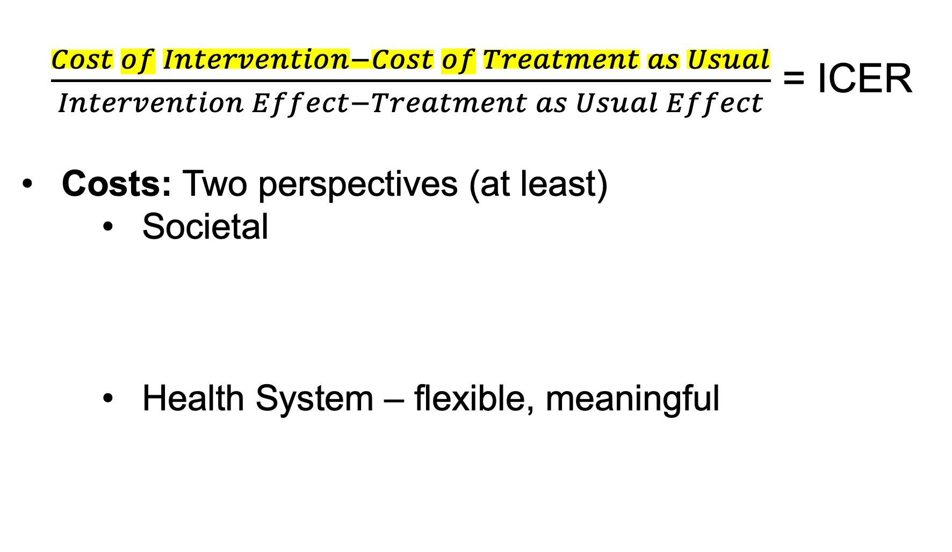
$\frac{Cost of Intervention−Cost of Treatment as Usual}{Intervention Effect−Treatment as Usual Effect}$ = ICER
Costs: Two perspectives (at least)
    Societal
    Health System – flexible, meaningful
Notes:
We then also want to take a narrower view, too, and we call that the health system perspective. That’s actually pretty flexible though. The health system could be something like all of Texas Medicaid, or the whole US healthcare system. But it could also be something like a college campus – like for my CRP calculator. We’re just narrowing down to things like medical costs, costs that would happen within whatever we’re calling the healthcare system, but not looking at stuff outside of that, like what participants could have been doing with their time.

Slide 29
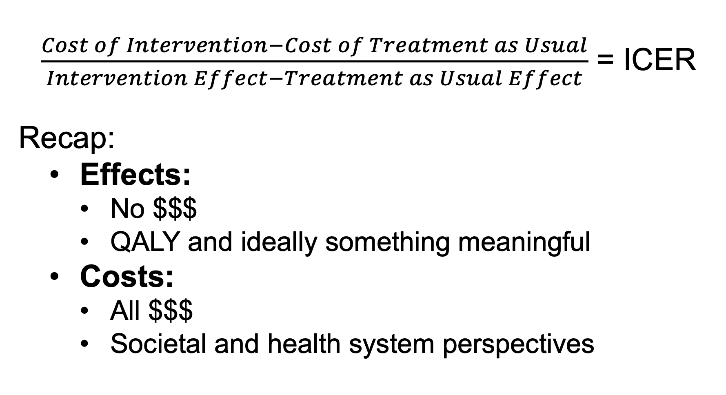
$\frac{Cost of Intervention−Cost of Treatment as Usual}{Intervention Effect−Treatment as Usual Effect}$ = ICER
Recap:
  Effects:
    No $$$
    QALY and ideally something meaningful
  Costs:
    All $$$
    Societal and health system perspectives
Notes:
So we have two different ways that we put a dollar value on this top part, and we’re not putting a dollar value on the bottom part, so we sidestep any trickiness or ickiness.

Slide 30
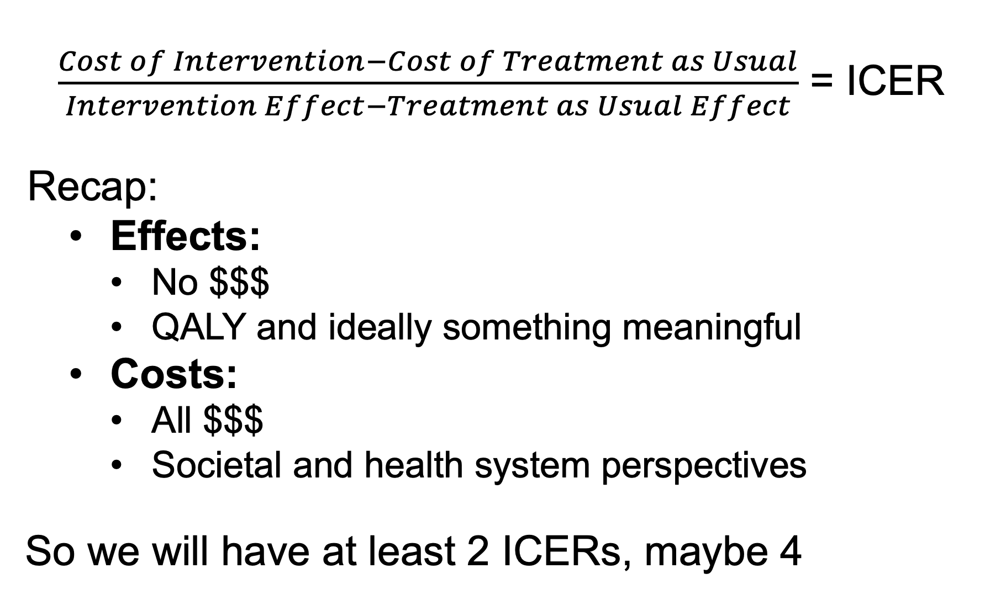
$\frac{Cost of Intervention−Cost of Treatment as Usual}{Intervention Effect−Treatment as Usual Effect}$ = ICER
Recap:
  Effects:
    No $$$
    QALY and ideally something meaningful
  Costs:
    All $$$
    Societal and health system perspectives
    So we will have at least 2 ICERs, maybe 4
Notes:
And since we want to look at two different kinds of costs, we have at least 2 ICERs. Ideally we should also look at some kind of meaningful outcome – something that’s more meaningful to the stakeholders than QALYs, and so if he have one, we’ll be looking at 4 different ICERS.

Slide 31
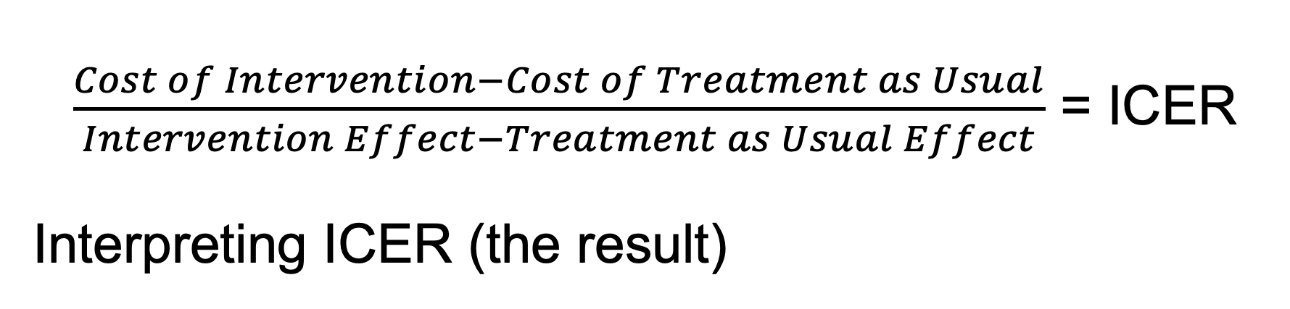
$\frac{Cost of Intervention−Cost of Treatment as Usual}{Intervention Effect−Treatment as Usual Effect}$ = ICER
Interpreting ICER (the result)
Notes:
So let’s talk about interpreting those ICERs. What’s a good ICER to have?

Slide 32
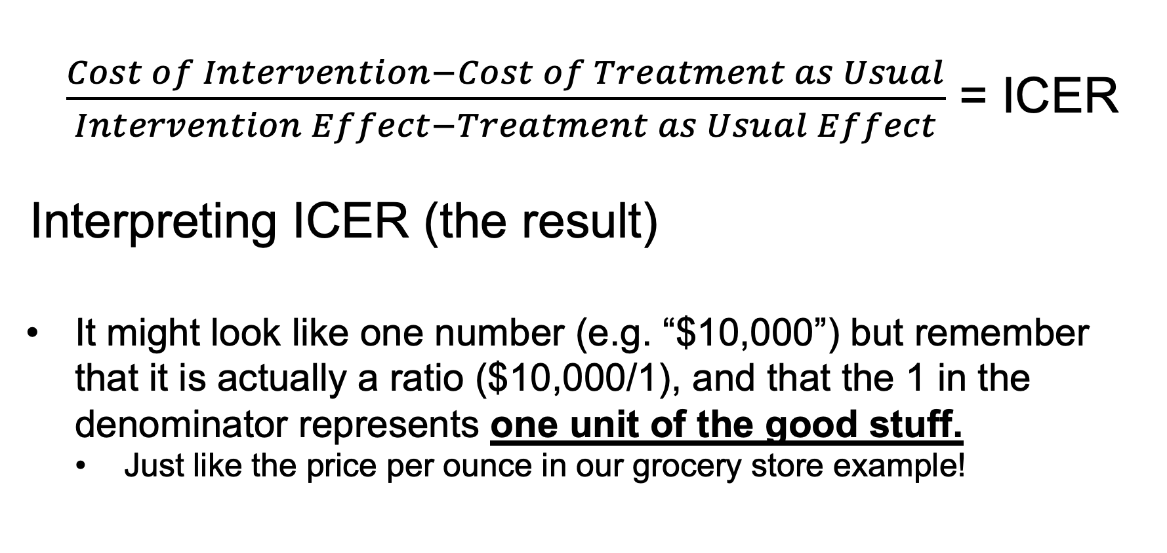
$\frac{Cost of Intervention−Cost of Treatment as Usual}{Intervention Effect−Treatment as Usual Effect}$ = ICER
Interpreting ICER (the result)
It might look like one number (e.g. “$10,000”) but remember that it is actually a ratio ($10,000/1), and that the 1 in the denominator represents one unit of the good stuff.
  Just like the price per ounce in our grocery store example!
Notes:
It looks like one number, but remember it’s a ratio, so it’s actually over 1, 1 unit of good stuff. So we read it and interpret it as “$10,000 per quality-adjusted life year” or “$100 per additional person in recovery.”
In isolation what does that mean though?

Slide 33
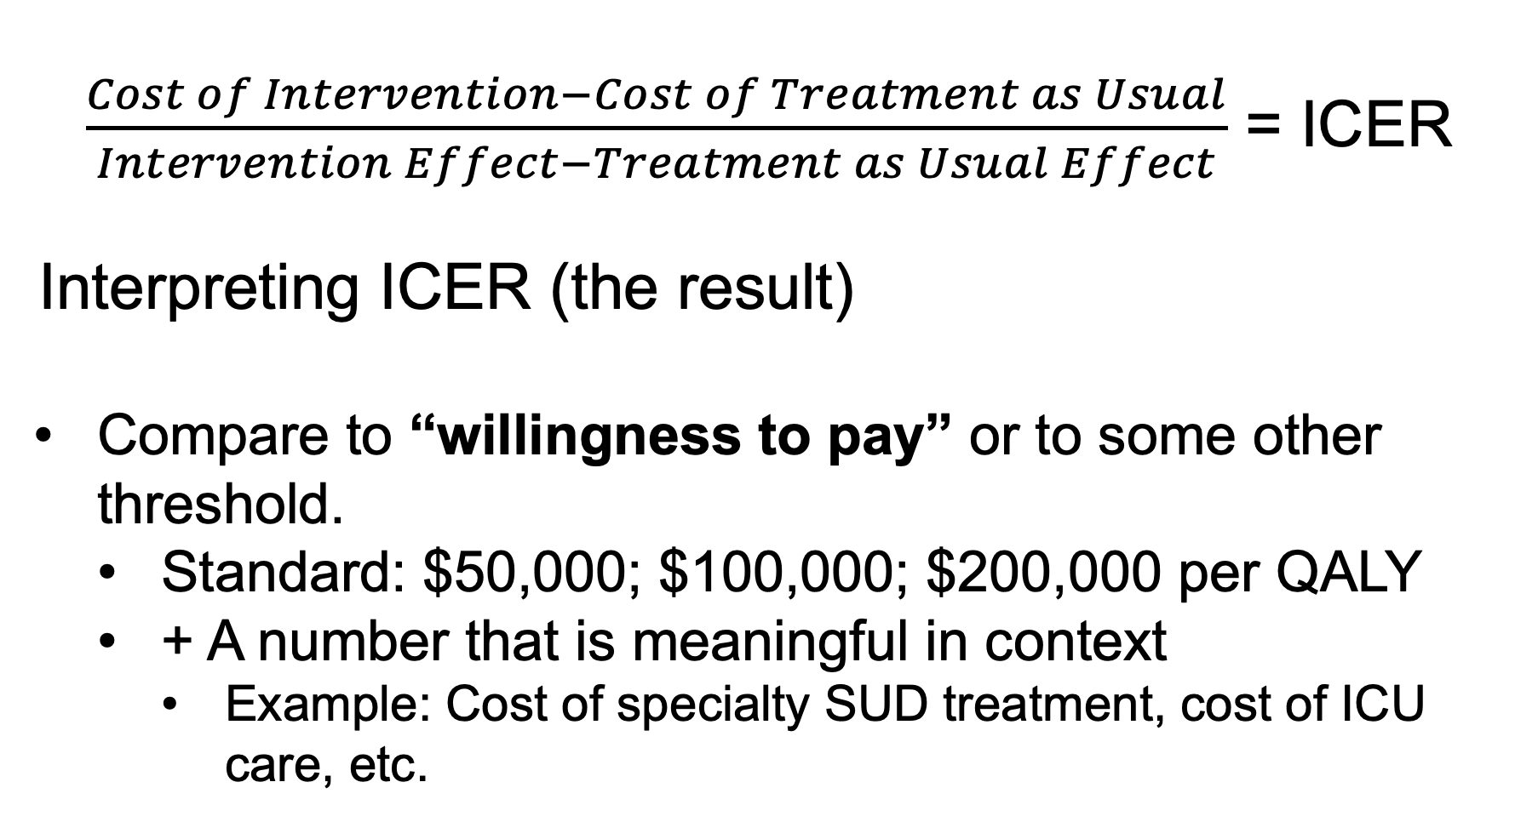
$\frac{Cost of Intervention−Cost of Treatment as Usual}{Intervention Effect−Treatment as Usual Effect}$ = ICER
Interpreting ICER (the result)
Compare to “willingness to pay” or to some other threshold.
  Standard: $50,000; $100,000; $200,000 per QALY
  + A number that is meaningful in context
    Example: Cost of specialty SUD treatment, cost of ICU care, etc.
Notes:
Look at Willingness to Pay thresholds
Standard to use $50k – that’s what dialysis used to cost for every year of life it added. But that was in the 70s, so people also like to use $100k and $200k to account for inflation.
But also good to use a number that’s meaningful. So in our case, maybe that’s the average cost of SUD specialty treatment? Or maybe it’s the cost of a visit to the emergency department? Or the ICER of another intervention – but in the peer-driven behavioral health world, well, there’s not a lot of other studies out there to compare ICERs!

Slide 34
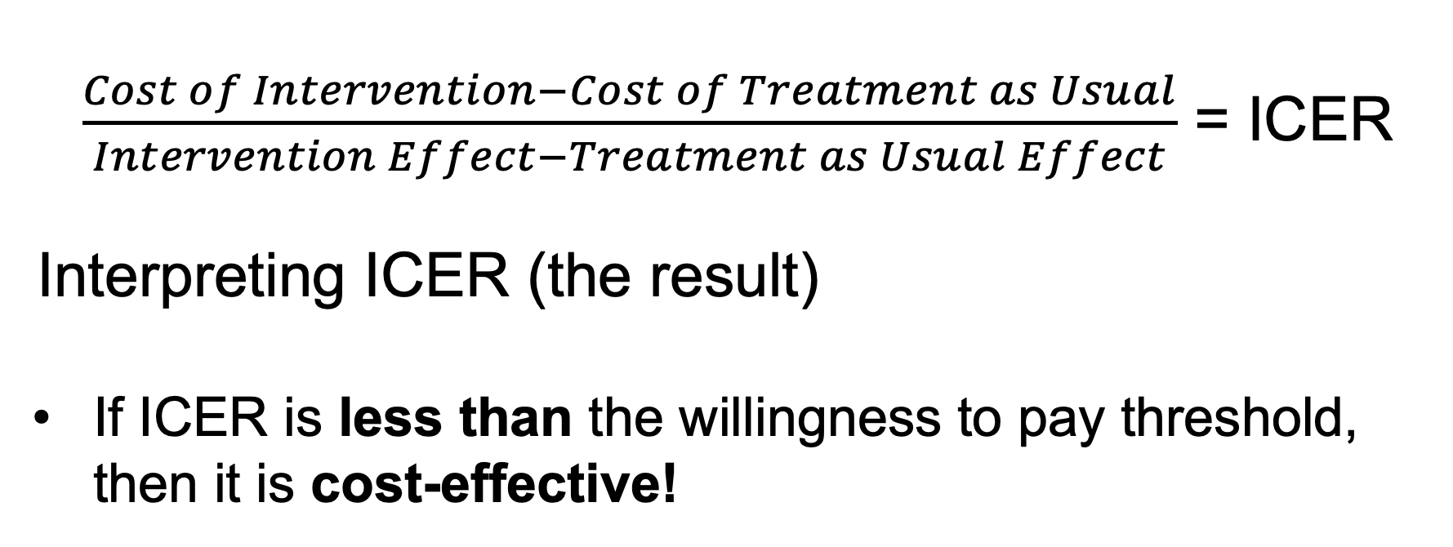
$\frac{Cost of Intervention−Cost of Treatment as Usual}{Intervention Effect−Treatment as Usual Effect}$ = ICER
Interpreting ICER (the result)
If ICER is less than the willingness to pay threshold, then it is cost-effective!
Notes:
So, any number below your willingness to pay threshold, it’s cost-effective!

Slide 35
$\frac{Cost of Intervention−Cost of Treatment as Usual}{Intervention Effect−Treatment as Usual Effect}$ = ICER
Interpreting ICER (the result)
If ICER is less than the willingness to pay threshold, then it is cost-effective!
“Easier to pass”
“Harder to pass”
$200,000
threshold
$100,000
threshold
$50,000
threshold
Smaller, more meaningful threshold (e.g. cost of treatment episode)
Notes:
So, any number below your willingness to pay threshold, it’s cost-effective!

Slide 36
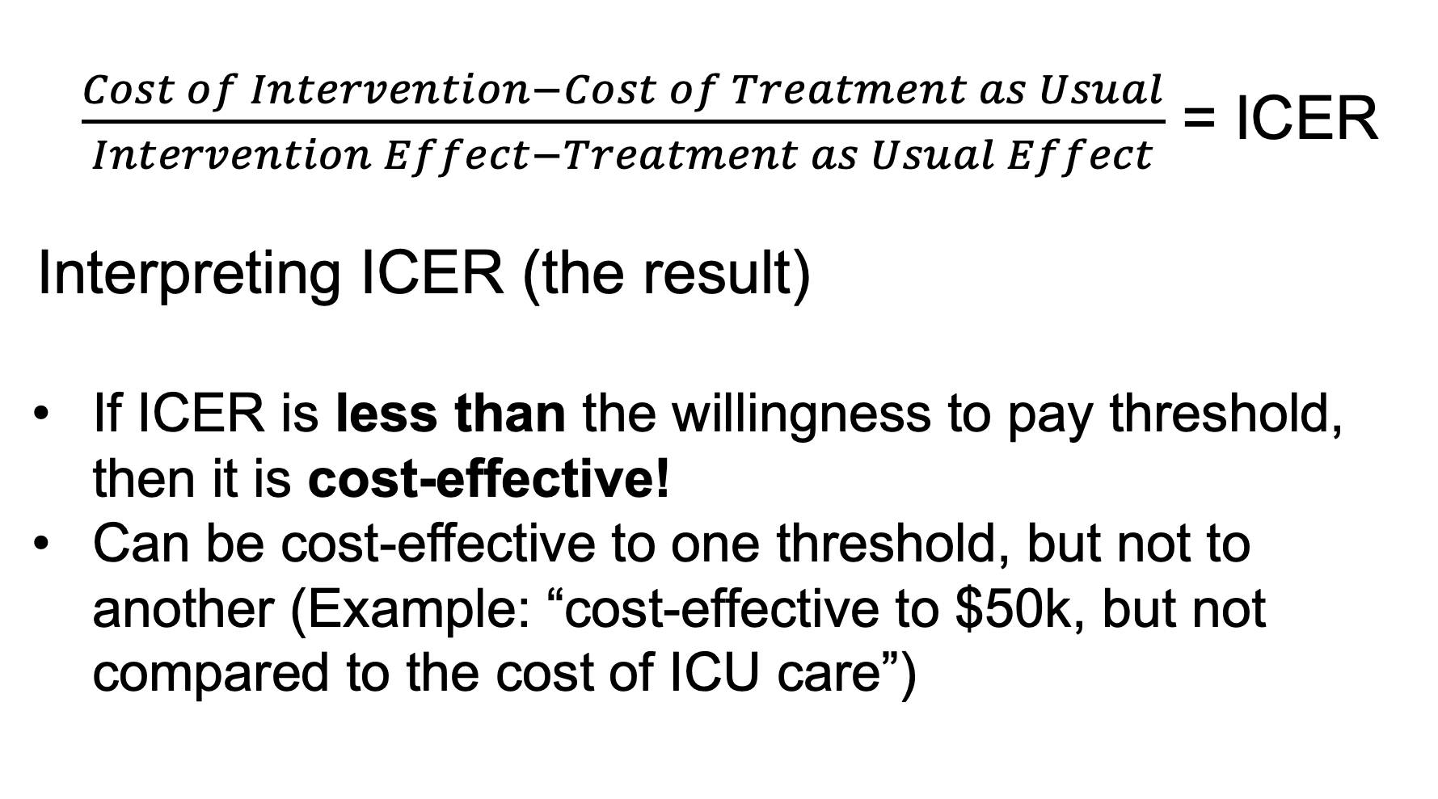
$\frac{Cost of Intervention−Cost of Treatment as Usual}{Intervention Effect−Treatment as Usual Effect}$ = ICER
Interpreting ICER (the result)
If ICER is less than the willingness to pay threshold, then it is cost-effective!
Can be cost-effective to one threshold, but not to another (Example: “cost-effective to $50k, but not compared to the cost of ICU care”)
Notes:
Can also look at multiple, so “not CE to threshold 1, but is CE to threshold 2”

Slide 37
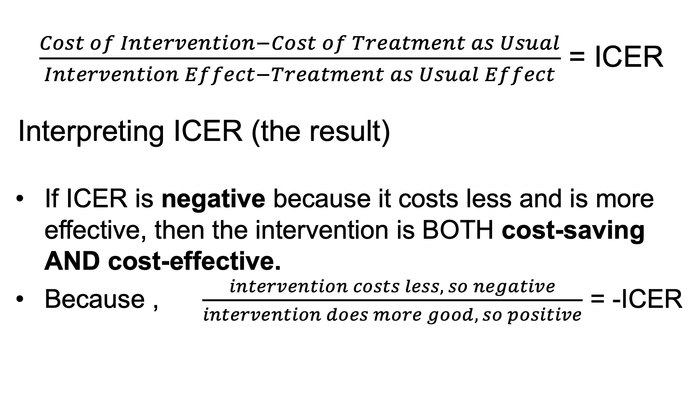
$\frac{Cost of Intervention−Cost of Treatment as Usual}{Intervention Effect−Treatment as Usual Effect}$ = ICER
Interpreting ICER (the result)
If ICER is negative because it costs less and is more effective, then the intervention is BOTH cost-saving AND cost-effective.
Because , $\frac{intervention costs less, so negative}{intervention does more good, so positive}$ = -ICER
Notes:
An ICER that is negative may indicate that you have an intervention that is BOTH cost-saving and cost-effective. If you get to a negative ICER because the intervention costs less but delivers more good stuff, then congratulations! But remember, if it’s negative because the bottom number is negative, that’s no good: it means it’s less effective, AND costs more.

Slide 38
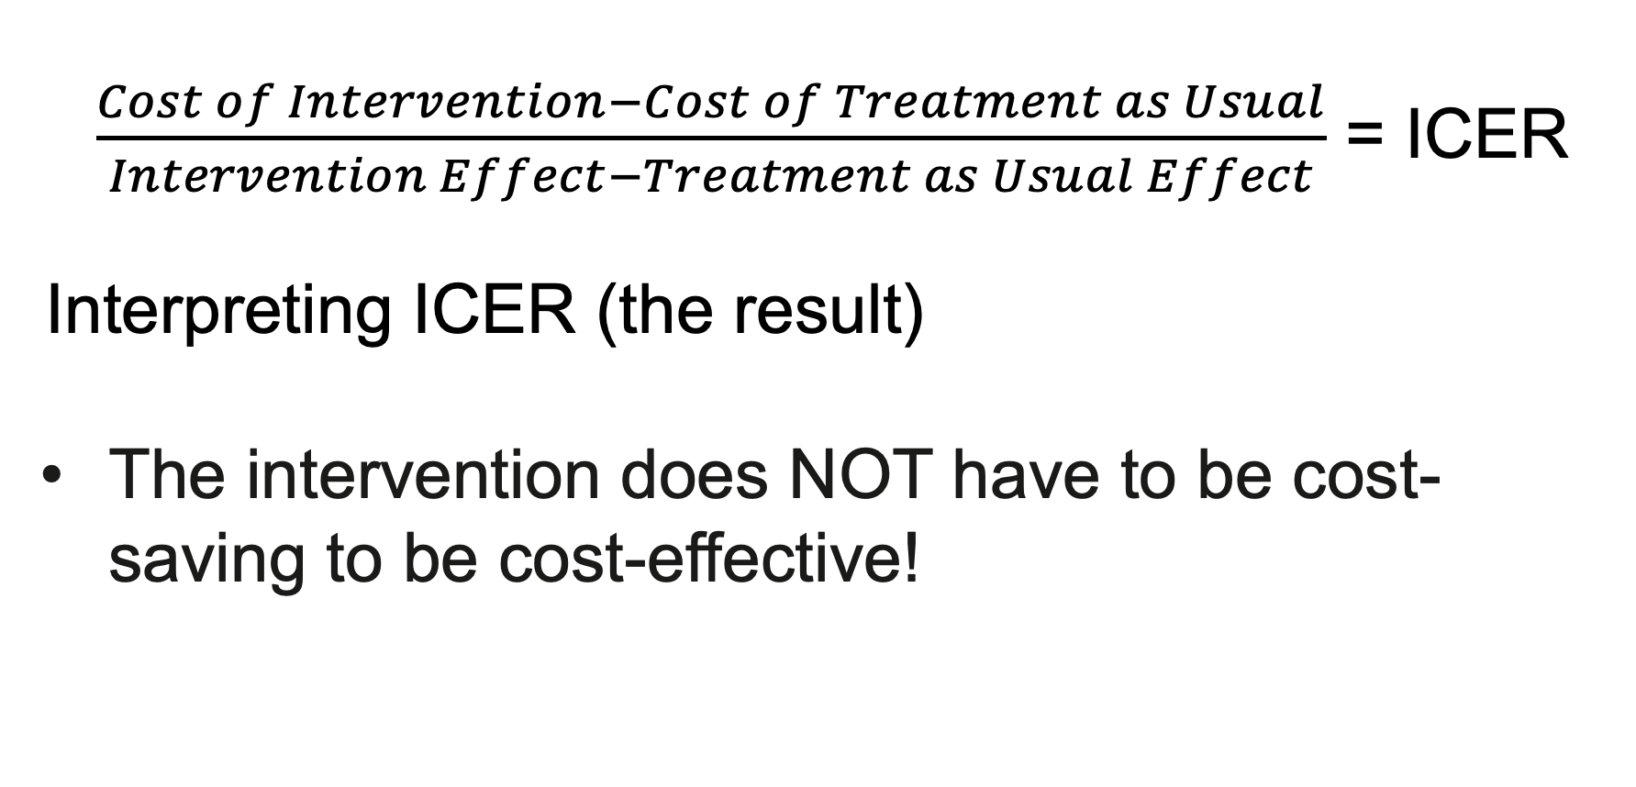
$\frac{Cost of Intervention−Cost of Treatment as Usual}{Intervention Effect−Treatment as Usual Effect}$ = ICER
Interpreting ICER (the result)
The intervention does NOT have to be cost-saving to be cost-effective!
Notes:
But remember, you don’t have to be cost-saving to be cost-effective!

Slide 39
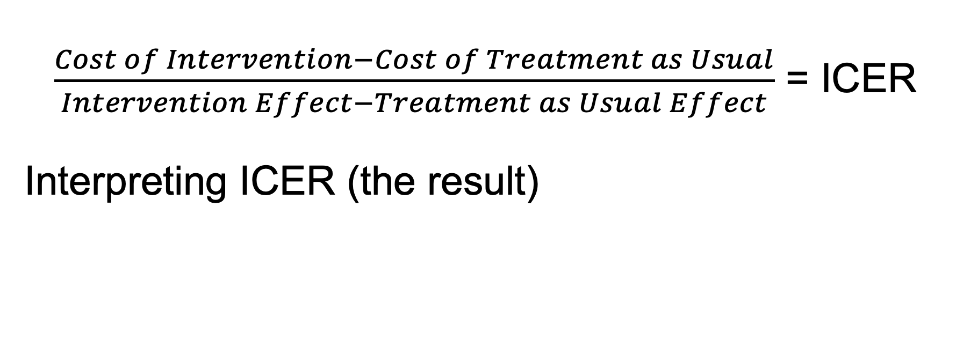
$\frac{Cost of Intervention−Cost of Treatment as Usual}{Intervention Effect−Treatment as Usual Effect}$ = ICER
Interpreting ICER (the result)
Cost-effective to whatever threshold the number falls below
Cost-saving AND cost-effective
$200,000
threshold
$100,000
threshold
$50,000
threshold
Smaller, more meaningful threshold (e.g. cost of treatment episode)
Below zero (because costs are less, but effects are better)
Notes:
So to recap, compare the ICER – your result – to the thresholds you set. Whatever thresholds it is below means that it is cost-effective to that threshold. If the ICER was $49,000 per life year added, then that’s cost-effective to the $50,000 threshold. If my ICER is negative, specifically if it’s negative because my top number is negative but my bottom number is still positive, then it’s both cost-effective AND cost-saving.

Slide 40
Dealing with Uncertainty
Base Case
One-Way Sensitivity Analysis
Multi-Way Sensitivity Analysis
Notes:
Often the costs and the effects of programs vary. Things may vary by location – wages are higher in some states or cities than in other places, for example – or different studies may find more or less good stuff from an intervention. So we usually look through all the available data, and we find an average across different sources of information. But, because there’s variation, we do need to account for that variation when we do a full study.

Slide 41
Dealing with Uncertainty
Base Case: Our basic model for a set time period. We’re not looking at any uncertainty here, we’re just using whatever numbers we have, usually an average or a median.
Calculator
One-Way Sensitivity Analysis
Base Case
Probabilistic Sensitivity Analysis
Notes:
For the calculator, and for our time with you today, we’re just focusing on this first step – the base case. This is where we put all the information we have together – all those averages or medians or single numbers – and we get our best estimate for an average program’s cost-effectiveness.

Slide 42
Dealing with Uncertainty
One-Way Sensitivity Analysis: Change one input at a time: how does cost-effectiveness change when input changed (for example: more participants, higher cost of naloxone, better retention of participants)
Calculator
One-Way Sensitivity Analysis
Base Case
Probabilistic Sensitivity Analysis
Notes:
One-way sensitivity analysis is when I change one variable at a time through the full range of variation to see how ICER is affected. Example: If I add participants, how does that change ICER? If I pay peer workers more, how does that change ICER? You CAN do this with calculator, but it’s not going to do it automatically for you. You’d need to do it by hand, changing that one variable of interest at a time and writing down your results somewhere to make that comparison. I’ll briefly show you what we found for PRSS in just a minute.

Slide 43
Dealing with Uncertainty
Full evaluation or academic papers
Calculator
One-Way Sensitivity Analysis
Base Case
Probabilistic Sensitivity Analysis
Notes:
probabilistic sensitivity analysis is really just for publication and academic audiences. We’re looking at all variation at once. What’s the chance that any given intervention would be cost-effective? The calculator cannot do this, but I’ll show you the results for this for PRSS in just a minute.

Slide 44
Outline for Today
Background and goals for the future
Learn about cost-effectiveness analysis
PRSS cost-effectiveness analysis results
Bystander naloxone distribution
Using the calculator
Notes:
So that takes care of the background. Next we’ll talk about what cost-effectiveness analysis is.

Slide 45
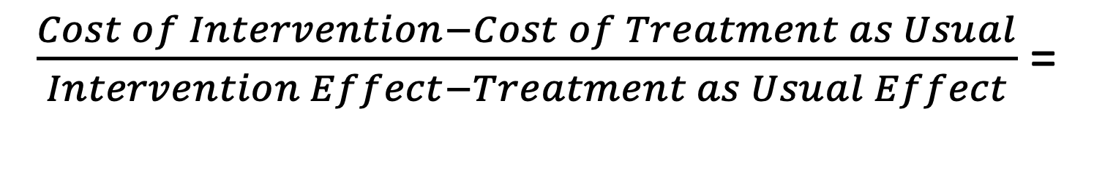
PRSS Model
$\frac{Cost of Intervention−Cost of Treatment as Usual}{Intervention Effect−Treatment as Usual Effect}$ =
Incremental Cost-Effectiveness Ratio
% Recovery
Differences in Costs
+ ~ 1 Year PRSS
=
Receives Specialty SUD Treatment
% Chaotic substance use
Discounted differences in QALYs, or # in recovery at 3 years
No PRSS (treatment only)
% Mortality
Notes:
Remember that our result of interest is the ICER (incremental cost-effectiveness ratio). We find it by dividing a difference in costs by a difference in effects. And remember that treatment as usual should be the current standard of care. Well, in real life, most people with SUD actually get nothing – no treatment, let alone specialty substance use treatment. But it’s not really fair to compare PRSS to doing nothing – doing anything will usually look better than doing nothing. So to set a fairer comparison, we set the starting point at specialty treatment – even though many of your participants aren’t coming to you after treatment, just know that in this analysis, we’re doing a conservative estimate of benefits – real benefits compared to what they would have otherwise gotten in real world situations would be even better most likely. So, in our model everyone has treatment, then either gets a year of PRSS or relies on the effects of treatment alone. In both groups, after that year, some % will remain in recovery, some % will have returned to chaotic substance use, and some % will have passed away for a variety of reasons. These differences lead to differences in costs and differences in quality adjusted life years and people in recovery. That’s what gives us our result – our ICER.

Slide 46
Results: Base Case
Results: Base Case – United States
571,927
or 2.25% more QALYs
than treatment only
319,404
or 40.75% more
people in recovery
than treatment only
PRSS Effects
Cost-effective to all thresholds
$5,898.60 per QALY
$10,562.08 per person in recovery
Health System Perspective
Cost-effective to all thresholds
$3,421.58 per QALY
$6,126.72 per person in recovery
Societal Perspective
Notes:
Now unsurprisingly PRSS is cost-effective no matter which way we look at it – heath system, societal, quality adjusted life years or in terms of numbers of people in recovery.

Slide 47
Results: Probabilistic Sensitivity Analysis
~85-95%
~60% - 70%
Notes:
In the probabilistic sensitivity analysis I simulated all the variation over 10,000 iterations and found that about 60-70% it was cost-effective compared to the cost of additional treatment episodes, and was almost always cost-effective by the $50,000 threshold.

Slide 48

Key Take-Aways
PRSS are cost-effective across wide variety of circumstances
One-way sensitivity analysis reveals peer worker pay and service utilization has less effect on cost-effectiveness than factors like PRSS effectiveness and retention.
  Impact efficiency through program improvement – not through depressing wages or limiting service utilization.
  Full results, tables of parameters, and formulas here:
https://bit.ly/SCM12023
Notes:
One-way sensitivity analysis revealed that peer worker pay and service use didn’t have much impact on cost-effectiveness, but how well the program performed absolutely did – so we have to focus on influencing efficiency by making our programs work well, rather than by holding pay low or limiting service. You can see the full detailed results of the analysis here if you want.

Slide 49
Outline for Today
Background and goals for the future
Learn about cost-effectiveness analysis
PRSS cost-effectiveness analysis results
Bystander naloxone distribution
Using the calculator
Notes:
So that takes care of the background. Next we’ll talk about what cost-effectiveness analysis is.

Slide 50
Bystander Naloxone Distribution Model
Coffin & Sullivan, 2013
Previous cost-effectiveness analysis of bystander naloxone distribution (just give naloxone to anyone who might witness an overdose).
Updated to 2019 parameters and converted to a component of the calculator.
Notes:
The bystander naloxone distribution work was a little more straightforward because the underlying analysis was already done. Marnie essentially updated all of the numbers used in that analysis and reconfigured it to work as a calculator component.

Slide 51
Bystander Naloxone Distribution Model
$\frac{Cost of Intervention−Cost of Treatment as Usual}{Intervention Effect−Treatment as Usual Effect}$ =
Incremental Cost-Effectiveness Ratio
A bystander gives naloxone they got from your RCO*
% Survives overdose
Differences in Costs
=
Experiences an opioid overdose
Discounted differences in QALYs, or # who survive the overdose
EMS gives naloxone
% Mortality
*Model includes probabilities of several factors, including presence of naloxone, administration of naloxone, EMS transport, etc.
Notes:
The bystander naloxone distribution model works really similarly, except we’re not really simulating people getting into and staying in recovery, because the focus here is on surviving an overdose. In the future, if information about post-overdose recovery becomes available, we’d love to refine the calculator to include that, but it’s just not the focus of this model. We look at both QALYs and number of people who survive the overdose in our effects in this model.

Slide 52
Outline for Today
Background and goals for the future
Learn about cost-effectiveness analysis
PRSS cost-effectiveness analysis results
Bystander naloxone distribution
Using the calculator
Notes:
So that takes care of the background. Next we’ll talk about what cost-effectiveness analysis is.

Slide 53
Inputs you will need - PRSS
  In line with Management Systems CAPRSS Standard.
  When in doubt, assume we are talking about a 1 year period.
  Number of people served (in 1 year: last year, average per year over 5 years, etc.)
  % participants retained in long-term coaching to graduation/completion or 1 year
  Of those retained, % in recovery (calculator based on abstinence AND sustained reduced use), will work for stricter or slightly more permissive definitions, as long as recovery is something different from chaotic substance use.
  Average age of participants
  Average number of engagements during the course of long-term PRSS (number of times they met with their peer worker 1:1, include brief engagements and longer ones, each time = 1).
  Then tell us the average length of each of those engagements. If there’s paperwork after each engagement, include that in the average length of time. Report in minutes.
  Hourly pay for peer workers delivering long-term PRSS.
    Annual salary / 52 / 40. Add fringe if appropriate. If it’s a flat amount, add it to the salary. If it’s a percentage, you can do: Hourly pay x (1 + fringe percent as a proportion). So if fringe is 35%, and my hourly pay is $22, then $22 x (1+0.35) = hourly pay with fringe.
Notes:
Here are the inputs you’ll need for the calculator. These are in line with the management systems CAPRSS standard. If you’re not already familiar with CAPRSS, standards, that’s OK! Our feedback from RCCs was that these are accessible but we would love additional feedback!

Slide 54
Inputs you will need - Naloxone
  We’re working on changing the first input. As of today (2/8/23): Percentage of your participants you want to give naloxone to. (Assumes that 20% already have it, so if you want to give it to every participant, enter 80%).
    Changing to: Enter the number of naloxone kits you wish to distribute.
  The cost of naloxone (nasal spray)
    Allows you to account for any special deals you may have arranged, if the naloxone was donated and thus free to you, if naloxone price increases, etc.
    If you don’t know, just use the default values.
Notes:
We know we need to change the first input for the bystander naloxone distribution tab. The analytic model is actually in the end all proportional, so that was the reasoning behind asking for a percent of participants. It’s not really very intuitive to use, though, so we are planning to tweak it in the near future to let it take a hard number of kits as an input. We think that’ll make it a little easier to use. For now, hopefully this additional explanation will help. Think about what percent of people who walk through your doors you want to give naloxone to. The best information we have right now says that actually about 20% will already have it. So if you want every single person who walks through your door to have naloxone if they don’t already, you’d write in 80%, because 80 + 20 = 100 percent. If you want to shoot for just half of your participants, because maybe the other half aren’t in a scenario where they’d likely witness an overdose, you can put in 30% because 30+20 = 50%. If you want an additional 50% to have it, then that’d give you a total of 70%. Make sense?
Then the cost of the spray. The default value is the cost in 2019. We’ve heard of some folks being able to work out special pricing deals, or getting it donated, and then of course the cost could always change and go up, so we want you to be able to input the price to account for those scenarios. If you don’t know, just use the default value.

Slide 55

Let’s look at the calculator!
https://go.uth.edu/cea

Slide 56
Coming Changes
  Pilot calculator, so a work in progress – please excuse our dust (and any typos you might find!)
  Will update how the calculator works as new information becomes available and as we get feedback.
  Working on tackling more pieces of the calculator, and adding other kinds of interventions that may or may not be relevant to your RCO or RCC.
  Hope to add more real-world scenarios: % who came to you from treatment, % who go to treatment because of engagement with PRSS, % who bypass treatment because of PRSS. (For now, post-treatment PRSS is a very conservative estimate: real cost-effectiveness is likely even better.)

Slide 57

Additional feedback or questions?
Please take our feedback survey!
https://redcap.link/calculator
H.Shelton.Brown@uth.tmc.edu
Sierra.J.CastedodeMartell@uth.tmc.edu
Margaret.B.Moore@uth.tmc.edu

Slide 58


