Slide 1
WELCOME
Justice, Diversity, Equity, Inclusion

Slide 2

Liberating Our Clients
Zina Rodriguez, MSW, RSWI, MCAP, CDE
Wife, Mommy, Sister, Titi/Auntie
She/Her/Ella

Slide 3
Workshop Objectives
Attendees will learn how liberation-based practices integrates lived experiences to build on clients’ resiliency and capabilities to heal.
01
Learn about culturally responsive tools that address race-based stress and cultural trauma.
Discuss how therapeutic conversations can promote healing and strength for marginalized communities who are exposed to daily macro- and microaggressions.
03
Notes:
Behavioral health providers are on the frontlines of our current mental health crisis and social justice issues. This workshop will explore how providers can intervene around the impact of socio-political factors with their clients and integrate social justice into their clinical work. We will review the liberation health framework which merges clinical and macro work into a unified way of working with individuals, families, and communities. We will review the concepts of liberation psychology which acknowledges the confluence of clients’ internal world with the systemic social political forces affecting health and well being.

Slide 4
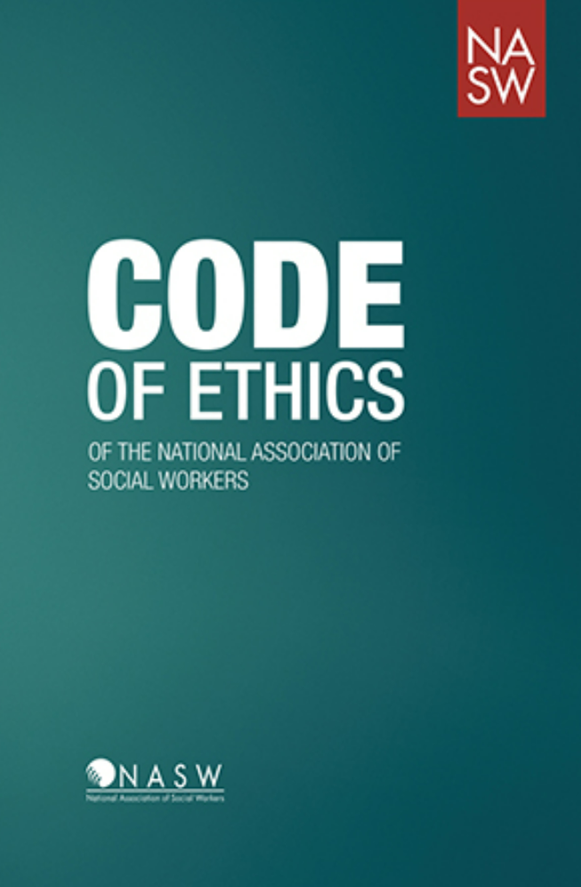
National Association of Social Workers
Service
Social Justice
Dignity and Worth of the Person
Importance of Human Relationships
Integrity
Competence
Notes:
I am a social worker and the framework for today’s discussion on Liberating Our Clients is guided by the Social Work code of ethics and with a focus on social justice issues impacting our client’s today.

Slide 5
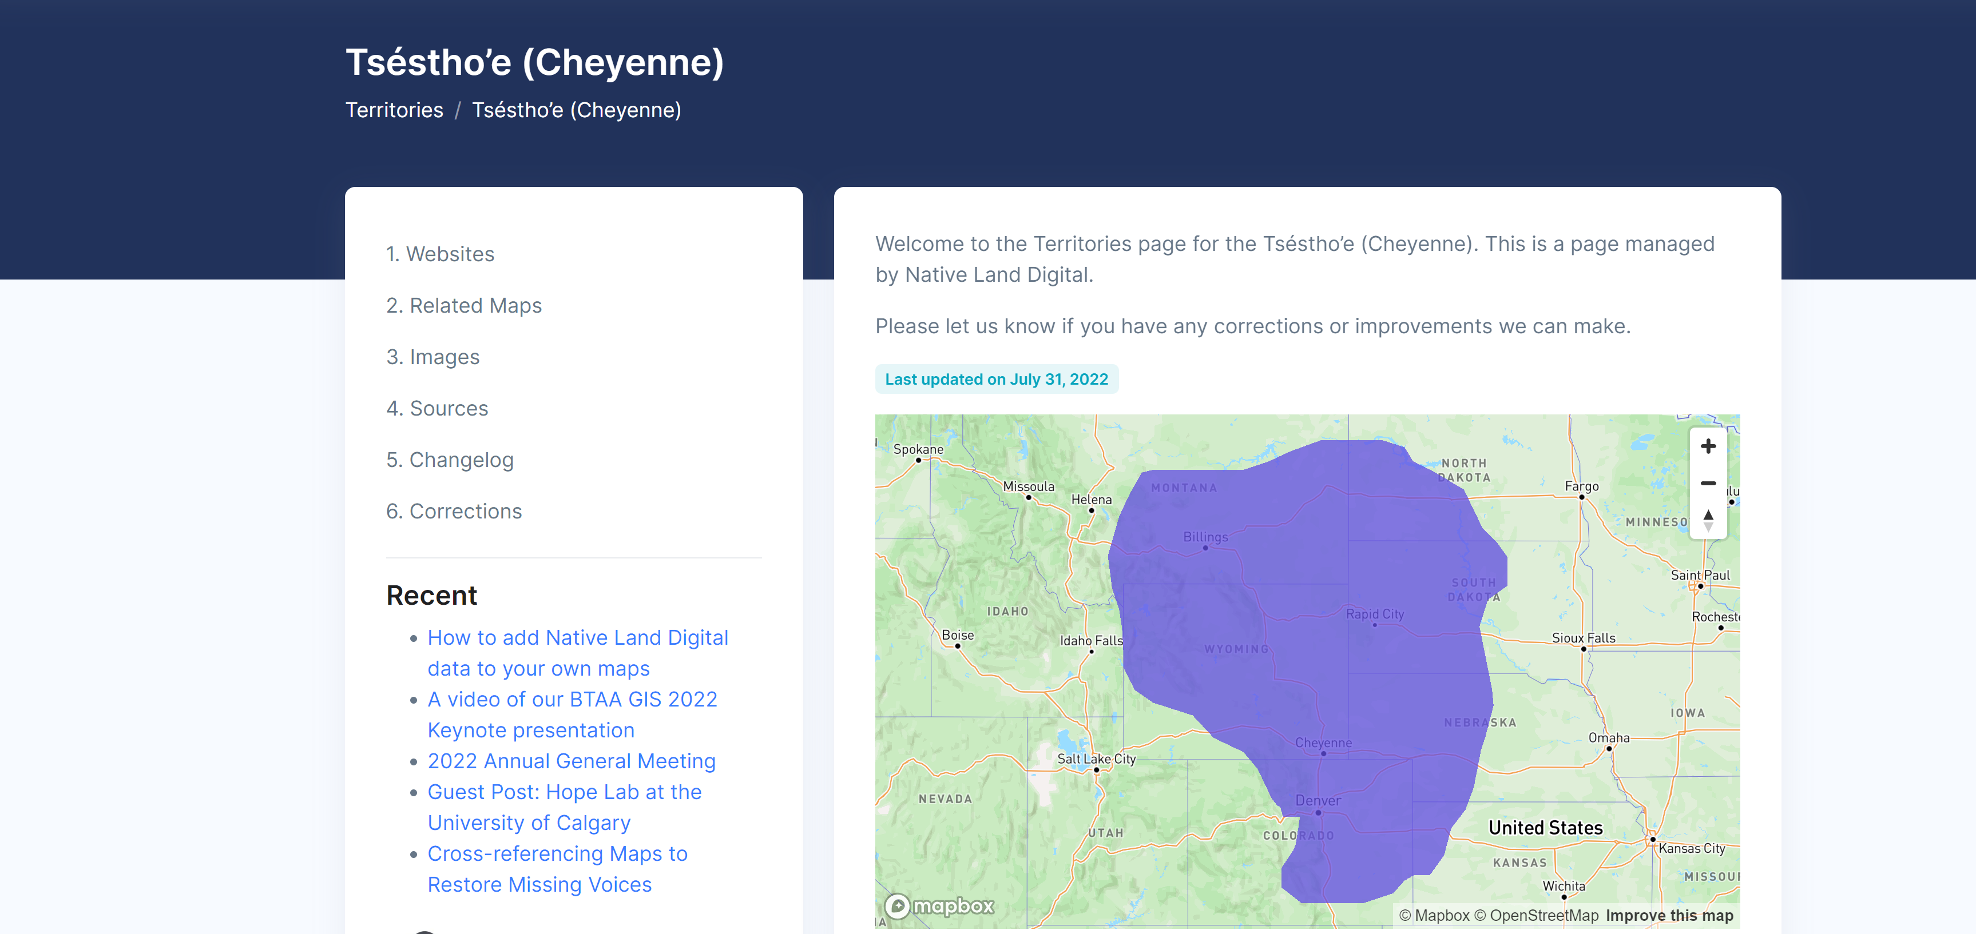
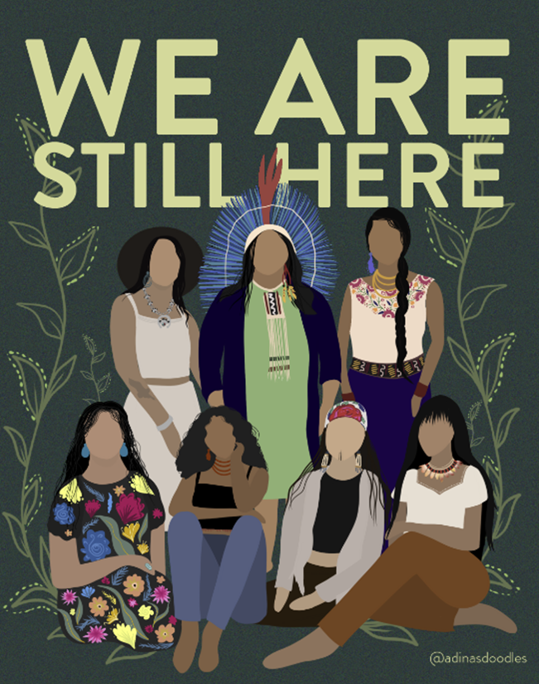
Native Land Acknowledgement
https://native-land.ca/
The Peaks Region is the traditional homeland of the Ute, Cheyenne, Arapaho, Comanche, Kiowa and Apache
Notes:
A great way to honor Dr. King’s legacy this week as we begin these Anti racism/DEI leadership workshops.
This work OPG has embarkeded is significant and will have impact.

Slide 6

Before we begin....
Language on racism can elicit strong emotion
Defensive reactions can shut down learning
A sense of futility can prevent future actions
Notes:
J

Slide 7

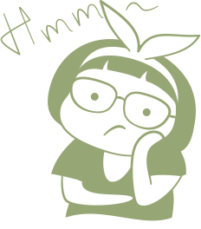



What are the common feelings & concerns during DEIB workshops?
GUILT
HESITANCE
SILENCE
WHERE DO I FIT IN?
PARALYSIS
Notes:
J

Slide 8

Grounding
Self Care
Breathe
Look for Windows and Doors
Feel Your Body (Unclench your jaw)
Move Your Body (Rock, Sway, Dance)
Pick Up and Feel Items Near You
Use an Anchoring Phrase/Affirmation
Visualize Someone You Love
Visualize a Place You Love

Slide 9
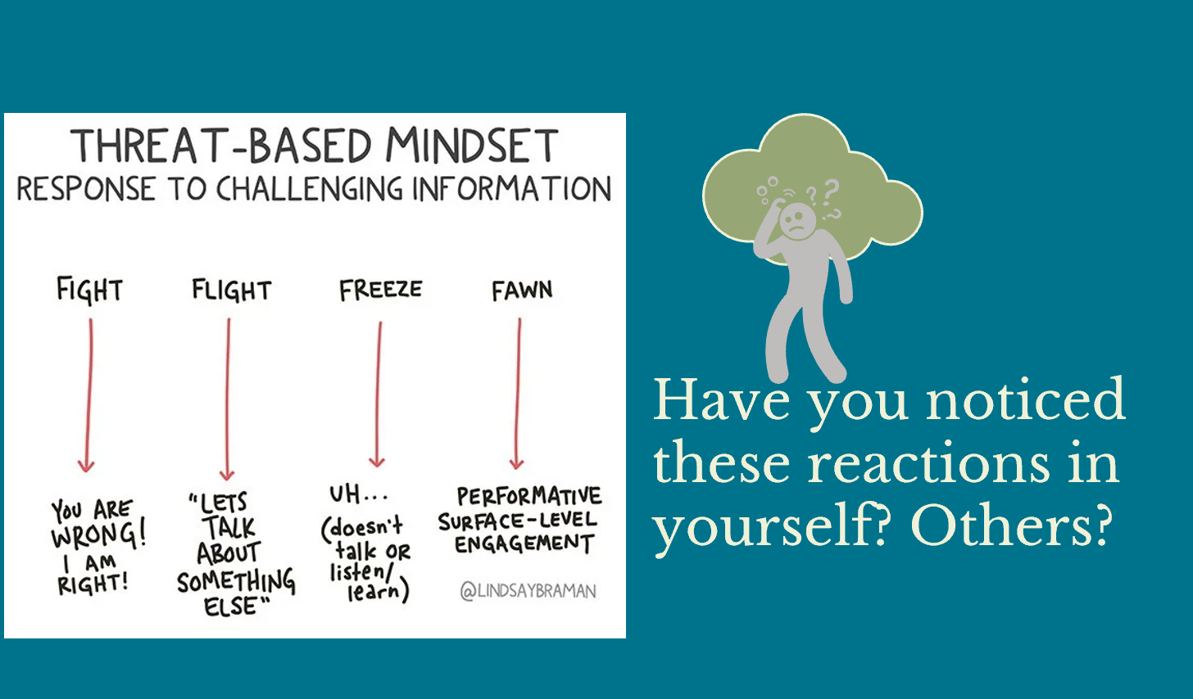

Slide 10

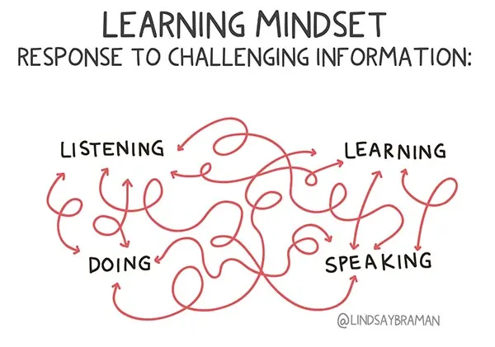

This is an active skill that we encourage you to embrace.
Notes:
J

Slide 11
BRAVE Space Agreement
Notes:
A great way to honor Dr. King’s legacy this week as we begin these Anti racism/DEI leadership workshops.
This work OPG has embarkeded is significant and will have impact.

Slide 12


Safe Space Brave Space Reframe
Agree to Disagree
Controversy with Civility
Don't Take Things Personally
Own Your Intentions & Your Impact
Distinguish Between Ideas & People
No Personal Attacks
Respect Others
Challenge with Care
Notes:
J

Slide 13

What are social justice issues impacting our clients today?
ⓘ Start presenting to display the poll results on this slide.

Slide 14
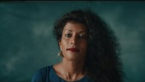
Notes:
Quote

Slide 15
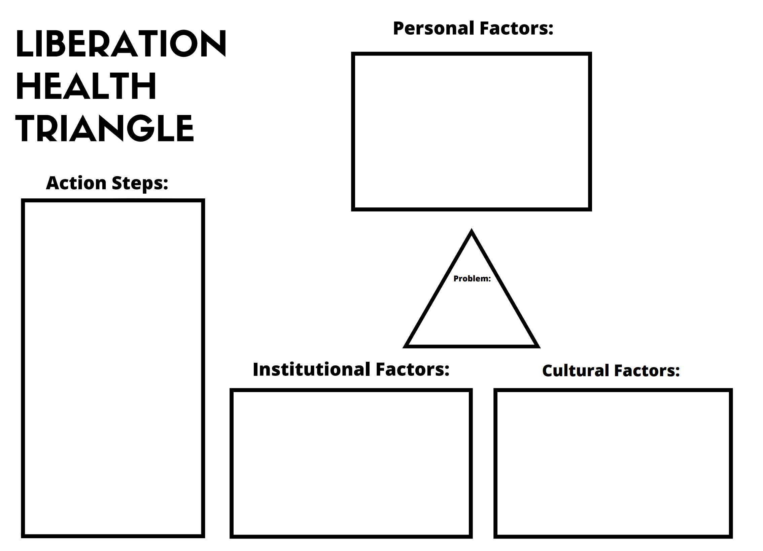
LIBERATION HEALTH MODEL
The model is a theory of human behavior that conceptualizes the problems of individuals and families that cannot be understood in isolation from the economic, political, cultural, and historical conditions which give rise to them.
It is also a method of practice that helps individuals, families, and communities understand the personal, cultural, and institutional factors that contribute to their problem and act to change these conditions; to liberate themselves from both internal and external oppressions.
Source: Belkin Martinez: Social Justice in Clinical Practice
Notes:
To begin a Liberation Health assessment, the first step is to see the problem or situation in its totality. In doing so, we can begin to dismantle dominant ideologies about individualism and “personal responsibility” which cause people to blame themselves or family members for problems that are caused by sociopolitical factors.

Slide 16
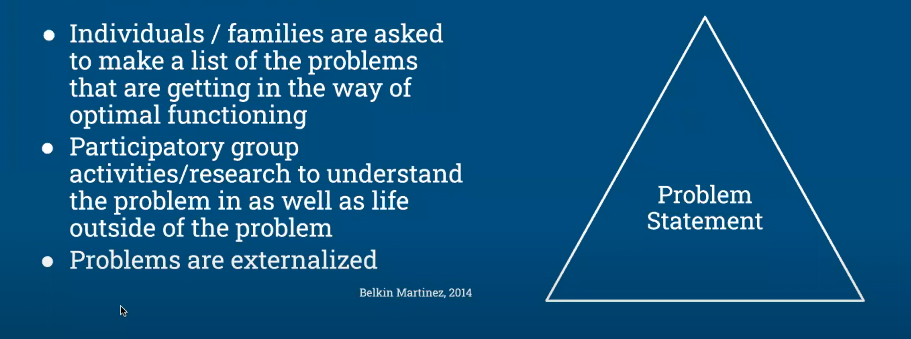
Define the Problem
Liberation Health Model

Slide 17
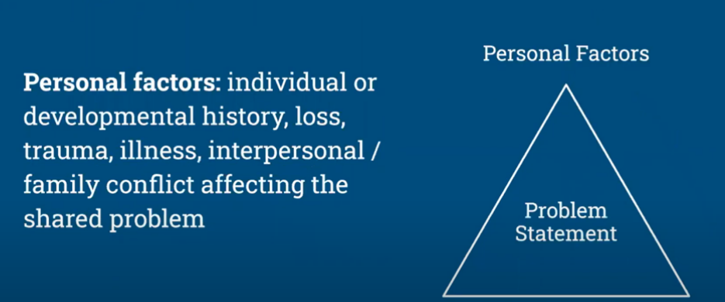
Identify Personal Factors
Liberation Health Model
Belkin, Martinez 2014

Slide 18
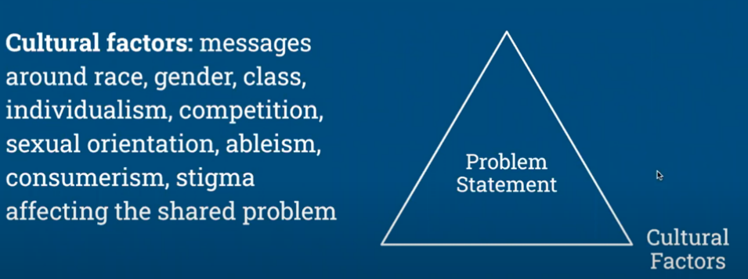
Identify Cultural Factors
Liberation Health Model
Belkin, Martinez 2014

Slide 19
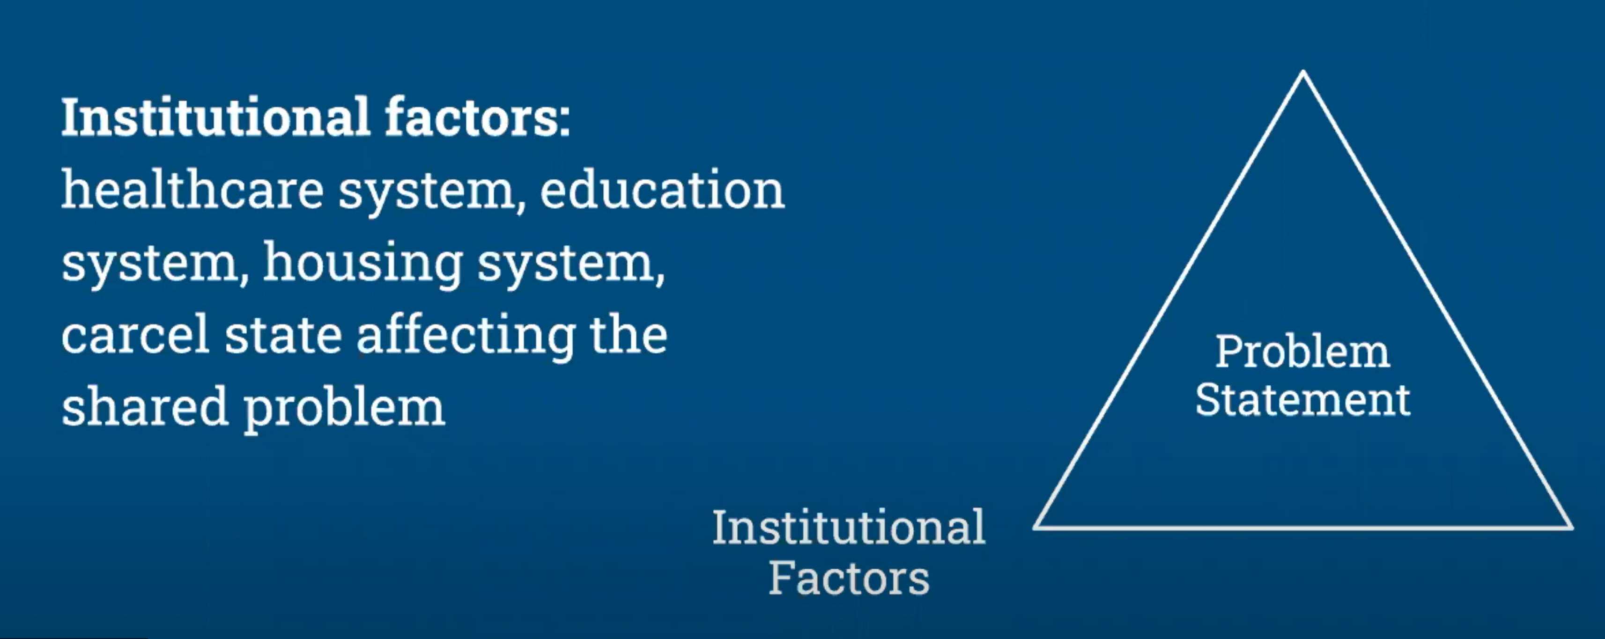
Identify Institutional Factors
Liberation Health Model
Belkin, Martinez 2014

Slide 20

Development of Action Plan
Liberation Health Model
Client exploration:
Who would I be if I weren’t carrying the messages I’ve internalized from the outside world?
What does my liberation look and feel like?
What would I be doing differently if I felt safe?
What communal support is available to me?
What strength can I get from my ancestors?
Clinician support:
Recognition/Witnessing
Validation
Identifying individual and communal strengths
Identifying coping skills/internal resources (somatic)
Deconstructing dominate and negative messages
Co-collaboration of communal support and engagement
Belkin, Martinez 2014

Slide 21


Therapists must convey to the patient that their paramount task is to build a relationship together that will itself become the agent of change.”
― Irvin D. Yalom, The Gift of Therapy: An Open Letter to a New Generation of Therapists and their Patients.
Notes:
In the next few slides we will explore how as clinicians we can support our clients during these times and the most critical factor being that of the thereaputic relationship and forming a trusting relationship. By walking along side of our clients during these times we can instill hope by being agents of change with them.

Slide 22
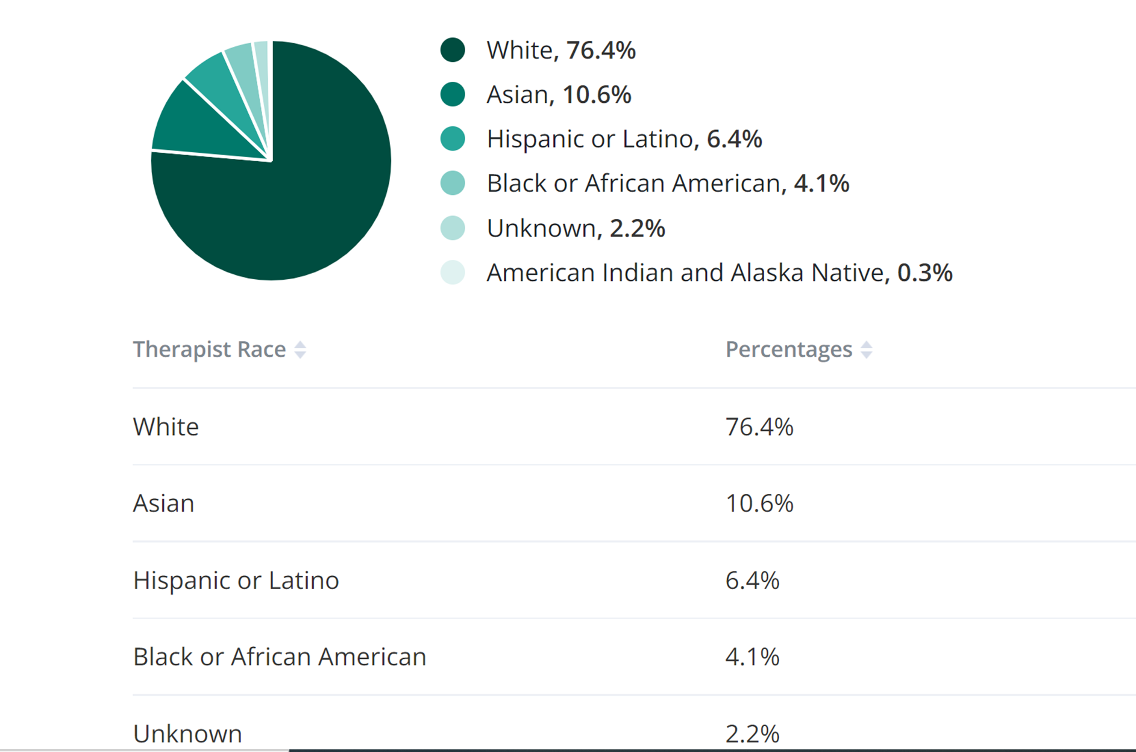
Clinician Demographics
Callout text here
Notes:
As you can see by the

Slide 23
Cultural Competence is a Myth
Culturally Affirming
Culturally Responsive
Culturally Sensitive
Seeing, validating, believing. Be an intentional ally.
Understand cultural differences, recognize potential biases, and apply culturally responsive modalities. Stories matter.
Understand intersectionality , don’t make assumptions, be curious w/o offending, pay attention to non-verbal cues.
Notes:
Quote

Slide 24

Implicit Bias
Implicit Biases are pervasive. Everyone posses them.
Implicit Associations we hold do not necessarily align with our declared beliefs or even reflect our own stances we would explicitly endorse.
Implicit Biases are flexible.
Implicit associations that we have formed can be generally unlearned.
What Are Our Biases?
Harvard Implicit Association Test (IAT)
Notes:
Without shame, blame or guilt we explore or biases and understand how our socialization has formulated these biases. The good news is we can unlearn through having a growth mindset and willingness to explore others experiences.

Slide 25

Have you taken an implicit bias test?
ⓘ Start presenting to display the poll results on this slide.

Slide 26
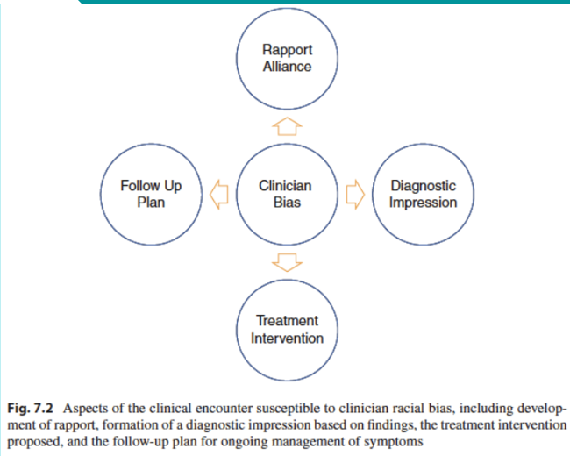
Clinical Impact of Bias
Notes:
Quote

Slide 27
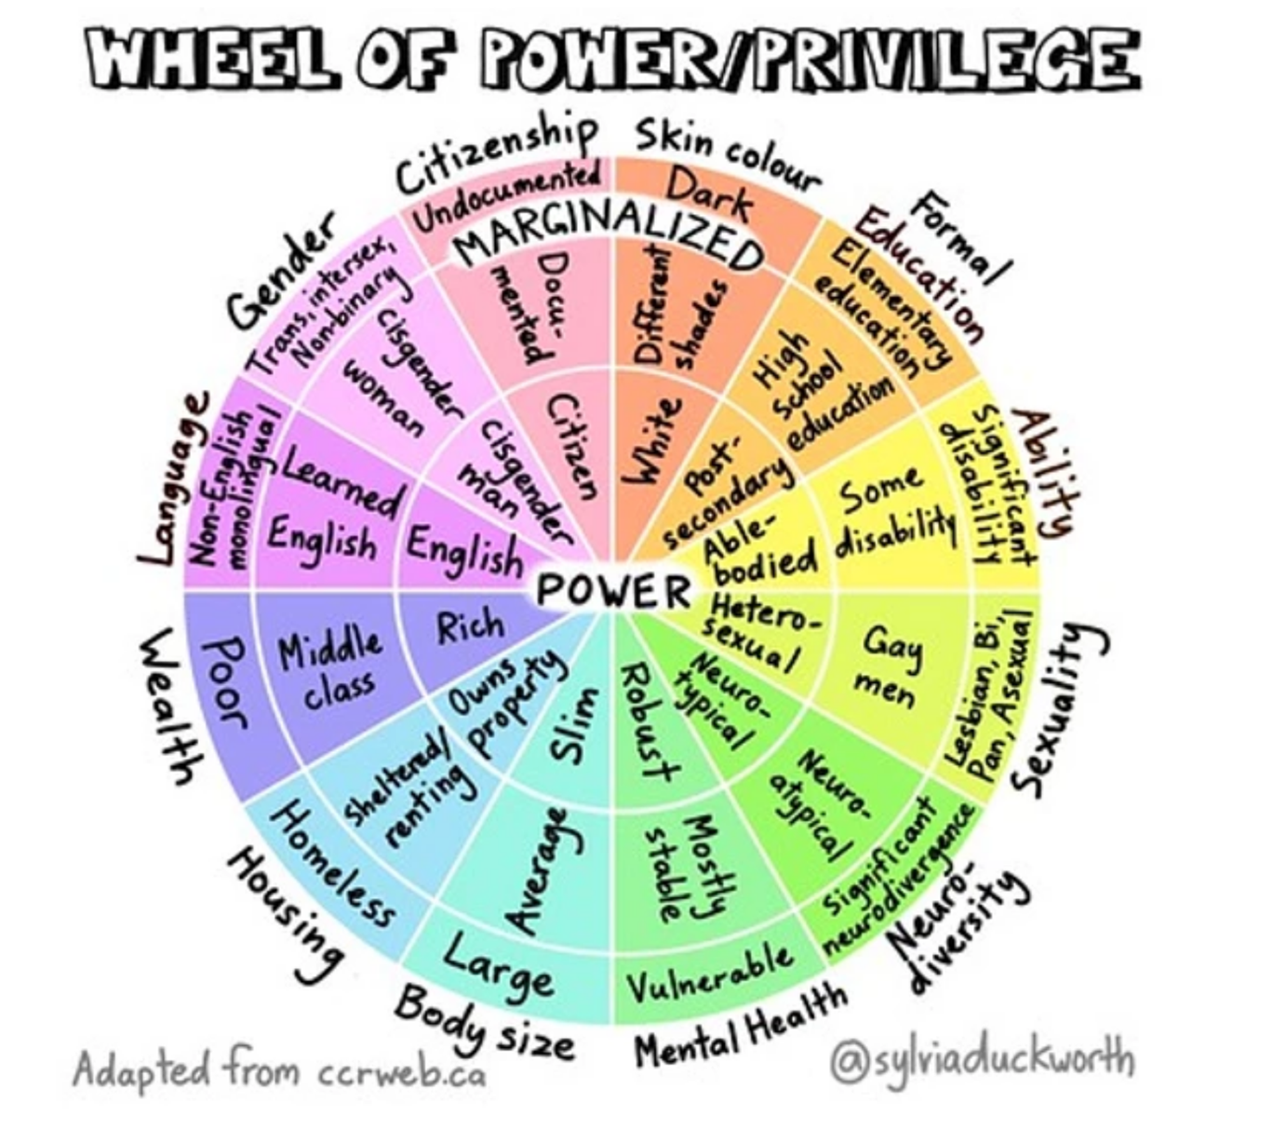
Impact on the Therapeutic Relationship
How does our privilege impact the therapeutic relationship?
How does our clients view of power and privilege impact the therapeutic relationship?
How can we mitigate the power differential in our therapeutic engagements?
Notes:
Quote

Slide 28
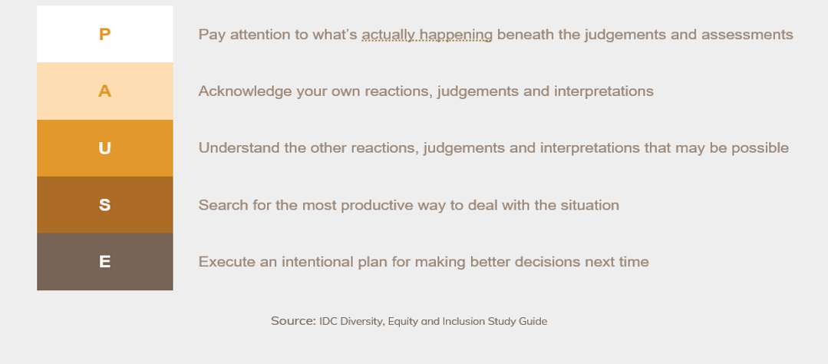
Bias Intervention Strategies
Notes:
Quote

Slide 29
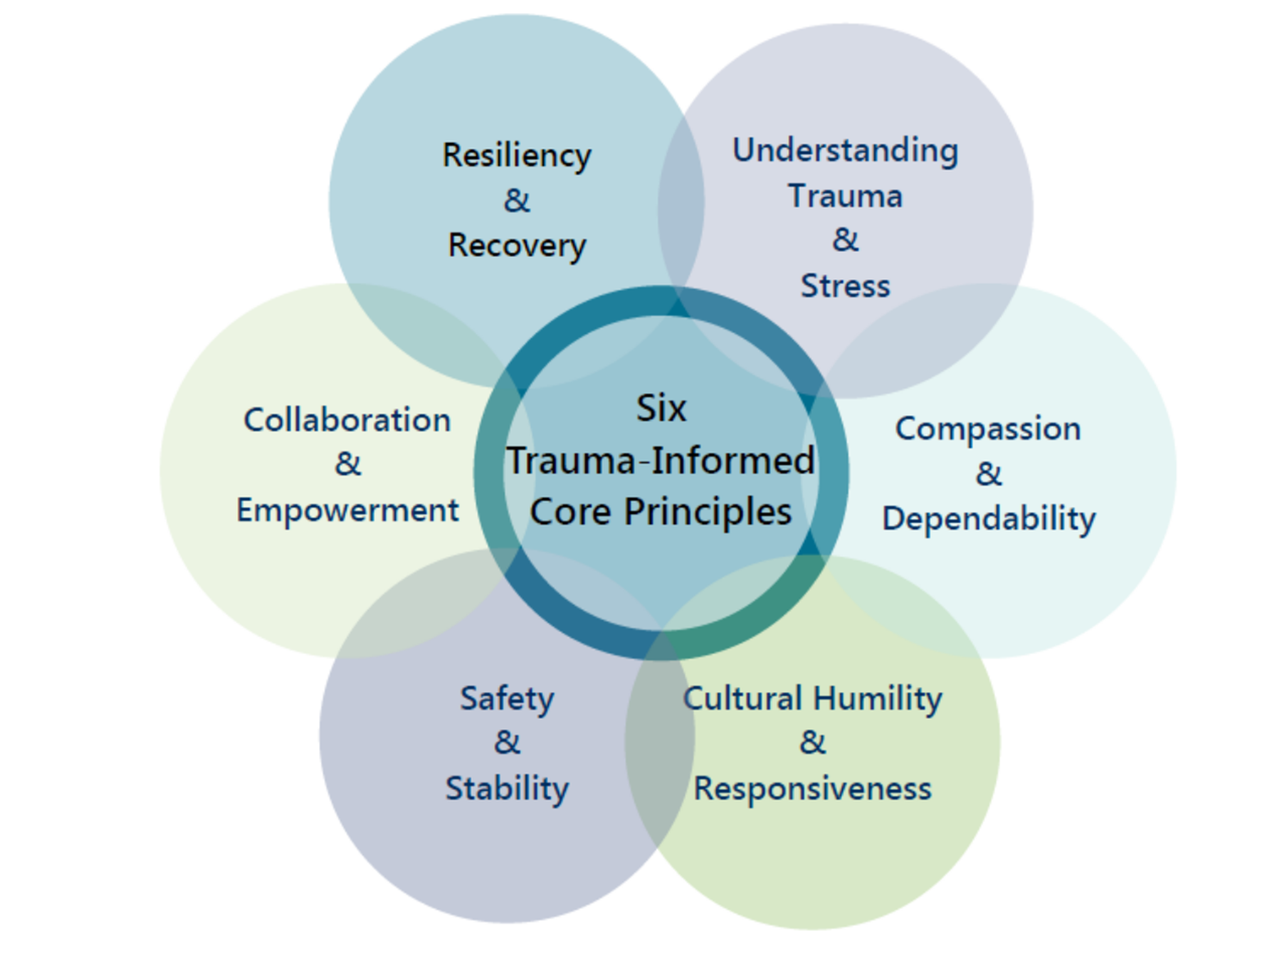
Trauma Informed Core Principles
The Foundation for Liberating Our Clients

Slide 30
Trauma is the imprint of chronic, toxic stress in our minds and bodies. It’s the powerlessness we feel when we cannot overcome something, or someone, causing us immense pain”.
– Natalie Y. Guiterrez, LMFT, The Pain We Carry: Healing from Complex PTSD
Notes:
Quote

Slide 31
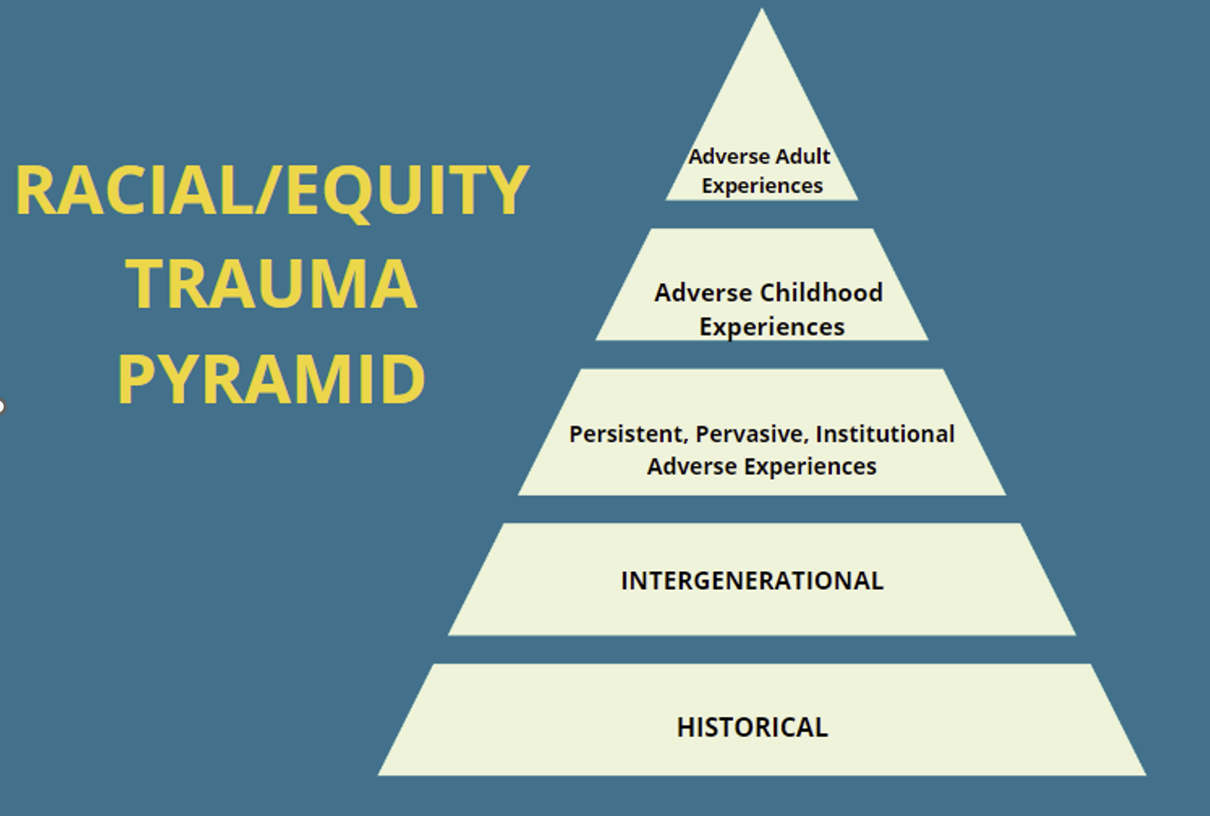
Beyond ACE -Adverse Adult Experiences
Vestiges of Colonialism
Patriarchy, Racism, Colorism
Identity
Belonging
Language
Acceptability ‘
Migration histories
Generational differences
Assimilation/Acculturation
Code Switching
Religion/Spirituality
Notes:
Trauma robs us of our self-love and completely changes our sense of SAFETY in the world. Trauma can be a single-incident experience or a series of painful incidents over time. It can start from before you were born, or at any stage of your life. It can be accumulated or prolonged exposure to traumatic experiences including facing racial/gender identity trauma, microaggressions and marginializations regulary. When your pain isn’t met with love and support, your traumatic experience can lead to posttraumatic stress disorder (PTSD) or complex posttraumatic stress disorder (CPTSD). And, when it comes to experiences of racism and oppression, even when you receive love and support you can still develop PTSD or CPTSD, because feeling othered every day can rob you of your sense of safety in the world. A

Slide 32
MACRO/MICRO AGGRESSIONS/
MICROINVALIDATION/MICRO-ASSAULT
Microinvalidation: Statements or behaviors that exclude, negate, or nullify the psychological thoughts, feelings or experiential reality of a person of color.
Micro assault: Explicit racial derogatory behaviors characterized primarily by a verbal or nonverbal attack intended to hurt the victim through name-calling, avoidant behavior, or purposeful discriminatory actions.
Microaggression: a statement, action, or incident regarded as an instance of indirect, subtle, or unintentional discrimination against members of a marginalized group such as a racial or ethnic minority.
Macroaggression: Large-scale or overt aggression toward those of a certain race, culture, gender.
Microinsult: Statements that demean a person's racial heritage or identity, often thought of as subtle insults and subtle snubs, frequently unconscious, but clearly convey a hidden insulting message to the recipient.

Slide 33
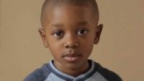
Notes:
Info & Left Picture slide

Slide 34
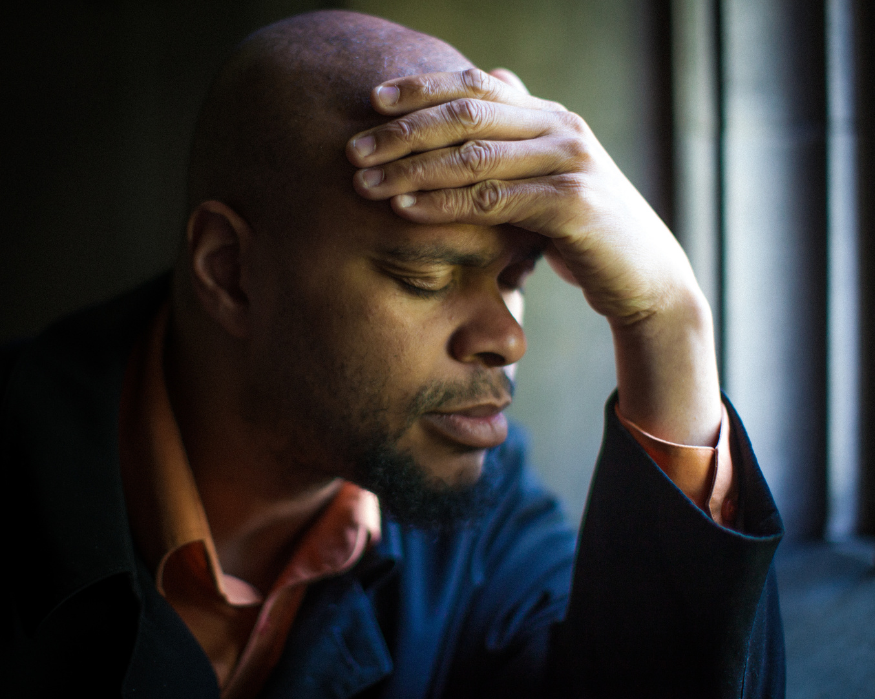
RACIAL BATTLE FATIGUE
Racial battle fatigue (RBF) is the cumulative psychological, social, physiological, and emotional impacts of racial micro and macro aggressions and racist abuse on racially marginalized groups.
Attempting to cope with these persistent hostile, violent, demeaning, dismissive, and toxic race-based stressors completely depletes one’s physical, emotional, and mental energy.

Slide 35
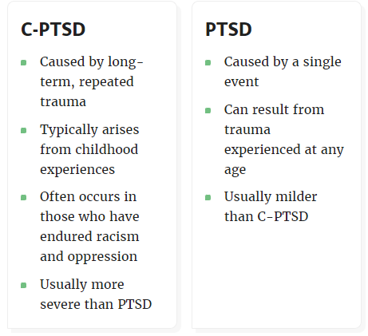
Complex PTSD Symptoms
Difficulty controlling emotions. Lost control over emotions, which can manifest as explosive anger, persistent sadness, depression, and suicidal thoughts.
Negative self-view. Can cause a person to view themselves in a negative light. Feeling helpless, guilty, or ashamed.
Difficulty with relationships. Relationships may suffer due to difficulties trusting others and a negative self-view.
Detachment from the trauma. A person may disconnect from themselves (depersonalization) and the world around them (derealization). Some people might even forget their trauma.
Loss of a system of meanings. This can include losing one's core beliefs, values, religious faith, or hope in the world and other people.

Slide 36
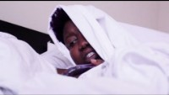
Notes:
Evelyn made this video prior to 2020 and it was her coping mechanism to use humor and social media to deal with her sadness, hurt, depression, and rage. This is an example of the vicarious trauma experienced by many. We are all impacted in some form or fashion. How do we recognize these symptoms in our clients as Complex PTSD

Slide 37
How are you feeling?
ⓘ Start presenting to display the poll results on this slide.

Slide 38

RACIAL TRAUMA-COPING STRATEGIES
Acknowledge
Discuss
Seek Support
Self Care
Empowerment through Resistance
Be Aware of Racial Battle Fatigue
Radical Rest!
Joy

Slide 39
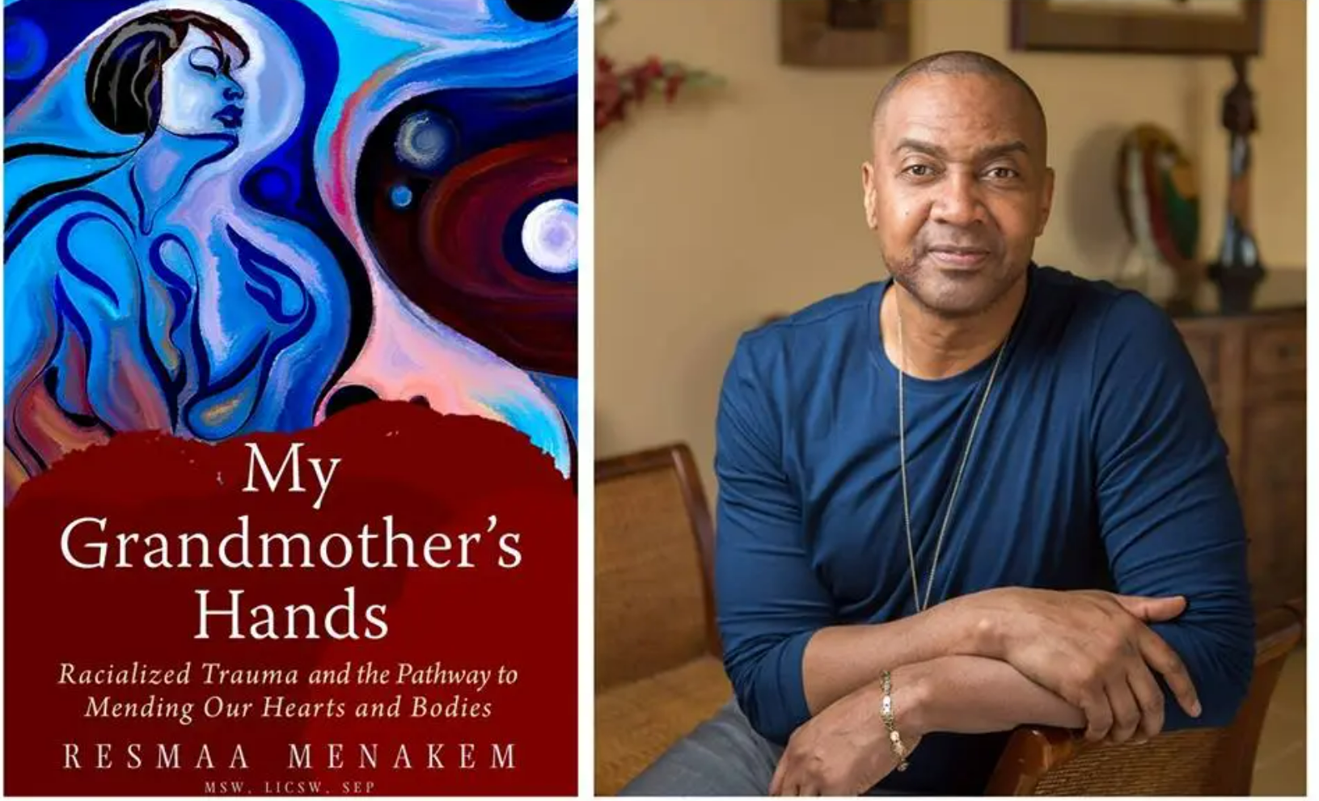
The Practice of Somatic Abolitionism
• Somatic Abolitionism is a living, embodied philosophy—a way of being in the world.
• It is a return to the age-old wisdom of human bodies respecting, honoring, and
resonating with other human bodies.
• Somatic Abolitionism is the resourcing of energies that are always present in
your body, in the collective body, and in the world.
• Somatic Abolitionism is a liberation practice.

Slide 40
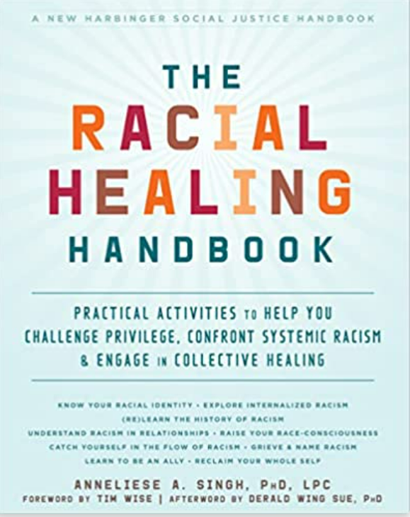
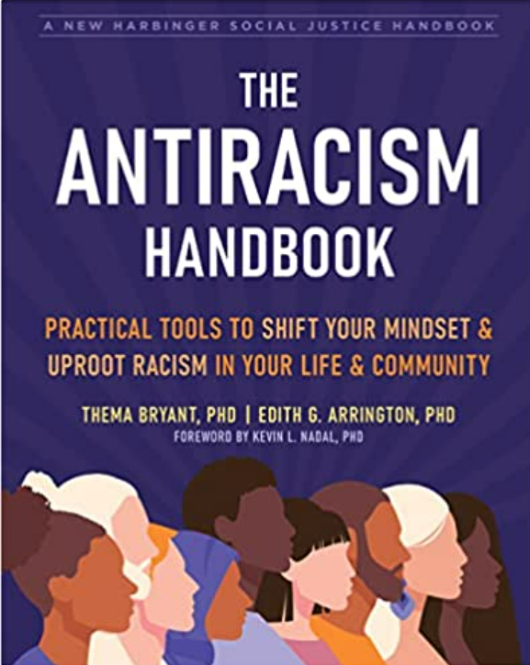
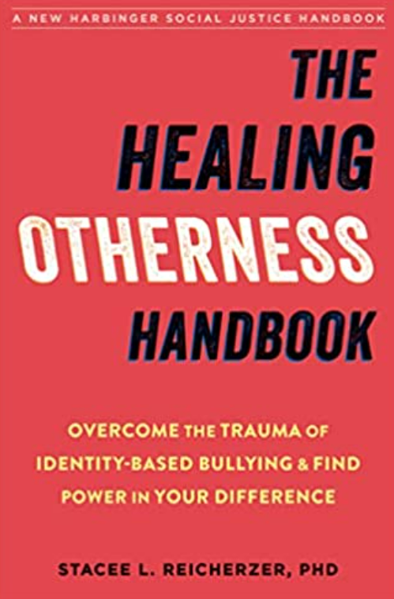
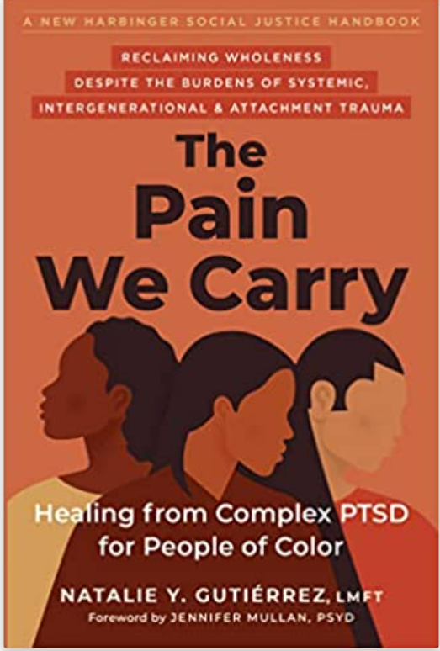
Resources for clients and clinicians
Liberating Our Clients

Slide 41
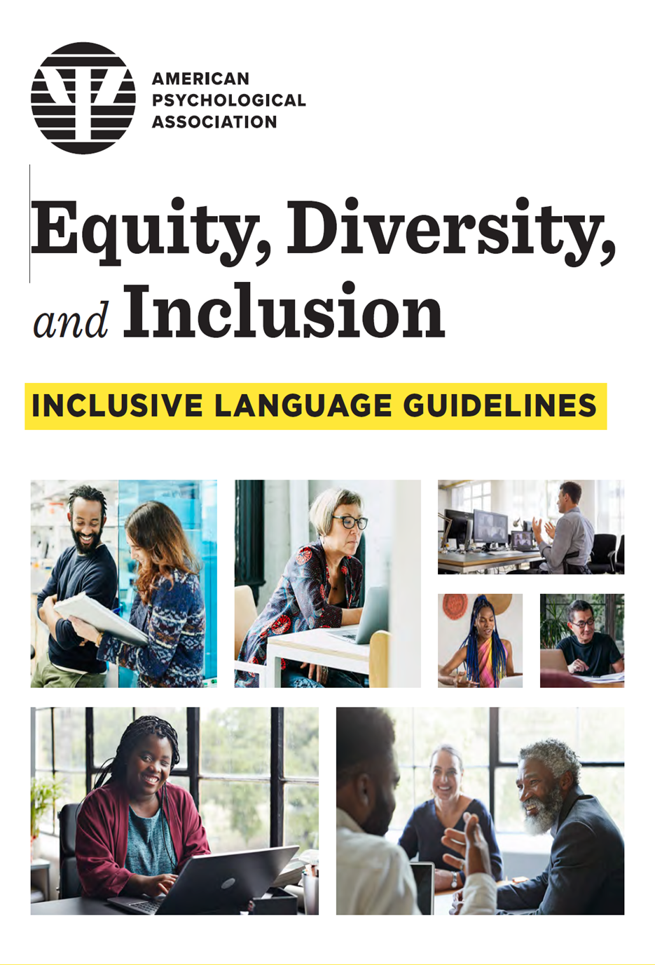
Inclusive Language Tools

Slide 42
We will all profit from a more diverse, inclusive society, understanding, accommodating, even celebrating our differences, while pulling together for the common good.”
–Ruth Bader Ginsburg
Notes:
Quote

Slide 43
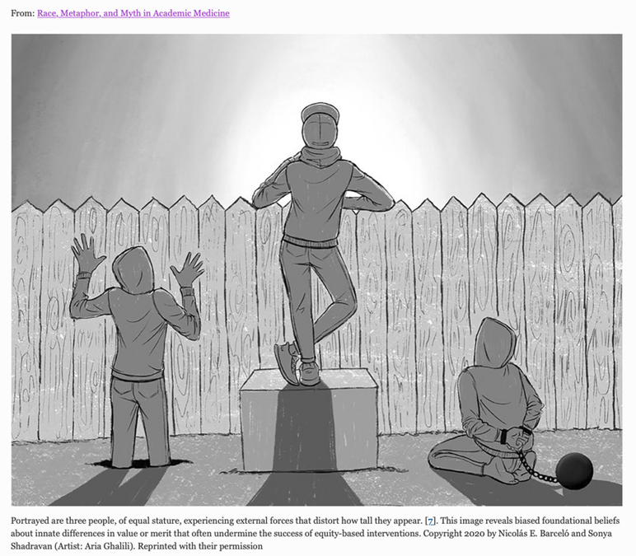
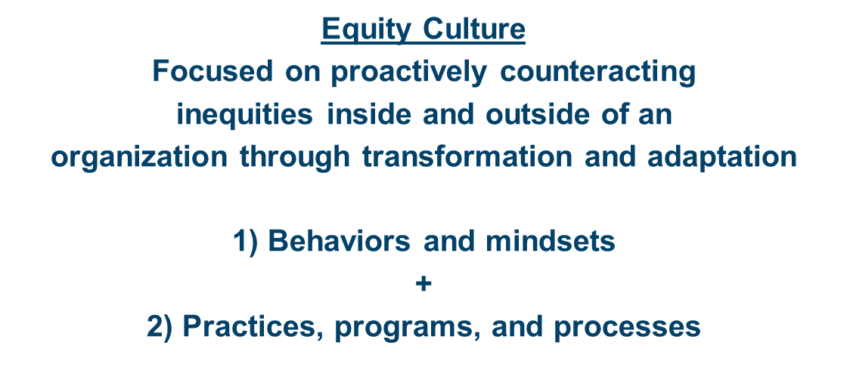
Institutional Change
Liberating Our Clients

Slide 44

Who has a seat at the table?

Slide 45
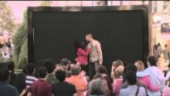
UBUNTU
I AM BECAUSE YOU ARE

Slide 46
Never doubt that a small group of thoughtful, committed citizens can change the world. Indeed, it is the only thing that ever has.
Margaret Mead
Notes:
Quote

Slide 47

Contact me for more information on creating inclusive healing spaces.
Zina Rodriguez, MSW, MCAP, CDE
zina@zndconsulting.com
305-771-4240

Slide 48
