Slide 1


Slide 2

Developing and Retaining the Peer Recovery Workforce: Improving Access to Substance Use Disorder Treatment
06/05/23
Faces and Voices of Recovery Leadership Summit
Karen A. Scott, MD, MPH, President
Ken Shatzkes, PhD, Program Director

Slide 3
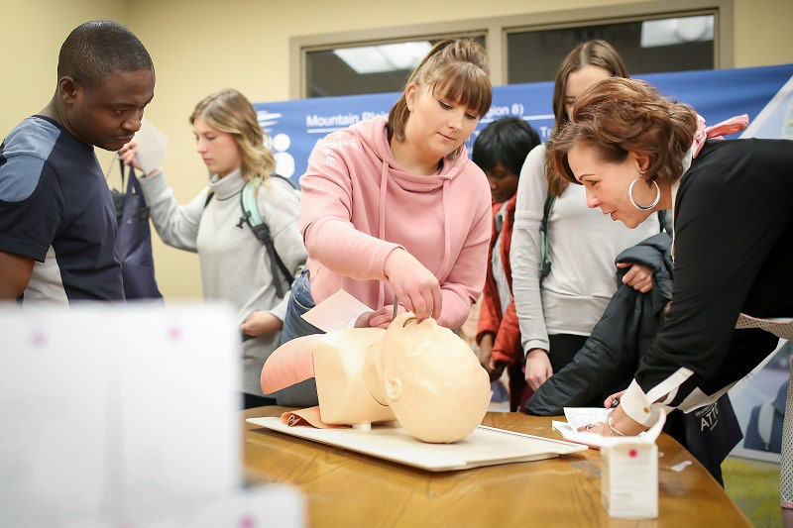




About FORE
Founded in 2018, the Foundation for Opioid Response Efforts (FORE) is a 501(c)(3) private, national, grantmaking foundation focused on one urgent public health emergency – the opioid crisis.
02
Vision
To inspire and accelerate action to end the opioid crisis
Mission
To convene and support partners advancing patient-centered, evidence- based solutions addressing the opioid crisis
Focus
With patients at the center, our focus includes:

Slide 4

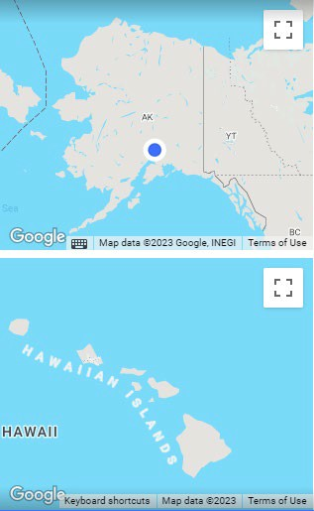
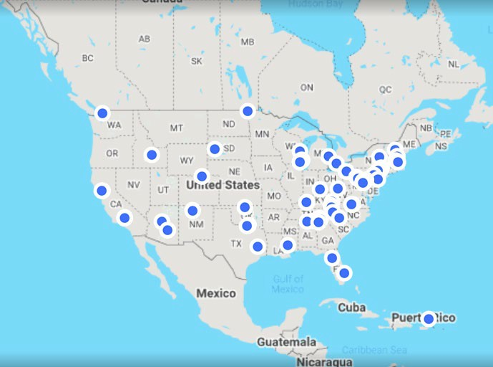
FORE Grantee Portfolio
03
See all FORE Grantees on our website:
https://www.ForeFdn.org/Our-Grantees/

Slide 5
FORE’s Grantmaking Programs
FORE grantmaking programs to date have focused on:
04
Access to treatment for vulnerable populations
Responding to the COVID-19 pandemic through recovery services and evaluation of regulatory policies
Innovation challenge to tackle some of the opioid crisis' most intractable problems (such as stigma, as well as generating more timely and actionable data)
Family- & community-based prevention for children and families at high risk
Supporting Community-Based Organizations responding to the overdose crisis
FORE Resources
Through issue and policy briefs, webinars, and articles, we are contributing current vital information to inform communities, providers, and policymakers on best practices and solutions.
See all FORE Grantees on our website:
https://www.ForeFdn.org/Our-Grantees/

Slide 6
Peer Survey Overview
05
The Foundation for Opioid Response Efforts (FORE) hoped to better understand the experiences, needs, and challenges faced by certified Peer Recovery Coaches (PRCs) across the country.
FORE contracted SSRS to conduct the Survey of PRCs.
The Survey of PRCs was a self-administered web survey that was fielded from October 25, 2022 to January 19, 2023 in 11 states.
A total of 1,174 PRCs who support individuals with opioid use disorder (OUD) completed the survey.

Slide 7
Methodology: Questionnaire Development
06
Informed by a two-phased qualitative study in 2021
A moderated online bulletin board, followed by in-depth interviews
Report released in July 2021
All research materials reviewed by an Expert Advisory Group
Consisting of academic researchers, people with lived experience, and those directly involved in supporting PRCs
Survey instrument pretested with five PRCs from FORE’s network
Across three states: Maryland, Michigan, and New York
IRB approved

Slide 8
Methodology: Sampling
07
State | Total Sample | Total Invited | Total Completed
Delaware | 150 | 150 | 73
Pennsylvania | 1565 | 398 | 154
Rhode Island | 173 | 173 | 76
Virginia | 927 | 456 | 171
Oregon | 1565 | 250 | 85
Maine | 104 | 104 | 57
Nevada | 228 | 228 | 84
New York | 3053 | 339 | 207
Arkansas | 166 | 166 | 43
Ohio* | 834 | 834 | 198
Idaho* | 653 | 653 | 26
FORE and SSRS conducted outreach to all 50 states to determine interest in survey participation.
9 states ultimately partnered with FORE and SSRS to conduct the survey with their certified PRCs; in 2 additional states,
peers were surveyed based on publicly available lists.
Across the states, between 3.98% - 61.06% of those invited completed the survey.
*Public list of PRCs

Slide 9
Research Considerations
A key challenge for this study was developing a representative sample since the certification process varies across states and there is no national registry of certified PRCs
Another challenge was completing enough interviews with certified peers in each state to be able to report on the data findings
08
Notably, in 9 of the 11 states we completed n=50 interviews or more. In the two remaining states we did not meet this threshold, so presenting the findings overall allows certified peers in those states to still be represented.
Weighting data to known benchmarks helps ensure that the sample design and systematic nonresponse do not bias survey results
We reviewed the possibility of weighting by individual states for which demographic benchmarks are available (i.e., DE, PA, RI, VA, OR)
Because these states showed survey demographics to be closely aligned with weighting benchmarks, we ultimately decided not to weight any data the state level for consistency.
In lieu of a national sample source, SSRS collaborated with the FORE team to leverage relationships between FORE and individual states/certification boards.
The findings and conclusions of the study reflect those who responded to the survey and should be used cautiously in any state or national level conclusions
Looking at the results overall offers a deep and nuanced perspective into a seldom- surveyed population and can serve as a guide for future research or policy recommendations. That said, we identified significant variation across states at some questions. In subsequent slides these are denoted with an asterisk (*).

Slide 10
Preliminary Findings: Respondent Demographics
09
Overall, most peers responding to the survey (55%) are between the ages of 30 and 49, while about a third (34%) are between ages 50 and 64.
Two-thirds (67%) of respondents are white, non-Hispanic; less than one in five (18%) respondents are Black or African American, non-Hispanic; roughly one in ten or fewer respondents identify as another race, non-Hispanic or Hispanic (7% and 9%, respectively).
Just over one third (35%) of respondents are male and almost
two thirds of respondents (63%) are female.
The majority of respondents (69%) make under $50,000 a year; only one quarter (26%) of respondents make $50,000 or more a year.

Slide 11
Preliminary Findings: Motivation for Becoming a PRC
10
Q: Thinking back to before you started working as a peer, what was the main reason you wanted to support people experiencing OUD?
54.6% 54.6%
Just over half of all peers (55%) say they want to support people experiencing OUD because of their personal experience/struggles with recovery and/or because of their desire to help others/give back/give hope.
“I have lived experience as I am in recovery too. Being a peer allows me to give back to people who were once in my position, and it allows me to share the tips I have learned throughout my recovery.”
60%
50%
40%
30%
20%
10%
8.4%
6.4%
0%
Personal Experience
Desire to help others
Family Experience
Show Recovery is Possible

Slide 12
Preliminary Findings: Reason for Certification
11
Q: Why did you decide to become certified?
PRCs report different reasons to become certified. Over two thirds (67.4%) of the respondents decided to become certified for career development. Nearly half of the respondents (42.2%) decided to become certified because of job requirement.
80%
70%
67.4%
60%
50%
42.2%
40%
30%
22.8%
20%
19.8%
17.5%
10%
0%
Pay Increase
Career Job Move from Development Requirement Volunteer to
Paid Work
Other

Slide 13
Qualitative Study: Certification Process
12
Two-thirds of PRCs who participated found the certification process mostly or very easy.
Common themes among those who found the process difficult include:
Lack of clarity about required steps
Difficulty finding classes/doing fieldwork
Anxiety about testing
Finding time to complete training

Slide 14
Preliminary Findings: Certification Process
13
Q: Overall, how easy or difficult was the certification process?
Very Difficult, 2.1%
Slightly over two thirds (69.1%) of respondents say the certification process was very (22%) or somewhat (47.1%) easy. About one third (31.1%) say that the certification process was somewhat (29%) or very difficult (2.1%).
For those who did find it hard, supporting oneself while training, finding classes/training and finding the time to do the classes/training were the major challenges.
Very Easy, 21.8%
Somewhat Difficult, 29.0%
Somewhat Easy, 47.1%

Slide 15
Preliminary Findings: Work Settings
14
Q: In which of the following settings do you currently support clients?
Peers reported working in a range of settings – including acute and primary care, recovery organizations, and courts - but are relatively less well represented in traditional mental health and addiction treatment programs.
Outpaitent Mental Health Treatment
7.2%
Primary Care Provider's Office
11.2%
Residential Treatment
3.7%
Community Based Organizations
6.1%
Opioid Treatment Programs
14.4%
Courts and Correctional Systems
26.5%
Recovery Community Organization (RCO)
59.4%
Emergency Room (ER)
15.3%

Slide 16
Preliminary Findings: Financial Compensation
15
% of peers who are very/ somewhat satisfied
(among PRCs who receive financial compensation, n=968)
Q: Do you receive financial compensation for the work you do as a PRC?
Q: How satisfied, if at all, are you with the financial compensation you receive for your work as a PRC?
82% of respondents receive financial compensation for the work they do as PRCs
48%
19%
Very satisfied
Somewhat satisfied

Slide 17
Preliminary Findings: Importance of Supervision
16
Q: How important, if at all, is it to have a supervisor that is a PRC themselves?
Eight in ten of the respondents (81.9%) find that it is very important (51.5%) or somewhat important (30.3%) to have a supervisor that is a PRC themselves.
Not at all important, 6.0%
Not too
important, 12.1%
Very Important, 51.5%
Somewhat Important, 30.3%

Slide 18
Preliminary Findings: Importance of Supervision
17
Q: Why is it important their supervisor is a PRC?
Out of the PRCs who say it is very or somewhat important that their supervisor is a PRC, most of them report the reason being better understanding of the role (85.3%), better able to be an advocate for PRCs within the organization (81.2%), and better able to provide advice or guidance (82.4%).
90%
80%
70%
60%
50%
40%
30%
20%
10%
0%
85.3%
82.4%
81.2%
9.9%
Better Better able to be understanding an advocate for
Better able to provide advice or guidance
Some other reason
of the role
PRCs in the organization

Slide 19
Qualitative Study:
Career Goals
Low pay – that may not be sufficient to cover their basic needs – was one of the greatest concerns among participating PRCs.
“I don't know [if I can afford to stay in this role]. I really don't. I don't know if going forward I had to think about myself and I have to think about my family and being able to care for myself. And so, if I can go back to school and get a bigger paycheck, then I might have to do that. Even though to be fair, I love my job. And I really don't want to change.”
18
Worries about job stability, particularly for grant-funded positions.
No clear opportunities for advancement in their careers as PRCs.

Slide 20
Preliminary Findings: Career Goals
19
Q: Thinking ahead two years, how likely is it that you will still be a PRC in 2024?
Eight in ten (85.8%) respondents say that it is very likely (61.5%) or somewhat
likely (24.3%) that they will still in a PRC in 2024
Very unlikley, 6.6%
Somewhat unlikely, 7.7%
Somewhat likely, 24.3%
Very likely, 61.5%

Slide 21
Preliminary Findings: Career Goals
20
Q: Thinking ahead five years, how likely is it that you will still be a PRC in 2027?
Very unlikely, 12.4%
Over two thirds (75.7%) of respondents say that it is very likely (46.6%) or somewhat likely (29.1%) that they will still be a PRC in 2027.
Nearly 1 in 4 respondents thought it unlikely they would still be in this role in 5 years.
Somewhat unlikely, 11.8%
Very likely, 46.6%
Somewhat likely, 29.1%

Slide 22
Preliminary Findings:
Career Goals
Q: What is the primary reason you are likely to find another career path?
21
30%
28.5%
25%
20%
19.9%
16.2%
14.6%
14.6%
15%
10%
6.6%
5%
0%
I want to make more money
I'm feeling burned out
There is no room I have different for advancement aspirations/want in this position to change career
I am planning to retire
Some othter reason
Out of the respondents who say they are unlikely to continue working as a PRC, almost one third (28.5%) reports compensation being the reason and 16.2% report the lack of career advancement as the reason.

Slide 23
Preliminary Findings:
Career Goals
Q: Which of the following factors, if any, would make you more likely to remain a PRC?
22
80%
70%
60%
50%
40%
30%
20%
10%
0%
74.5%
62.9%
39.1%
25.2%
11.9%
A pay increase
Time off for mental health reasons
More room for The ability to further advancement/career my education in the
Some other reason
growth
field, while continuing as a PRC
Out of the respondents who say they are unlikely to continue working as a PRC, over two thirds (74.5%) report a pay increase would make them more likely to remain a PRC
Nearly 63% reported they were looking for room to develop and advance their career.

Slide 24
Upcoming Work
23
FORE Report – June 2023: Data and Policy Implications
In-depth analyses including:
State variation
Work experience by type of setting and supervisor
Burn-out and self care
Need for on-going training

Slide 25
Summary and Policy Implications
24
This is a workforce strongly driven by a mission to give back
Serving populations across many different settings and with many different tasks
Reasonable pay, career growth opportunities, and supportive work environments needed
Variations across states show that state policies can facilitate or present barriers to increasing the peer workforce

Slide 26
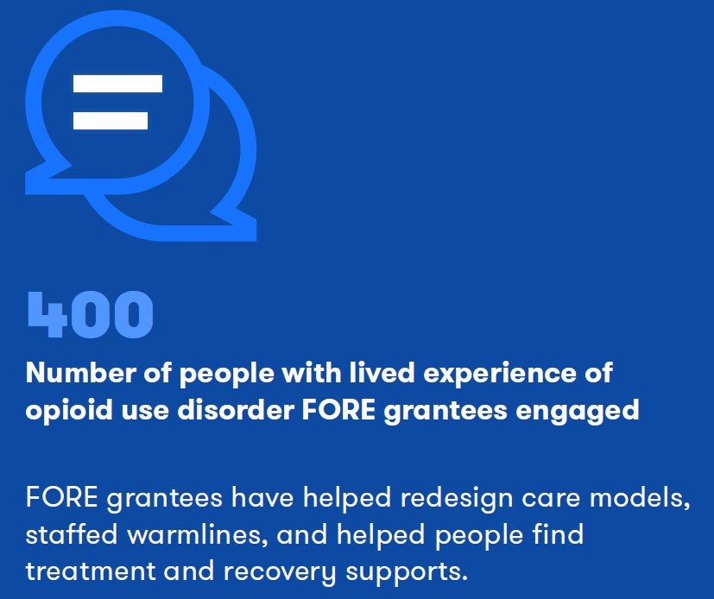
Impact of FORE Grantees
25

Slide 27

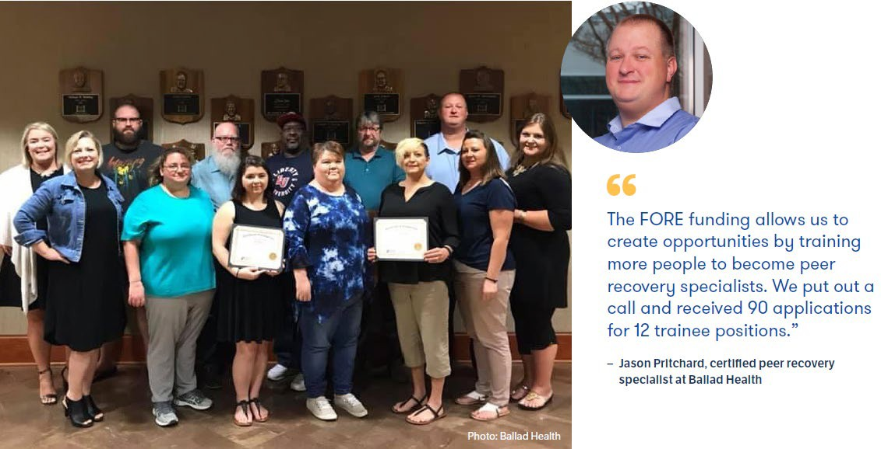
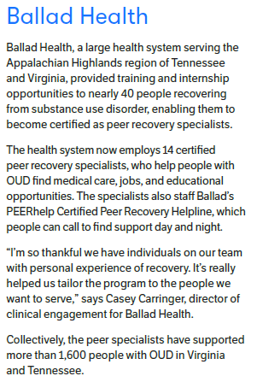
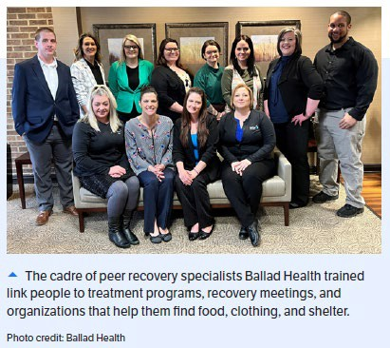
FORE Grantee: Ballad Health
26

Slide 28
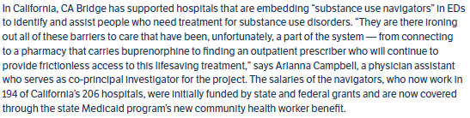
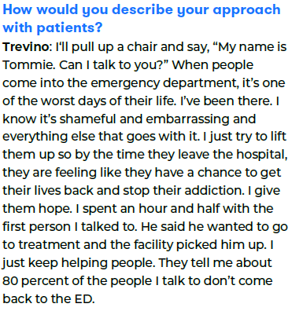
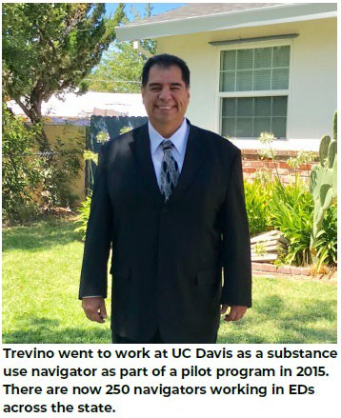

FORE Grantee: California Bridge
27

Slide 29
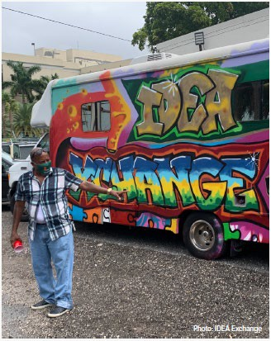

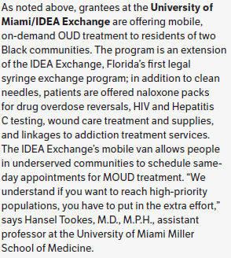
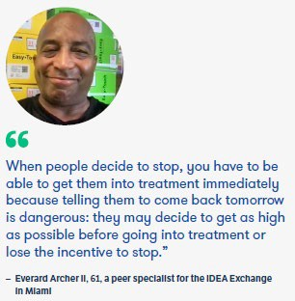
FORE Grantees: University of Miami
28

Slide 30
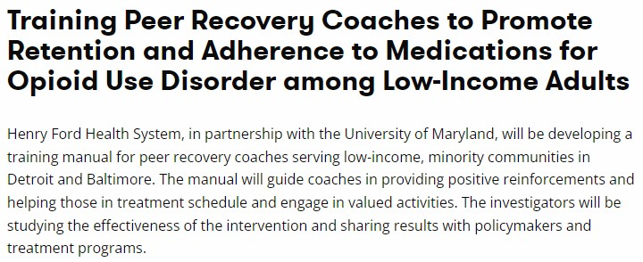



FORE Grantee: Henry Ford Health System
29

Slide 31
Take Care of Yourself!
Thank You For Your Work!
30

Slide 32

General inquiries: info@ForeFdn.org
Follow ongoing updates on our website: www.ForeFdn.org
The information contained in this document is confidential and may not be used, published or redistributed without the prior written consent of the Foundation for Opioid Response Efforts.

Slide 33


