Slide 1
WELCOME
Harm Reduction

Slide 2

The intersection of recovery and harm reduction: revising the substance use spectrum
Heather ogden, cprs, crsp, cadci
Linkage to care coordinator, cdc foundation
Training coordinator, ncaar bh

Slide 3

what is harm reduction?
Harm reduction is used in everyday life. Examples of harm reduction:
Seatbelts
Airbags
Bike Helmets
Condoms
Antidepressants/Vitamins
MASKS, vaccines

Slide 4
what is harm reduction in Substance use?
Alternating alcohol and water
Designated drivers/sober rides
Alcohol breathalyzer steering locks
Housing First Programs
Moderation programs
Needle distribution/exchange
Pharmacotherapy (MAT)
Overdose Prevention Sites
Switching substances (e.g. heroin to alcohol/marijuana)
Naloxone/Narcan
Nicotine patches/gum/medication
Vaping/e-cigarettes
Decriminalization of illicit substances
Legalization of illicit substances
Decriminalizing/Legalizing sex work

Slide 5

Social work guidelines based on nasw code of ethics
Social workers’ primary goal is to help people in need and to address social problems
Social workers challenge social injustice.
Social workers respect the inherent dignity and worth of the person.
Social workers recognize the central importance of human relationships.
Social workers’ primary responsibility is to promote the well-being of clients
Social workers respect and promote the right of clients to self-determination and assist clients in their efforts to identify and clarify their goals.

Slide 6
Peer philosophy
You’re in recovery when you say you are
Meet them where they are, and help them get to where they want to be
There are multiple pathways to recovery
My recovery is different from your recovery
Recovery is “A process of change through which individuals improve their health and wellness, live a self-directed life, and strive to reach their full potential.”

Slide 7
The ethics of harm reduction
1. Problematic behaviors are best understood and addressed in the context of the whole person in their
social environment.
2. Meet the patient as an individual.
3. The patient has strengths that can be supported.
4. Challenge stigmatization.
5. Problematic behaviors are used for adaptive reasons.
6. Problematic behaviors use falls on a continuum of harmful consequences.

Slide 8
The ethics of harm reduction
7. Do not hold any other preconceived notions as a precondition of the therapy before really getting to know the individual.
8. Engagement in is the primary goal.
9. Start where the patient is.
10. Look for and mobilize the patient’s strength in service of change.
11.Develop a collaborative, empowering relationship with the patient.
12.Goals and strategies emerge from the therapeutic process.
https://doctorsonly.co.il/wp-content/uploads/2014/11/05_Examining-the-Ethical.pdf

Slide 9
Harm Reduction, peer support, or social work???
“Meet people where they are”
Person centered
Promotes a continuum of care
Each person is an expert on themselves
Based on what the person wants, not what is decided for them
Is designed to be an ongoing process, not a finite service

Slide 10



The traditional view of harm reduction and substance use the substance use spectrum
ABSTINENCE RESPONSIBLE USE HARM REDUCTION SUBSTANCE USE DISORDER RECOVERY

Slide 11

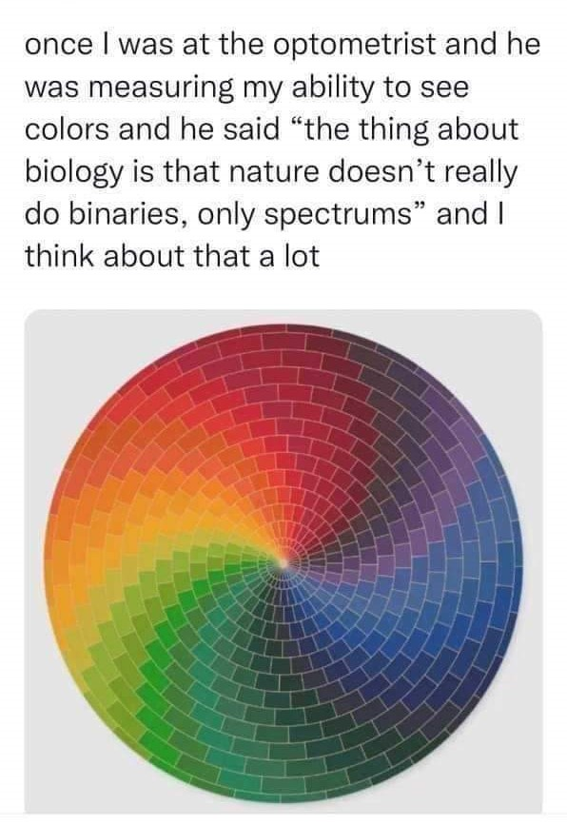
What is a spectrum?
1. a band of colors, as seen in a rainbow, produced by separation of the components of light by their different degrees of refraction according to wavelength.
2. used to classify something, or suggest that it can be classified, in terms of its position on a scale between two extreme or opposite points.

Slide 12

color theory
Mixing different hues creates a unique color.
If the hue is incorrect, other colors, or more of the same original colors, can be added to change the shade.
If you don’t like the first color, you can toss it out and remix it.
Adding other colors on top of the first can change the outside view, but the color still exists.

Slide 13
We agree that recovery:
Has multiple pathways
Is an ongoing process
Looks different for everyone
Is based on each individual
Changes over time
Is a continuum (spectrum)

Slide 14
recovery theory
Mixing different paths creates a unique color.
If the first path doesn’t work, other methods can be used or added to the first one to achieve recovery.
If you don’t like the first path, you can leave that path and choose a new one.
Adding other methods on top of the first can change the view, but the recovery path still exists.

Slide 15

Bending the spectrum into the wheel
Circles are continuous, without lines. They have no intersections.
Recovery is a continuous learning process. Different elements make different color combinations, all unique to the painter (individual).
Continuing to look at “silos” in substance use prevents us from giving maximum assistance to those we serve.

Slide 16
There is no intersection of harm reduction and recovery: it’s a circle!
RECOVERY IS HARM REDUCTION
AND
HARM REDUCTION IS RECOVERY

Slide 17
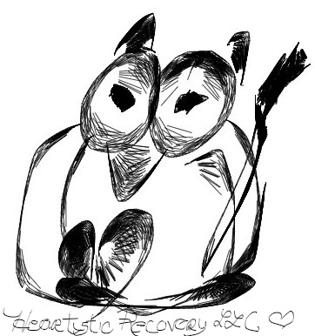
Your recovery Palette: Pick one color for each element
Substance Use
Mental Health
Neurospicy elements
Trauma history
Marginalized status.
Family member SUD/MHI
Loss of family member/close loved one to SUD/MHI

Slide 18
What color is your recovery?
Using the provided supplies, paint your own recovery. It can look however you want it to: a spectral line, a shape, a circle, a blob of mixed colors.
Yours will look completely different from everyone else’s, though there will be similarities and overlap. Still, the end result is completely unique to you.
As you do, remember this is what we want to give the people we work with.
We supply the tools, but they have the freedom to choose which ones they want to use AND to create their own personal spectrum of recovery.

Slide 19
Heather Ogden HeArtistic Recovery LLC. heArtisticRecovery@gmail.com

Slide 20


