Slide 1
WELCOME
Justice, Diversity, Equity, & Inclusion

Slide 2





J O N A T H A N L O F G R E N , P H . D . , L A D C
H E - H I S
D O N ’ T B E C O L O R - B L I N D I N 2 0 2 3
T H E C O L O R O F A D D I C T I O N ,
T R E AT M E N T A N D R E C O V E RY

Slide 3



Introductions
What is the Color of Addiction (SUD), Treatment, and Recovery?
JEDI
Theories, Philosophies, Beliefs, Attitudes
Diversity of Addiction (SUD), Treatment, and Recovery
Beyond the Status-quo of Unpopularity (don’t see, don’t hear, don’t speak)
A G E N D A

Slide 4




C O L O R - B L I N D Q U I Z ?
True or False?
SUD/Addiction sees no color.
Treatment sees no color.
Recovery sees no color.
SUD Policies, Laws, and Practices are color-blind.
Any and everybody has access to quality treatment and recovery services in US.
Racial/Ethnic consumer populations treatment outcomes are no different that outcomes of their sustaining majority population counterparts.
I do not see the color-gender-sex of people I work with.
I see the complexity of SUD stuff through a lenses of Justice, Equity, Diversity, Inclusion.

Slide 5

J . E . D. I . S TA R S
Justice
Equity
Diversity
Inclusion
How does JEDI work relate to Addiction, Treatment and Recovery? How does JEDI work impact your work?

Slide 6

J E D I N E E D E D AT W O R K
Justice; all/most of the evidence supports the IDEA that there are justice disparities related to SUDs based on
the color of a person’s skin (ethnicity-race-class-culture)
Racial Profiling policies like ‘broken windows’, ‘identification checks’, and racial bias impact police interactions
(individually and institutionally); often related to drug possession and use suspicions
Arrests; the disparities in law enforcement arrests related to substance use, possession, and distribution is significant between the sustaining majority population and all diverse racial/ethnic populations
Convictions related to SUDs; most racial/ethnic diverse populations are convicted of Drug related offenses at a much higher rate than conviction rates of Drug related offenses among the sustaining majority population
Disparity of Juvenile conviction rates are higher than adult rates
Prison and Probation Sentences related to SUDs are far higher, more serious and longer among racial/ethnic
populations than those same sentences among the sustaining majority population

Slide 7

J E D I N E E D E D 2
Equity; all/most of the evidence supports a lack of EQUITY in our education, prevention, intervention, treatment, and recovery support services
Racial/Ethnic diverse service providers receive less funding than their sustaining majority provider counterparts
Evidence and Promising practices reach Racial/Ethnic diverse providers and consumer populations much longer after initial dissemination of those practices to sustaining majority populations
Racial/Ethnic/ LGBT+ provider and consumer populations less likely to be engaged in SUD research than their
sustaining majority counterparts
Racial/Ethnic providers much more focused on survival and sustainability than they are on quality improvement than their sustaining majority counterparts
Racial/Ethnic/LGBT+ consumer populations have less access to quality services, receive services later in their SUD
process, and have lower outcome rates than their sustaining majority consumer population counterparts

Slide 8

J E D I N E E D E D 3
Diversity by consumer population rarely matches diversity by provider population
Workforce development efforts continually fall short (start-stop-start-stop)
Treatment outcomes positively affected by diversity representation (when consumers see their respective race/cultures represented at all levels of a service provider entity)
Services and curriculum rarely reflect the diversity of populations served with exception of the
sustaining majority

Slide 9


J E D I N E E D E D 4
Inclusion is a gap that impacts policy, practice, service delivery, consumer service engagement
Leadership disparity gap
Policy gap
Community engagement gap
Consumer engagement gap
Service development gap

Slide 10





PEOPLE
Race and Hispanic Origin
White alone, percent | 75.8%
Black or African American alone, percent(a) | 13.6%
American Indian and Alaska Native alone, percent(a) | 1.3%
Asian alone, percent(a) | 6.1%
Native Hawaiian and Other Pacific Islander alone, percent(a) | 0.3%
Two or More Races, percent | 2.9%
Hispanic or Latino, percent(b) | 18.9%
White alone, not Hispanic or Latino, percent | 59.3%
U S P O P U L A T I O N

Slide 11
T H E C O L O R O F S U D S ( B R U S H S T R O K E S )
SUD prevalence among diverse populations varies by substance, age, gender, socio-economic status; correlations link prevalence to Social Determinants of Health (disparities) and Adverse Childhood and Persistent Traumatic Experiences:
Linguistic diversity of SUD/addiction among diverse populations is as diverse as the
populations themselves. Different racial/ethnic groups define SUD differently.
Native American – cultural and spiritual connection deficits
Hmong – medical and spiritual connectedness problems
Euro-American – Health, medical, character problems, disease victim
Somali – religious, psychiatric/psychological/disease/illness, family problems (shame, stigma)
African American – religious, social, and moral problems
LGBT+ - identity, family, mental health problems
Hispanic/Latino American – family and religious problems

Slide 12
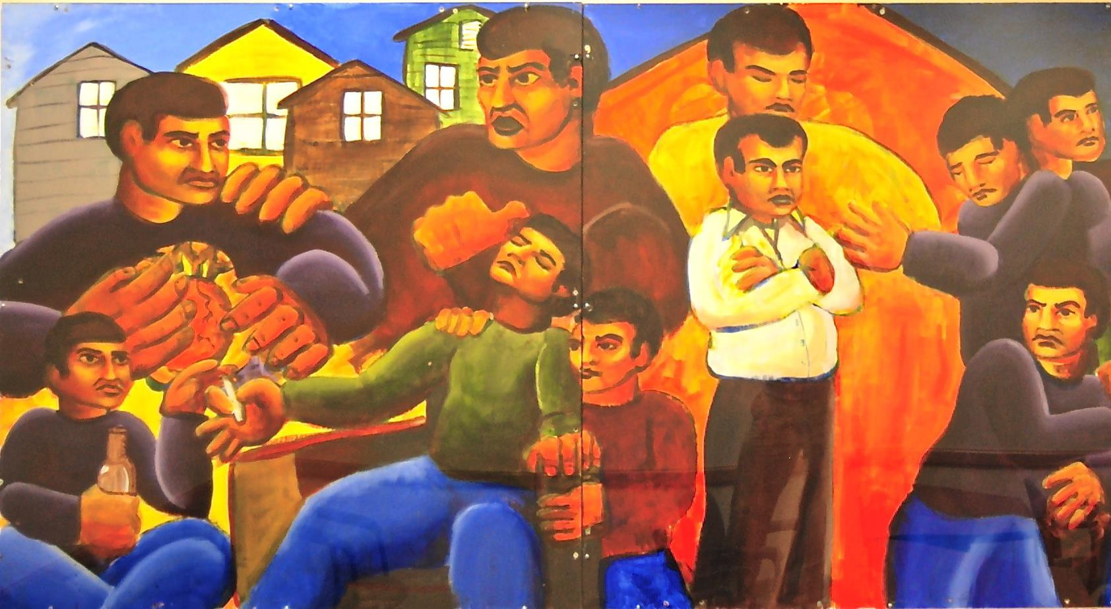
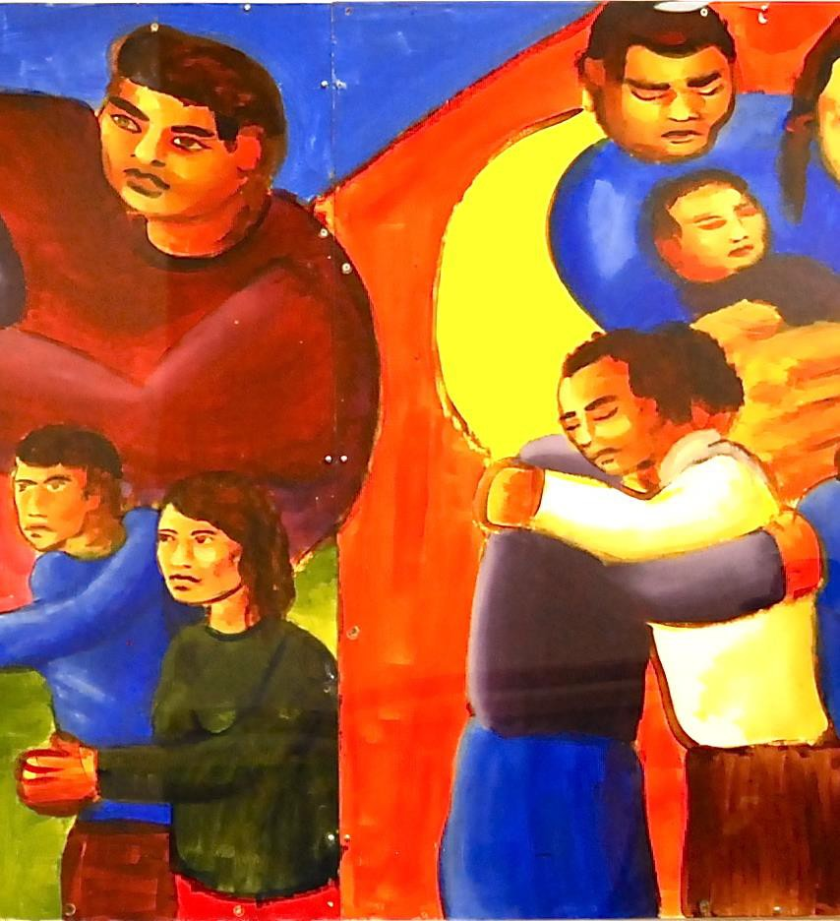



FA M I L I A

Slide 13
C R I T E R I A A N D C O L O R
DSM V
ASAM
Intoxication/Withdrawal
Biomedical
Emotional/Behavioral/Cognitive
Readiness for Change
Relapse/Continue Use
Recovery Environment
How are these criteria evaluated within the context of race/ethnicity/culture?
Used larger amounts/longer
Hazardous use
Repeated attempts to control use or quit
Neglected major roles to use
Social or interpersonal problems related to use
Much time spent using
Activities given up to use
Physical or psychological problems related to use
Craving
Tolerance
Withdrawal

Slide 14

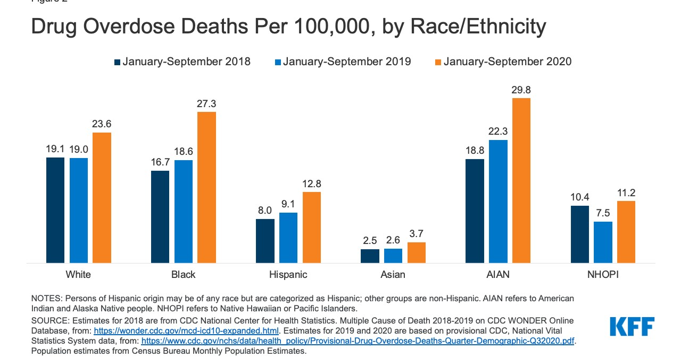

Slide 15
T H E C O L O R O F T R E AT M E N T
Access limited to mostly sustaining majority population provider services
Service Models designed, developed, and studied mostly by and on sustaining majority populations
Mis-diagnosis phenomenon
SUD curriculum and service adaptations rarely done with fidelity (guess patch-work at best)
Provider Outcomes of services delivered to SUD consumers show lower rates of service completion, program service goal attainment, and service satisfaction among racial/ethnic diverse consumers than outcomes of sustaining majority consumer populations (what is our training and provider role?)
Service Environment scans rarely reflect the diversity of populations served, rather décor and textiles
reflect the sustaining majority population

Slide 16
A WAY O F B E I N G W I T H P E O P L E :
Be a Partner (Collaborative & Engaging)
Be Evocative & Empowering (Curious about Their Perspective)
Be Accepting (Unconditional Regard/Worth, Affirmative, Empathic, Allow for Autonomy)
Be Compassionate (Practice Lovingkindness)
The Spirit of Motivational Interviewing
These humanistic attributes exemplify what is possibly the greatest single predictor of client success; the rate in which the helper believes the help-ee can change
These attributes also exemplify a degree of cultural language and behavior that virtually every cultural
group desires

Slide 17
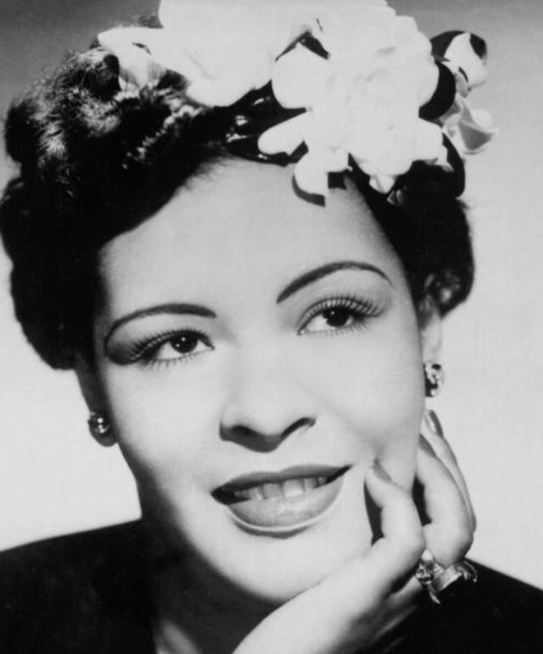
“Imagine if the government chased sick people with diabetes, then sent them to jail. If we did that, everyone would know we’re crazy. Yet we practically do the same thing every day of the week to sick people hooked on drugs.”
- Billie Holiday

Slide 18
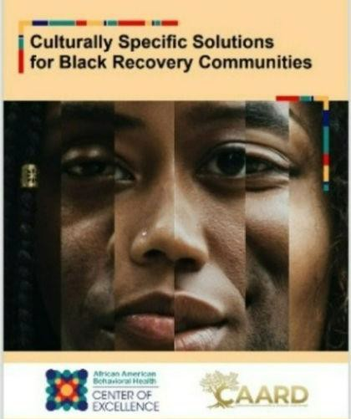

T H E C O L O R O F R E C O V E RY
Linguistic diversity of recovery among diverse populations
Pathways
Community Recovery Organizations in diverse communities
www.theCAARD.org

Slide 19
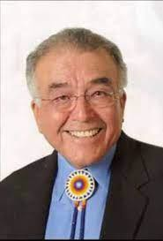





‘In recovery you can move a tree, but to sustain recovery you must heal the land’
Don Coyhis, President, White Bison
paraphrased

Slide 20



M U LT I P L E PAT H WAY S
“Allah has the power to cure any illness or problem. I developed the faith to find His comfort. I also relied on SUD and MH treatment for support”
Farhia Budul, Founder of Niyyah Recovery Initiative
Photo from the play; Redemption (2022)

Slide 21
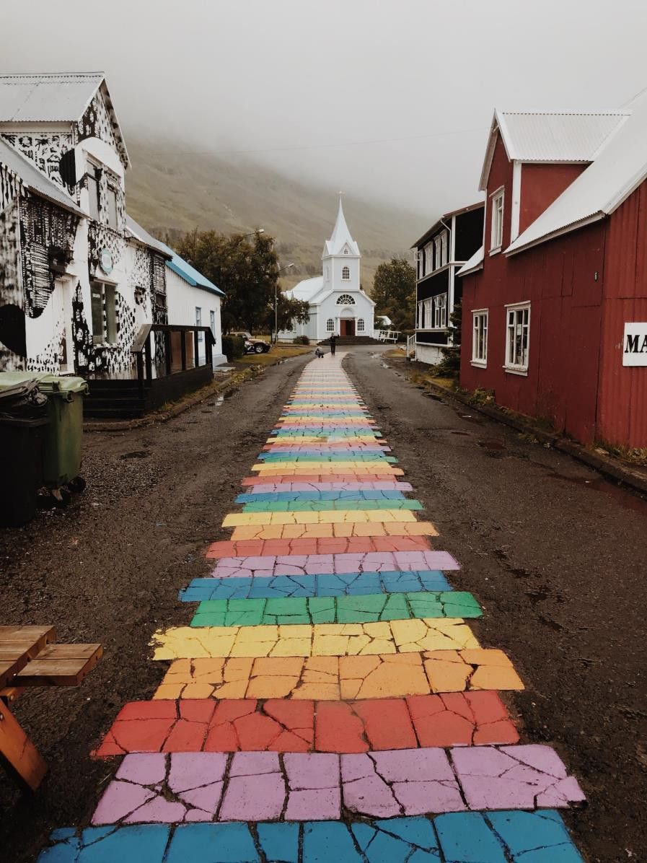


M U LT I P L E
PAT H WAY S 2
Abstinence
Collegiate
Community
Cultural Expression and Creativity
Diet
Education
Familial
Harm Reduction
Health/Wellness/Exercise
Holistic
Religious
Social

Slide 22

R E C O V E RY D I V E R S LY D E F I N E D
SAMHSA = “A process of change through which individuals improve their health and wellness,
live a self-directed life, and strive to reach their full potential.”
Wellbriety = to be sober and well; that we must find sobriety from addictions to alcohol and other drugs and recover from the harmful effects of drugs and alcohol on individuals, families and whole communities.
African American recovery is restorative, holistic, and preventive; it includes physical, mental, social, and spiritual growth. Recovery embraces values and traditions of African American culture, and it's communal and interconnected with our people. Recovery involves participating in family, neighborhood, community, and individualized healing that contributes to sustained health and wellness.
Hispanic and Latino people often emphasize the family and community, focus on strengths, and reinforce identity (and intersectionality) when talking about what recovery is to them.

Slide 23
C O L L E G I AT E R E C O V E RY
Engagement equity gaps
½ of diverse students with SUD/COD receive services compared to their sustaining majority
counterparts
Diverse students 2x more likely to be punished for SUD related behaviors then their sustaining
majority counterparts
Target engagement, bring these activities to diverse student networks (don’t expect them to
come to you)
Inclusion of cultural activities within CRP/CRC services
Inclusion of diversity lenses within CRP/CRC membership criteria

Slide 24

D I V E R S I T Y A DV O C AC Y
Go to the community
Get to know the people – make real meaningful connections
Involve the community/family/elders/youth
Find some art and other expressive cultural stuff
Learn diverse language meaning around SUD, treatment, and recovery
Self-assessment and assess your organizations through JEDI/IDEA
lenses
Call-in and Call-out – create space for growth
Practice with Lovingkindness

Slide 25


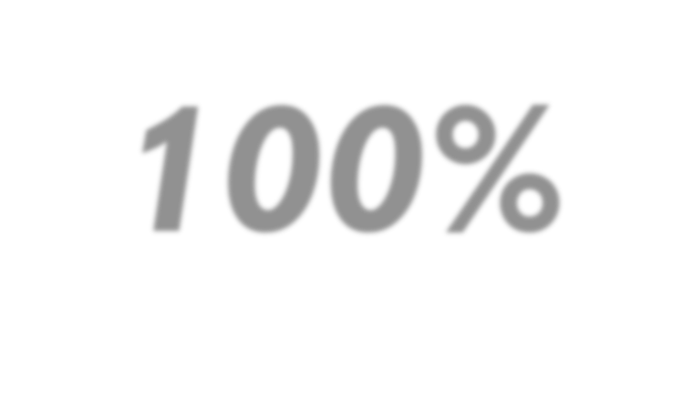

B E L I E V E
100%
The degree to which Justice, Equity, Diversity, Inclusion can be achieved
The degree to which our services can change
The degree to which All People can change

Slide 26


C O M M E N T S
&
Q U E S T I O N S

Slide 27
A F E W S O U R C E S
Holly N. Hagle, Marlene Martin, Rachel Winograd, Jessica Merlin, Deborah S. Finnell, Jeffrey P. Bratberg, Adam J. Gordon, Cheyenne Johnson, Sharon Levy, Doreen MacLaneBaeder, Rebecca Northup, Zoe Weinstein & Paula J. Lum (2021) Dismantling racism against Black, Indigenous, and people of color across the substance use continuum: A position statement of the association for multidisciplinary education and research in substance use and addiction, Substance Abuse, 42:1, 5-12, DOI: 10.1080/08897077.2020.1867288
E. Sherwood Brown, Carlos Tirado, Abu Minhajuddin, Maureen Hillhouse, Bryon Adinoff, Walter Ling, Geetha Doraimani, Christie Thomas (2011). Association of Race and Ethnicity with Withdrawal Symptoms, Attrition, Opioid use and Side-effects during Buprenorphine Therapy.
Sara Matsuzaka & Margaret Knapp (2019): Anti-racism and substance use treatment: Addiction does not discriminate, but do we? Journal of Ethnicity in Substance Abuse, DOI: 10.1080/15332640.2018.1548323
Ben Lewis, Lauren Hoffman, Christian C. Garcia, Sara Jo Nixon (2019). Race and Socioeconomic Status in Substance Use Progression and Treatment Entry. University of Florida, Department of Psychiatry, Gainesville, FL
Center for Substance Abuse Treatment (US). Improving Cultural Competence. Rockville (MD): Substance Abuse and Mental Health Services Administration (US); 2014. (Treatment Improvement Protocol (TIP) Series, No. 59.) Available from: https://www.ncbi.nlm.nih.gov/books/NBK248428/

Slide 28
A F E W M O R E S O U R C E S
Miller, W., Rollnick, S. (2013). Motivational Interviewing, Helping People Change (3rd ed)
https://c4innovates.com/brsstacs/BRSS-301-Recovery-Collegiate-v21-508v2-authors-feb-5.pdf
Nirmita Panchal, Rachel Garfield, Cynthia Cox, Samantha Artiga (2021). Substance Use Issues Are Worsening Alongside Access to Care. https://www.kff.org/policy-watch/substance-use-issues-are-worsening-alongside-access-to-care/
US Census (2022). https://www.census.gov/quickfacts/MN
Lofgren, J., Powell, J., Reed, K., Sanders, M. (2021). African American Recovery & Recovery Principles defined
Presented by Jonathan Lofgren, Ph.D., LADC. Email @ Jonathan.Lofgren@minneapolis.edu

Slide 29
