Slide 1
WELCOME
Leadership Development

Slide 2
From participant to ceo
If I can do it, so can you
Honesty Liller, CPRS

Slide 3
Learning objectives
Develop a more comprehensive understanding of their own ability to lead, advance their skillsets and capabilities to lead in the nonprofit sector, and improve upon the existing network of nonprofit colleagues.
Clearer understanding of self, tools to lead and develop others, concrete visions for their role as a leader, and confidence in their ability to positively impact their organization.
Opportunity for professional growth in an environment tailored for their passion of giving back to the recovery community.
Improvement of active listening skills and delegation of job duties
Company culture, accountability, employee engagement, financial health, goal setting, growth challenges, sustainability, and “balance”.
Identify personal and professional challenges and learn how to embrace them with positivity.
Coping with intense workloads and building a team you can fully trust and rely on to accomplish tasks.
​
​

Slide 4
The Mcshin foundation
Founded in 2004, The McShin Foundation is Virginia's leading non-profit, full-service Recovery Community Organization (RCO), committed to serving individuals and families in their fight against substance use disorders. While providing the tools for recovering individuals to create positive lifestyles, we aim to spread the word of recovery and educate families, communities, and government regarding SUDs as well as reduce the stigma attached to them. McShin is the only RCO in Virginia accredited by the Council on Accreditation of Peer Recovery Support Services (CAPRSS).
A little about me….
Woman in recovery from a substance use disorder since May 27, 2007
Mom of 2 kids & 2 doggies, wife, sister, daughter, and friend
Certified Peer Recovery Specialist in Virginia
Best-selling author of “Scattered Pink”
Chief Executive Officer of The McShin Foundation
Recipient of the Vernon Johnson Award given by Faces and Voices of Recovery in 2015

Slide 5
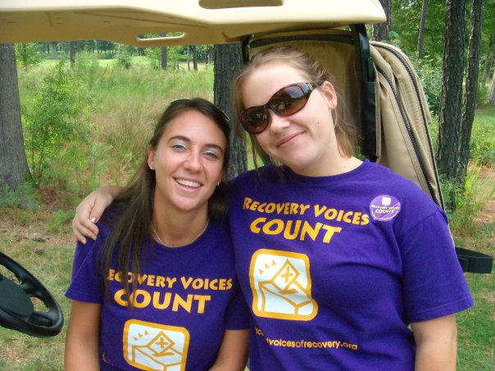
How did i start?
Entered into McShin in 2007, lived in housing for 5 months
Staying in recovery
Started employment at McShin as a peer leader
Slowly learned how to be an advocate in the recovery movement in early recovery
Learned how to educate our community about SUD
Many challenges in early recovery home/work life
Challenges of being new in recovery as well as being a woman in this field

Slide 6
Passion is energy. Feel the power that comes from focusing on what excites you.
Oprah Winfrey

Slide 7
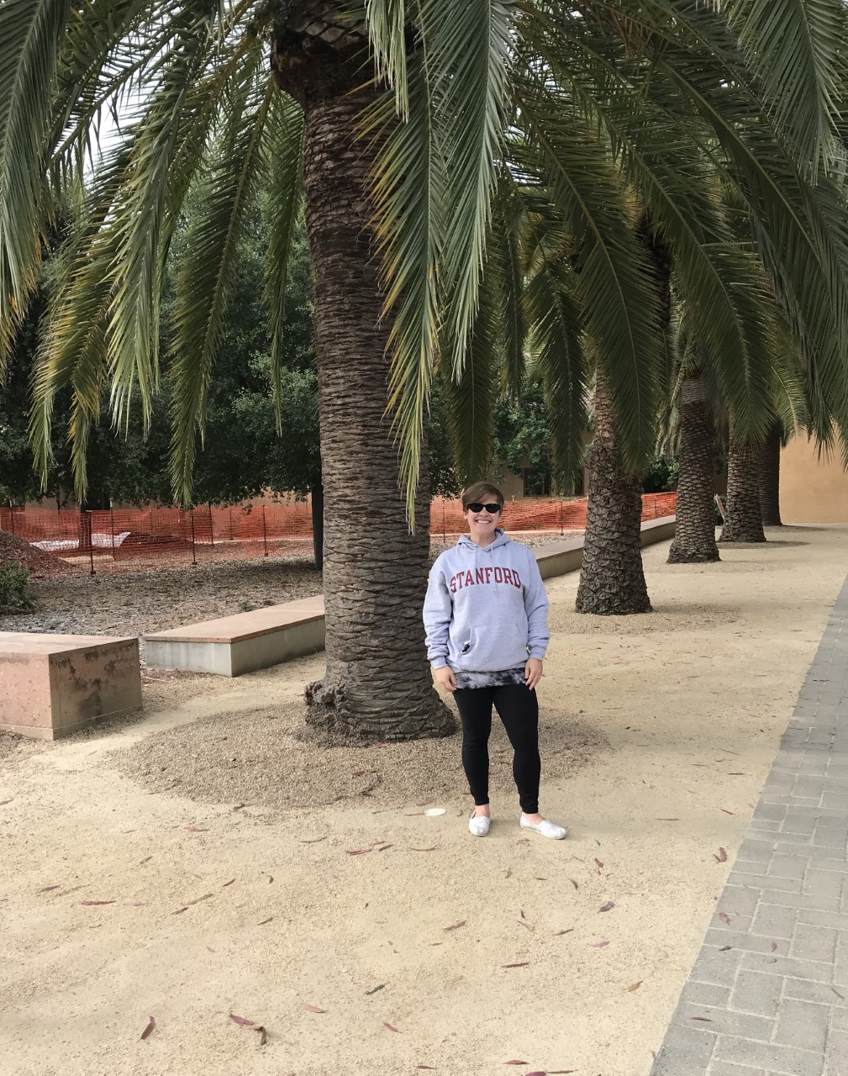
Learn, learn listen, listen
Stanford/ENLP – Apply for Leadership Programs
Personal/Recovery goals - CONSTANT
Online webinars/courses – Most are FREE
Self teach – Follow on social media/newsletters
Mentors – Best thing I have done and still do
Boards – Volunteer to be on a board
Interviews/publications – Make the time to do this
Trial and Error – Learn, forgive, learn, keep moving

Slide 8
How do you build your organization
Develop a plan – Mission Statement
How are you going to serve your community
Create a Board of Directors
Find a space/building/office to help people recover
Funding
Staffing Plan
Reduce the negative outlook on addiction

Slide 9
Things you will need to know
Community Events
Staffing Challenges and Strengths
Being A Voice For Those In Recovery & Their Families
Following a Budget, Funding Streams
Fill the Needs Of Your Community
Programming

Slide 10
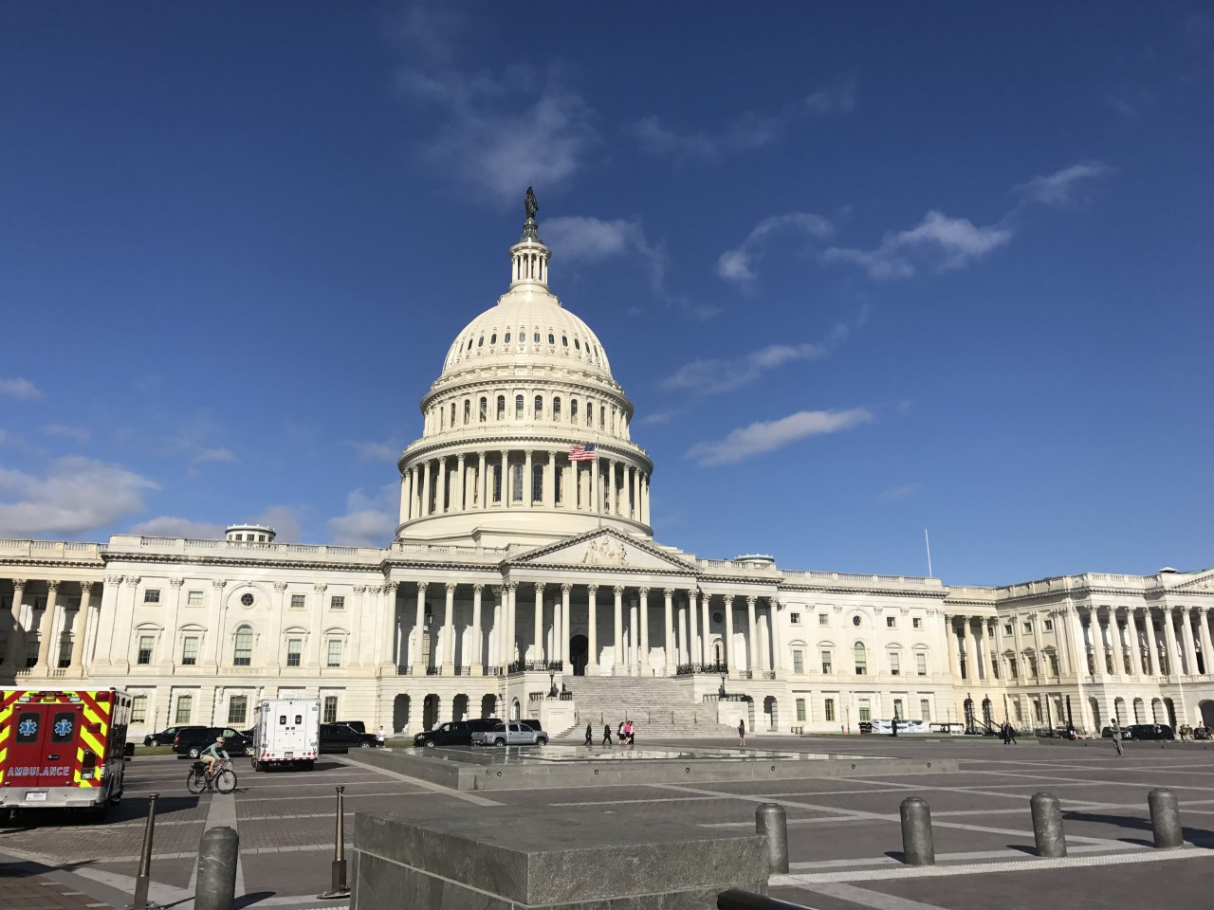
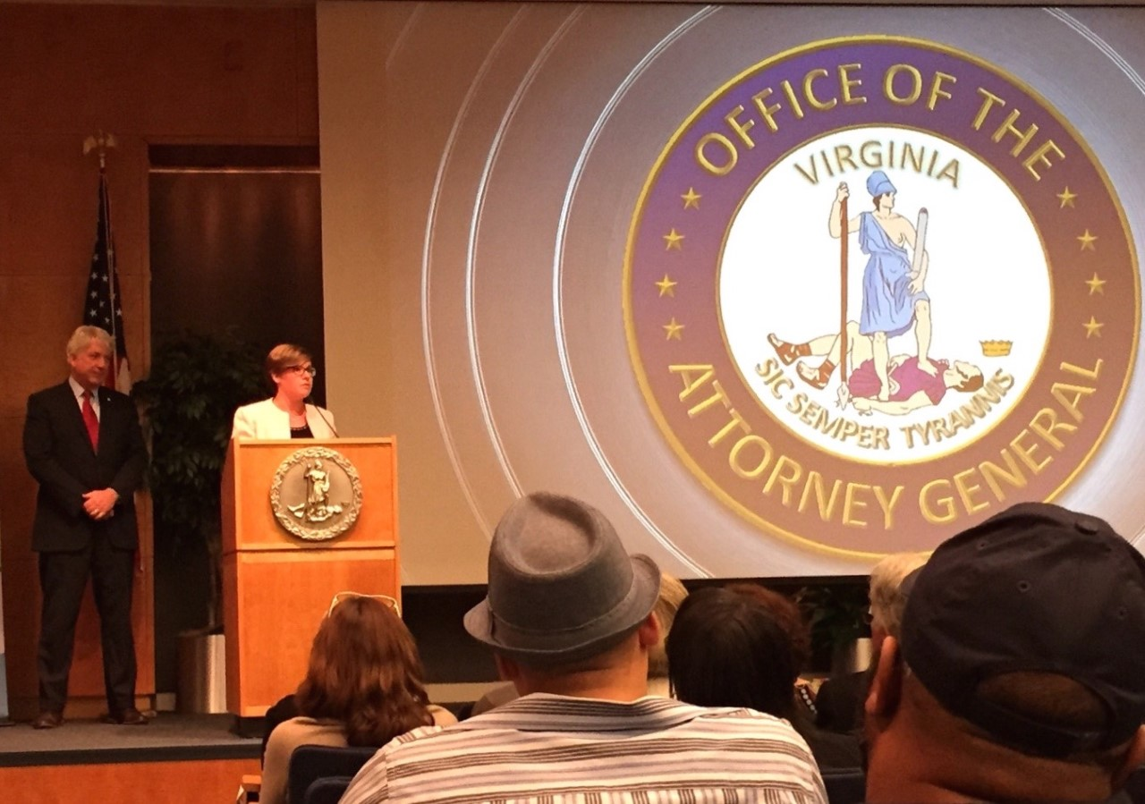
Advocate for change
Advocating for Yourself
Virginia Recovery Advocacy Project
Local and Federal Legislation
Town Hall Meetings
Voter Registration
Peers and Family Members Involved
Media and Editorials
Recovery Community Supporters
Local Business Partnerships

Slide 11
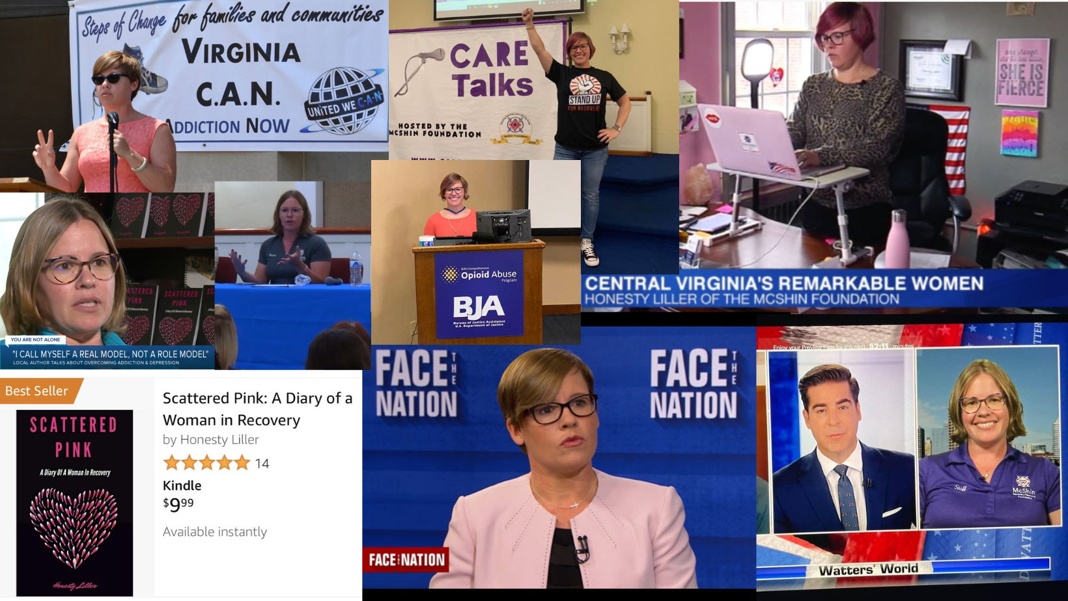
Be the voice
Understand your role in the conversation/meeting/interview
Know your audience - There are ways to talk in different situations
Get people involved that love your mission
Be a resource to underserved communities
Be at the table on local coalitions & policy making committees
Speak up for yourself and what you need

Slide 12



HOW WE GET THERE
Culture
accountability
sustainability
Create an environment of empathy and structure
Cultural Competency trainings and implementation
Wellness activities/staff events
To yourself first
Ethics
Surveys from those you serve and staff
Budget
Fundraising
Program Development
Reputation

Slide 13
Keep going…….
Fun activities in recovery and life
Education about SUD’s and recovery
Be a community resource
Multiple Pathways of Recovery
Being open to change
Being innovative with what is going on in your community
Make changes where needed

Slide 14
Live your best life
“I believe success means achieving goals in your life. Some may say success is a fiscal word, but I have so many different successes that make me a happy human that isn’t just my paycheck. I live in Radical Gratitude and I show others how to do so.”

Slide 15
THANK YOU
Honesty Liller, CPRS
CEO of The McShin Foundation
honesty@mcshin.org
www.mcshin.org

Slide 16
