Slide 1


Slide 2
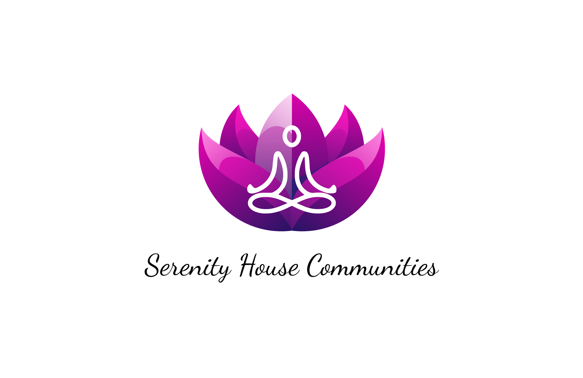
1019 Church Street
Flint, Michigan, 48502
810-336-1018
www.flintserenityhouse.org

Slide 3
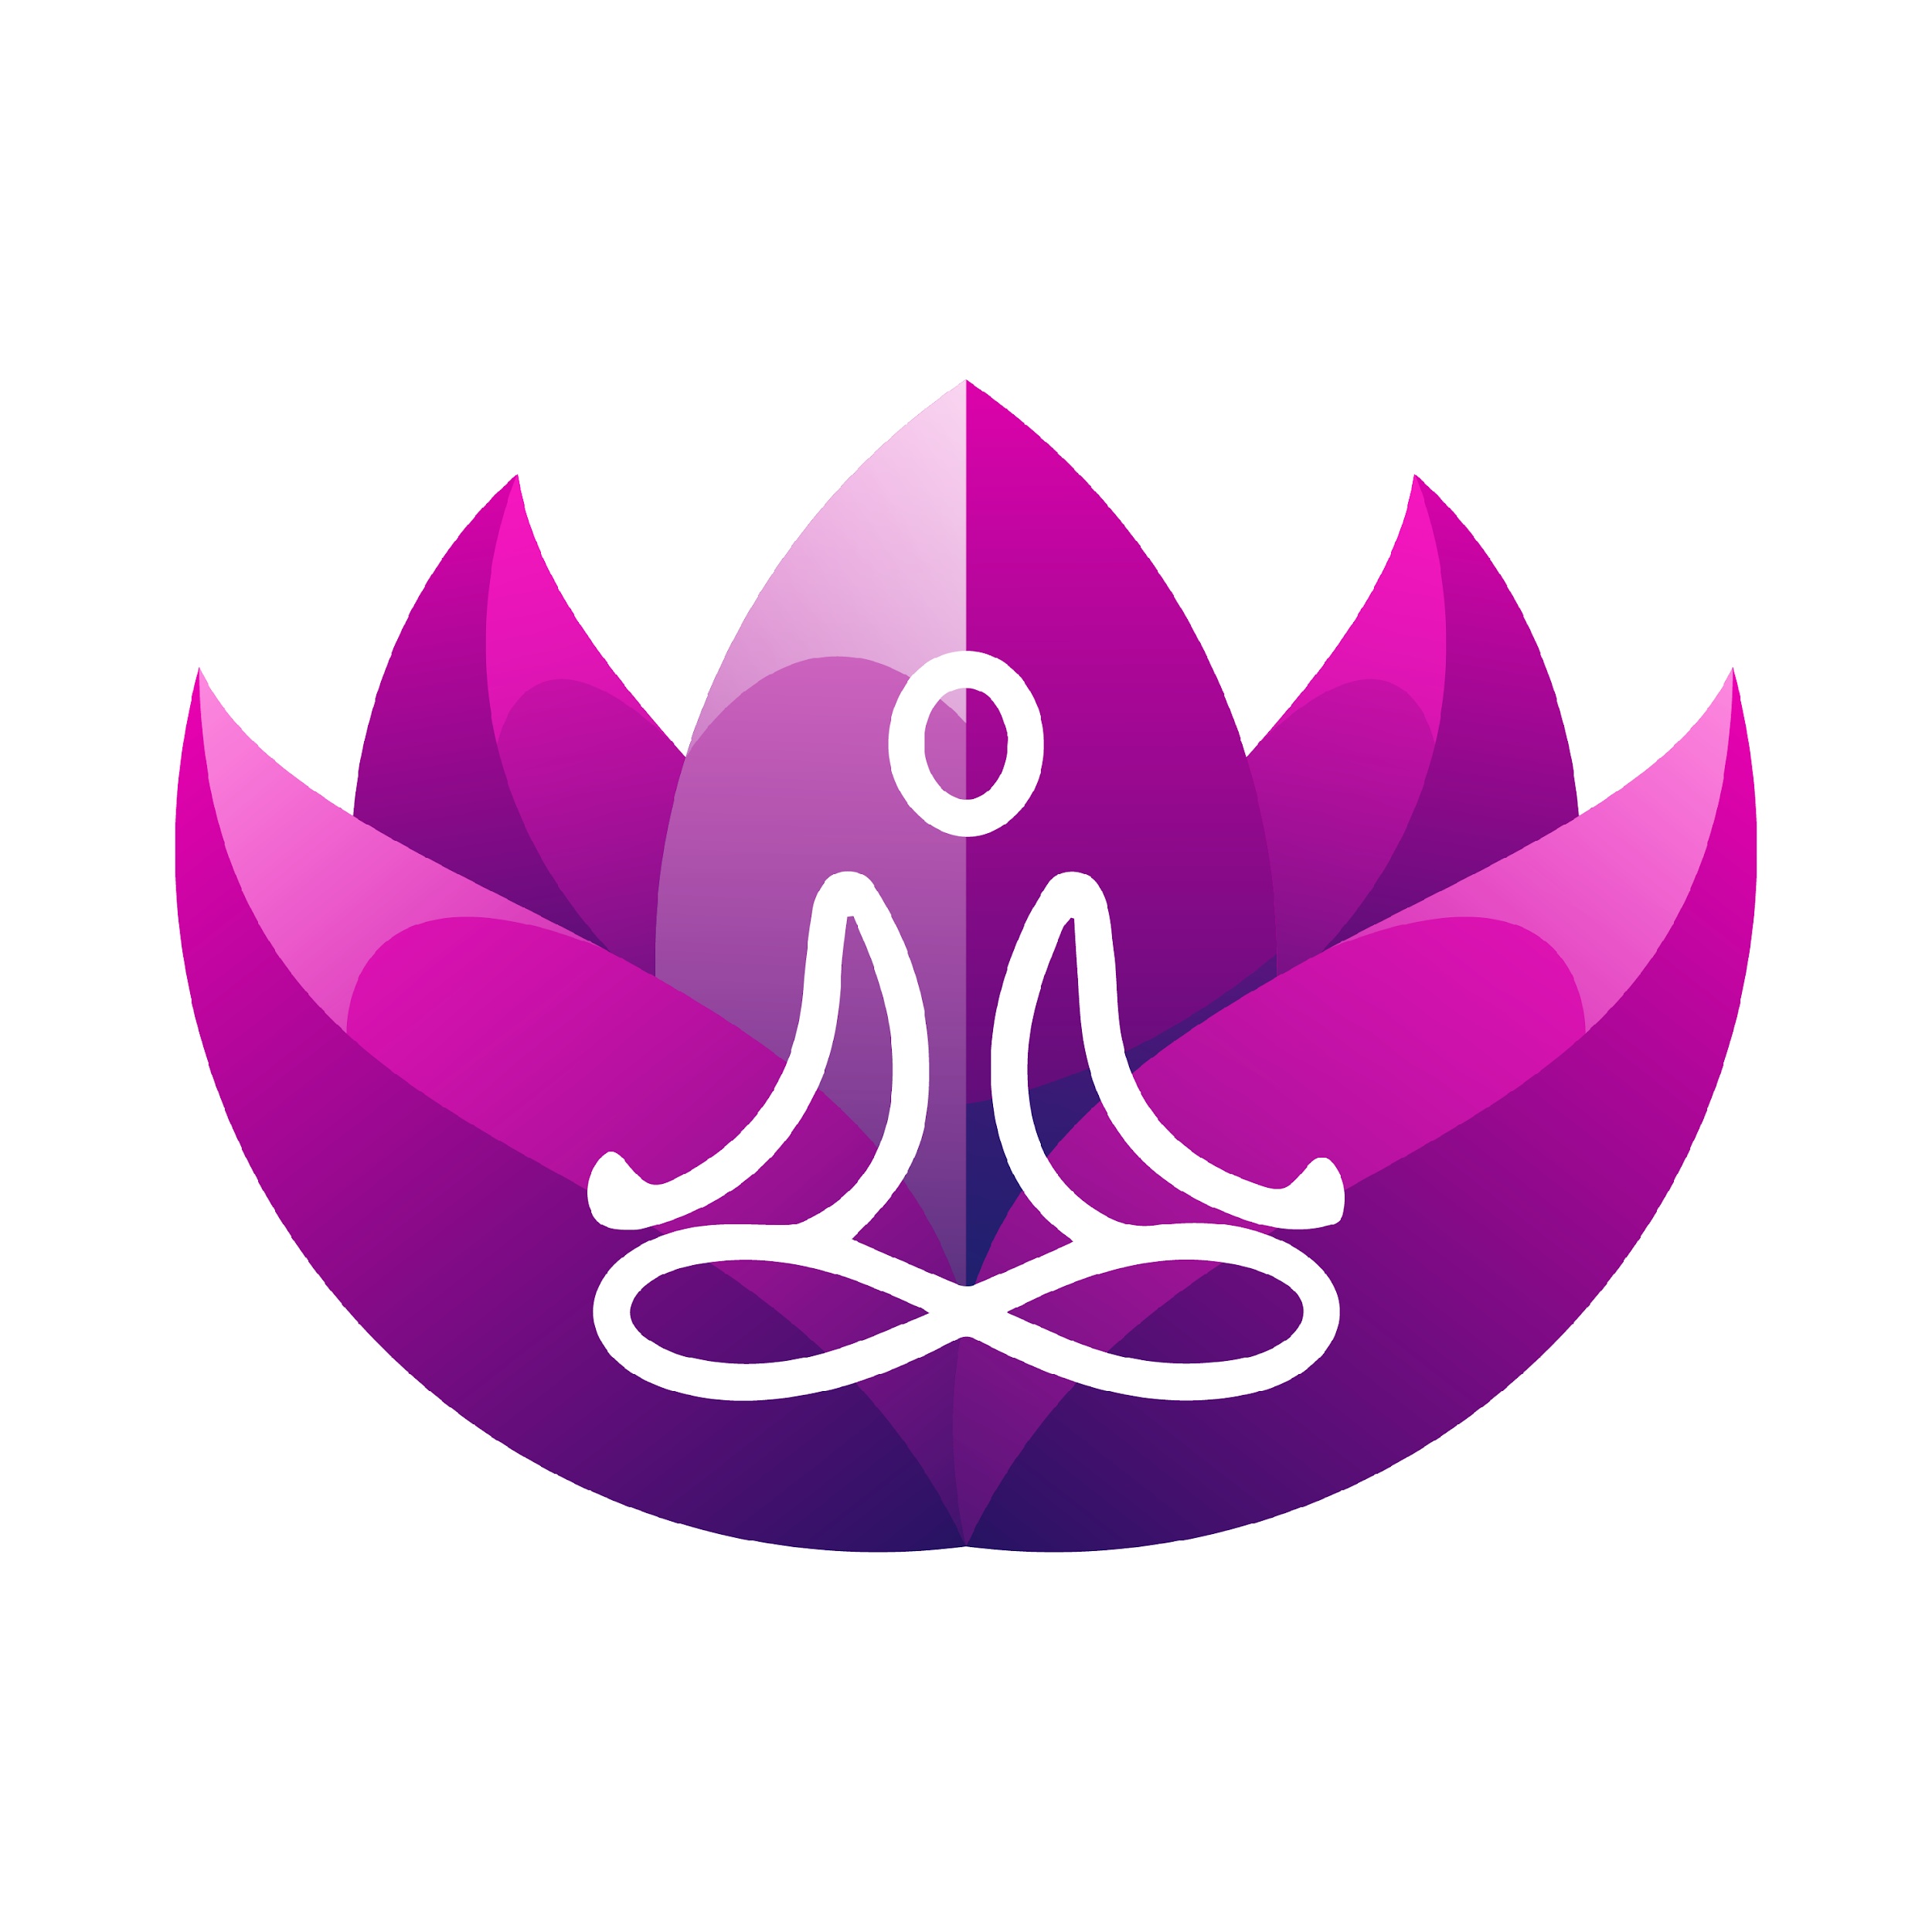
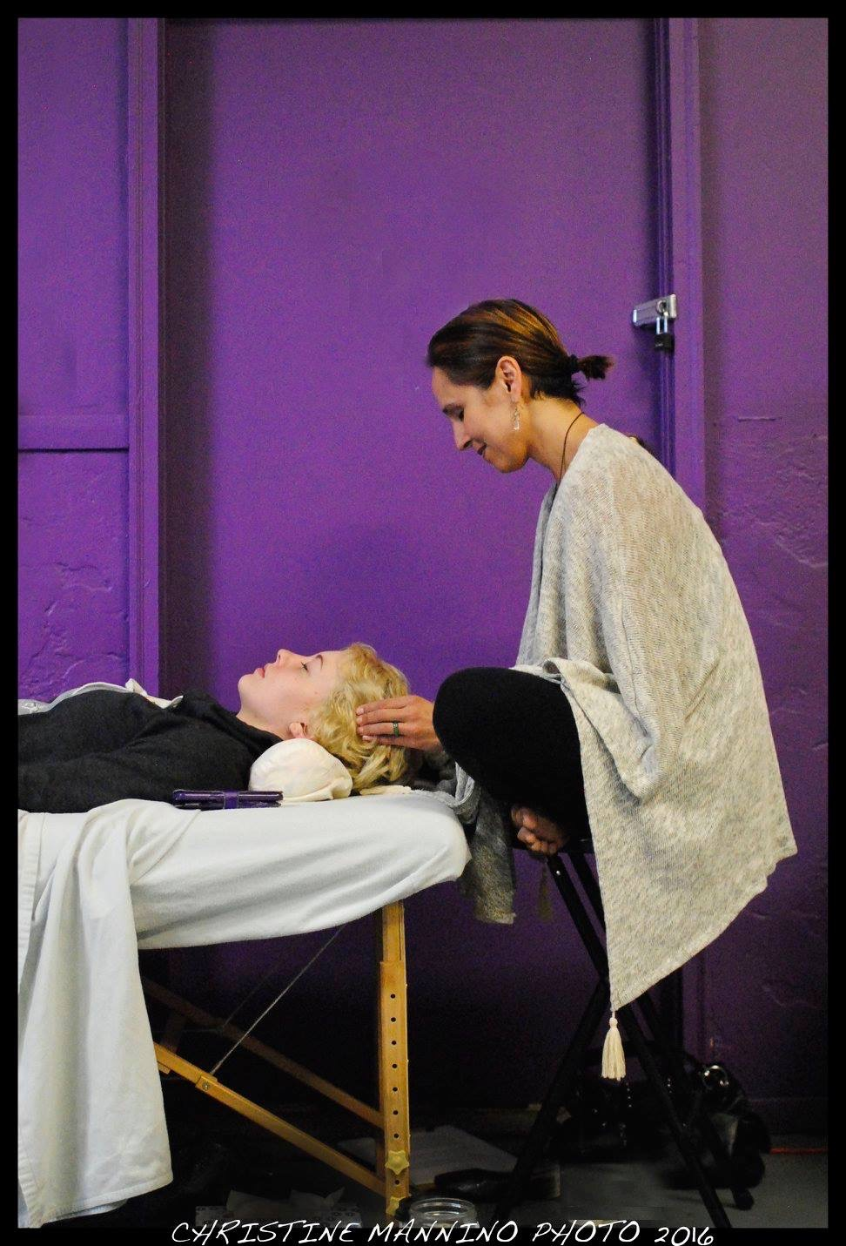
Introduction
Master’s degree in Composition and Rhetoric from the University of Michigan
Bachelor’s in Telecommunications from Michigan State University.
Former news and feature reporter for newspapers and magazines
Former college professor (writing)
Founding director of the Serenity House Communities (2015)
Trained in recovery coaching through Genesee Health Systems in 2016
Member of the Genesee County Prevention Coalition, Advisory board member of Genesee County’s Family Against Narcotics advisory , member of Faces & Voices for Recovery and SUD Advisory Council Member for Genesee Health System
Certified Usui Reiki master teacher and developer of Recovery Reiki®
Certified Acudetox Specialist through NADA and POCA
Founder of Serenity House Communities founded in 2015
I AM NOT A MEDICAL PROVIDER

Slide 4
Agenda
Defining holistic recovery
Learning about a variety of holistic approaches for recovery and the data captured
Learning about incorporating holistic modalities with recovery coaching
Learning how to implement holistic recovery options in your life and recovery center
Experiencing a guided meditation with a singing bowl

Slide 5
Defining Holistic Recovery
Encompasses an individuals whole life, this includes mind, body, spirit-- and community
Highly individualized non-medical approach that focuses on bringing the body back into alignment
The focus is not on the disease but the person
Recovery supports involve healing the cause of the condition, not just alleviating the symptoms
The goal is to inspire participants to take responsibility for their well-being
Encourage participants to understand that they are their own healer

Slide 6
Holistic Modalities
Meditation practices
Nutrition to heal
Acupuncture, Acudetox/5NP and Battlefield Acupuncture
Emotional Freedom Techniques/Tapping
Energy work like Usui Reiki, Holy fire® reiki, karuna® reiki, Recovery Reiki®, Access Consciousness®
Sound healing- drumming, singing bowls, tuning forks, solfeggio frequencies, binaural beats
Yoga- kundalini, Ashtanga, Hatha, Yin
Breath work
Massage- myofascial, Swedish, trigger point, acupressure, Cranial Sacral Therapy
Flower essences, essential oils, smudging
Herbology
, NAET, meridian therapy, Qu Gong, Access Consciousness
Cold exposure therapy, crystal therapy, bio mats, salt cave therapy, float tanks, Red Light Therapy

Slide 7
Meditation Practices
Mindfulness Meditation
is one the most powerful meditation techniques, which lays emphasis on cultivating a highly receptive mindful attention toward any action or objects within your sphere of influence. To practice mindfulness, focus on your breath and the body. Notice with your senses all that is around you without judgment. Name what you are experiencing if you like. The goal is to become the observer of thought and emotion
Meditation with Mantra
Creating the gap is training the mind to concentrate and focus on the nothingness or the Void. This allows your mind to be calm and awaken beyond thought and even beyond your sense of self. Mantras are used to create space between thoughts. A commonly known mantra is Om. When a thought arises, the mantra is voiced either in the mind or vocally. The mantra then helps to create the gap. It is said that the gap is where healing occurs. It is also the place where peace, love, bliss, and joy live
Analysis Meditation
This type of meditation is a container for inner work to be done. In analysis meditation, usually done at the end of the day, we bring up triggers from past wounding or current wounding. The meditation begins with focusing on the breath and allowing intrusive thoughts in the mind without trying to resist or use mantra to create the space in between them. In this meditation container we feel the emotions attached to the triggering thoughts. This is where shadow work can occur. These meditations are designed to last no longer than 20 minutes.

Slide 8
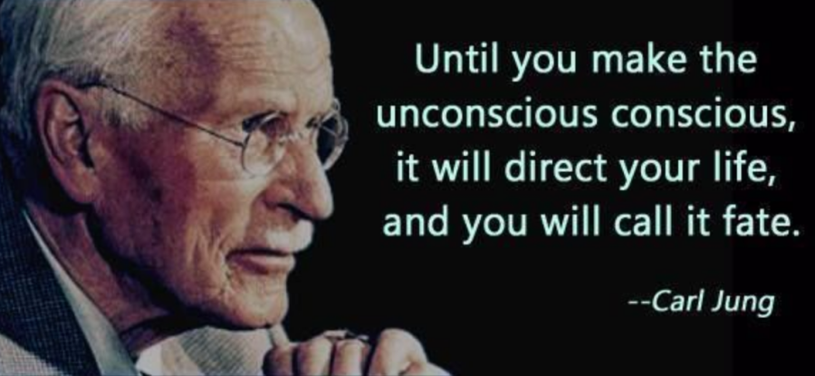
Shadow Work
There is no coming to consciousness without pain. People will do anything, no matter how absurd, in order to avoid facing their own Soul. One does not become enlightened by imagining figures of light, but by making the darkness conscious.”
- Carl Jung, Swiss psychiatrist

Slide 9
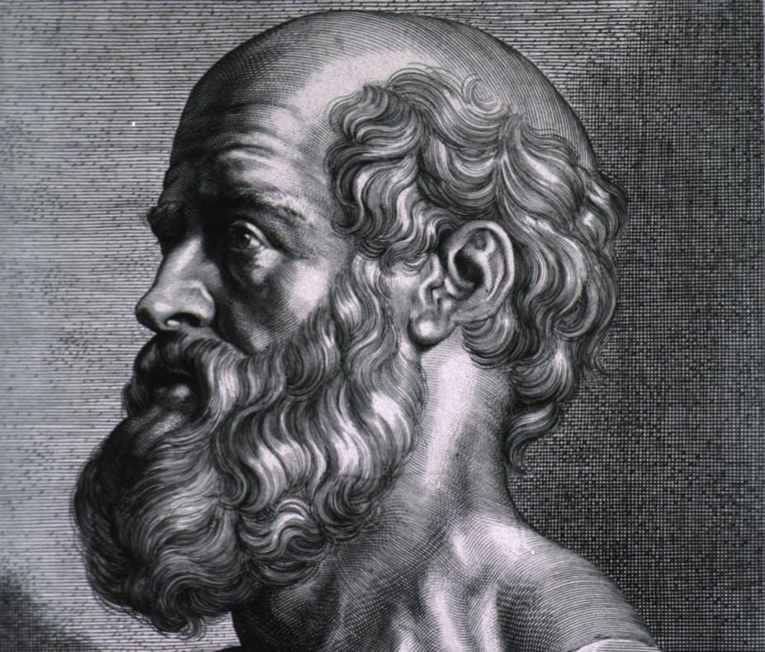
Nutrition
“Let food be thy medicine, and let medicine be thy food.”
~Hippocrates

Slide 10
The Microbiome
The human microbiome: Not much is known yet through science
According to the National Institute of Health, we carry about 10 times more bacteria than human cells in our bodies which translates to 2-6 pounds of bacteria.
We have a virome with even more viruses than bacteria
The NIH Human Microbiome Project started in 2008. 300 healthy individuals, across several different sites on the human body: nasal passages, oral cavity, skin, gastrointestinal tract, and urogenital tract
NIH is finding that if we can change the microbiome we can harness its healing powers

Slide 11
Gluten
Gluten means glue; it gives the gooey texture in bread
Gluten is in wheat, barley, and rye
Leaky gut occurs when there’s an assault from the Standard America Diet (SAD)
The purpose of the blood–brain barrier is to protect against circulating toxins or pathogens that could cause brain infections, while at the same time allowing vital nutrients to reach the brain
It doesn’t have to be Celiac’s disease. Other’s ways gluten can harm the system:
-Brain fog
-Neurological disorders (dementia, Alzheimer's, schizophrenia, etc.)
-Anxiety/depression
-ADD
-Autism
Glyphosate/ Round Up TM

Slide 12
Gluten Psychosis Case Study
14-year-old normal girl
2012: irritability, headache, sleep problems, behavior altered, crying spells, apathy, halitosis, hallucinations
Admitted to neuropsychiatric outpatient clinic and put on benzodiazepine treatment
Symptoms worsened with complex hallucinations and admitted to a psychiatric ward
A myriad of tests came back normal except an EEG showed mild nonspecific abnormalities and slow-wave activity. A diagnosis of autoimmune encephalitis and steroid treatment initiated with slight improvement
In September 2012, shortly after eating pasta, she presented crying spells, relevant confusion, ataxia, severe anxiety and paranoid delirium…referred to the psychiatric unit
A double-blind challenge test was performed with wheat flour and rice flour (one pill containing 4 g of wheat flour or rice flour for the first day, following two pills in the second day and 4 pills from the third day to 15 days, with seven days of wash-out between the two challenges). During the administration of rice flour, symptoms were absent. During the second day of wheat flour intake, the girl presented headache, halitosis, abdominal distension, mood disorders, fatigue, and poor concentration, and three episodes of severe hallucinations

Slide 13
Dairy
Dairy contains hormones, can cause an autoimmune response, can disrupt insulin levels, increase inflammation, and can cause excess mucous
Dairy proteins can easily cross the blood brain barrier
Humans are the only mammals who consume milk after infancy
Dairy Alternatives: Almond Milk, Cashew Milk, Oat Milk, Rice Milk. There are cheese replacements and sour cream replacements in the health food store
Be mindful of too much soy
Use raw milk and butter

Slide 14
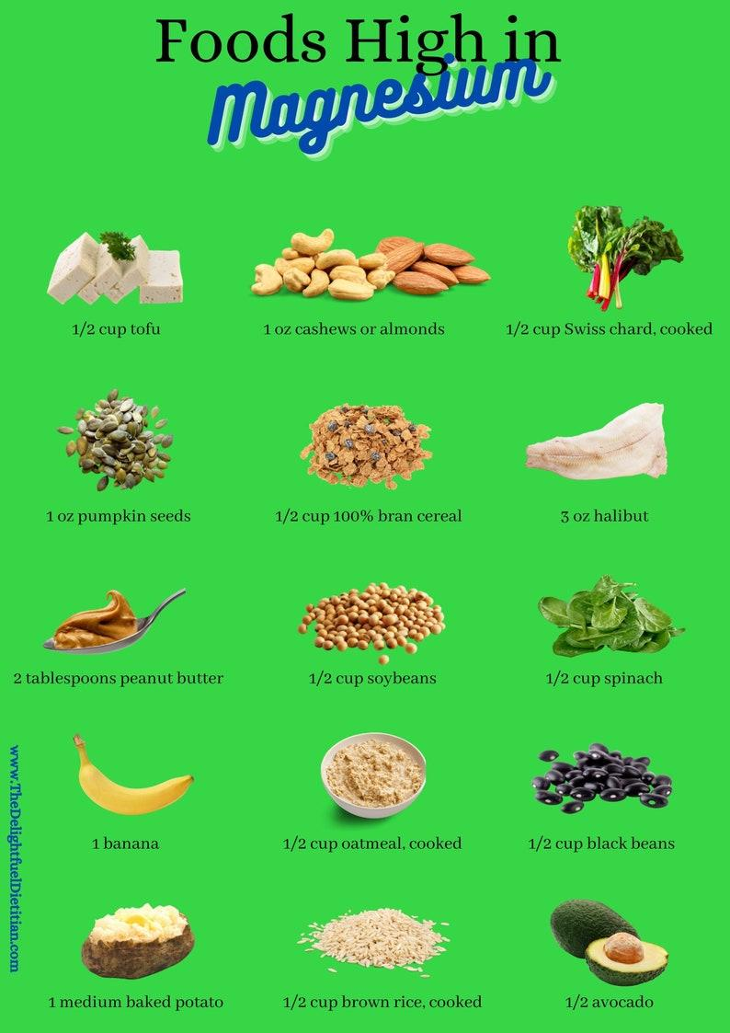
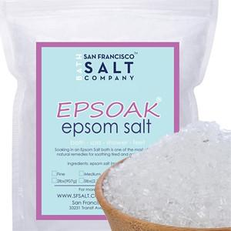
Magnesium
Magnesium is far more than an essential mineral, it is also a major electrolyte in the body
70 percent of Americans are Magnesium deficient
-Promotes heart health
-Improves sleep
-Digestive wellness
-Relaxes muscles and reduces pain
-Promotes bone health
-Prevents PMS
-Helps with migraines
-Prevents restless legs
-Prevents fatigue
-Promotes mental health

Slide 15
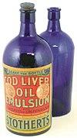
Vitamin D
Vitamin D is a fat-soluble vitamin that is naturally present in very few foods, added to others, and available as a dietary supplement.
Vitamin D can't be metabolized without sufficient magnesium levels, meaning Vitamin D remains stored and inactive for as many as 50 percent of Americans
Vitamin D promotes calcium absorption in the gut
Vitamin D has other roles in the body, including modulation of cell growth, neuromuscular and immune function, and reduction of inflammation
Vitamin D3 is actually a steroid hormone because it is only produced in the presence of ultraviolet light (American Heart Journal Vol. 239)
Cod liver oil is a great source of Vit A & D

Slide 16
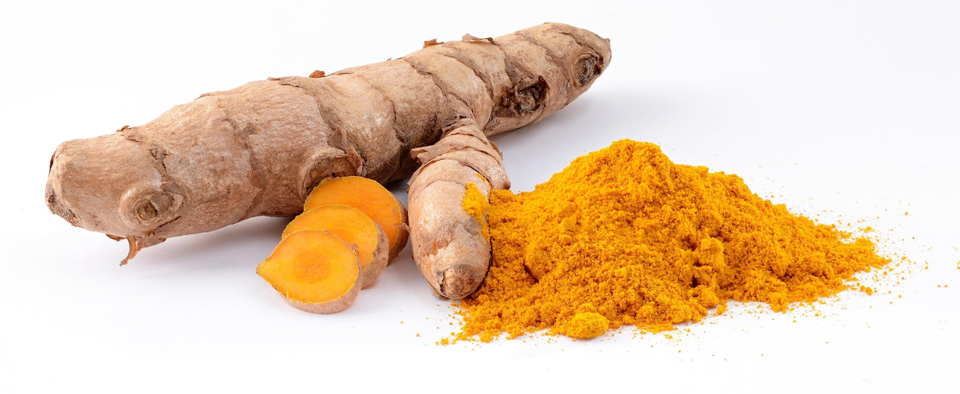
Adaptogenics
Adaptogens are herbal pharmaceuticals. They work to counteract the effects of stress in the body. Stress causes very real physical changes in the body, including harming the neurological, endocrine, and immune systems. Adaptogens have stimulant properties that help counteract those harmful effects
Turmeric is a a spice that comes from the curcuma longa plant. The turmeric root, or rhizome, grows underground and looks similar to ginger
Ashwagandha is a powerful antioxidant and is derived from India
Mushrooms like cordyceps and chaga
Drink in tea or take supplements
-Fights inflammation
-May Prevent & Treat Alzheimer's Disease
-Cancer fighting properties
-Helps with arthritis
-May reduce PMS & Depression symptoms

Slide 17
The Healing Crisis
We live in a toxic world filled with toxic thoughts, toxic emotions, toxic food, toxic water, and toxic air, it’s wise to remember healing crises are part of the healing path
This means there will be some uncomfortably and what may seem like sickness is in actuality toxins leaving the body. Remember the body wants balance and it has an intelligent system that is always trying to get back to homeostasis if we let it
The story your ego and pain-body will tell you is you’re doing something wrong or you’re not doing enough of something. This is where meditation can help with the observer role. You will better be able to witness the story your ego and pain-body are telling you rather than being an active participant. This is not to say you will not be taken over at times; it just means there is awareness behind the detoxification process
When you are going through a healing crisis, try to let go and trust the process and remember you’ve acquired not only your trauma in this life, but trauma from past lives which includes intergenerational trauma

Slide 18
The 5-Point Protocol (Acudetox) Services
Developed in the 1970’s at Lincoln Hospital in Bronx, New York to help support people in a drug and alcohol treatment setting. It provided another option along with or in place of Medication-Assisted Therapy (MAT)
The Young Lords & Black Panthers advocated for its use
The 5-Point Protocol is a form of acupuncture in the ear. Acudetox is scientifically proven to reduce cravings, minimize withdrawal symptoms, increase calmness, relieve stress and emotional trauma, and encourages inner quiet and strength
Taught by a trained specialist from the National Acupuncture Detoxification Association (NADA) or the People’s Organization for Community Acupuncture (POCA)

Slide 19
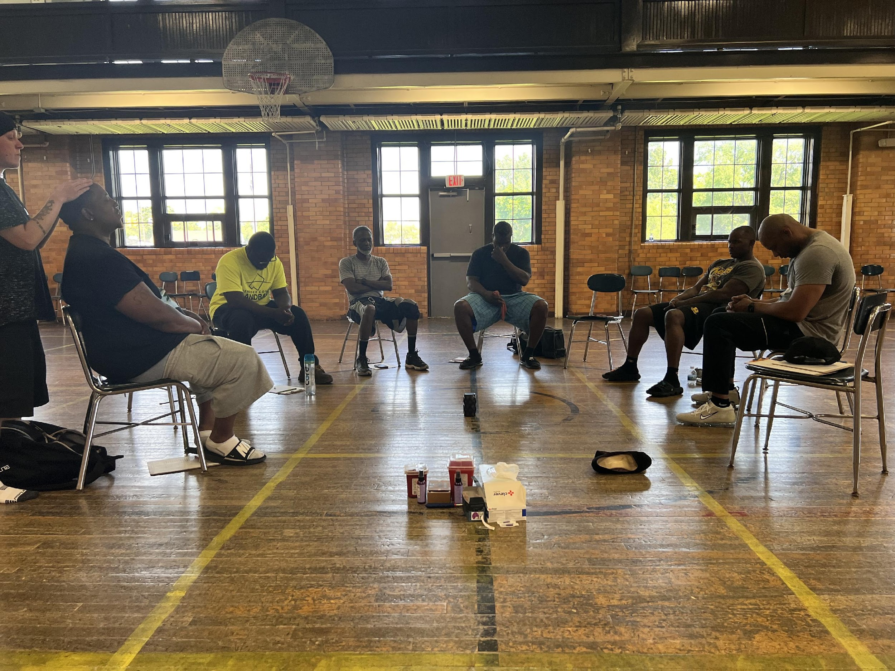
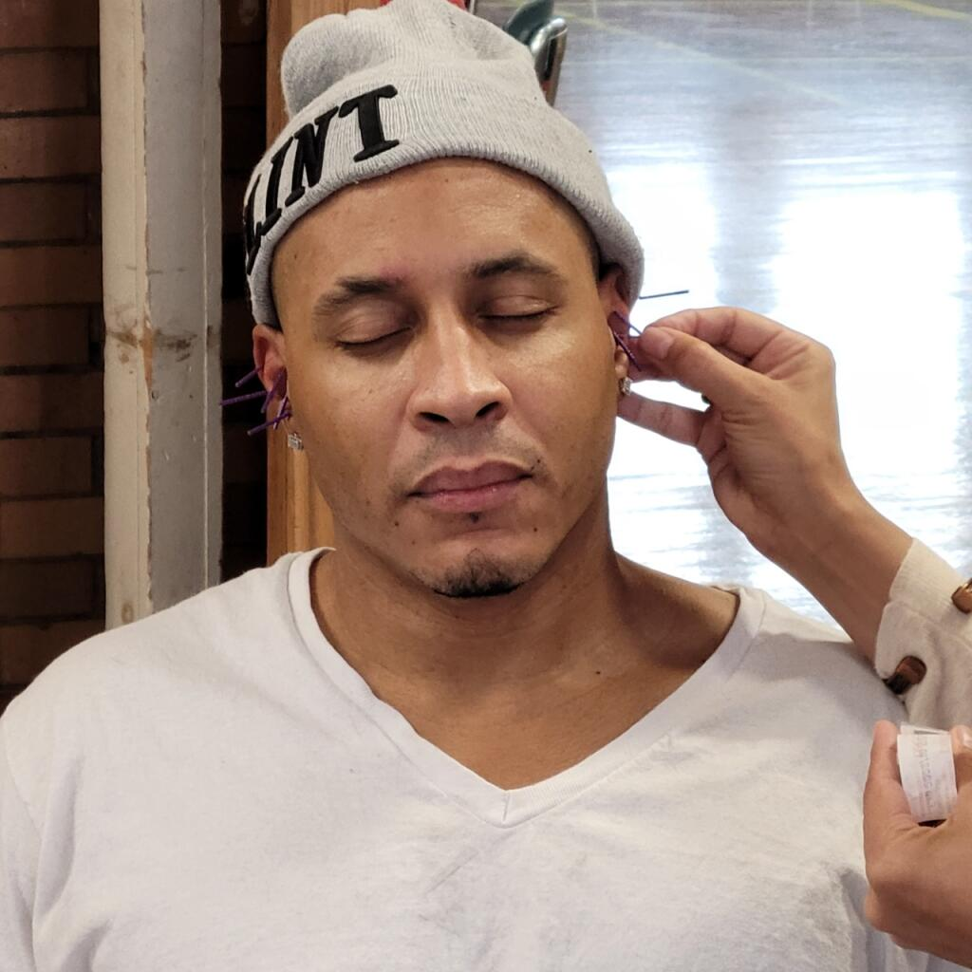
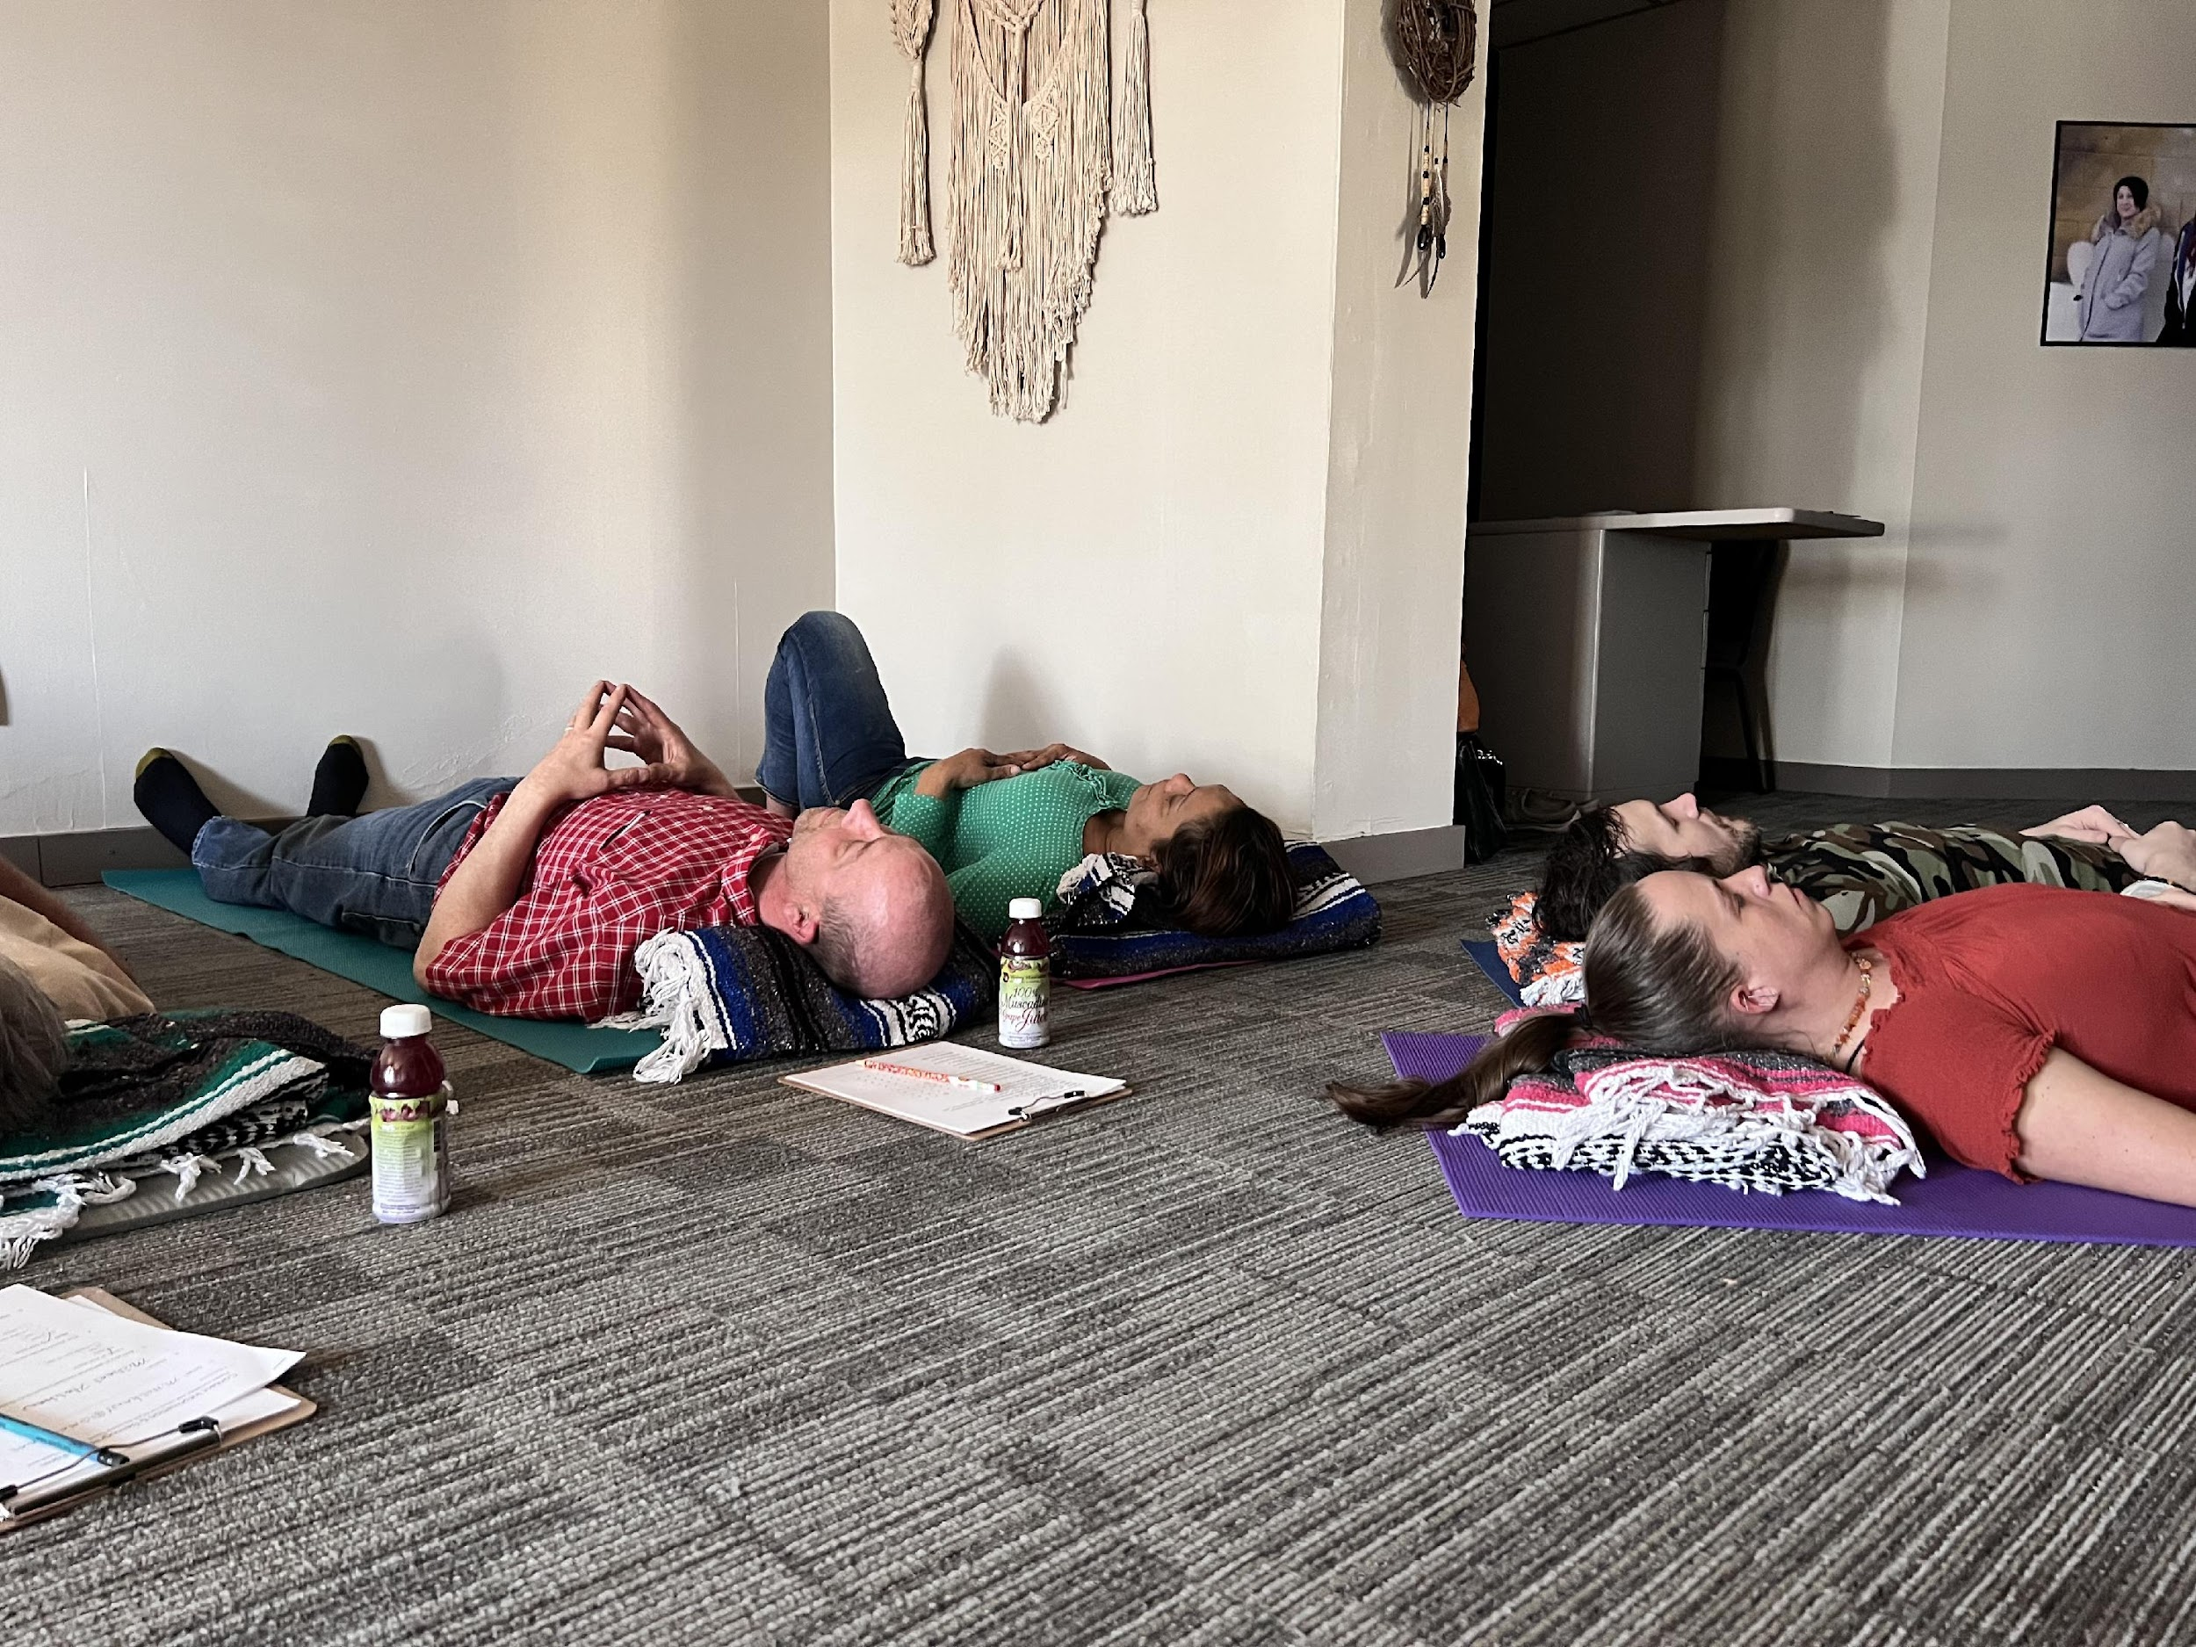

Slide 20
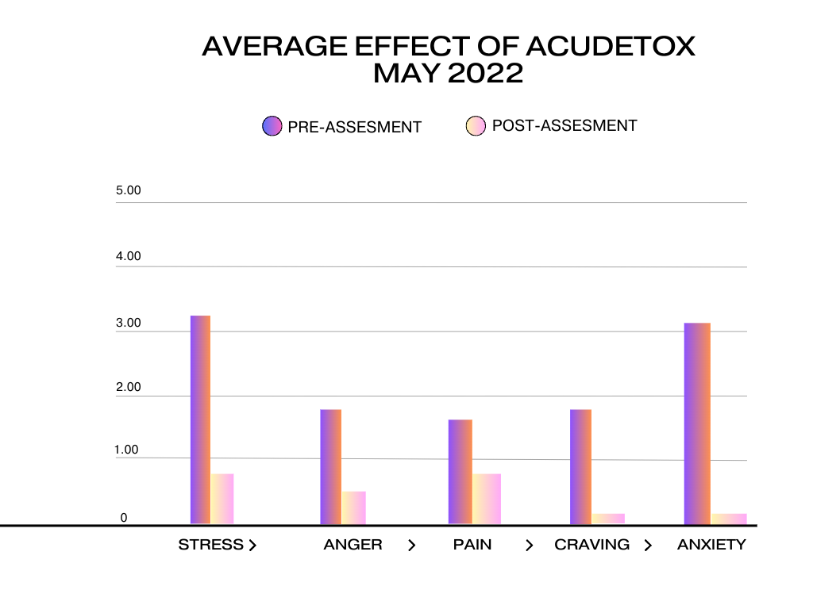

Slide 21
Recovery Reiki ®
Usui Reiki is a form of touch therapy that gets the body to relax so that it can begin the process of healing
Reiki used in over 800 American Hospitals which include Henry Ford , Beaumont Hospital and US Army for their Combat Warrior Stress Reset Program
Recovery Reiki ® is a way to deliver reiki to specifically heal addiction, codependency and trauma though not only energy medicine but through gut health, meditation practices, inner child work and more
During our groups a trained Recovery Reiki® Practitioner provides a safe space for a group of people to heal from the trauma and pain associated with addiction and codependency
Recovery Reiki® level I, II & III trainings occur quarterly at our location
Serenity House has trained 70 Reiki I practitioners, 35 Reiki II practitioners, and 11 Reiki Master teachers and 61 Recovery Reiki® Level I practitioners, 18 Level II and 2 level III practitioners
Recovery Reiki Manual: Self-healing & Emotional Mastery, Barnes & Noble& Amazon (Trademarked program)
Funded by the Community Foundation of Greater Flint

Slide 22
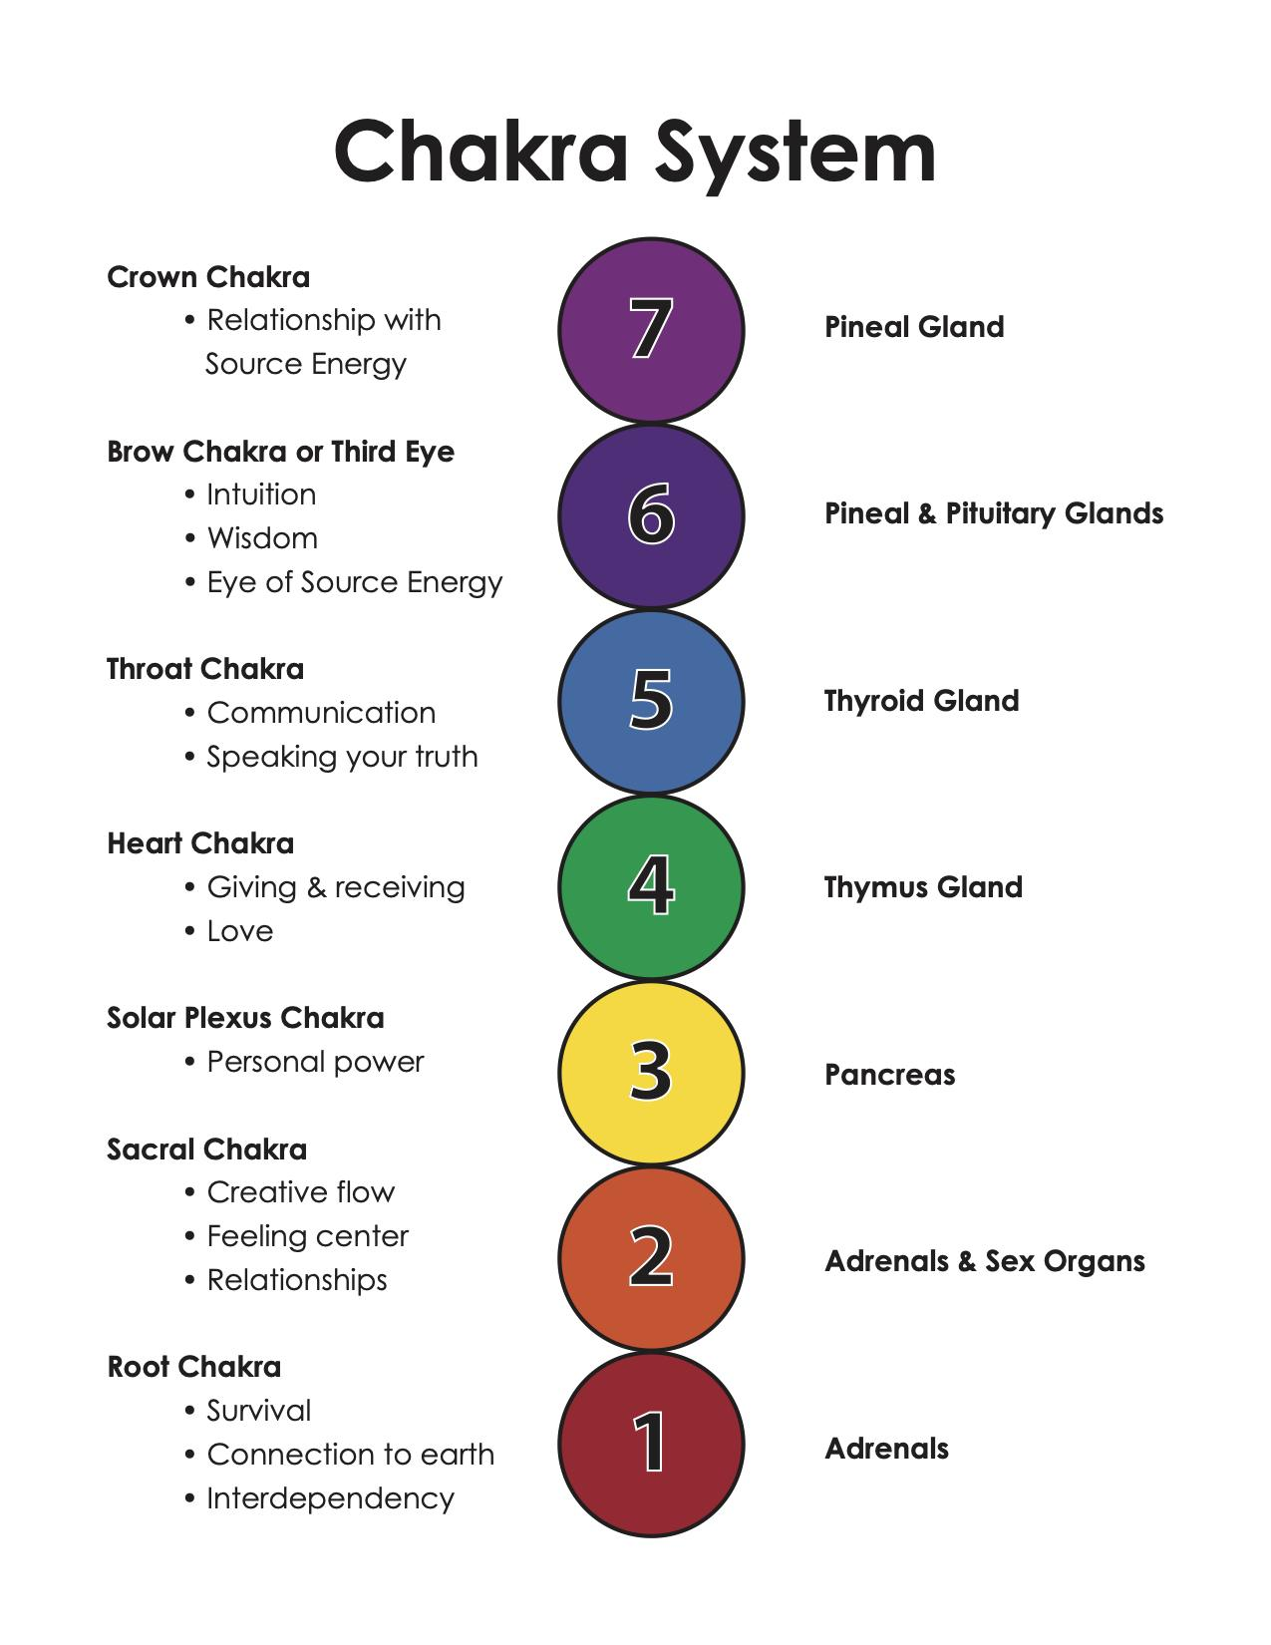
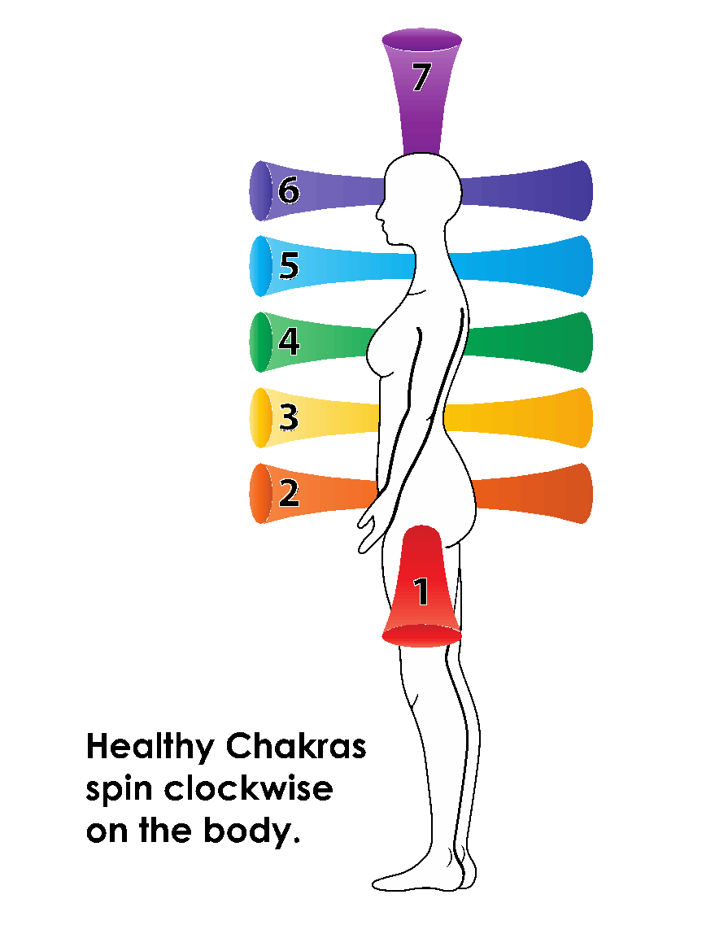

Slide 23
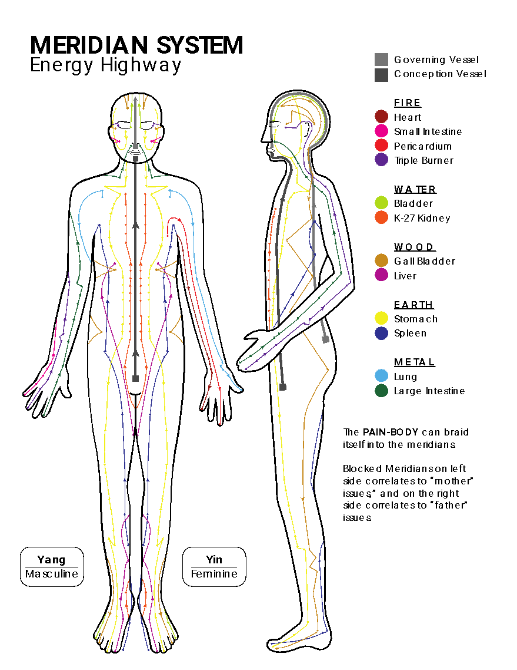

Slide 24
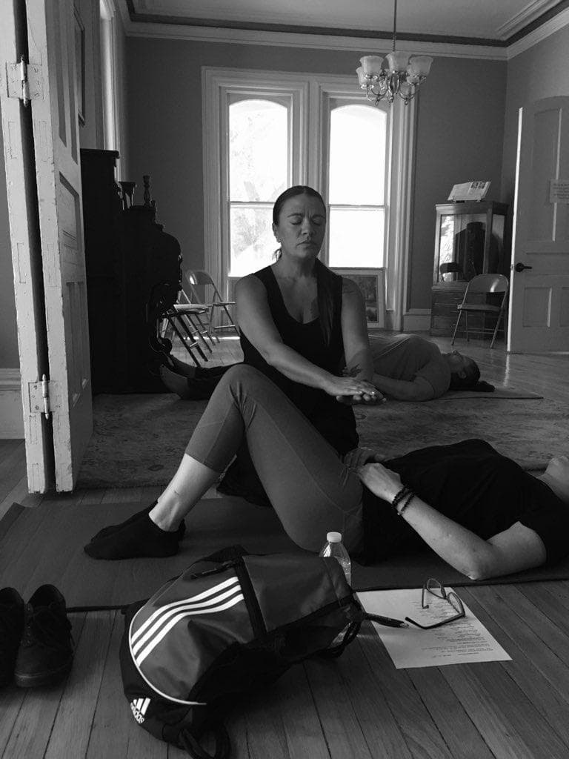

Slide 25
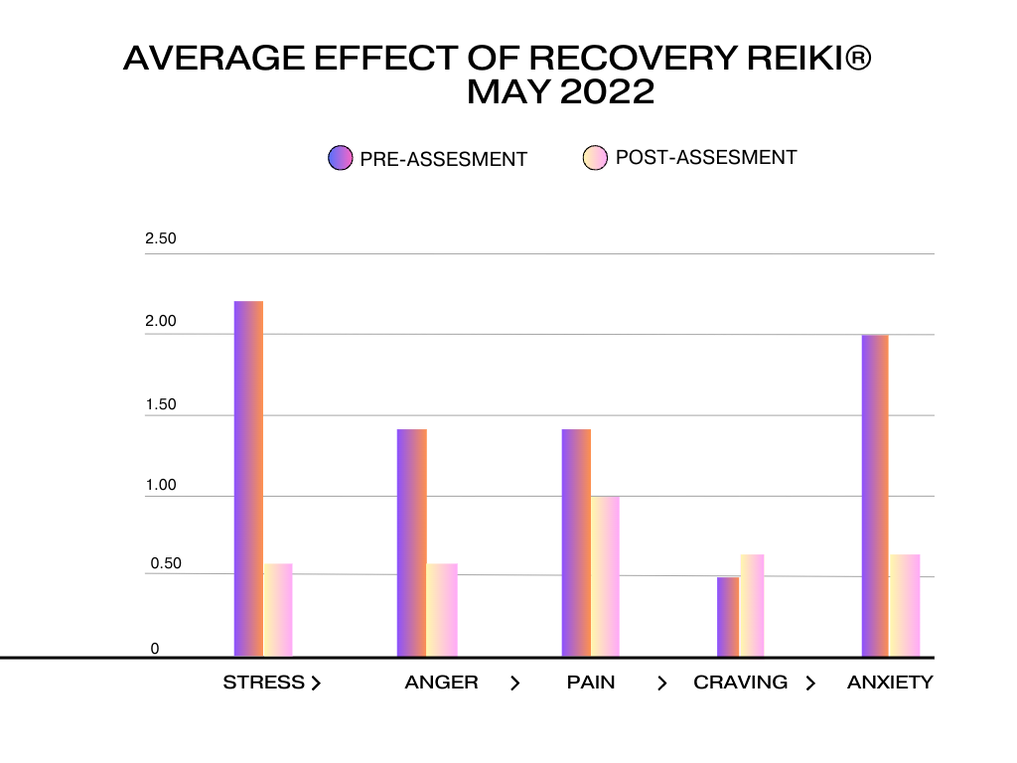

Slide 26
Emotional Freedom Technique
EFT is a mind-body tool based on acupressure and psychology. When we’re stressed, our thinking brain isn’t active as the strong emotions take hold of us
EFT helps in returning the body to a state of calm which further helps in gaining clarity in a stressful situation. It helps in reducing stress, anxiety, pain and in transforming our beliefs
By stimulating the meridians on the body along with statements about what you are going through, you activate your body’s rest and digest system, the parasympathetic nervous system
EFT utilizes acupressure points and other psycho-therapeutic techniques to give you freedom from painful memories, cravings, physical issues and helps in trauma recovery

Slide 27
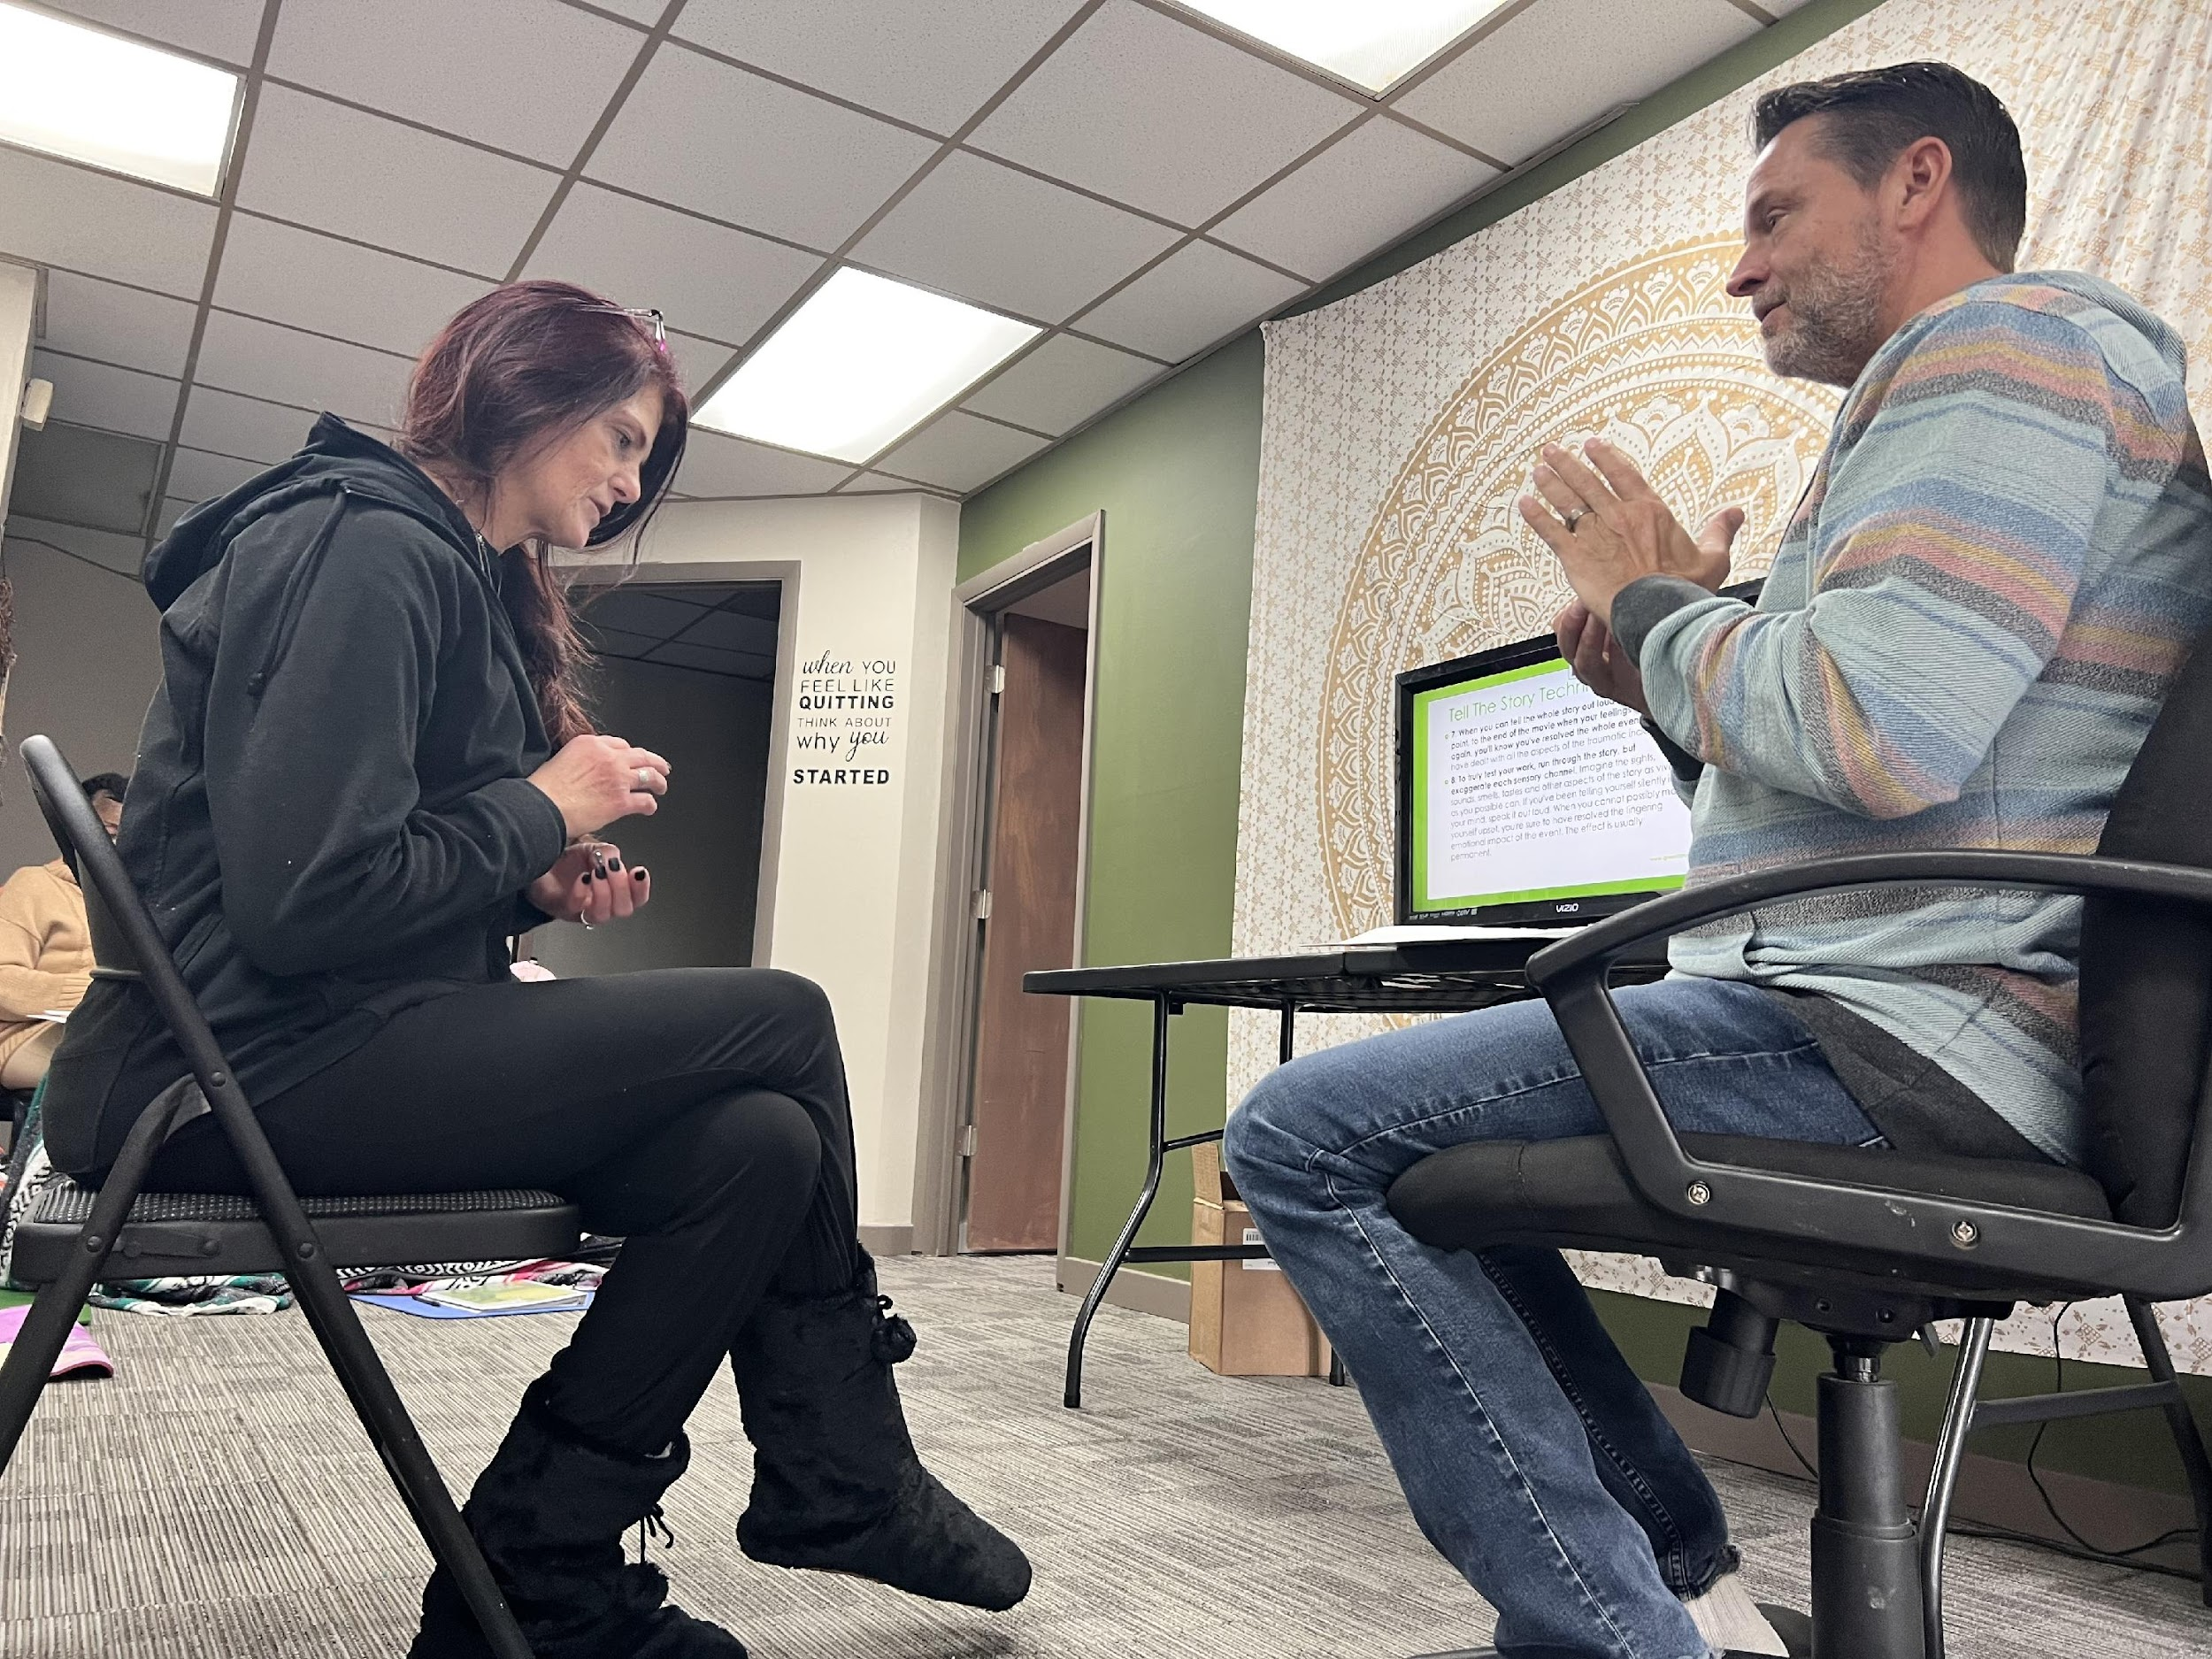

Slide 28
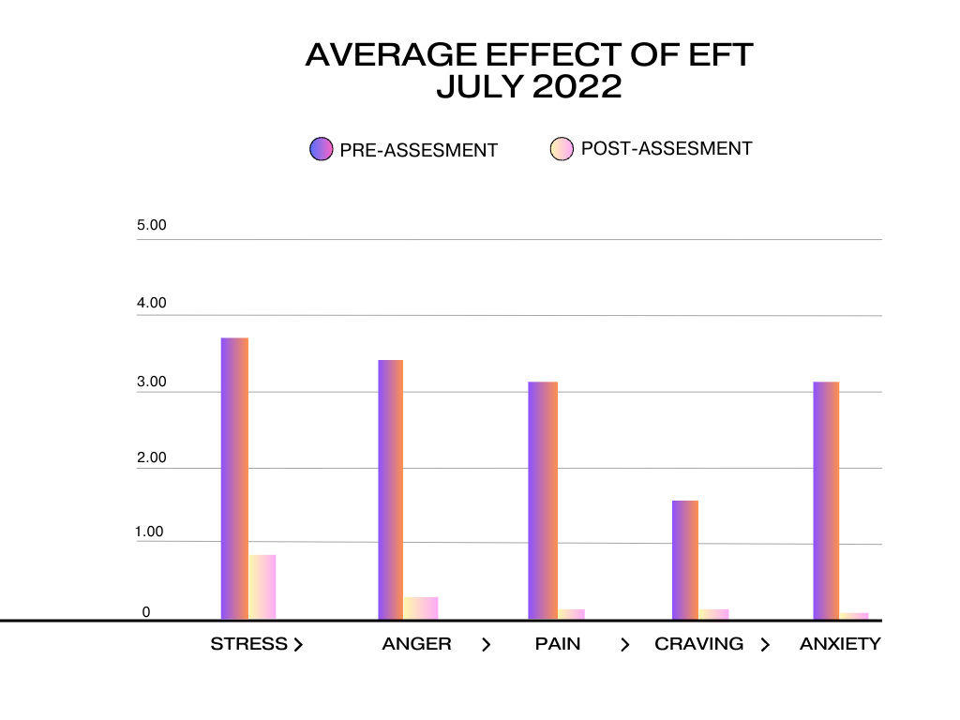

Slide 29
Holistic Peer Recovery Coaching
We meet people where they are at in their recovery journey
We help change the narrative surrounding substance use disorder i.e not using the terminology ‘addict” but person with SUD
Multiple pathways is at the heart of recovery coaching, we refer out to AA, NA and other support groups available
We specialize in the holistic recovery support services
We offer the 5np & EFT during each individual session with participants along with awareness events throughout the year
We offer four weekly Acudetox, EFT & Recovery Reiki® groups and a closed holistic healing group for drug and sobriety court

Slide 30
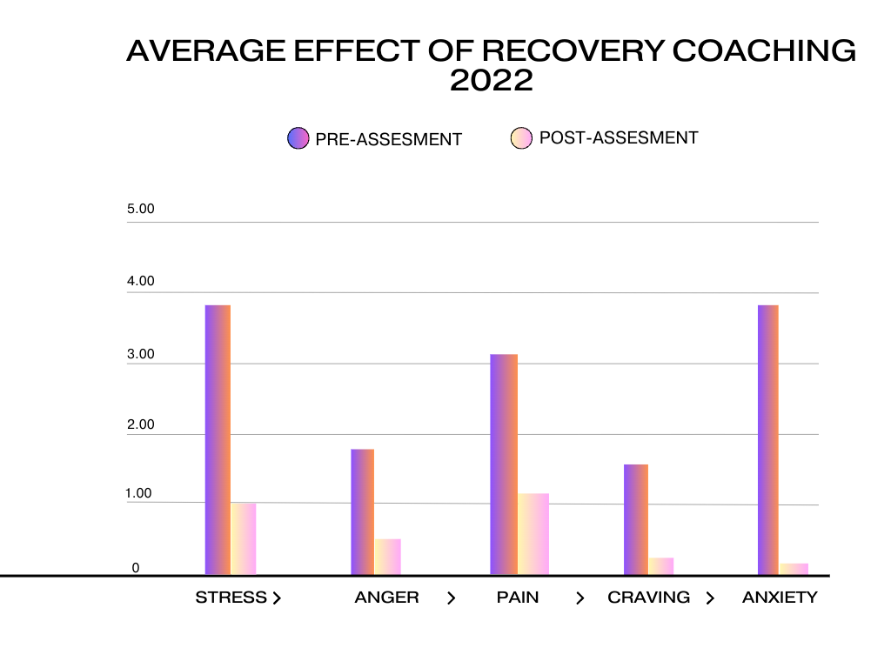

Slide 31
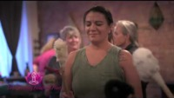
SHC in Motion

Slide 32
Integrating Holistic Recovery Into Your Center
Start of slowly
Implement self-care into the workplace with self-care plans
Find reliable and trustworthy healers to support your program
Consider investing in holistic trainings to enhance your recovery and that of your participants
Specifically track short term and long term outcomes of using holistic practices

Slide 33
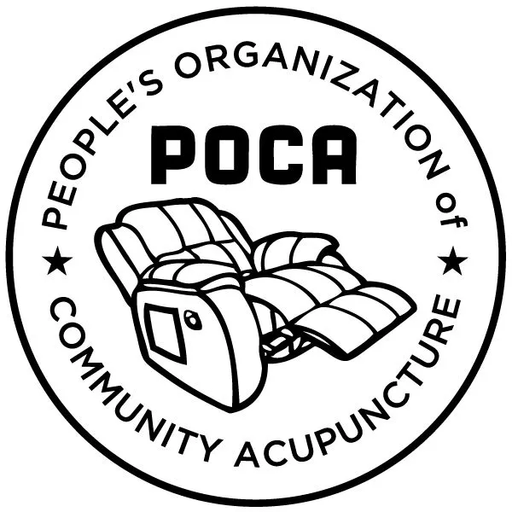
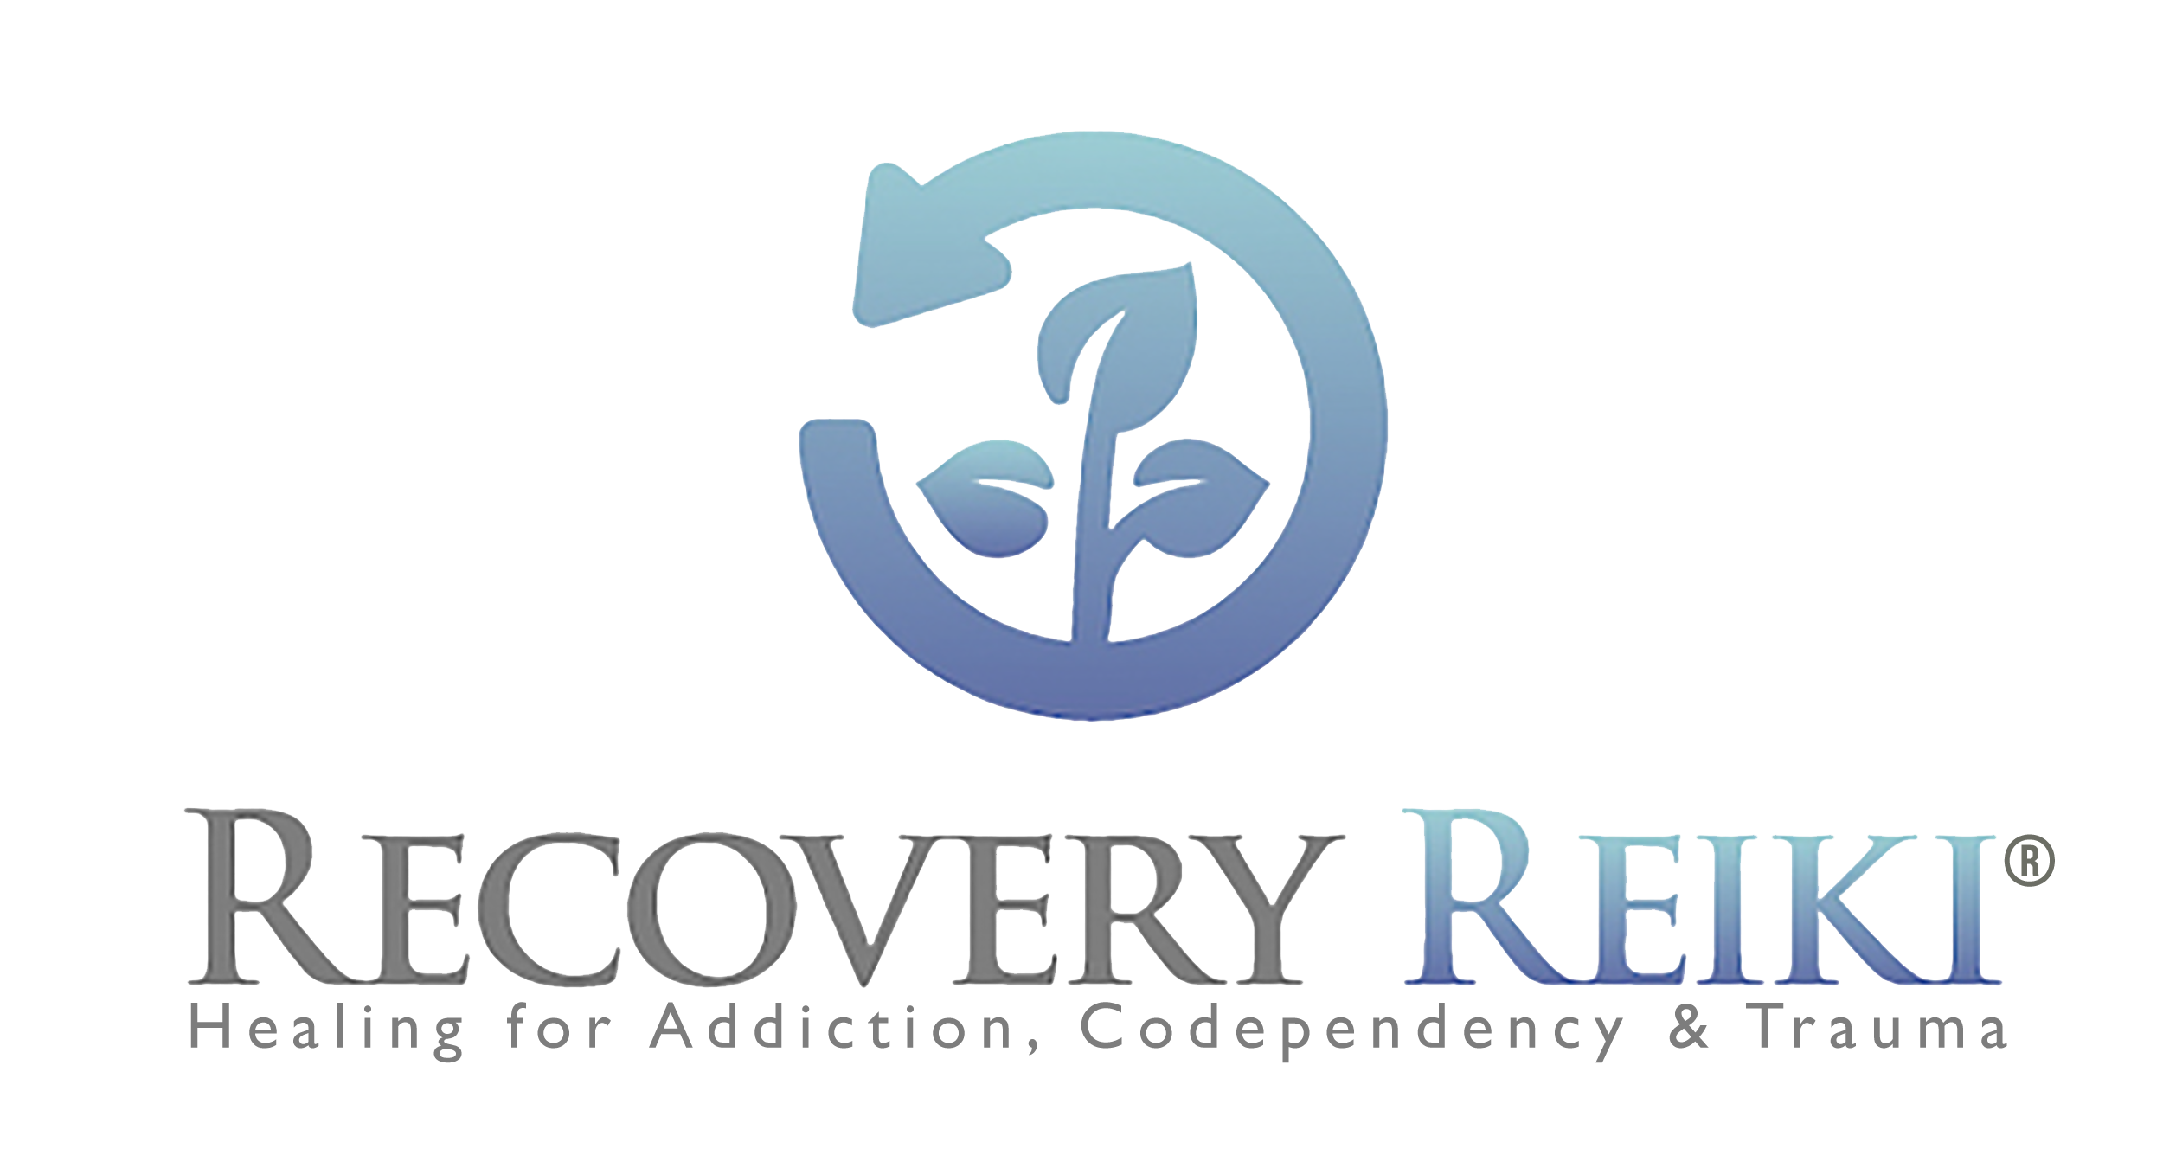

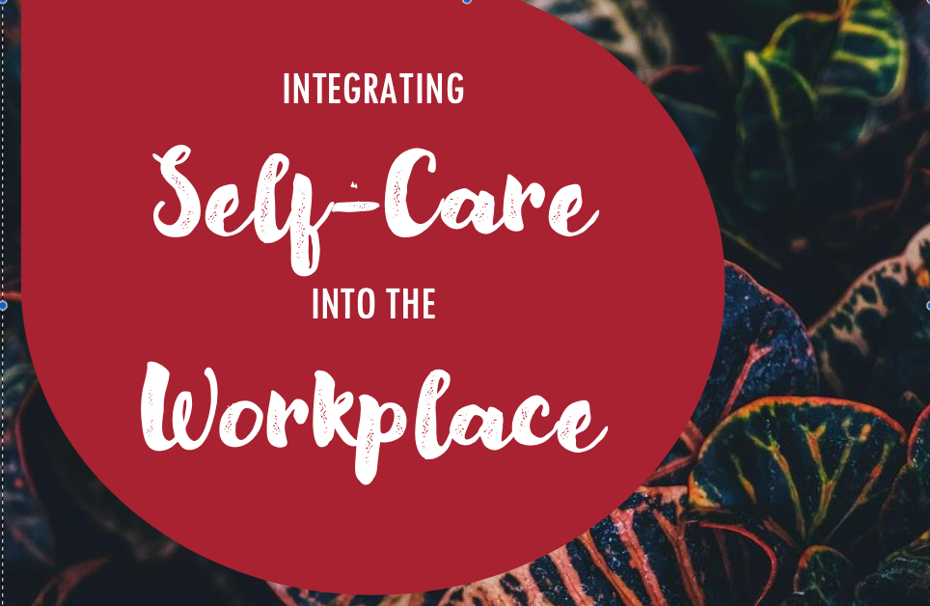
Trainings
Integrating Self-Care into the Workplace Trainings
Recovery Reiki® Trainings, Level I, II & III
Emotional Freedom Technique Trainings
5-Point Protocol/ Acudetox POCA

Slide 34
Serenity House Communities
1198 Robert T Longway Blvd.
Flint, MI, 48503
www.flintserenityhouse.org
FOLLOW US ON SOCIAL MEDIA!
www.facebook.com/flintserenityhouse
www.instagram.com/flintserenityhouse
www.twitter.com/flintserenity01
We’re on Youtube at Serenity House Communities

Slide 35
