Slide 1
WELCOME
Advocacy & Outreach

Slide 2
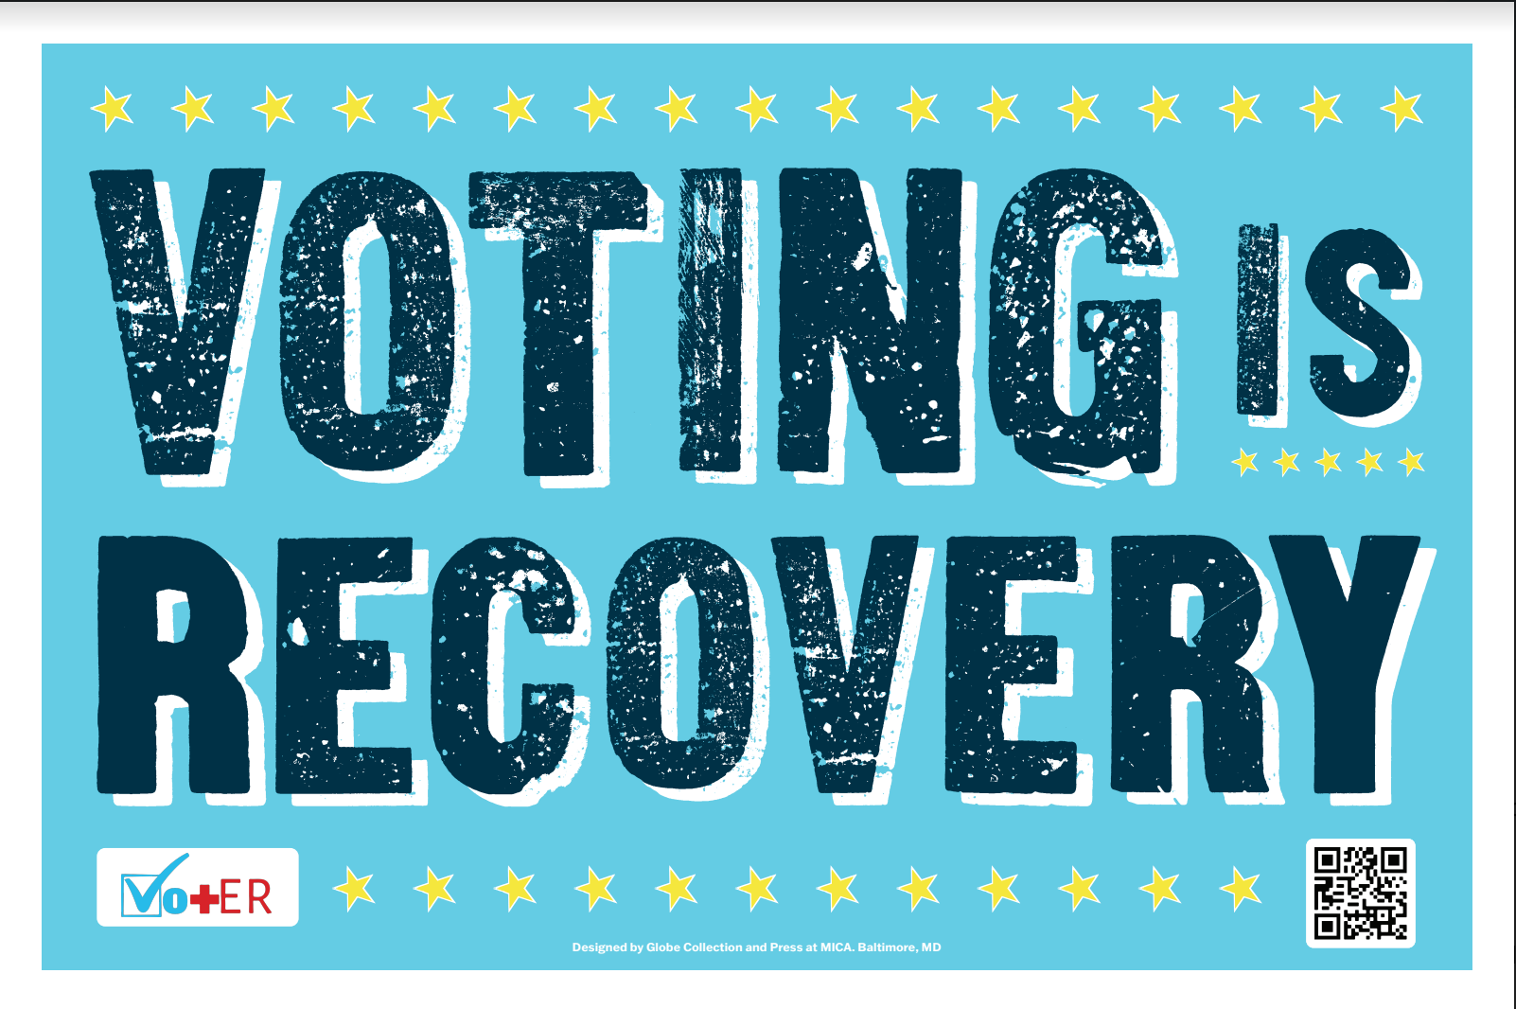

Slide 3







Optional for healthcare providers and patients alike to use
Leigh
Chelsea
June 2023
www.vot-er.org
@vot_er_org

Slide 4

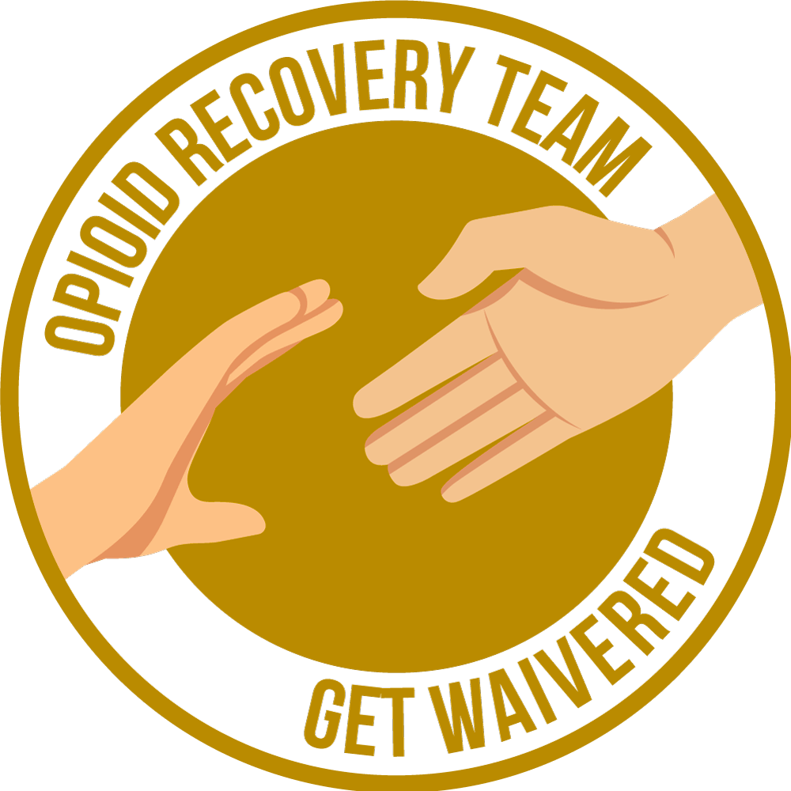




Proudly in partnership with over 500 hospitals, clinics, healthcare associations, and organizations
Notes:
Vot-ER is a 501(c)(3) nonprofit organization working to integrate civic engagement into healthcare. We partner with over 500 institutions to bring nonpartisan civic engagement tools and programs to every corner of the healthcare system. Since 2020, we’ve helped nearly 60,000 Americans register or prepare to vote.

Slide 5


Demographic Overlap
Unregistered eligible voters
Patients most marginalized by our current health system
young,
low-income,
patients of color
Notes:
Nearly ⅓ of all eligible voters did not cast a ballot in the 2020 election. When you look at the top three groups of people who disproportionately make up that ⅓ of voters, they’re people who are young, low-income, and people of color. When you consider the patients who come into our emergency rooms for low acuity complaints and the patients who are most marginalized by our current healthcare system, it’s these same three groups.

Slide 6
ARE YOU REGISTERED TO VOTE?
62% of unregistered voters have NEVER been asked
to register to vote.
Pew Voting Frequency Survey
Notes:
We know that most of them have never been asked to vote. So, what if these patients were asked to register to vote? How would this begin to transform their health care experience?

Slide 7
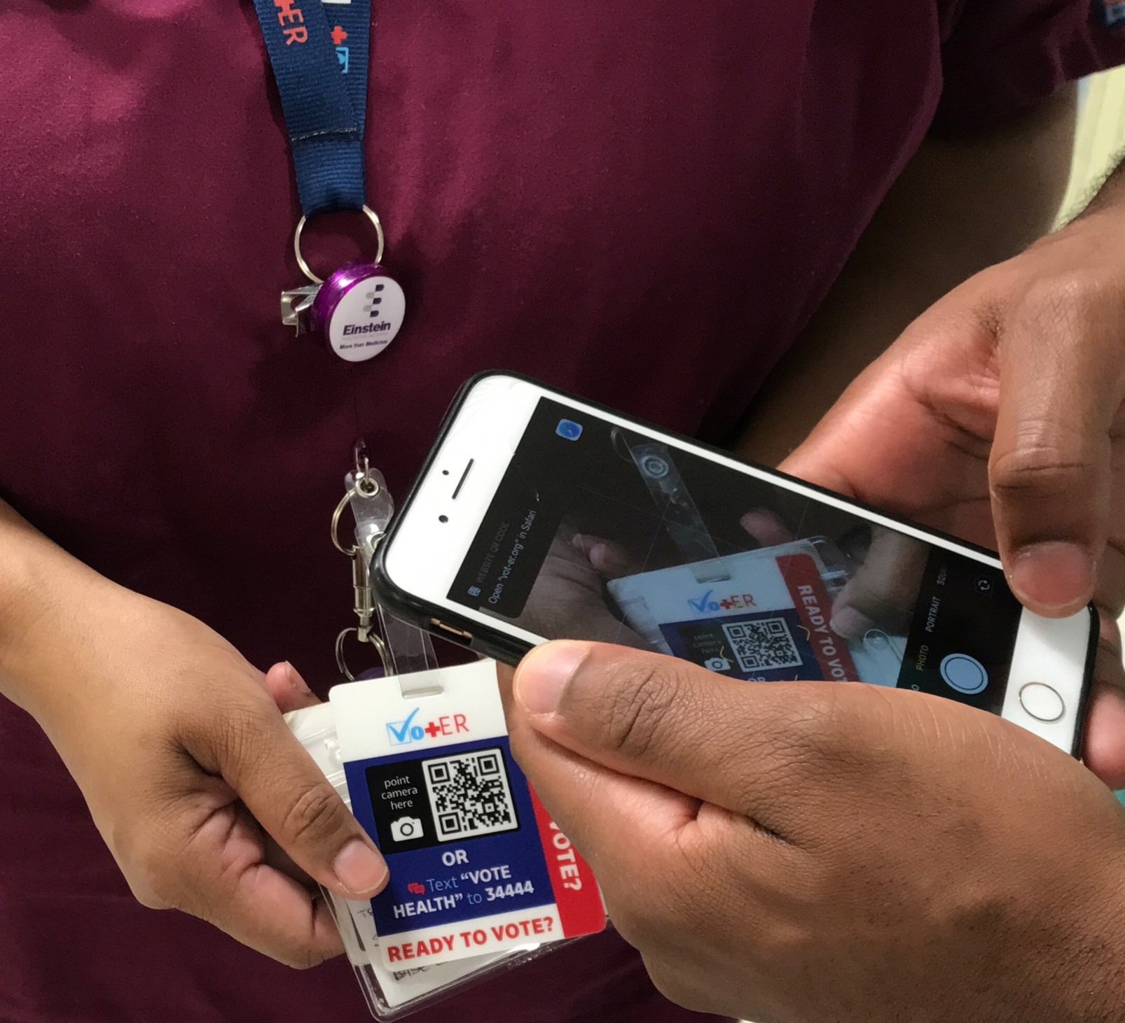
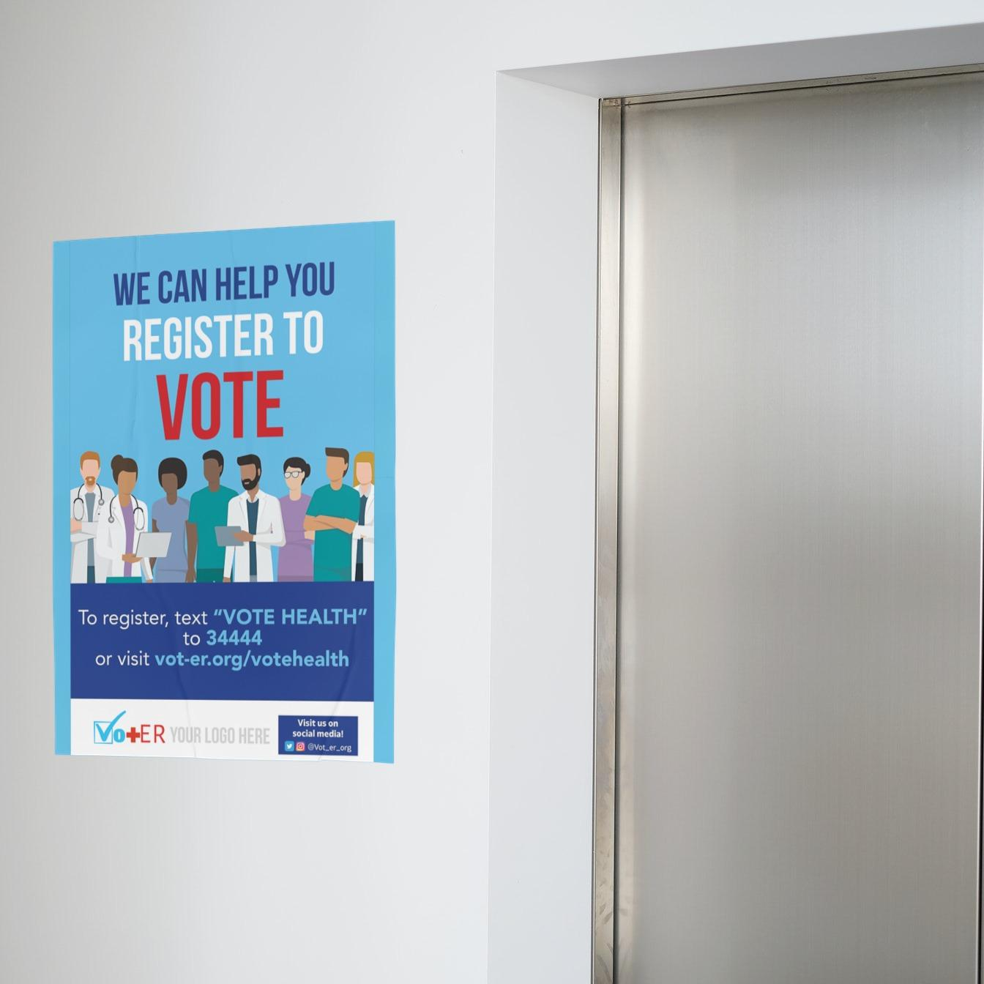
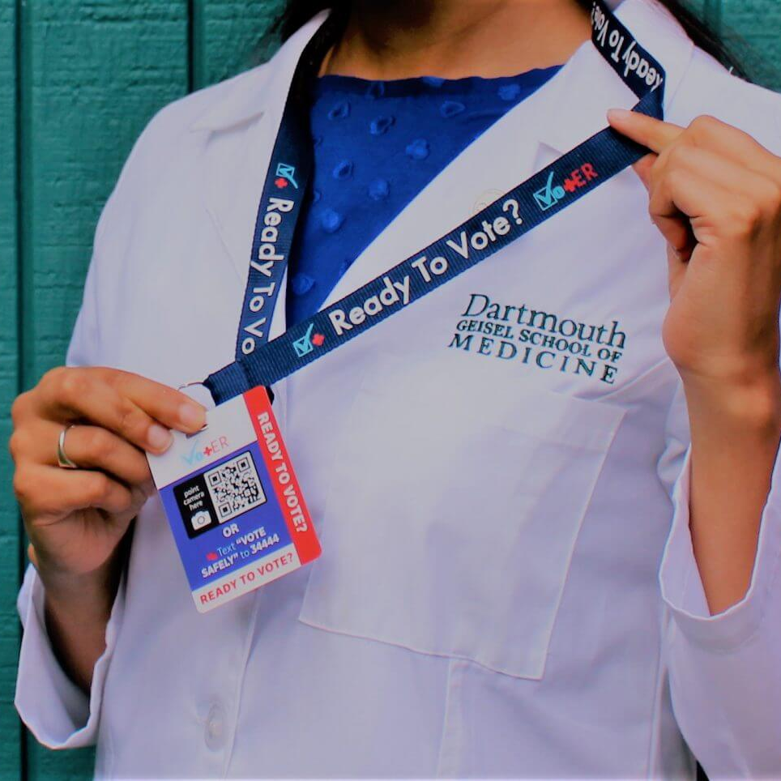
Vot-ER Tools & Programs
Vot-ER badges
Posters
Healthy Democracy Campaign
Notes:
This is where Vot-ER comes in. Vot-ER offers several tools to help make it easier for patients to participate in the democratic process.
First, Vot-ER offers badges which allow providers across all role groups and specialties to help their patients vote by mail, vote early in person, or find their election day polling place. Over 25,000 healthcare providers across the country are using these badges. It’s as simple as giving our patients the QR code or text message code and letting them scan it on their phone.
Vot-ER also offers posters to hang in waiting rooms. Over 500 hospitals and clinic sites are currently using these posters.
Vot-ER also puts together the Healthy Democracy Campaign, a national medical school competition to find out which medical school can register the most voters during National Civic Health Month each August that is being expanded to include interprofessional students in programs for nursing, social work, and more for the first time this year! Johns Hopkins

Slide 8
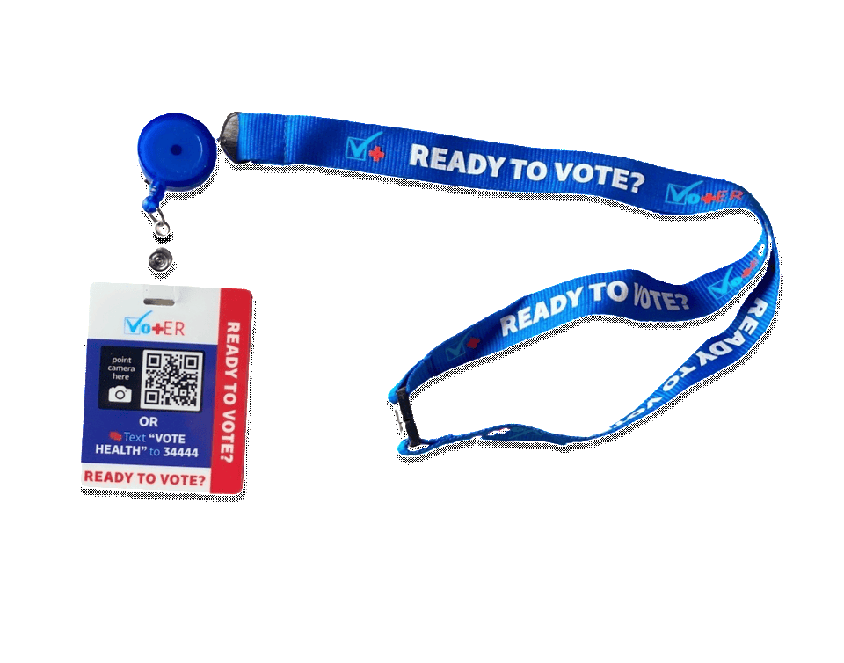


Vot-ER tools are
undisruptive
optional
nonpartisan

Slide 9
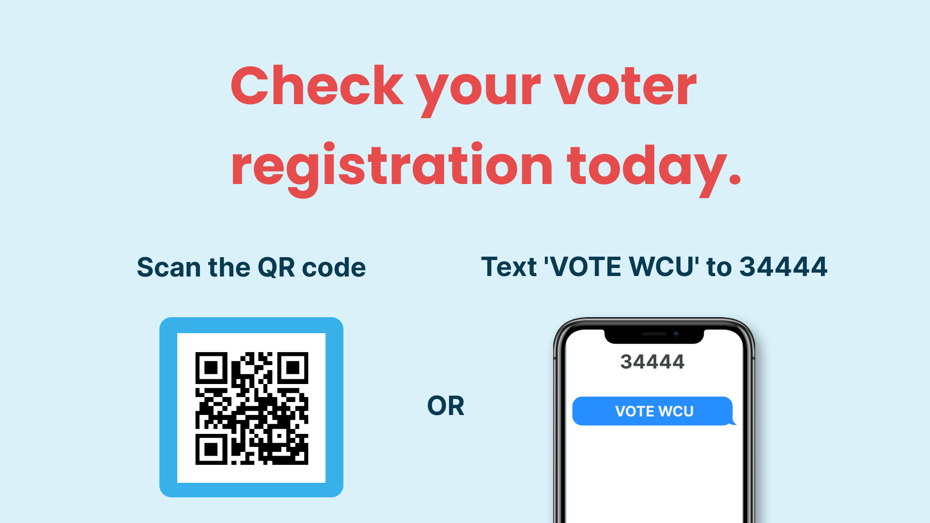
Text ‘VOTE RECOVERY’ TO 34444
VOTE RECOVERY
Notes:
CHELSEA
And speaking of 20,000 unregistered folks in Buncombe County, why don’t we go ahead and make sure that none of the people in this room are among those 20,000 – besides, there’s no better way to learn how the tools work than by trying it out yourself, so let’s give it a shot while we’re here together! On the screen you’ll see a QR code that is attached to WCU, as well as a short text code. You can use your phone to scan the QR or text the code – you can also visit vote.health/WCU in your browser window.
Let’s take the next 30 to 60 seconds together to scan, text, or type in that url.

Slide 10
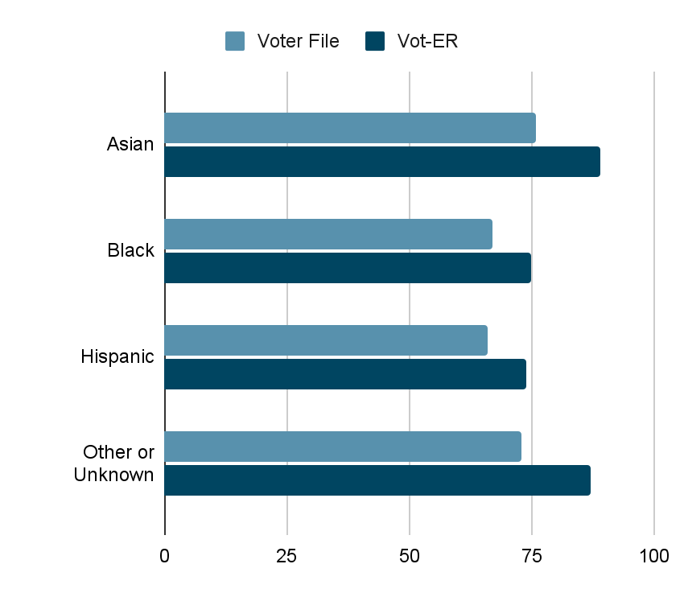
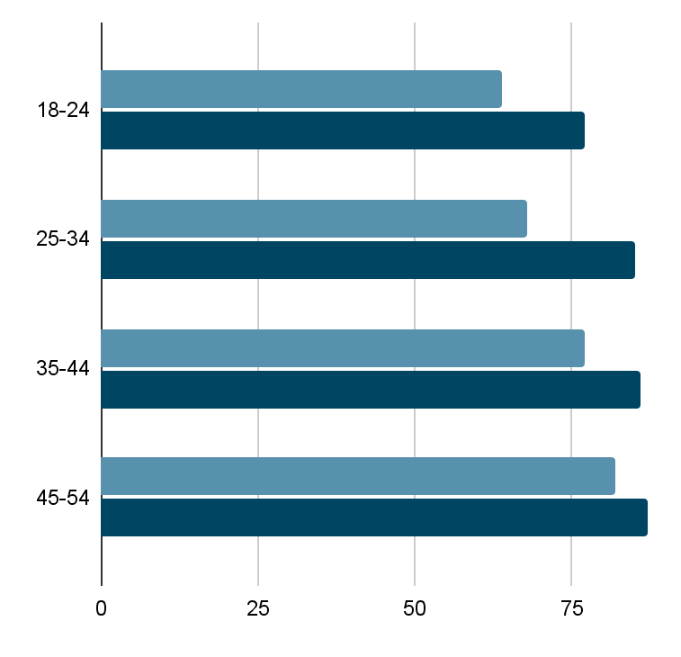
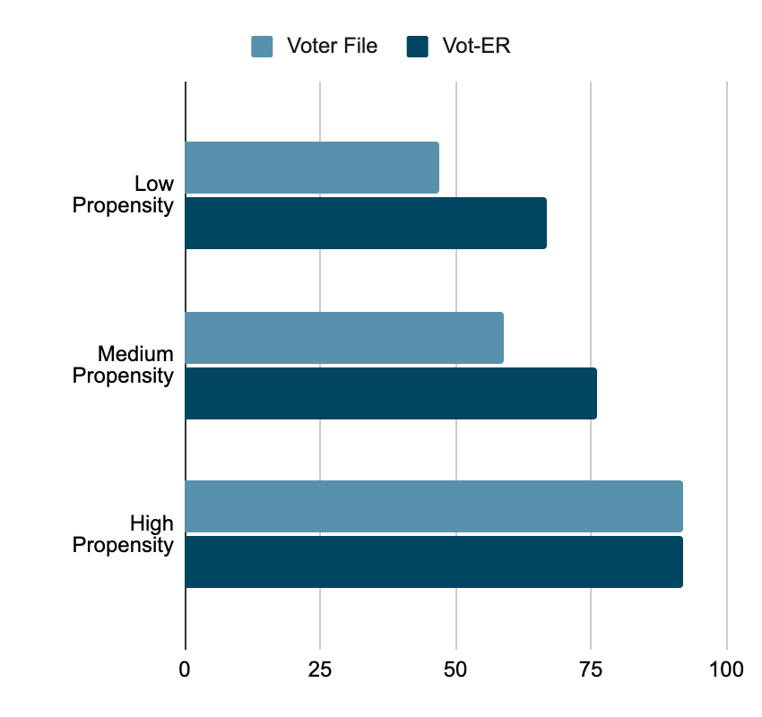
Healthcare based voter access WORKS
Vot-ER had higher turnout for people of color …
… the young …
… and high-opportunity voters.
Higher turnout by 20%
% turnout of registered voters in 2020
Source: 2020 TurboVote Voter File Match Report for Vot-ER, turnout by segment
Notes:
Thank you all for doing that. I want to share with you all the statistics that show how powerful that landing page can be.
We went into 2020 with a hunch that healthcare providers are generally trusted messengers. We know this isn’t universal – there are communities that have been mistreated by healthcare. But we had a hunch it would work, especially since our community of healthcare providers is a very diverse group.
Our early surveys from providers suggested they were reaching exactly the groups who generally don’t vote, and that they were having wonderful conversations about voting.
And then we got our data back. And it validated what we’d hoped to see. Not only did we touch more voters of color than are in the electorate, not only did we touch more young voters than are in the electorate, they ultimately voted at higher rates than their peers from the same background. And when you think how small of margins make a difference in most elections, these numbers make a difference.

Slide 11
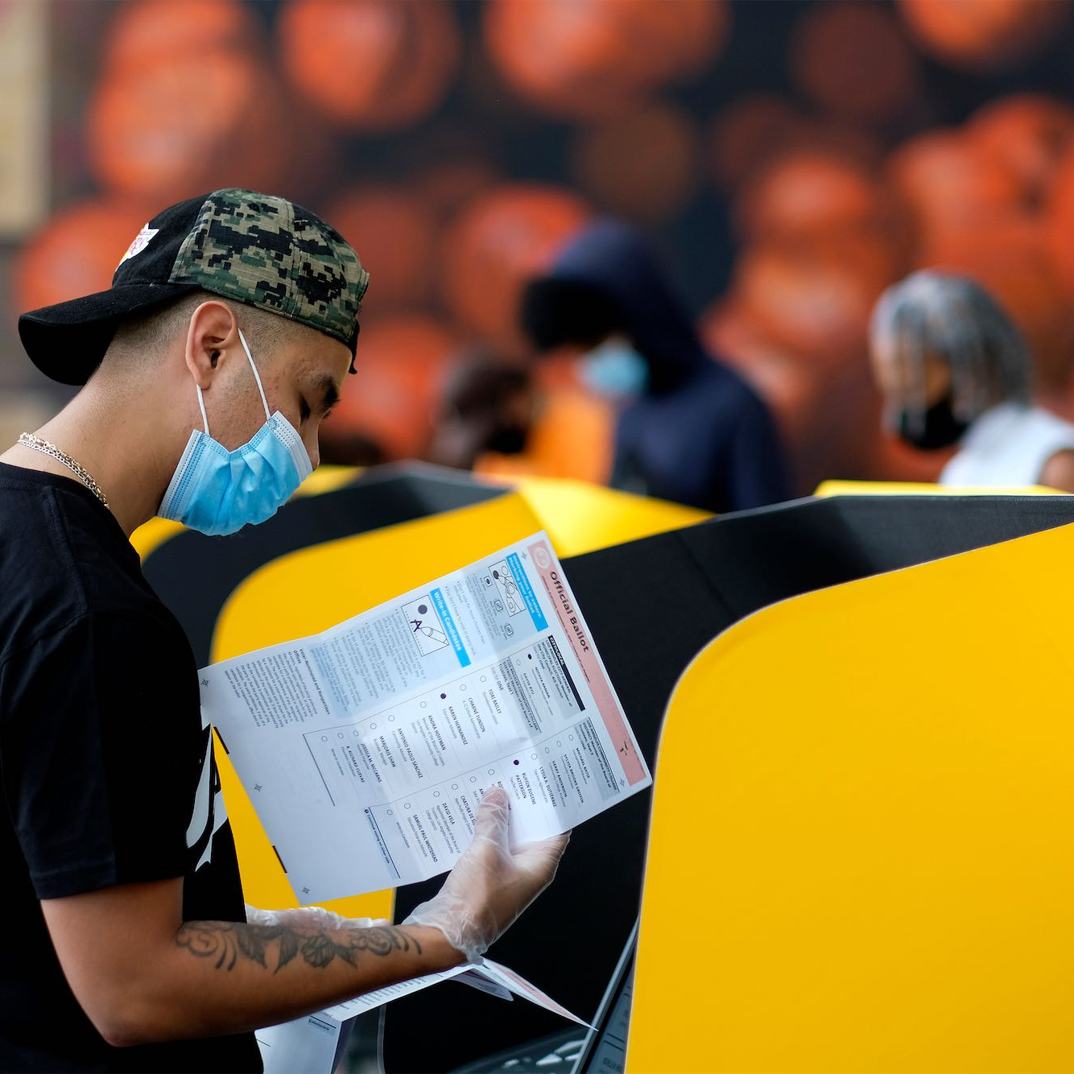
Voting & Recovery
Voter registration
is a
substance use disorder
treatment and prevention tool.

Slide 12
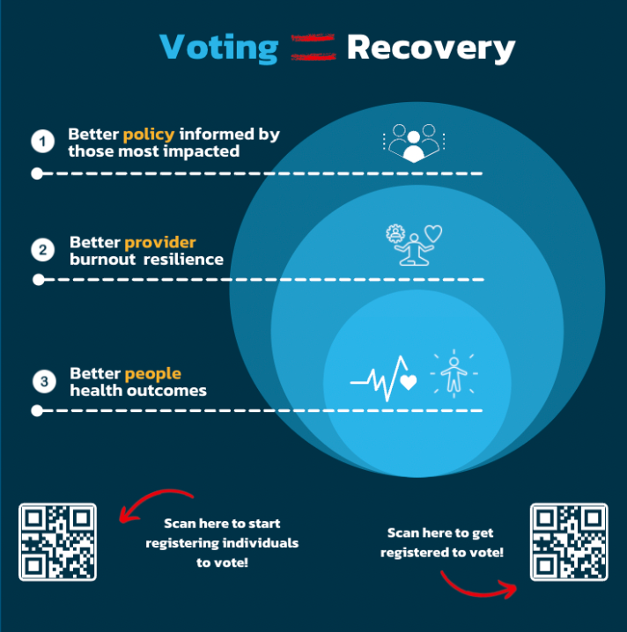

Slide 13
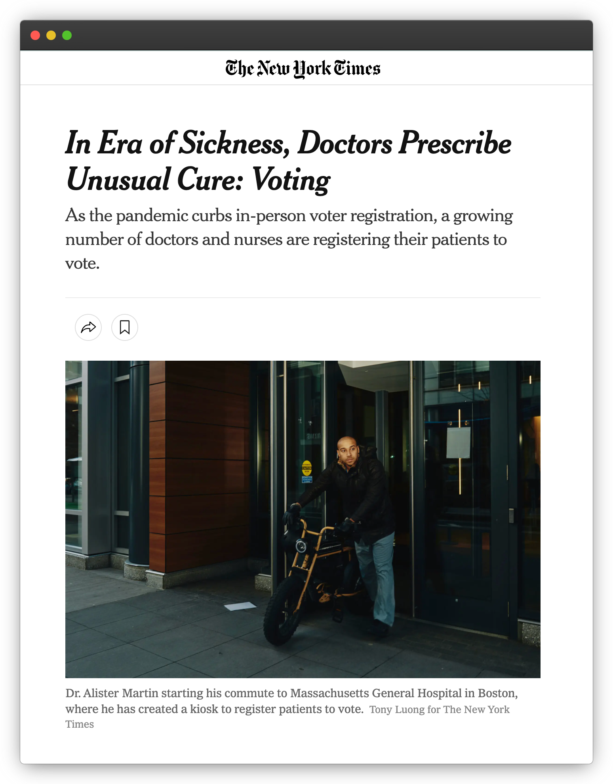
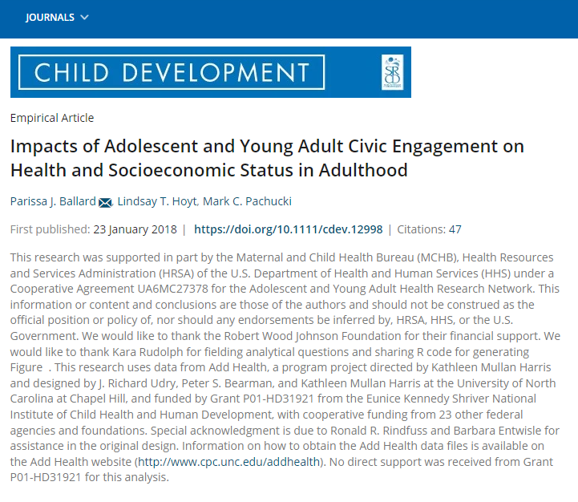

What the Research Shows
MEZZO:
Better Provider Health
MICRO:
Better Individual Health
MACRO:
Better Health Policy
Notes:
As service professionals, we can intervene with all kinds of treatments for the issue that is being presented by our clients. But we can also impact the cause of the issue, the underlying condition, and systemic structures that are at the root of the issue; and we do this through civic engagement. In order to address the social determinants of health, we need to point our interventions towards the structural determinants of health.
The connections between civic engagement and health outcomes are becoming more clear every day with the research.

Slide 14

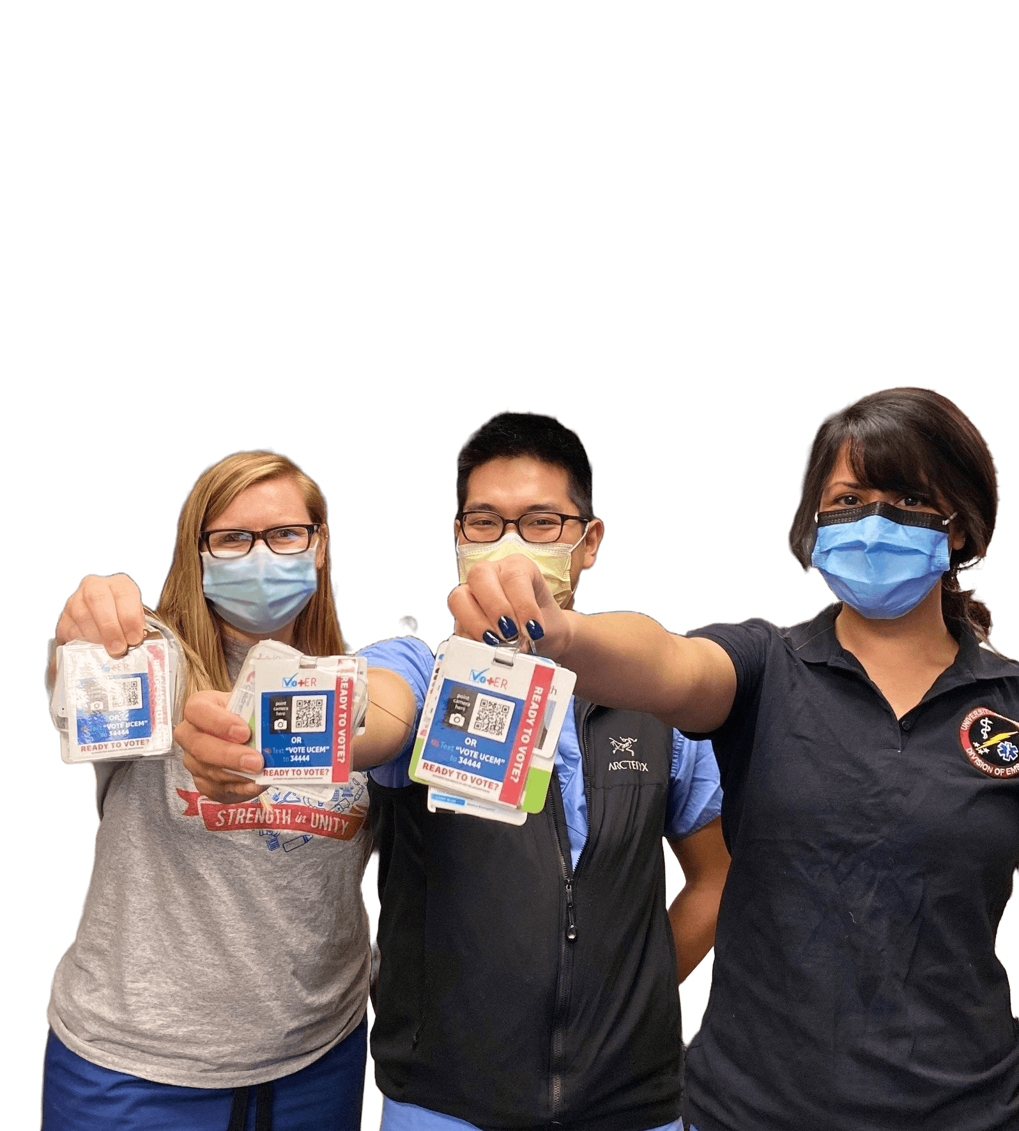
Better Individual Health
Research indicates that people who engage in civic engagement experience improved mood, self efficacy, and social connection.
Sources: Sanders, 2001; Thoits & Hewitt, 2001; Klar & Kasser, 2009; Anderson, Ballard & Syme , 2015; Ballard, Hoyt, & Pachucki, 2019
Notes:
MICRO - On the individual level, we see civically engaged folks experience improved mood, self efficacy, self determination, dignity, empowerment, social connections, and health outcomes in general. In communities of folks that are in active substance use or mental health crisis, this can be especially supportive for the healing and recovery process. One international study of 44 countries saw that civically engaged patients were associated with better self-reported health. Other studies have found that individuals that do not stay civically engaged report poorer health in proceeding years (Arah, 2008). And finally, in an analysis of data collected from 280,000 survey respondents found that voting is consistently positively associated with self-rated health scores, independent of income inequality.

Slide 15

Better Provider Health
Research indicates that providers who civically engage with the people they serve experience more agency and optimism about those people.
Sources: Vot-ER HDC, 2020; other study coming out soon…
Notes:
MEZZO - When Vot-ER surveyed the providers and medical students who got involved with their work, they found that an overwhelming number of providers got involved because they cared deeply about addressing social inequities. Healthcare providers often struggle working within a healthcare system that doesn’t help the most vulnerable. Engaging with patients around civic participation has been an outlet for providers to make a positive impact for these patients. Half of respondents said they used their Vot-ER badge to improve social determinants of health, and 93% said that their efforts represented a “positive, immediate impact they can have on their community and their community’s health.” 79% said Vot-ER “increased their sense of connection to other healthcare providers.” 51% said that Vot-ER helped to prevent workplace burnout. And 81% said that doing this work made them feel more hopeful in their own work.

Slide 16
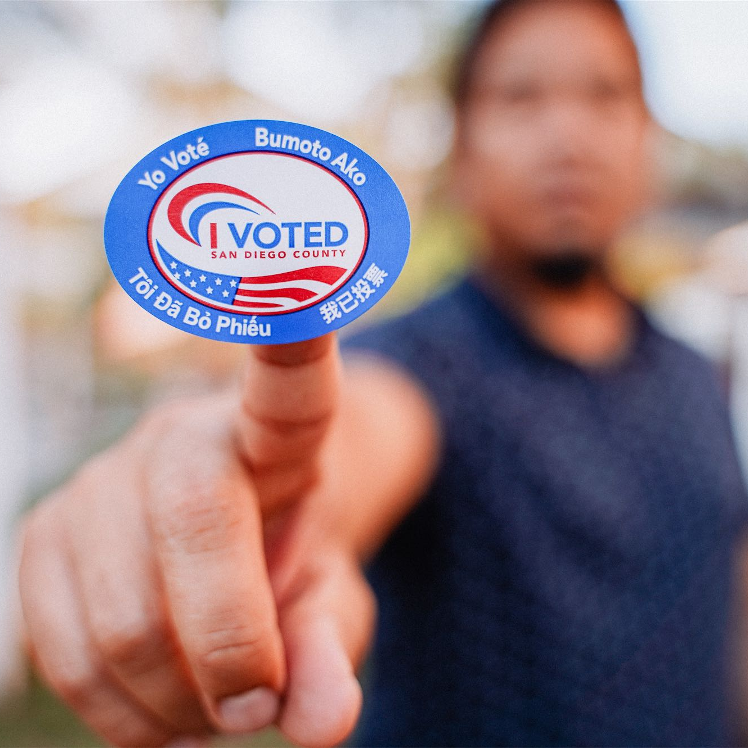
Better Health Policy
Research indicates that increased civic engagement in vulnerable populations results in policies that more effectively solve public health problems.
Source: WHO, 2010; Dawes, 2020
Notes:
MACRO -
And finally, on the most zoomed out macro level, we see that policies that more effectively solve public health problems are more likely to be implemented when vulnerable populations participate in civic engagement and when voters turnout in larger numbers that are more representative of the broader electorate.
When we include the voices of the most marginalized populations in the democratic process, the results are policies that more effectively meet the needs of those populations and are less likely to cause harm or contribute to vulnerability in those communities…
Not only are the effects of voter turnout beneficial, but they are substantial. Research shows that expanded turnout to include marginalized populations could increase the amount of money going into public support programs by a third… imagine if your agency had an additional ⅓ of the current funding that you have to operate on. Now imagine if every agency were able to expand their resources in that same way.

Slide 17
Case Example: Opioid Crisis

Slide 18
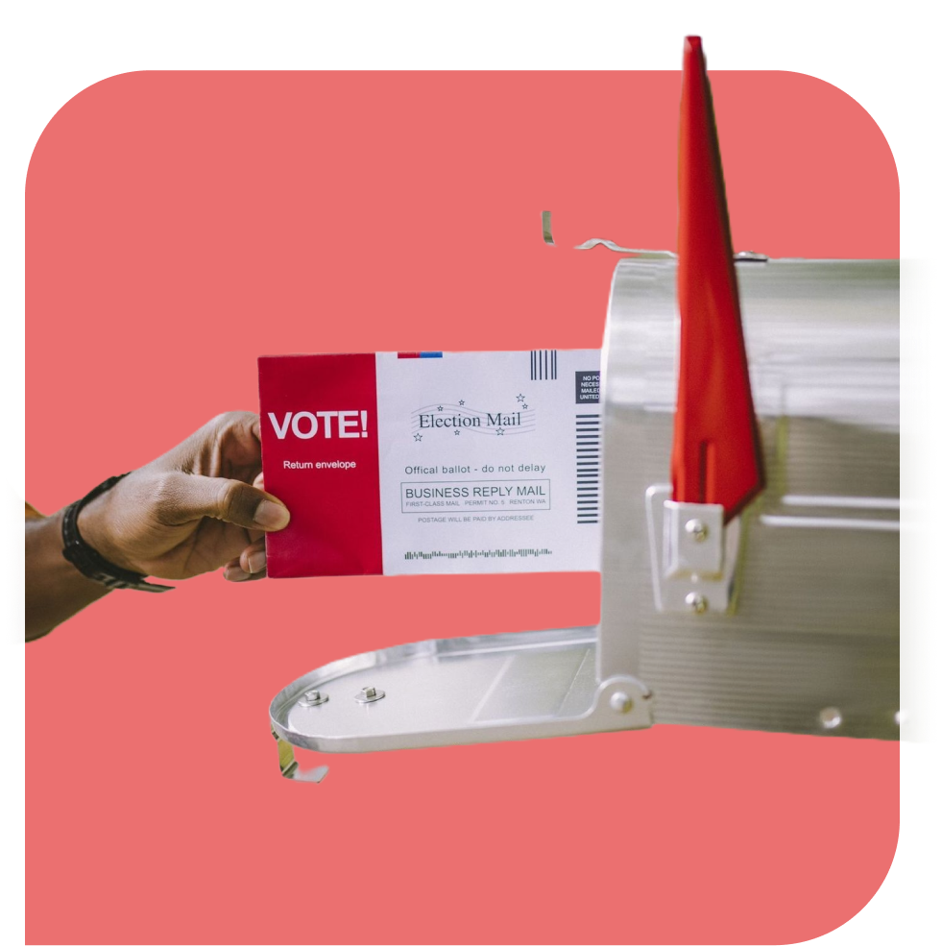

Opioid Settlement Tracker.com
Sum of settlements reached between opioid corporations, states, and localities is
$54.07 billion… and counting.

Slide 19

2.7%
The amount of tobacco settlement money that has been spent on
treatment and prevention.

Slide 20

Opioid settlement money
Supplant instead of supplement
Buy a helicopter for personal use
Optional for healthcare providers and patients alike to use
Republican
Democrat
opioidsettlementtracker.com

Slide 21
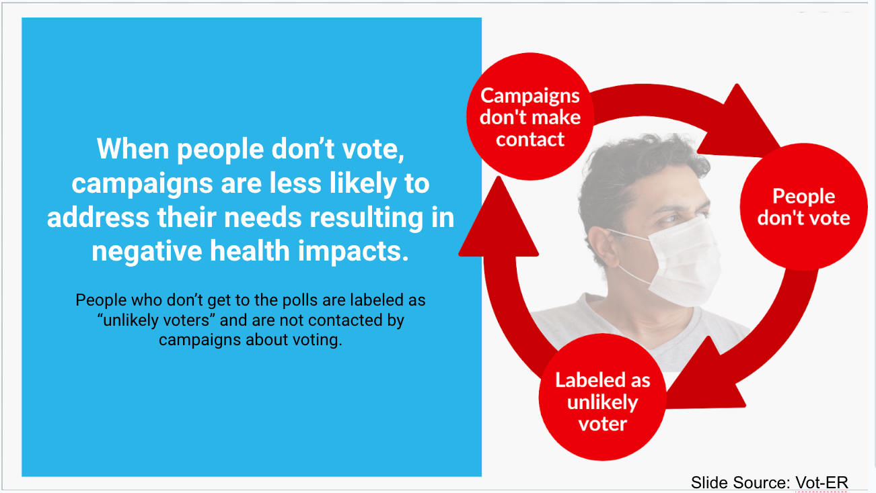

Slide 22
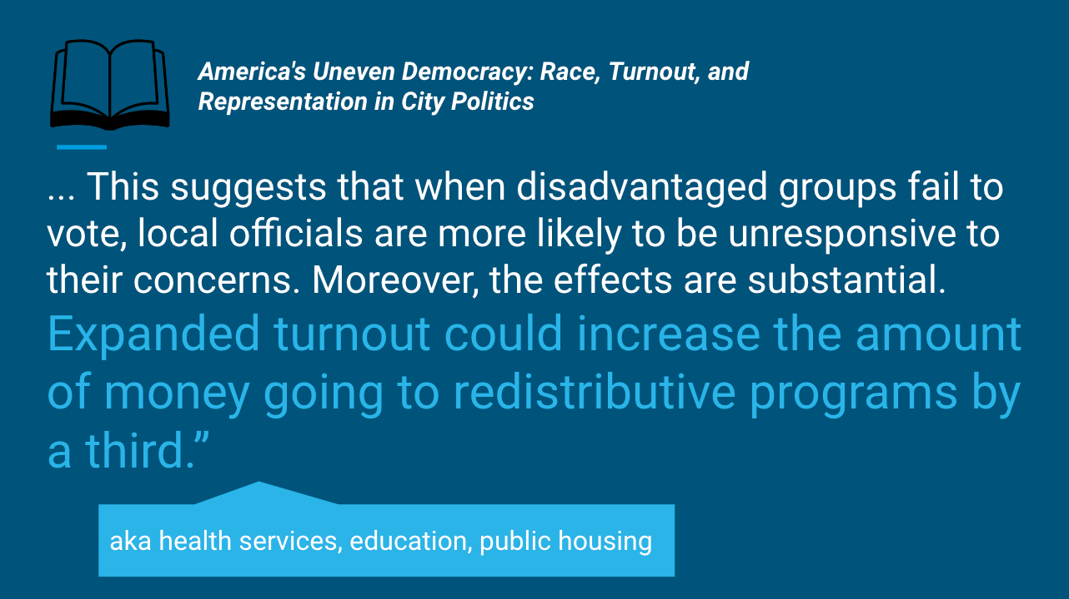

Slide 23
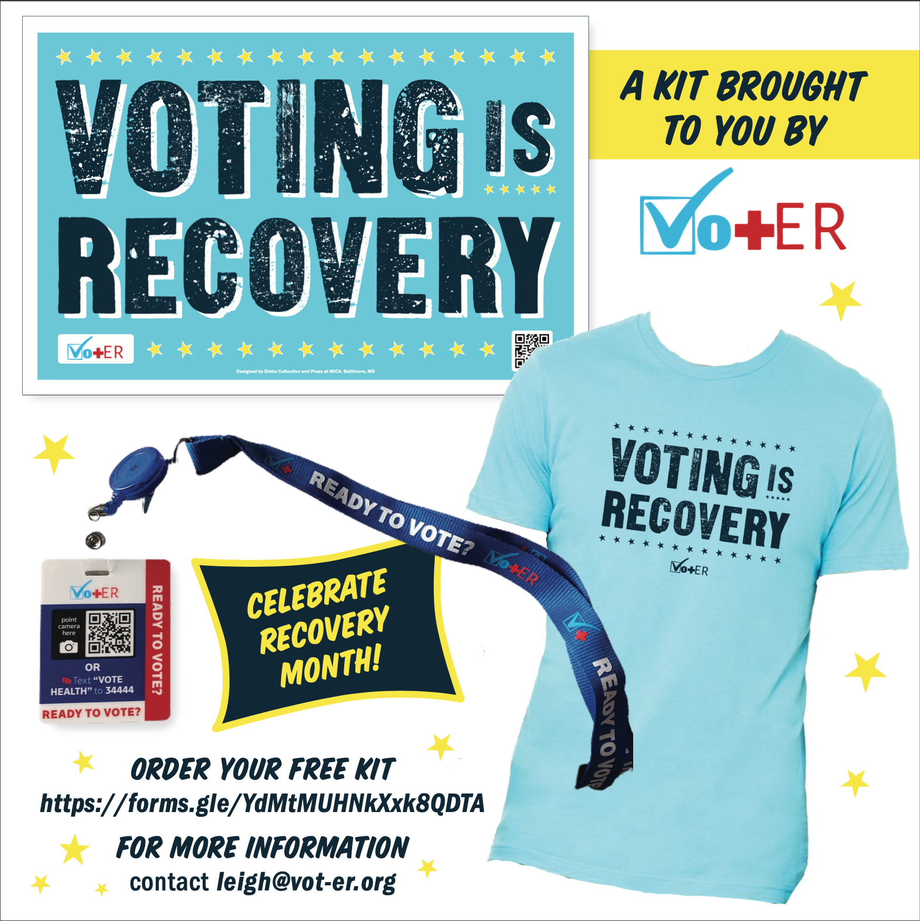

Slide 24
#VotingIsVeteranRecovery
#VotingIsWomensRecovery
#VotingIsLGBQTRecovery
#VotingIsDisabilityRecovery
#VotingIsIndigenousRecovery
#VotingIsRuralRecovery
#VotingIsRecovery

Slide 25
