Slide 1
WELCOME
Harm Reduction

Slide 2
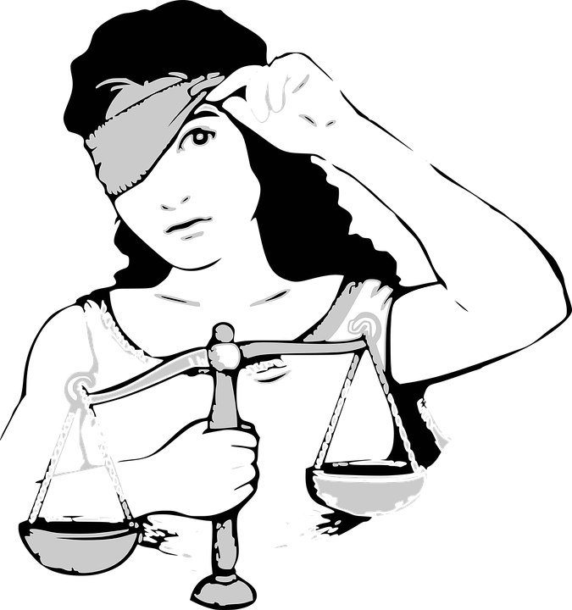
The History of
United States
Drug Policy
Chad Sabora BA, MS, JD

Slide 3
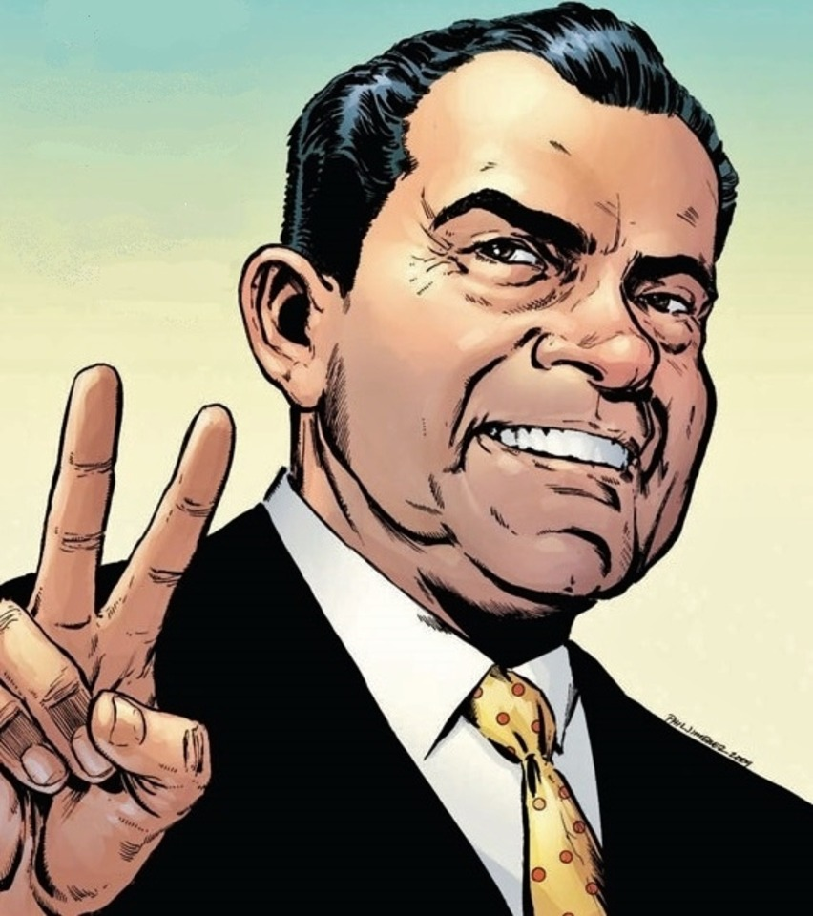
Did Not Start the War on Drugs

Slide 4
The Panic of 1873
1873 was the year a severe economic crisis begin. With the Chinese Americans accounting for one in four Californian laborers, white laborers see Chinese laborers as competition for the few available jobs. The Long Depression generates strong Anti-Chinese sentiments throughout the West Coast. As Americans face high levels of unemployment, they lash out against people who do not fit what several historians describe as the Euro-American concept of "real Americans” These factors created a racially antagonistic environment.

Slide 5
The real definition of the “war on drugs”
Drugs are a weapon cunningly employed to wage war against society's most vulnerable groups including those in the BIPOC, LGBTQIA, and other minority communities. Throughout history, certain marginalized communities have been unjustly branded with drug associations, thereby giving license to the majority to label them as morally corrupt or depraved. Alas, the true motivation behind such maneuvers is usually not about drug control, but rather a more nefarious agenda that uses drugs as a tool to rapidly weaponize society.

Slide 6
The first ever narcotic ban in the US occurred in San Francisco in 1875 with the banning of opium smoking and opium dens. The new ordinance while banning opium dens and opium smoking did not mention any other form of opium. By banning only opium smoking and the opium dens, the city essentially targets the Chinese communities and their cultural habit of smoking opium.

Slide 7
The economic side of the debate allows Congress to avoid the deeper issue of racial prejudice. Andrew Gyory defines the Chinese Exclusion Act as the most racist legislation of its era. Gyory goes a step further by arguing that the racist national atmosphere stemming from the Chinese Exclusion Act would eventually help the entire nation accept the Jim Crow South. With racial prejudice as an underlying motive of the Chinese Exclusion Act lawmakers could in the future accept the precedent of anti- Chinese sentiments as a basis for legislation.
When evaluating the regulation of narcotics, Congress once again would accept legislation with an underlying racial prejudice against Chinese Americans.
Andrew Gyory, Closing the Gate: Race, Politics, and the Chinese Exclusion Act, Chapel Hill: The University of North Carolina Press, 1998

Slide 8
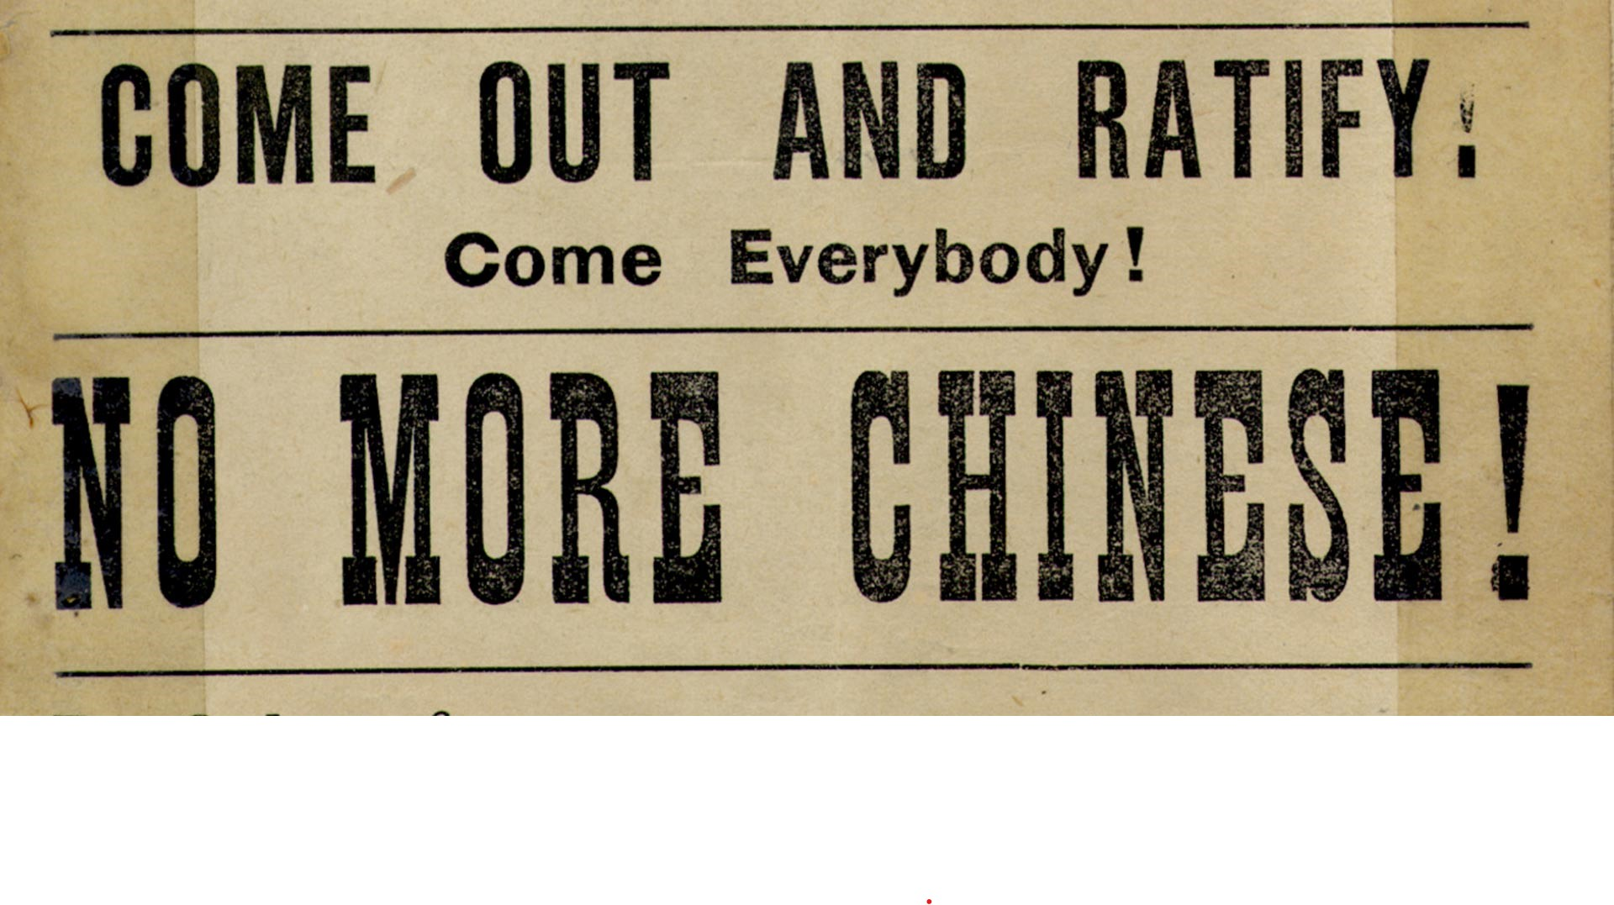
Now that we have that out of the way

Slide 9
The Chinese exclusion act was not only about immigration
Established by Chinese migrants, opium dens in US sprung up in San Francisco's Chinatown during 1840s
In 1840 New Englanders also brought 24,000 pounds of opium into the US, catching the attention of Customs which promptly put a duty fee on the import
Drug could be bought in five-ounce tins for eight dollars and opium dens had bunks to relax on while smoking
In 1909 the Smoking Opium Exclusion Act banned the importation of opiates used purely for recreational use
Our government feared that white woman were being turned into sex slaves by the Chinese

Slide 10
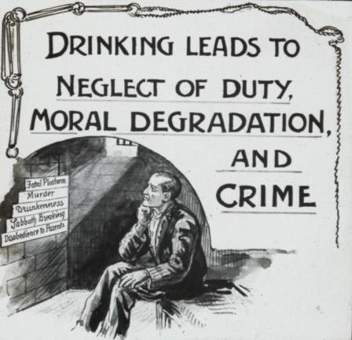
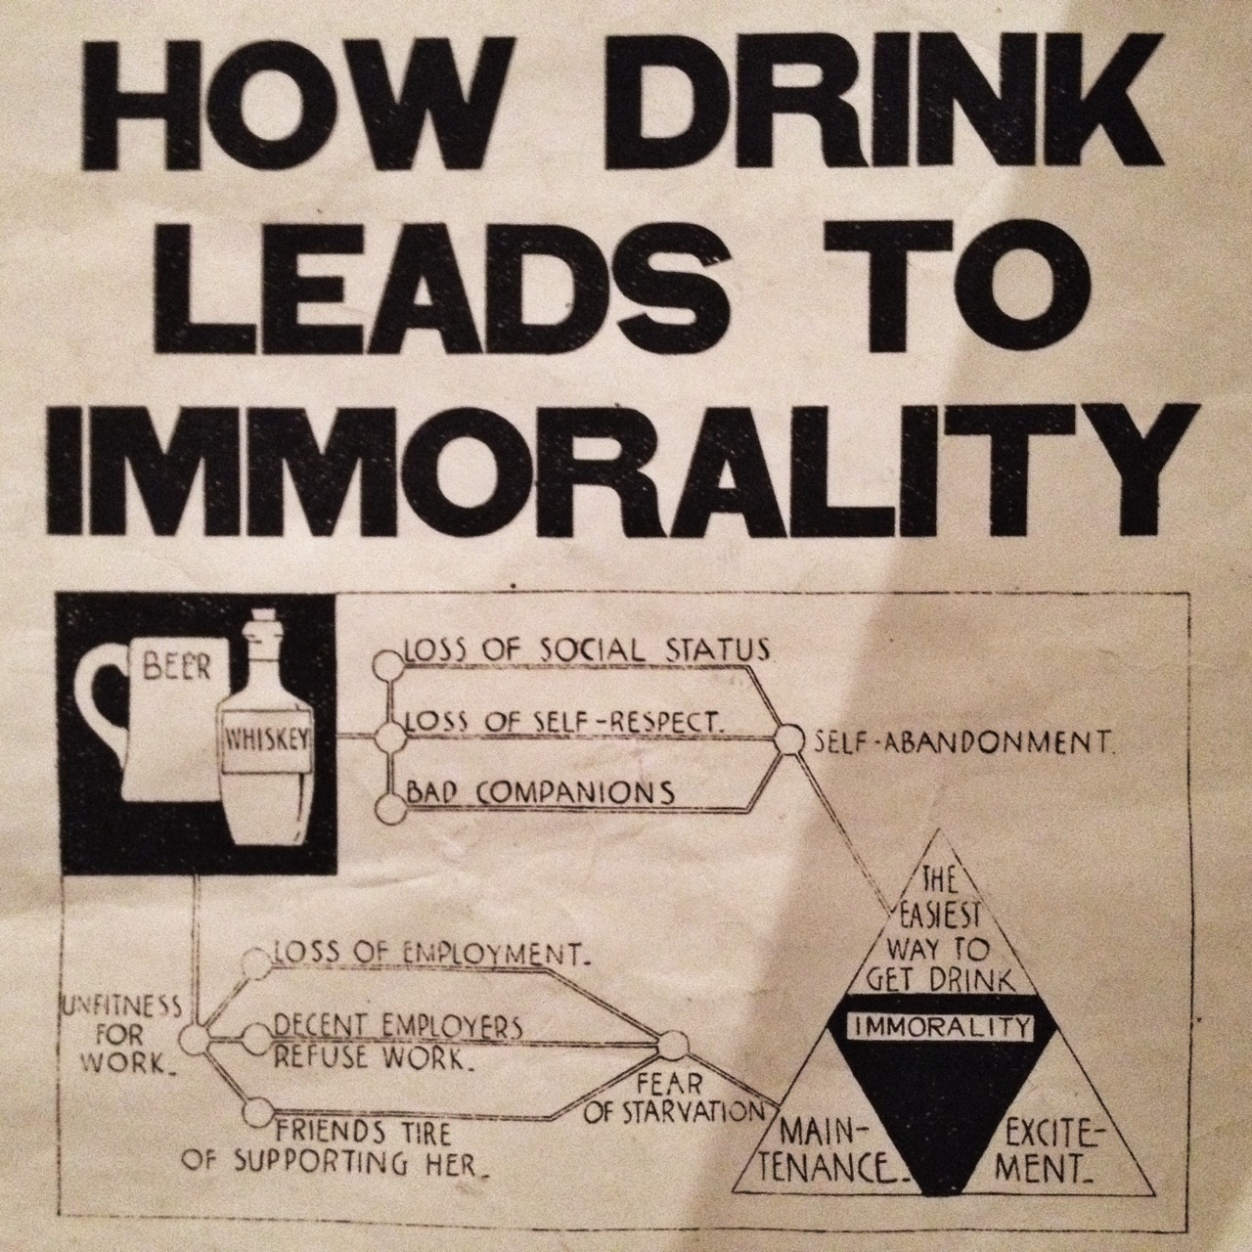
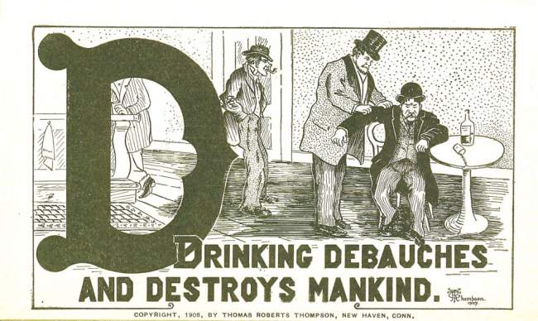
The Temperance Movement
Notes:
This is when morality was firmly put over science in our government

Slide 11
Pure Food and Drug Act of 1906
Under the law, drug labels, for example, had to list any of 10 ingredients that were deemed "addictive" and/or "dangerous" on the product label if they were present, and could not list them if they were not present.
This was the real start of federal overregulation.

Slide 12
A brief historical look at significant drug policy decisions and harm reduction
The Harrison Narcotics Act
(1914)
The strict language void of interpretation read…. “an act to provide for the registration of, with collectors of internal revenue, and to impose a special tax upon all persons who produce, import, manufacture, compound, deal in, dispense, sell, distribute, or give away opium or coca leaves, their salts, derivatives, or preparations, and for other purposes.”

Slide 13
On its face that act was not about prohibition it was about taxes
Let’s remember what we all learned in school about the government. The legislative body and makes laws and then the Supreme Court interprets them. It was the Supreme Court’s interpretation of the Harrison Narcotics Act which actually created prohibition and dictated the future of treatment and recovery.

Slide 14
Webb et al… V. United States
(1917)
This case involves the provisions of the Harrison Narcotic Drug Act, considered in No. 367, just decided, ante, 249 U. S. 86.
If a practicing and registered physician issues an order for morphine to an habitual user thereof, the order not being issued by him in the course of professional treatment in the attempted cure of the habit, but for the purpose of providing the user with morphine sufficient to keep him comfortable by maintaining his customary use, such order is not a physician's prescription under exception (b) of § 2 of the act
In non-legal terms the Court held that prescriptions of narcotics for maintenance treatment was not within the discretion of physicians and thus not privileged under the Harrison Narcotics Act
Notes:
Webb would treat people with OUD using maintenance with morphine.

Slide 15
United States v. Doremus, 249 U.S. 86
(1919)
The US Supreme Court upheld a tax on drug sales that was set in motion by the Harrison Narcotics Act and realized how it could be used as a tool for regulation without directly expending Congressional power oppressively
THE CHIEF JUSTICE dissents because he is of opinion that the court below correctly held the act of Congress, insofar as it embraced the matters complained of, to be beyond the constitutional power of Congress to enact because, to such extent, the statute was a mere attempt by Congress to exert a power not delegated -- that is, the reserved police power of the states.

Slide 16
In 1918, after three years of the Harrison Act and its devastating effects, the secretary of the treasury appointed a committee to look into the problem. The chairman of the committee was Congressman Homer T. Rainey; members included a professor of pharmacology from Harvard, a former deputy commissioner of internal revenue responsible for law enforcement, and Dr. A. G. Du Mez, Secretary of the United States Public Health Service. This was the first of a long line of such committees appointed through the years. Among its findings ¹⁰ were the following:
Opium and other narcotic drugs (including cocaine, which Congress had erroneously labeled as a narcotic in 1914) were being used by about a million people. (This was almost certainly an overestimate; see Chapter 9.)
The "underground" traffic in narcotic drugs was about equal to the legitimate medical traffic.
The "dope peddlers" appeared to have established a national organization, smuggling the drugs in through seaports or across the Canadian or Mexican borders-especially the Canadian border.
The wrongful use of narcotic drugs had increased since passage of the Harrison Act. Twenty cities, including New York and San Francisco, had reported such increases. (The increase no doubt resulted from the migration of addicts into cities where black markets flourished.)

Slide 17
1936 summary of Harrison Narcotics Act effects
August Vollmer, Berkeley, CA police chief, former president of the International Association of Chiefs of Police
“… Drug addiction, like prostitution and like liquor, is not a police problem; it never has been and never can be solved by policemen. It is first and last a medical problem, and if there is a solution it will be discovered not by policemen, but by scientific and competently trained medical experts whose sole objective will be the reduction and possible eradication of this devastating appetite. There should be intelligent treatment of the incurables in outpatient clinics, hospitalization of those not too far gone to respond to therapeutic measures, and application of the prophylactic principles which medicine applies to all scourges of mankind.”
Notes:
August Vollmer, The Police and Modern Society, (Berkeley, 1936), pp. 117-118.

Slide 18
The Volstead Act
Also known as Alcohol Prohibition 1919-1933
Have you ever asked yourself why this happened?

Slide 19
Anti-Saloon League was formed in 1893 (Immediately preceding the Temperance Movement.
The league was successful in getting many states to ban alcohol prior to 1917 by claiming that to drink was to be pro-German and this had the intended results because many of the major breweries at the time had German names. Additionally, many saloons were immigrant-dominated which further supported the narrative or agenda being pushed.
Many saloons were immigrant owned and dominated which further highlights the real motives behind prohibition.
It was in fact legal to own alcoholic beverages that were obtained before the Prohibition, as well as serve these types of drinks to family or guests in the home with proof of purchase on hand. This allowed numerous individuals, specifically those who were wealthy to stockpile these beverages before Prohibition.
(it is almost as if the elite knew what was happening and had time to prepare???)

Slide 20
Harry Anslinger and the Federal Bureau of
Narcotics
Established through the Treasury Department on June 14th, 1930
This would later become what we know now as the DEA
Responsible for the start of all of this and it began with the marijuana act of 1937 and the opium control act 1942.
Some Famous quotes by Anslinger;
“Colored students at the Univ. of Minn. partying with (white) female students, smoking [marijuana] and getting their sympathy with stories of racial persecution. Result: pregnancy”
“Two Negros took a girl fourteen years old and kept her for two days under the influence of hemp. Upon recovery she was found to be suffering from syphilis.”
“Reefer makes darkies think they're as good as white men.”

Slide 21
Marihuana Tax Act of 1937
The goal of the act of was to reduce the production of hemp through heavy taxation. This act effectively made marihuana illegal.
The men behind the curtain
Harry Anslinger
Andrew Mellon
William Randolph Hearst
The Dupont Family

Slide 22
Opposition to the Act
The American Medical Association (AMA) opposed the taxation because the tax was imposed on physicians prescribing cannabis, retail pharmacists selling cannabis and the cultivating of medical cannabis, Dr. William Woodward. legislative counsel for the AMA, testified on behalf of the AMA.[He stated that the claims about marijuana addiction, violence, and overdosage were not supported, and that the law should not burden further investigation into medical use.
Fiorella La Guardia – Mayor of New York (1934 – 1946) Appointed a commission on investigation and produced the La Guardia Report. The report was prepared by the New York Academy of Medicine and concluded the following.

Slide 23
Findings from the La Guardia Report
Marihuana is used extensively in the Borough of Manhattan, but the problem is not as acute as it is reported to be in other sections of the United States
The introduction of marihuana into this area is recent as compared to other localities.
The cost of marihuana is low and therefore within the purchasing power of most persons.
The distribution and use of marihuana is centered in Harlem.
The majority of marihuana smokers are Blacks and Latin-Americans.
The consensus among marihuana smokers is that the use of the drug creates a definite feeling of adequacy.
The practice of smoking marihuana does not lead to addiction in the medical sense of the word.
The sale and distribution of marihuana is not under the control of any single organized group.
The use of marihuana does not lead to the use of heroin, morphine or cocaine and no effort is made to create a market for these narcotics by stimulating the practice of marihuana smoking.
Marihuana is not the determining factor in the commission of major crimes.
Marihuana smoking is not widespread among school children.
Juvenile delinquency is not associated with the practice of smoking marihuana.
The publicity concerning the catastrophic effects of marihuana smoking in New York City is unfounded.
Therefore, according to the LaGuardia Report, the gateway drug theory is without foundation (points 7 and 9).

Slide 24
The Single Convention on Narcotics
(1961)
Initiated by the United States and ratified by the UN this created the international framework for the control of narcotics.
According to a 1954 interview with United States Commissioner of Narcotics Harry Anslinger, the cumbersome process of conference and state-by-state ratification could take many decades.
The Single Convention on Narcotic Drugs, 1961 (Single Convention, 1961 Convention, or C61) is an international treaty that controls activities (cultivation, production, supply, trade, transport) of specific narcotic drugs and lays down a system of regulations (licenses, measures for treatment, research, etc.) for their medical and scientific uses; it also establishes the International Narcotics Control Board.

Slide 25
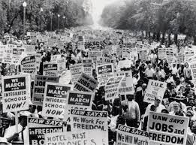
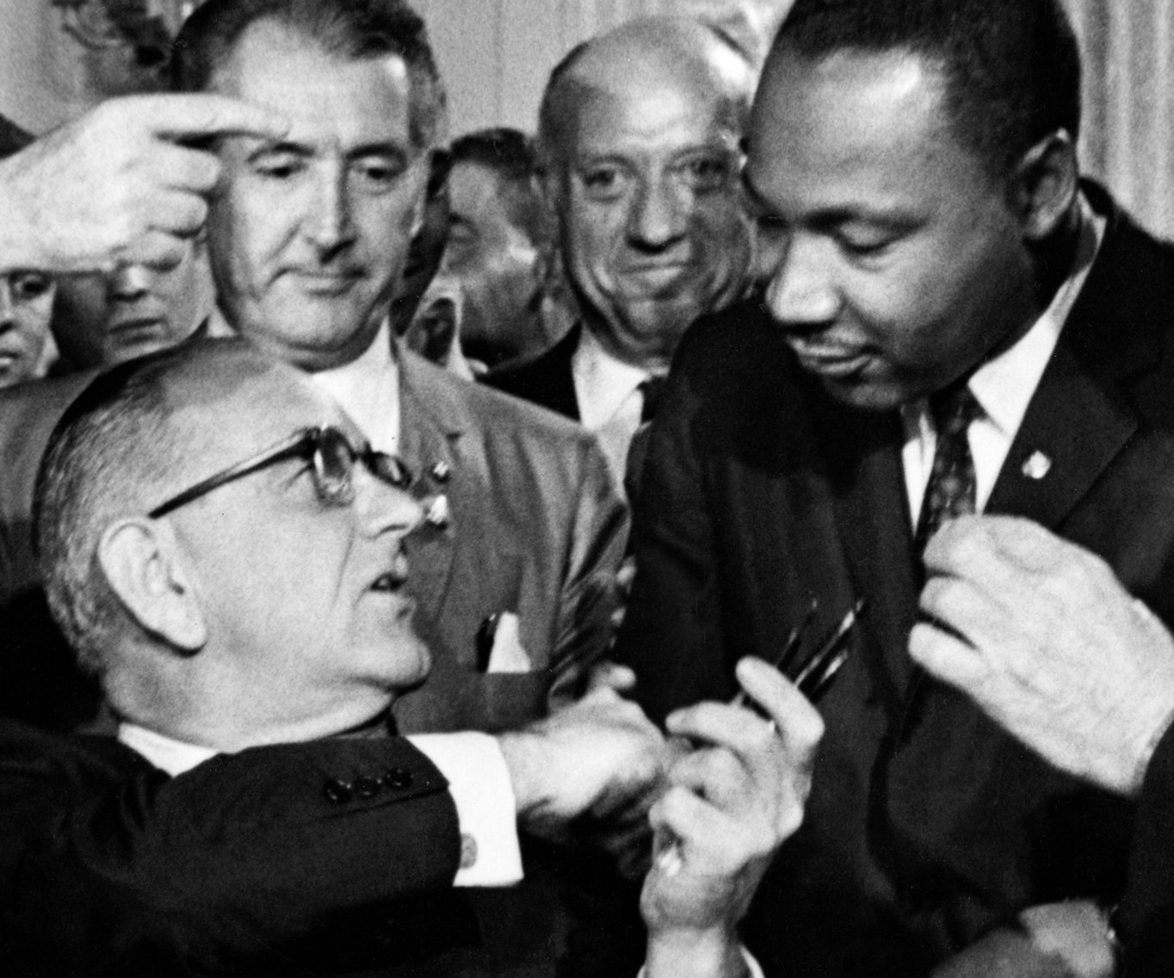
The Civil Rights Act of 1964

Slide 26
And how did we feel about that
June 17th, 1971 – Richard Nixon declared THE WAR ON DRUGS
Make mistake this was a well intentional design to implement what we now call the New Jim Crow
The architecture and design was formulated long before Nixon he just happened to be the President when it was time. Honestly, could we ask for a better scapegoat?

Slide 27
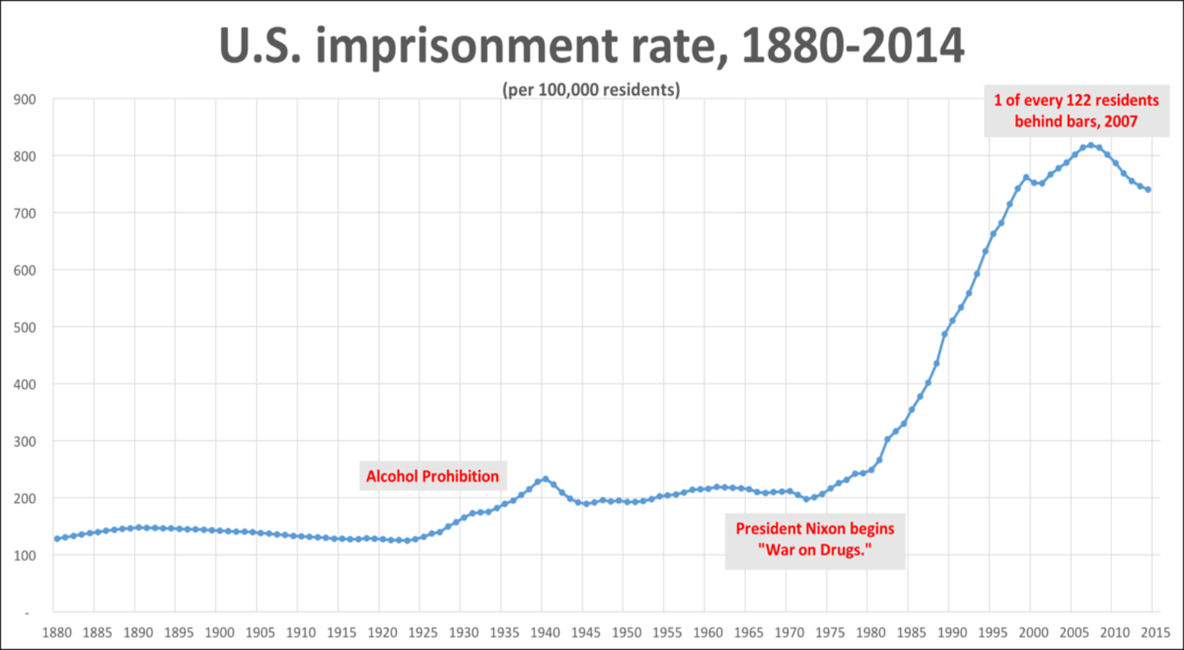
The Results

Slide 28
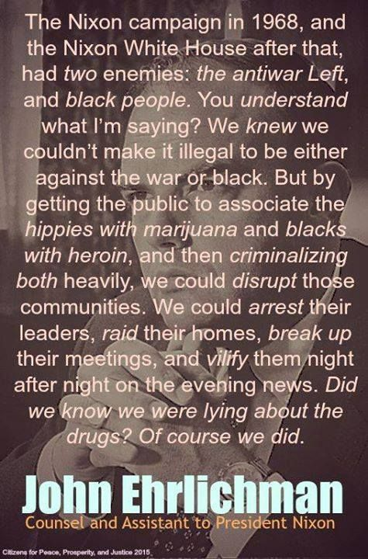
The Great Hornswoggling of 2016

Slide 29

The quote was not published until 2016 from an alleged interview that happened in 1994 by author Dan Baum
Baum passed away in 2000 but it’s been alleged that he left that quote out of his book published in 1996 because it did not fit the narrative. The book was entitled, “Smoke and Mirrors: The War on Drugs and the Politics of Failure.” They expect us to believe that quote which would have been a bombshell in 1996 narrative of are failed war on drugs???

Slide 30
The Game is Afoot
By 2016 everybody who was involved in that era of the Nixon Administration had died
Richard Nixon invested money into treatment programs such as OTP’s more than any other president up until Obama
Ehrlichman was convicted for his participation in Watergate.
Richard Nixon refused to offer him a presidential pardon while he had the opportunity to do so.
The real damage done by the war on drugs happened under the Reagan administration.
In 1987 Ronald Reagan gave Ehrlichman a presidential pardon.
“When you have eliminated all which is impossible, then whatever remains, however improbable, must be the truth.”

Slide 31
Crack, the CIA, and Mandatory Minimums
Freeway Rick Ross
Iran Contras
Dark Alliance
Anti-Drug Abuse Act of 1986 (100 -1 disparity between crack and powder of cocaine)

Slide 32
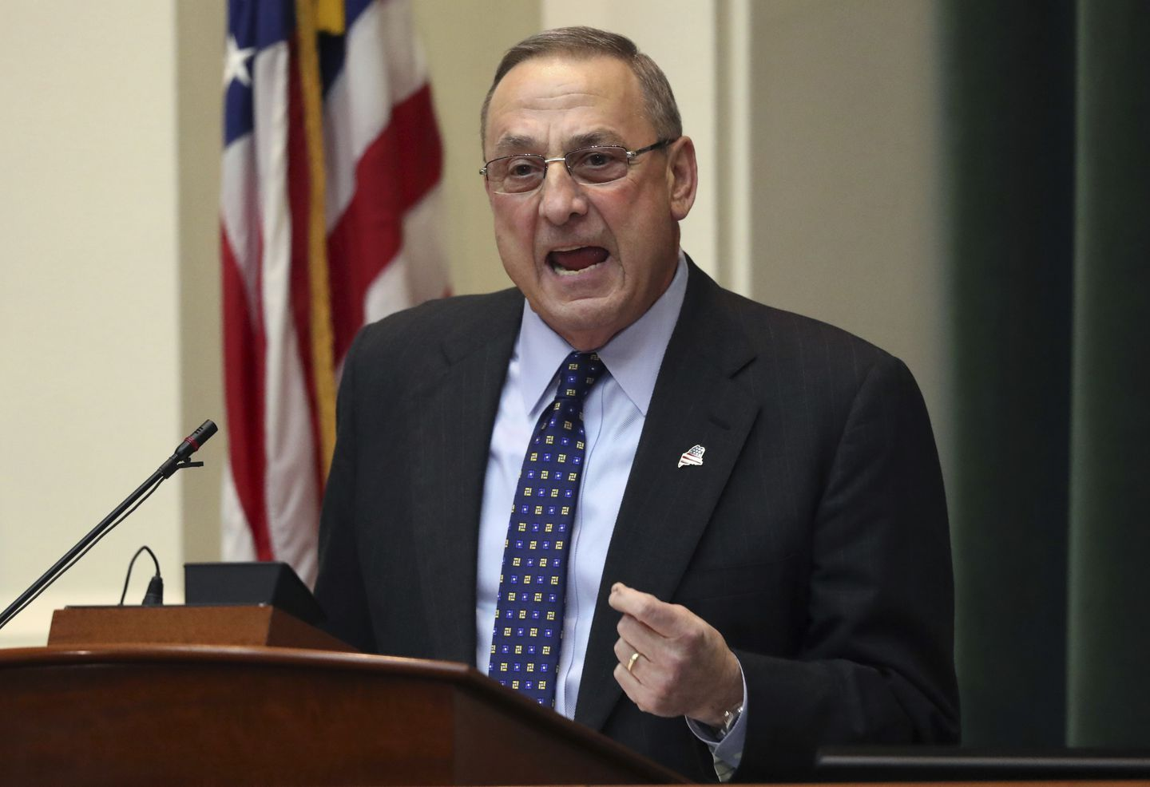

Not much has changed
Sheriff Joe cooked a woman to death “Marcia Powell” and tent city operated for 24 years!
“these are guys by the name D-Money, Smoothie, Shifty. These type of guys that come from Connecticut, New York. They come up here, they sell their heroin, then they go back home. Incidentally, half the time they impregnate a young, white girl before they leave, which is the real sad thing because then we have another issue we gotta deal with down the road” Gov Lepage 2013

Slide 33
THE RYAN WHITE ACT
United States Drug Policy
Harm Reduction

Slide 34
2000 Drug Addiction Treatment Act
The Drug Addiction Treatment Act of 2000 (DATA 2000), Title XXXV, Section 3502 of the Children's Health Act, permits physicians who meet certain qualifications to treat opioid addiction with Schedule III, IV, and V narcotic medications that have been specifically approved by the Food and Drug Administration for that indication.
Since there is only one narcotic medication approved by the FDA for the treatment of opioid use disorder within the schedules given, DATA 2000 essentially governs the prescription of buprenorphine (Schedule III) for the treatment of opioid use disorder.

Slide 35
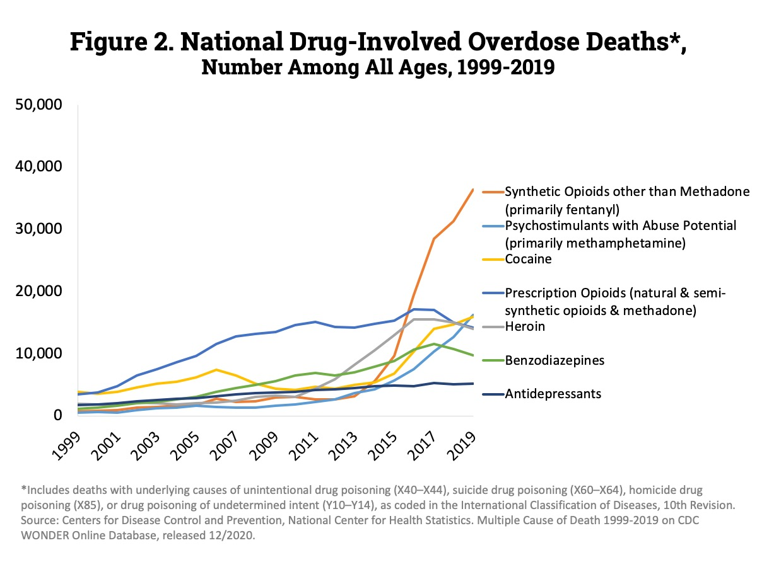
Increased prohibition prescription painkiller
CDC prescription guidelines

Slide 36
This is NOT an opioid epidemic

Slide 37

We are past the point of corrective action
Drug Policy

Slide 38
Question and Answers?

Slide 39


