Slide 1
WELCOME
Leadership Development

Slide 2


Give and Take: A Peer-Ally Conversation About Building Recovery Capital
Tom Jackson, RPRS
Alison Jones Webb, MA, MPH
Virginia Recovery Advocacy Project

Slide 3
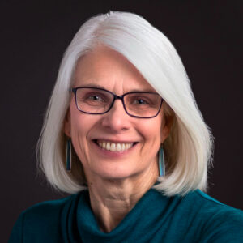
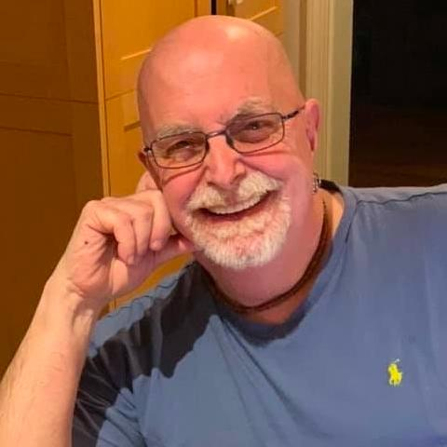
Who We Are
Alison Jones Webb is a public health specialist, recovery advocate, affected family member, and author of Recovery Allies: How to Support Addiction Recovery and Build Recovery-Friendly Communities (North Atlantic Books, 2022). She has written extensively about recovery from addiction, treatment, and harm reduction. Her book relies on interviews with people in recovery and research to show readers that there is real hope for people with addictions, and that we all have an important role in helping to support and sustain their recoveries. She is a certified prevention specialist, trained recovery coach, FAVOR Recovery Ambassador, and a member of the Virginia Recovery Advocacy Project.
Tom Jackson’s day job as a Registered Peer Specialist at Virginia’s Western State Hospital and his night job as an Organizer with the Virginia Recovery Advocacy Project work together to support and advocate for people with co-occurring conditions. His Civil Rights, Anti-War, and HIV/AIDS/LGBTQIA+ rights advocacy, his personal recovery since 1991, and his training in Relational Organizing engage and call others to action to fix our broken treatment system. He finds hope in the dedication and recovery of the clients he works with, in the recovery work he does, in the new PRS Hope Brokers he trains, and in motivating and supporting others to end the war on drugs and make Recovery the Epidemic.
Notes:
Tom wanted to call this “A Peer and an Ally Walk into a Bar…) but Alison said no.

Slide 4

Why Are We Here?
We intend this as a community forum, where everyone is a participant.
We’ll discuss the connections between peers and allies in building personal, social, and community recovery capital.

Slide 5
Favorite Quotes
How do people get better? They change their social networks, and they engage in meaningful activities.
–Dr. David Best
Our house is on fire and you’re talking about the chemistry of the paint. What are you doing to put out this fire?
-A parent of a child in crisis, as told to Tom Insel in Healing
Notes:
Tom wanted to call this “A Peer and an Ally Walk into a Bar…) but Alison said no.

Slide 6
AGENDA
What is a peer?
What is an ally?
Why do we need each other?
How can allies support peers?
How can peers support allies?
Q&A

Slide 7
HOW Can Allies and Peers Collaborate to Increase Recovery Capital?
Some specific activities to consider
Employment opportunities
Family support
Recovery housing
Landlord education
Ensure access to services
Link to trainings
Financial literacy
Smoking cessation
Other
Please suggest more!

Slide 8
WHERE Can Allies and Peers Collaborate to Increase Recovery Capital?
Some specific settings to consider
Employment
Carceral
Healthcare
Advocacy settings
Housing
Wellness
Faith-based/spiritual
Please suggest more!

Slide 9
WHAT Can Allies and Peers Collaborate do to Increase Recovery Capital?
Some specific strategies to consider
Education and awareness
What is SUD? What is recovery
Advocacy 101
Outreach (combat NIMBYism)
Overdose prevention
Recovery Month and other celebrations
Advocacy calls to action
Please suggest more!

Slide 10
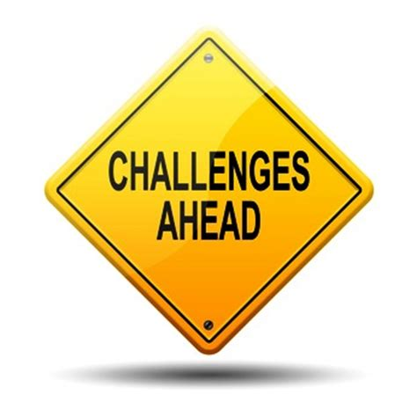
Lack of knowledge (what is recovery, pathways of recovery, what is advocacy)
Disagreement within recovery community (advocacy issues)
Decriminalization?
Harm reduction?
Systems change?
Funding strategies
Please suggest more!

Slide 11
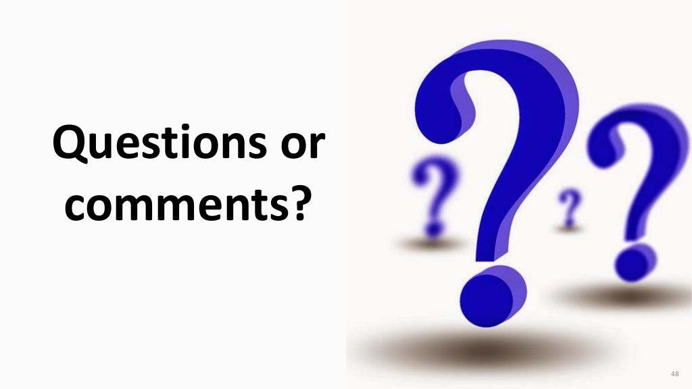
Questions? Comments?

Slide 12
THANKS!
Tom Jackson
jacksonta@gmail.com
www.linkedin.com/in/jacksonta/
Tom Jackson
jacksonta@gmail.com
Alison Jones Webb
alison.jones.webb@gmail.com
www.alisonjoneswebb.com
www.linkedin.com/in/alisonjoneswebb/

Slide 13
