Slide 1


Slide 2

Healing Justice:
Strategies for Individual & Collective Care & Wellness on the Organizational Level
Lois Stepney, MSW, LISW-S
&
Lynette Cashaw-Davis, MA, CPRS
June 6th, 2023
Image credit: https://www.takingcharge.csh.umn.edu/healing-justice-equity

Slide 3
Land Acknowledgement
Let’s Read this Together Please
“We are currently on land that is the ancestral lands of the Anacostans (also documented as Nacotchtank), and the neighboring Piscataway and Pamunkey peoples. I honor and respect the diverse Indigenous peoples who have stewarded this land, and acknowledge the role I have to work for social, economic, racial, and environmental justice.”

Slide 4
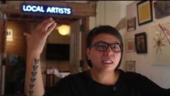
Land Acknowledgement

Slide 5


Today’s Agenda
Image credit: https://www.nature.com/articles/d41586-018-06619-3
Presenters Positionality/Training Framework
Review of Official Learning Objectives
What is “healing justice” and what is the healing justice framework for organizations
Why should I consider bringing a healing justice framework to my Recovery Community Organization?
Centering collective care and healing – Dancing Mindfulness
Adjourn

Slide 6
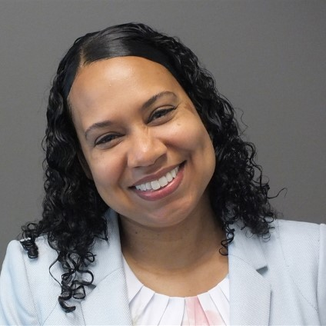
A note about my positionality….
A black, cis-gendered, middle-aged woman
28 plus years of social work practice experience in the mental health and crisis intervention fields including social administration…
Current supervisor to EDSW’s at NCH
Full-time PhD Candidate with a specialization in wellness

Slide 7
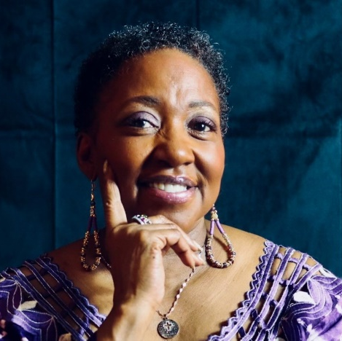
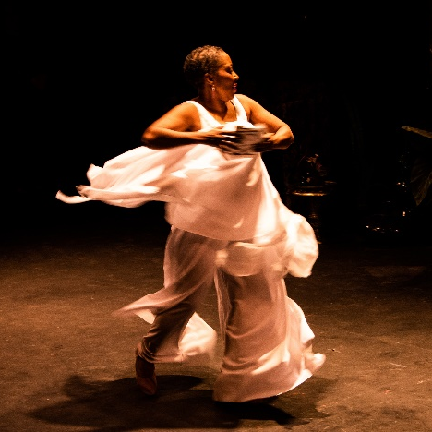
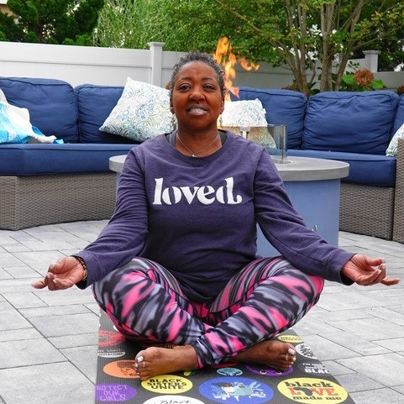
Lynette Cashaw-Davis, MA, CPRS, RYFT-200
Person in long-term recovery from substance use disorder since May 4, 2007
Certified Peer Recovery Supporter and supervisor
Community servant, recovery advocate and consultant
Lifelong dancer and creative artist
Dancing Mindfulness facilitator and YogaFaith instructor

Slide 8
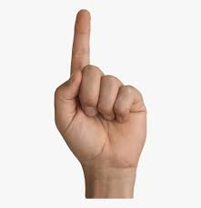
Training Objectives mage credit: Bilal Karaduman https://www.kindpng.com/imgv/hbRihRw_finger-png-image-title-hand-one-finger-png/
  Participants will be able to explain the concept of healing justice in relation to their own practice setting.
Notes:
8

Slide 9
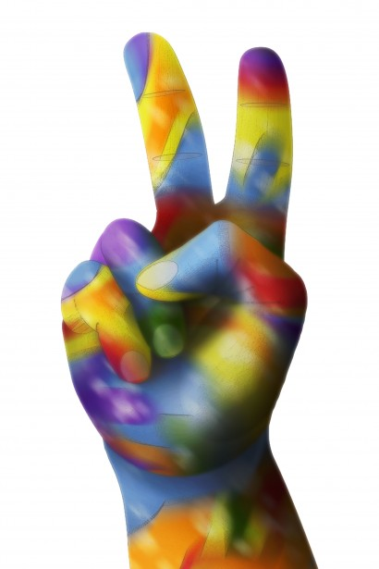
Learning Objective
Image credit: https://www.publicdomainpictures.net/en/view-image.php?image=66341&picture=peace-hand
Participants will be able to identify at least one potential benefit of bringing a healing justice organizational framework to their own practice setting.

Slide 10
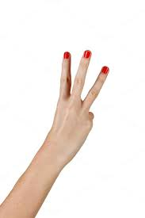
Training Objectives
Image credit https://www.pinterest.com/pin/6825836921093180/
  Participants will be able to experiment with mindful dance as a means of centering healing within a collective care space.

Slide 11

Definitions
Image credit: https://artofverbalwar.com/wp-content/uploads/2019/07/what-you-talkin-bout-willis-quote-1.jpg

Slide 12
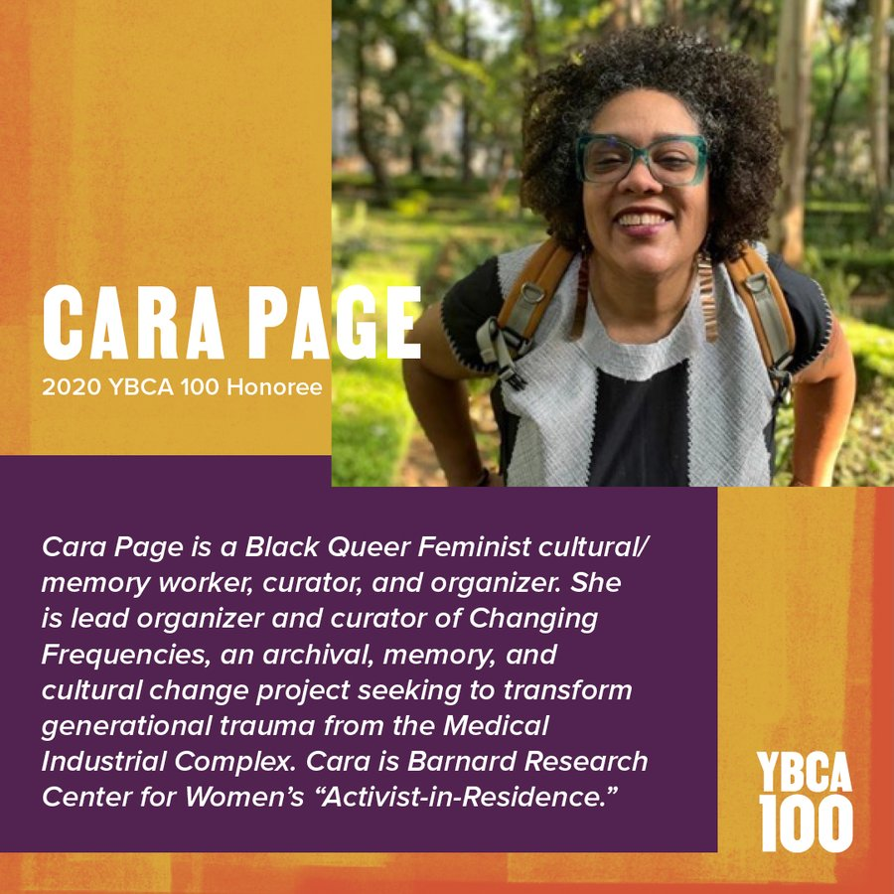
Informed by the work of
Cara Page
Image credit: https://twitter.com/ybca/status/1374137596352196610

Slide 13

“Healing Justice”
Image credit: https://carapage.co/about/
As defined by Cara Page and the Kindred Healing Justice Collective, “healing justice...identifies how we can holistically respond to and intervene on generational trauma and violence, and to bring collective practices that can impact and transform the consequences of oppression on our bodies, hearts and minds.”

Slide 14
And more on what is “healing justice”?
“Healing justice is the practice of reimagining wholeness at the intersection of intergenerational trauma, current structures of oppression, and a generative and co-created future. We hold that joy and pleasure create possibility to be in right relationship with ourselves, each other, and the land. We strive to demystify medicine and healing, and to make them accessible to everyone. We believe that each person is an expert of their own experience, body and needs, and that it is necessary to address the roots of trauma and injustice for individual and collective transformation.”
Allied media conference 2018 healing justice practice space and healing justice track coordinators

Slide 15
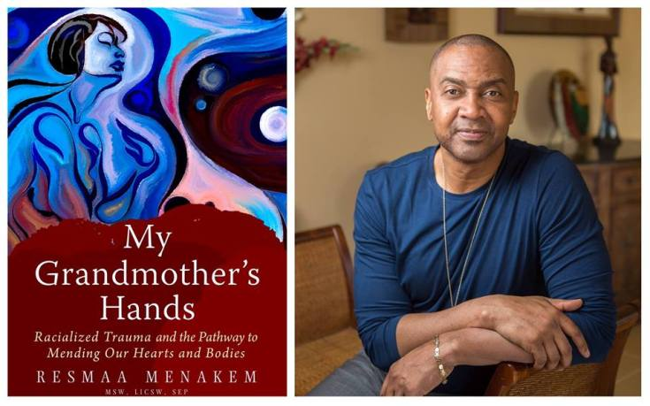
Informed by the work of
Resmaa Menakem,
MSW, LICSW, SEP
Image credit: https://spokesman-recorder.com/2017/10/18/grandmothers-hands-enlightening-approach-heal-racial-trauma/

Slide 16
Menakem suggestions adapted for today’s session…
Metabolize Trauma
Choose the hard work of working with clean pain
Healing work starts with individual bodies healing from trauma
Harmonizing with other bodies…
Collectively redefining culture – traumatic retentions, anti-racist, anti-oppressive culture

Slide 17
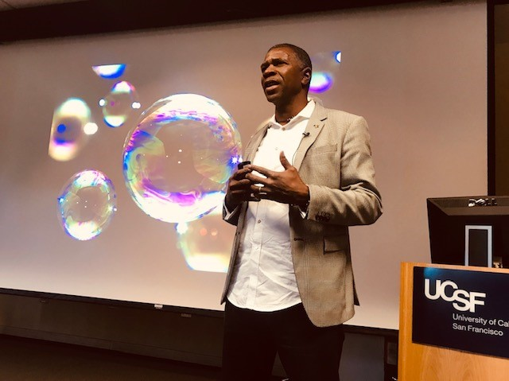
Informed by the work of Shawn Ginwright, PhD
This Photo by Unknown Author is licensed under CC BY-SA-NC

Slide 18
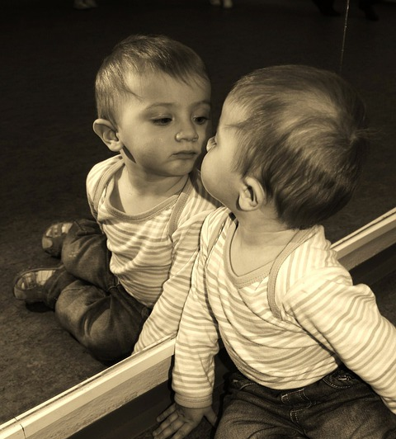
Dr. Ginwright’s contribution….
Awareness: from lens to mirror
Connection: from transactional to transformative relationships
Vision: from problem-fixing to possibility-creating
Presence: from hustle to flow
Image credit: child-856132_960_720.jpg (540×720) (pixabay.com)

Slide 19
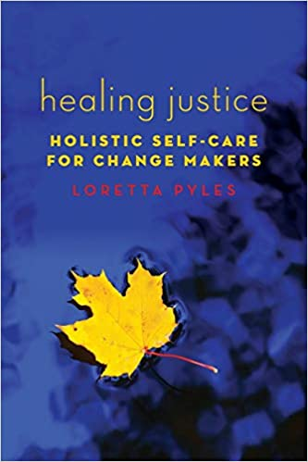
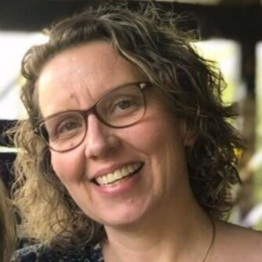
Informed by the work of
Loretta Pyles, PhD
Image credit: https://www.transformnetwork.org/healing-justice-online-class

Slide 20
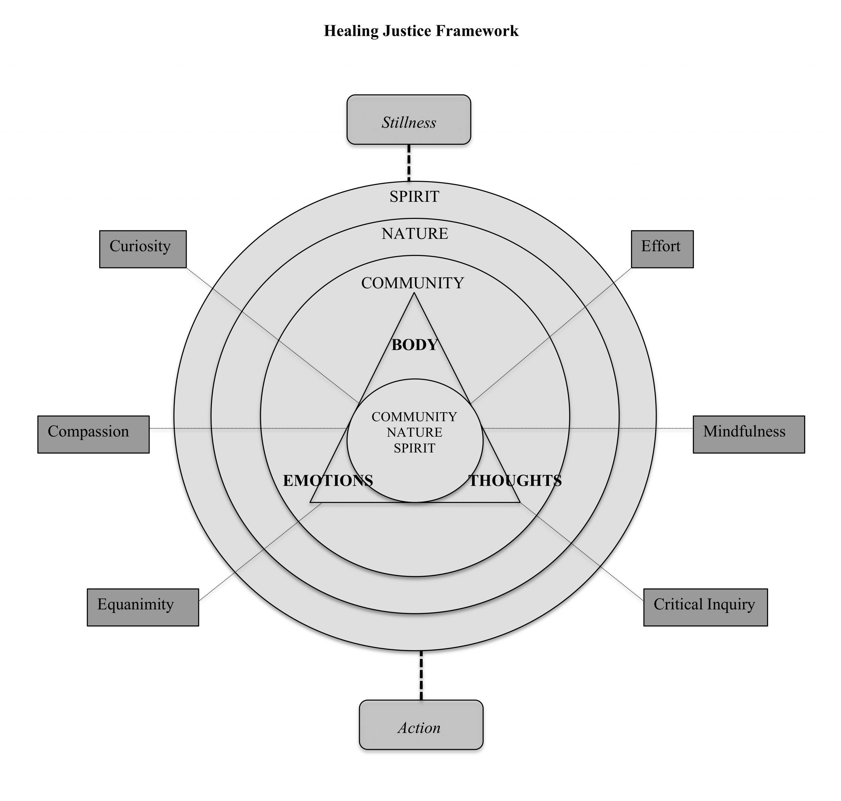
Image credit: https://arrow-journal.org/healing-justice-for-a-world-on-fire/figure-3-1-healing-justice-framework/

Slide 21
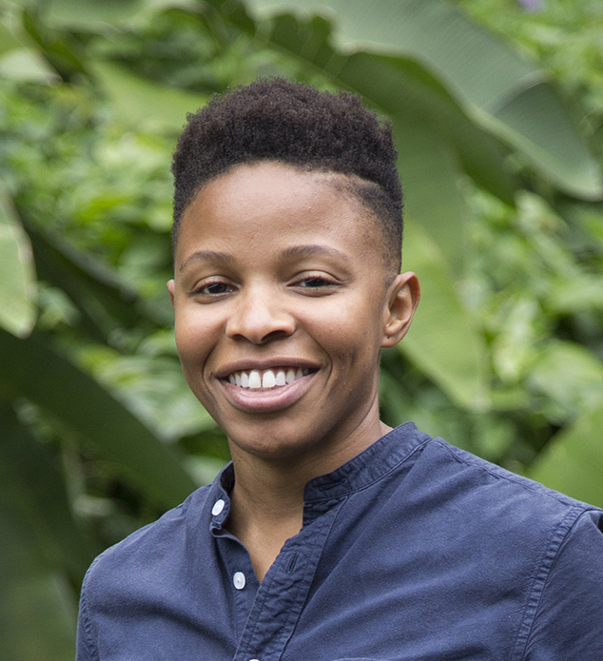
“We heal so that we can act and organize.” https://www.huffpost.com/entry/healing-justice_b_5899e8ade4b0c1284f282ffe
Image credit https://prentishemphill.com/

Slide 22
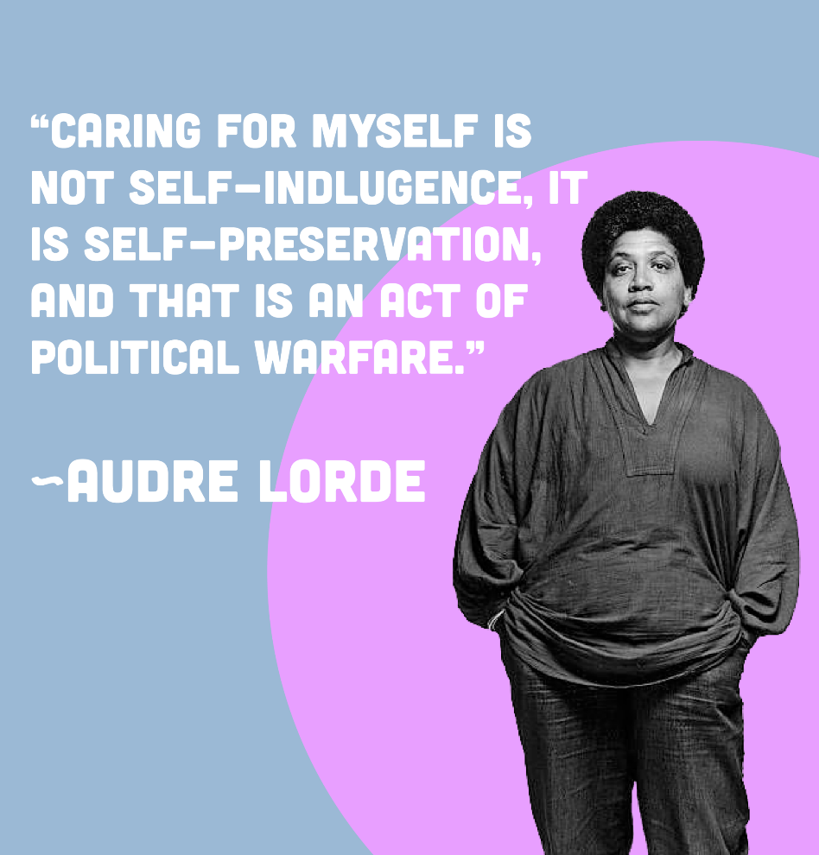
Addressing our own wellbeing, and healing allows us to BE the Revolution!!!
Image credit https://globeandfeminist.com/2020/07/24/self-care-day/

Slide 23

Healing Justice!
I heal
You heal
We all heal – it is only when we engage in this work as a collective that we can hope to fulfill the aims and goals of supporting recovery within our communities.
This Photo by Unknown Author is licensed under CC BY-NC

Slide 24

Questions the Healing Justice Framework May Suggests we Ask About Member Problems…
Is it me, is it you, is it them? Where is the breakdown? Community, Nature, Spirit?
Image credit: ILLUSTRATION BY AURÉLIA DURAND, LETTERING BY SHANNON ANDERSON
https://www.learningforjustice.org/magazine/fall-2020/this-conversation-is-anti-racisthttps://www.learningforjustice.org/magazine/fall-2020/this-conversation-is-anti-racist

Slide 25
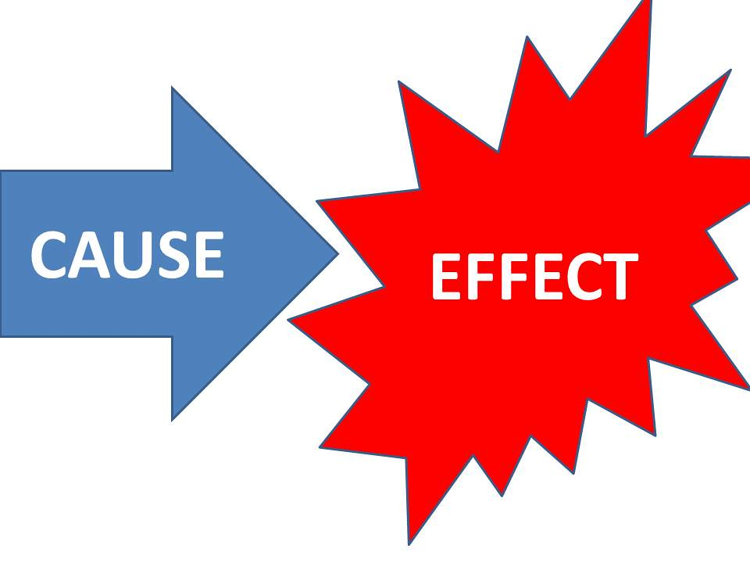
Questions the Healing Justice Framework May Suggests we Ask About Member Problems…
What external factors are causing dis-ease in the body, thought, emotions?
This Photo by Unknown Author is licensed under CC BY

Slide 26

Questions the Healing Justice Framework May Suggests we Ask About Member Problems…
What wholistic strategies have been used to transform the individual and the community they live in?
Image credit: https://en.wikialpha.org/wiki/Optimus_Prime_(Aligned_

Slide 27

Questions the Healing Justice Framework May Suggests we Ask About Member Problems…
Stillness –VS- Action
Individual –VS- Collective
Current reality –VS- Collectively Reimagined Future
This Photo by Unknown Author is licensed under CC BY-NC
Image credit: https://en.wikialpha.org/wiki/Optimus_Prime_(Aligned_

Slide 28
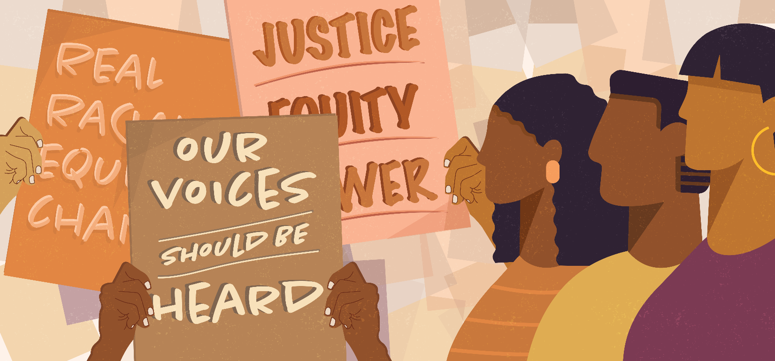
Healing Justice Incorporates Social Justice
Image credit: https://www.urban.org/racial-equity-analytics-lab

Slide 29
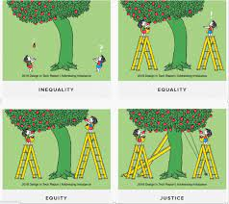
Healing Justice invites us to imagine what could be…
Image credit: https://www.health.pa.gov/topics/Health-Equity/Pages/Health%20Equity.aspx

Slide 30
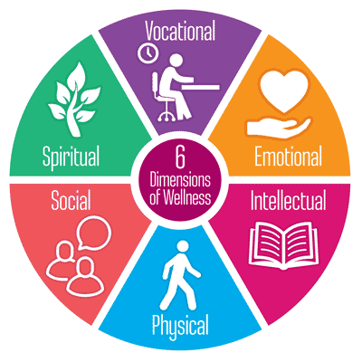
A Healing Justice Organizational
Pyles, 2020
Image credit: https://methwick.org/2019/11/6-dimensions-of-wellness-for-all/
The workplace articulates a healing justice mission through key messages internally and externally, for example, messages about social justice, community building, and wellness for all.

Slide 31
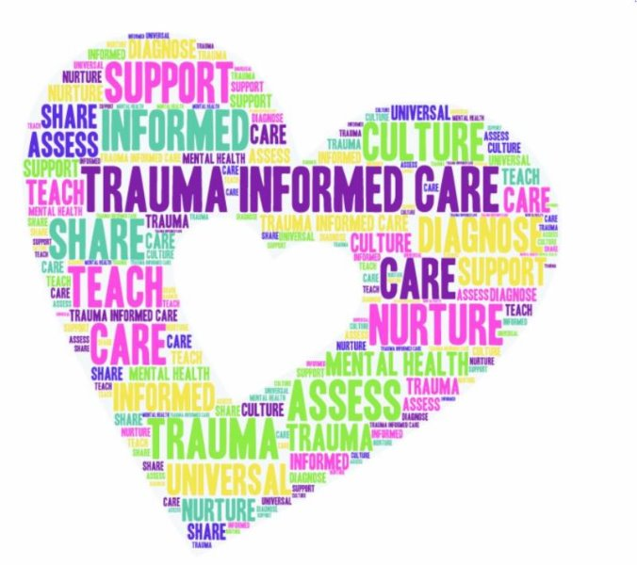
A Healing Justice Organizational
Pyles, 2020
Image credit: https://www.moesc.net/vnews/display.v/ART/5ca607f8b076a
The workplace is trauma informed, that is, it understands and provides support regarding the impact of trauma, secondary trauma, and historical and intergenerational trauma.

Slide 32
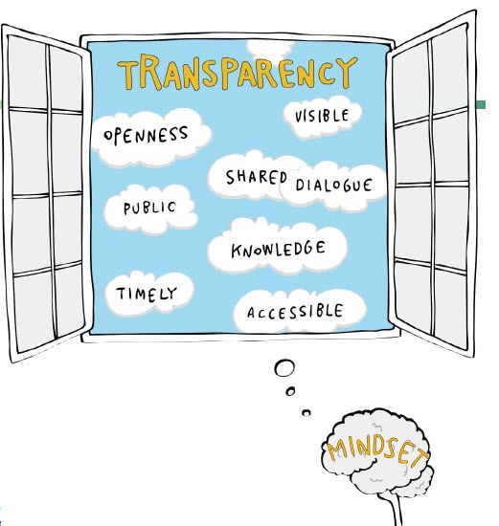
A Healing Justice Organizational
Pyles, 2020
Image credit: https://jarthur.co/transparency-in-the-workplace/
Participatory, transparent, and accountable decision making exist in the workplace, for instance, through collective bargaining or client participation.

Slide 33

A Healing Justice Organizational
Pyles, 2020
Workplace cultural norms support self-care for workers, for instance, taking breaks, using vacation time, and offering reflective processes for staff.
Image credit: https://axerosolutions.com/blog/taking-breaks-at-work-how-to-motivate-your-staff-to-be-awesome

Slide 34
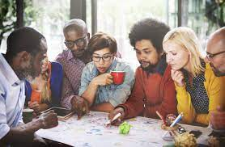
A Healing Justice Organizational
Pyles, 2020
There is a sense of community or belonging in the workplace.
Image credit: https://nycofficesuites.com/2018/11/15/best-practices-for-working-with-different-cultures-in-the-workplace/

Slide 35
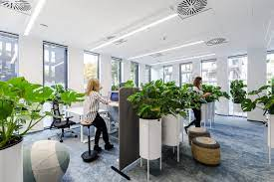
A Healing Justice Organizational
Pyles, 2020
The environment in the workplace is inviting, for instance, exposure to sunlight, plants, and attractive and comfortable spaces.
Image credit: https://archello.com/project/the-greenest-office

Slide 36

A Healing Justice Organization
Pyles, 2020
Workers are rewarded for their work, for example, individually, socially, and financially.
Image credit: https://snacknation.com/blog/employee-reward-systems/

Slide 37
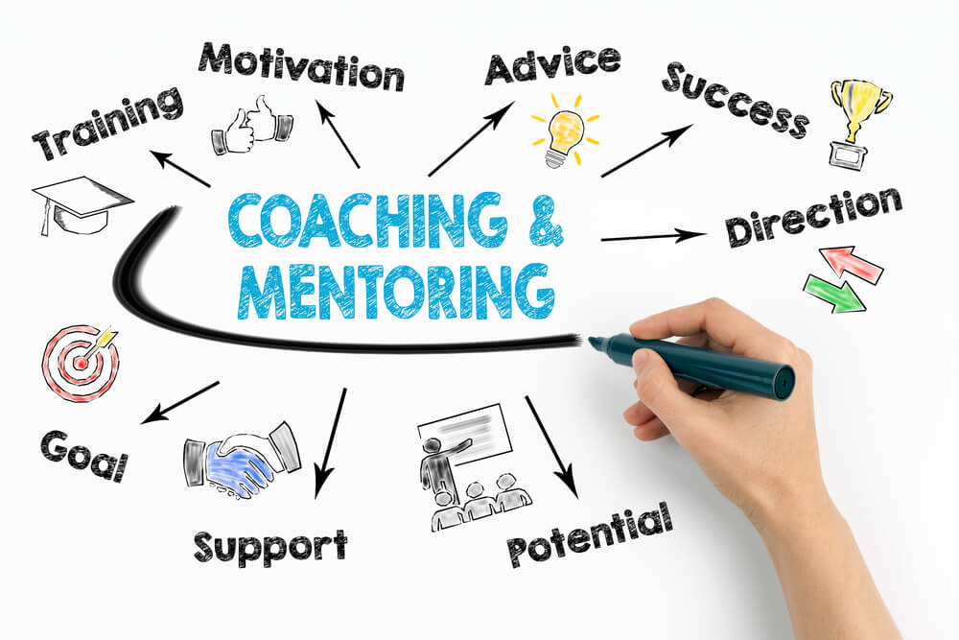
A Healing Justice Organizational
Pyles, 2020
There is opportunity to learn and grow professionally, for example, adequate supervision, mentoring, and professional development opportunities.
Image credit: https://trainingmag.com/how-to-use-coaching-and-mentoring-to-upskill-your-employees/

Slide 38
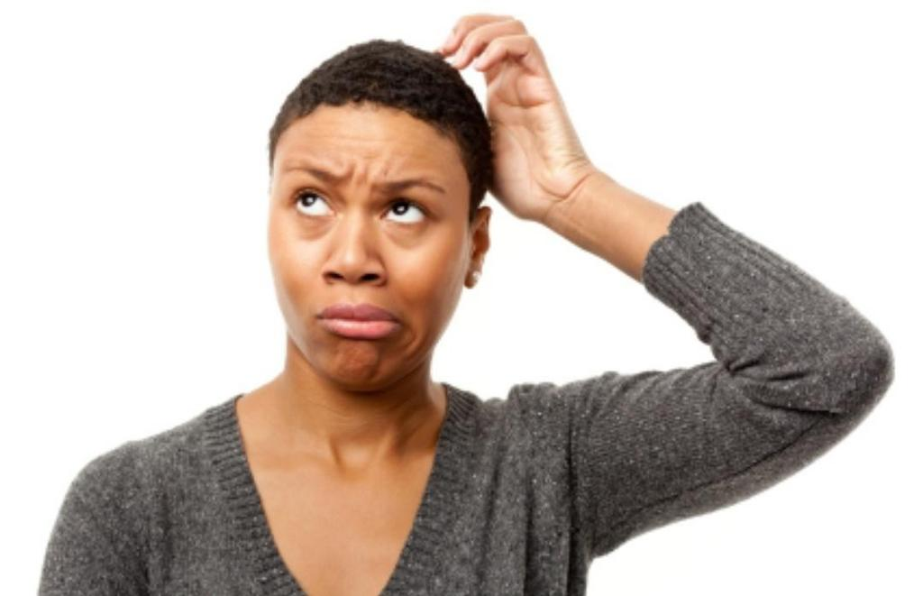
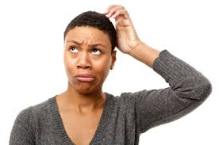
So Lois why should I consider bringing a healing justice framework to my Recovery Community Organization?
This Photo by Unknown Author is licensed under CC BY-SA-NC

Slide 39
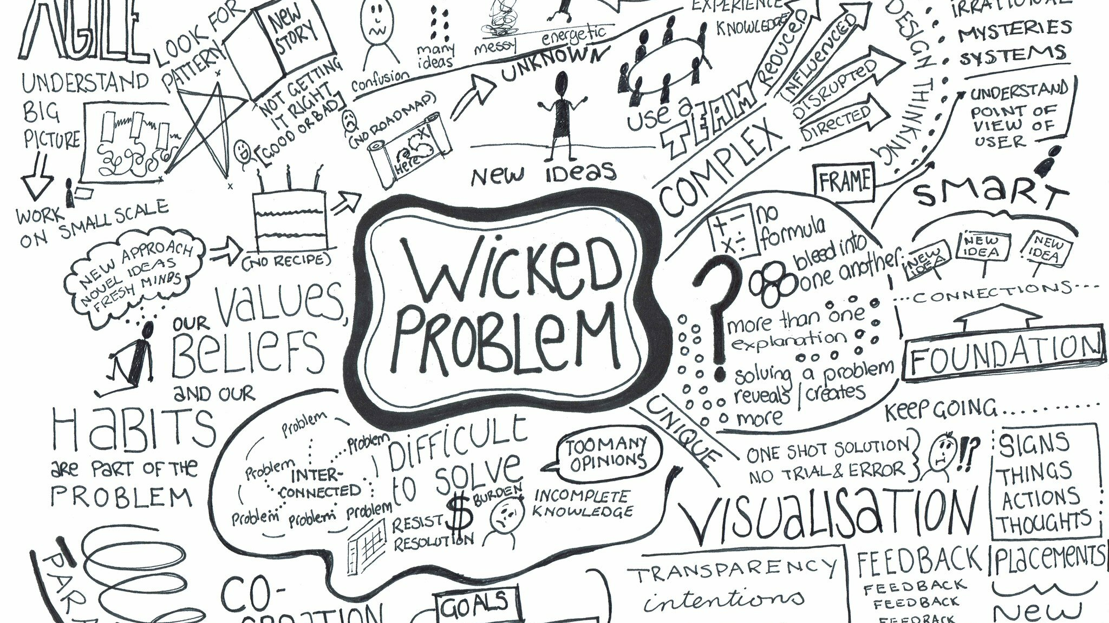
This Photo by Unknown Author is licensed under CC BY-ND

Slide 40
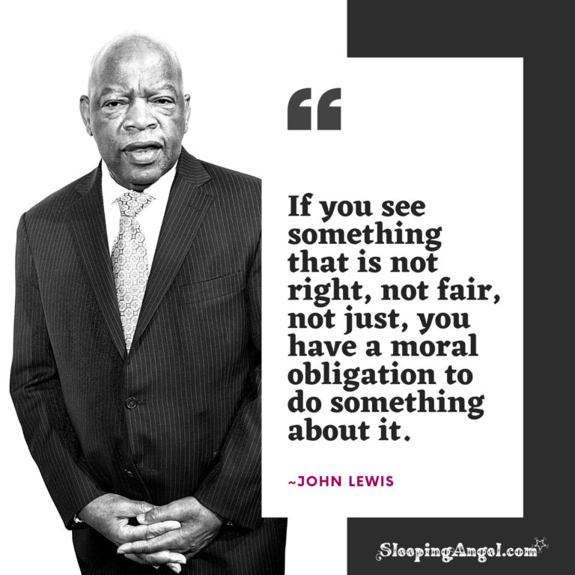

Slide 41
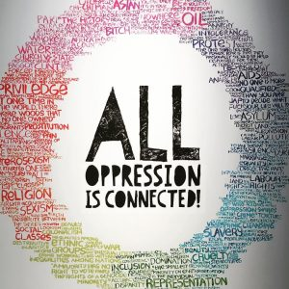
This Photo by Unknown Author is licensed under CC BY

Slide 42
The Trauma of Racism is…
NYU Silver https://studylib.net/doc/14321863/racism-trauma-the-of
"The result of chattel slavery, Jim Crow, lynching, de facto and legal discrimination, oppression, employment discrimination, poverty, social alienation, hate crimes, demonization of non-white cultures, discriminatory child welfare practices, mass incarceration, unjust imprisonment, racially biased justice systems, mandatory sentencing, inhumane treatment within society institutions, unethical medical experiments on ethnic and racial minorities, forced sterilization of Black women, the school to prison pipeline, inferior schools and education, the achievement gap, the sequestering of minority students in special education programs, racial housing segregation, inhumane housing conditions, and discriminatory policing."

Slide 43

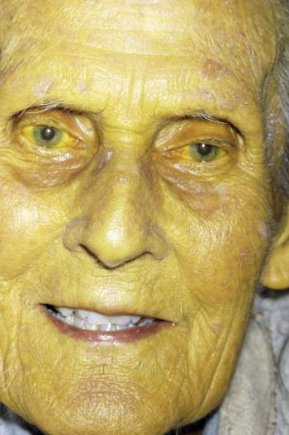
Racism Hurts Everybody
DR P. MARAZZI/SCIENCE PHOTO LIBRARY https://bostonreview.net/race/jonathan-m-metzl-dying-whiteness
The white body that refuses treatment rather than supporting a system that might benefit everyone is a metaphor for the decline of the nation as a whole.

Slide 44
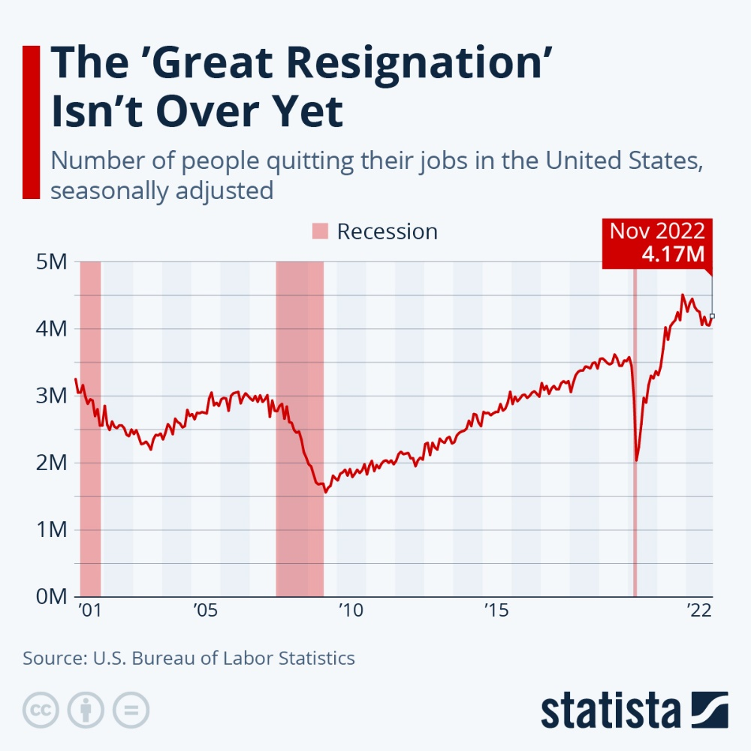
Great Resignation
Image credit: https://www.statista.com/chart/26186/number-of-people-quitting-their-jobs-in-the-united-states/

Slide 45
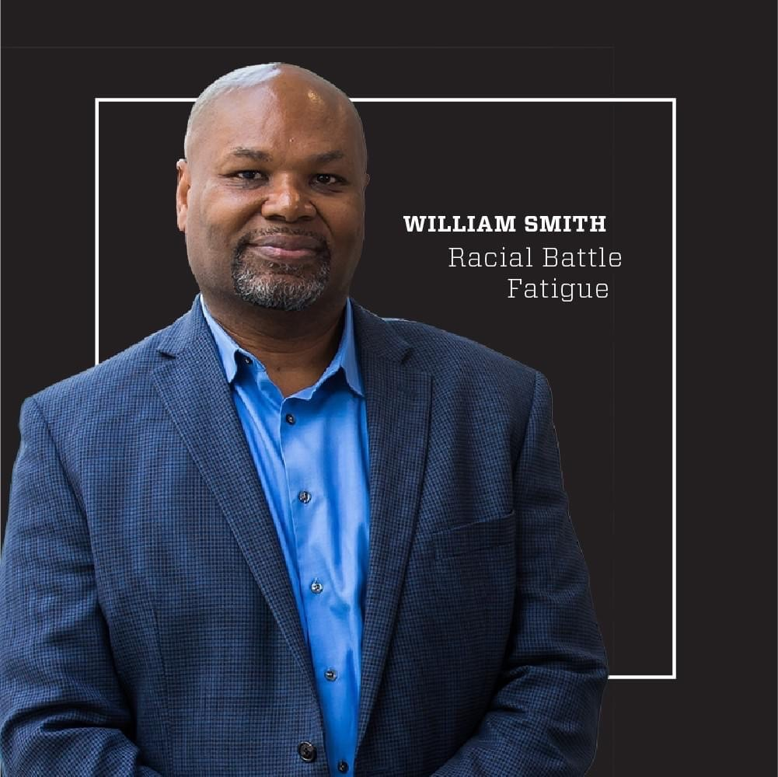
Image credit: https://www.facebook.com/DrSmithRBF/
Image credit: https://www.facebook.com/DrSmithRBF/

Slide 46
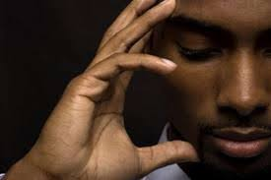
Racial Battle Fatigue Signs and Symptoms https://www.ttsdschools.org/site/handlers/filedownload.ashx?moduleinstanceid=16190&dataid=25559&FileName=Racial%20Battle%20Fatigue%20-%20Handout.pdf
*suppressed immunity and increased sickness
*tension headaches *trembling and jumpiness
*chronic pain in healed injuries
*elevated blood pressure
*a pounding heartbeat.

Slide 47
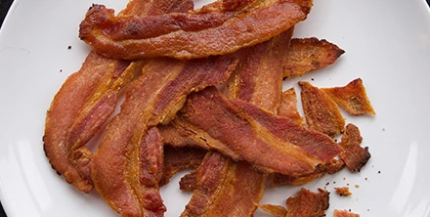
Work Related Stress and Traumatic Stress Reactions
Image credit: https://www.bbcgoodfood.com/recipes/crispy-bacon

Slide 48
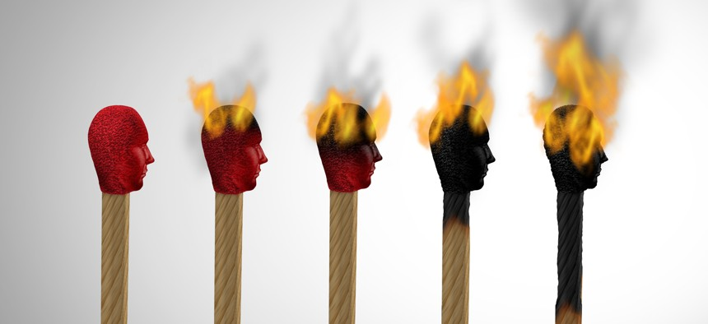
Burnout
Image credit: https://cdn.route-fifty.com/media/img/cd/2020/12/22/1burnout/860x394.jpg?1627406888

Slide 49
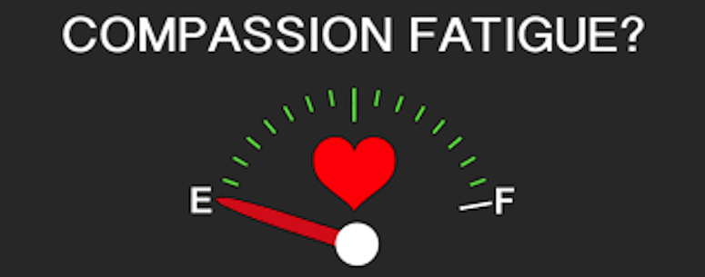
Compassion Fatigue
Image credit: https://loveandgrace.us/compassion-fatigue-an-exhaustion-of-the-frontline-worker/

Slide 50
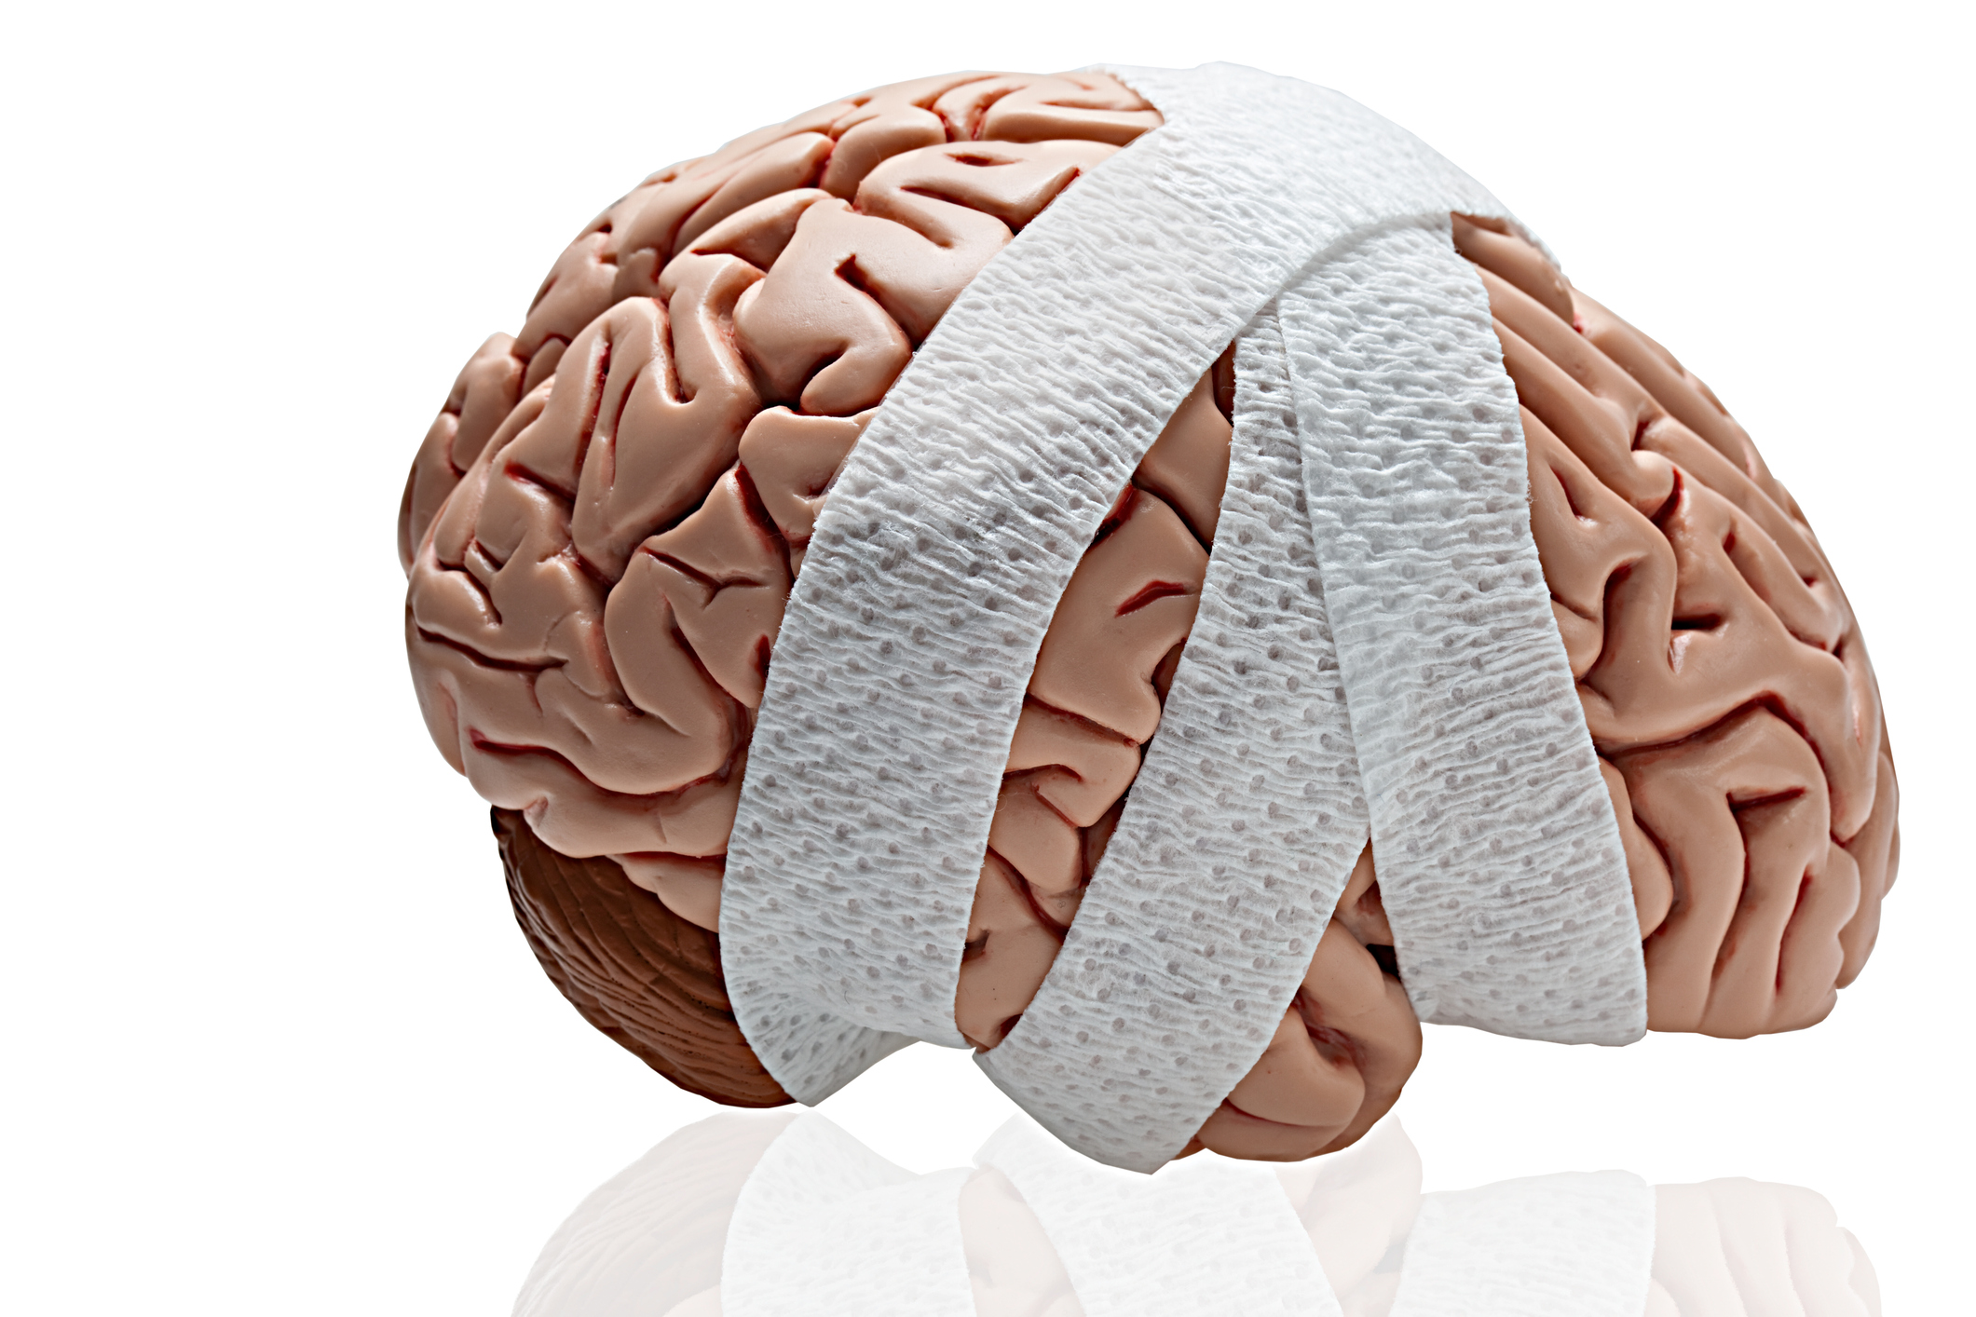
Secondary Traumatic Stress
Image credit: Creator: DebbiSmirnoff
Credit: Getty Images
Copyright: Debbi Smirnoff

Slide 51

Second Victim
Image credit: https://beterra.com/wp-content/uploads/iStock-1288085378-2048x1366.jpg

Slide 52

Vicarious Trauma
Image credit: https://cdn.britannica.com/15/152315-050-226AA671/twin-towers-skyline-Lower-Manhattan-World-Trade-September-11-2001.jpg?w=300&h=300

Slide 53
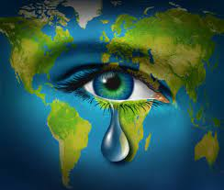
Eco-Grief
Powers & Engstrom, 2020
Cannot turn off – feel intense pressure to stay connected to work emails, the news, etc.
Physical, mental, emotional, social and spiritual burden worrying about humanity and the earth and our collective future.

Slide 54
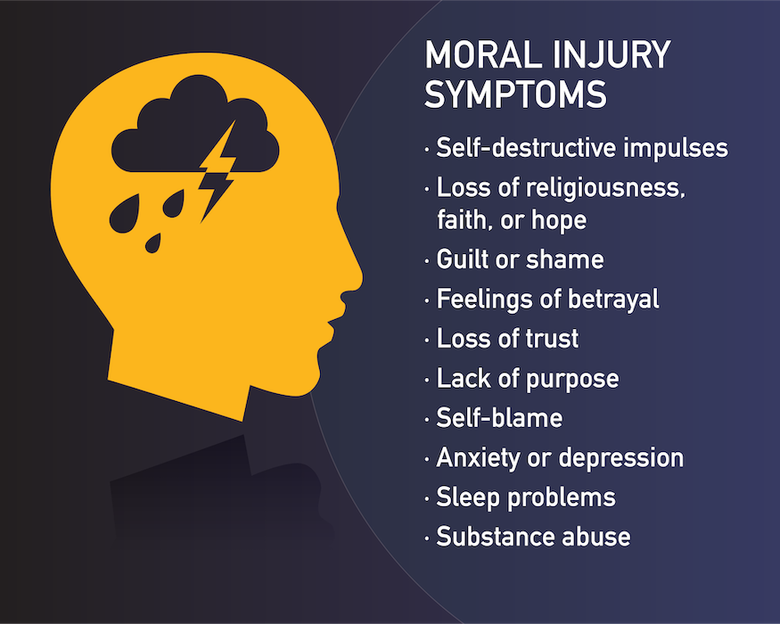
Moral Injury
Reamer (2021)
Image credit: https://www.hprc-online.org/social-fitness/couples-intimacy/help-your-relationship-recover-ptsd-tbi-and-other-invisible
“… The sort of harm that results when someone has perpetrated, failed to prevent, or witnessed acts that transgress deeply held moral beliefs.”

Slide 55
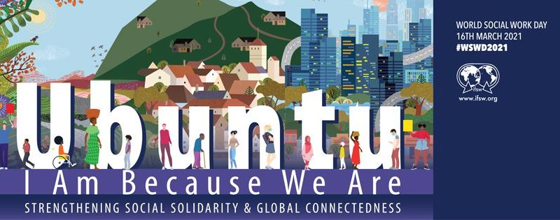
Ubuntu
Image credit: https://www.ifsw.org/wp-content/uploads/2021/07/thumbnail-1-800x315.jpeg

Slide 56
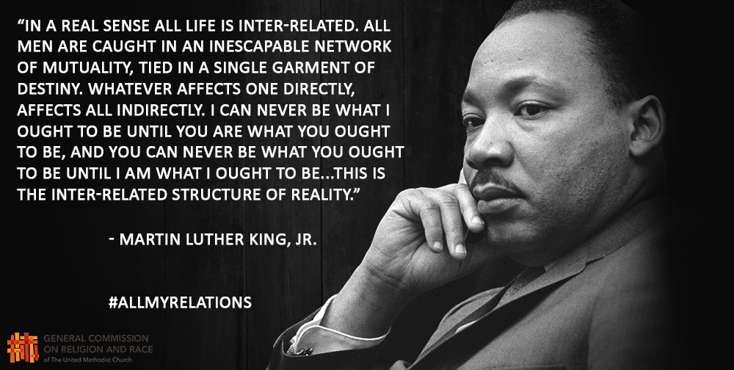
The beloved community, radical love…
Image credit: https://www.mvmediation.org/blog/conflict-resolution-ideas-day-40

Slide 57
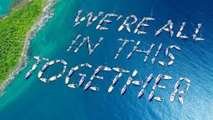
Or another way of looking at this is…
Image credit: https://www.nauticamag.com

Slide 58
“Healing Justice and Radical Healing” with Dr. Shawn Ginwright https://youtu.be/XtRmFnqmPYo to consider:
Moving from trauma informed care to “Healing Centered Engagement” – “Healing Centered Strategies”
“Healing is a political act”
“Healing is perhaps one of the most courageous acts of justice we can engage in because it means that my wellbeing is a right – our well-being is a right. Not an individual going to do self-care….”
“I have an understanding of those factors that actually created and harmed my well-being in the first place.”

Slide 59
Considering Dr. Shawn Ginwright’s statements:
Think/pair/share
When you hear the terms “healing centered engagement” and “healing centered strategies” in the context of what we have been discussing and learning thus far, what comes up for you as you consider bringing healing justice intentionally into your Recovery Community Organization?

Slide 60
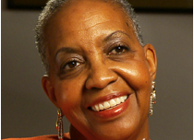
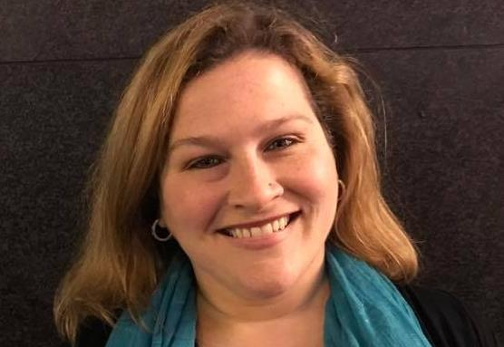

Lynette Cashaw-Davis
My Influences
Frances Frazier, MA
Founder, Black Girl Rising, Inc. (Ohio-based prevention and empowerment program for adolescent Black Girls)
Dr. Jamie Marich, Ph.D., LPCC-S, REAT, RYT-500, RMT
Developer, Dancing Mindfulness (the practice of dance and movement as meditation)
Nikki Meyers, MBA, E-RYT500
Founder, Y12SR, Yoga of 12-Step Recovery (combines practical tools of 12-step programs and somatic-based tools of yoga)

Slide 61
Looking at Recovery through the lens of equity and inclusion and committing to the elimination of disparities and addressing stigma by embracing culture-informed practices in recovery spaces
Rhythm and Moves
Mindful Black Girls
Mindfulness in Recovery
Collective Healing Through Movement

Slide 62
7 Attitudes of Mindfulness*
*According to Jon Kabat-Zinn, Director Stress Reduction Clinic at the University of Massachusetts Medical Centre, excerpted from his book Full Catastrophe Living (pp 33-40).
NON-JUDGMENT: Being an impartial witness of your own experience
PATIENCE: Accept the fact that sometimes things must unfold in their own time.
BEGINNER’S MIND: Allows us to be receptive to new possibilities and prevents us from getting stuck in the rut of our own expertise.
TRUST: It is far better to trust in your intuition and your own authority, even if you make some mistakes, then always to look outside yourself for guidance.
NON-STRIVING: Meditation’s only goal is for you to be yourself – where you are trying less and being more.
ACCEPTANCE: Seeing things as they actually are in the present.
LETTING GO: Intentionally put aside the elevation of some experience more that others – a way of letting things be, without grasping and pushing away.

Slide 63
Seven Elements of Dancing Mindfulness*
BREATH –Being attuned to the power of breath is a vital doorway to mindful awareness.
SOUND – Can refer to music, but also the tones generated by breath, heartbeat, and motion like stomping feet, clapping hands, or chanting.
BODY – Honoring the body and the information it gives you about emotional content is vital.
MIND – How we take in and send out information; the mechanism of humanity that makes mindful awareness possible.
SPIRIT – May be done through religion, cosmic flow of the universe, or relationship with a chosen Higher Power- we honor all paths.
STORY – Stories can be told in the first, second, or third person, and can be the true experience or a character that emerges.
FUSION – The coming together of all these elements - reflection and rest at the end of the practice allow them to settle in and crystallize.

Slide 64
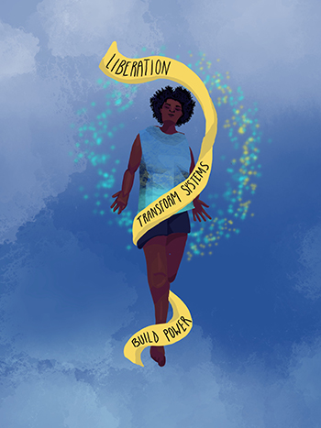
Other evidence based collective healing to consider your organizational setting…
Theatre/skits
Drum Circles
Trauma sensitive yoga
Activism
Story telling
Structured workshops like this!
Image credit: https://www.pwn-usa.org/wad-2019/

Slide 65

Final Reflections
Image credit: https://stenzelclinical.com/the-search-for-happiness-vs-the-discovery-of-joy/
Any liberating thoughts brewing as you consider the ways to bring the principles of Healing Justice back to your organization and community?

Slide 66

THANK YOU
Image credit: https://commons.wikimedia.org/wiki/File:Thank-you-word-cloud.jpg

Slide 67
Partial Bibliography –
Look at slides for other resources
Blignault, I., Jackson Pulver, L., Fitzpatrick, S., Arkles, R., Williams, M., Haswell, M. R., & Grand Ortega, M. (2014). A Resource for Collective Healing for Members of the Stolen Generations: Planning, Implementing and Evaluating Effective Local Responses. Retrieved from http://healingfoundation.org.au/wordpress/wp-content/files_mf/1423201338MuruMarriFINALSCREEN.pdf
Cook-Cottone, C. P., & Guyker, W. M. (2018). The Development and Validation of the Mindful Self-Care Scale (MSCS): an Assessment of Practices that Support Positive Embodiment. Mindfulness, 9(1), 161–175. https://doi.org/10.1007/s12671-017-0759-1
Crabtree, S. A., Bell, C. A., Rubert, D. A., Sandage, N. G., & Stavros, G., (2021). Humility, differentiation of self, and clinical training in spiritual and religious competence. Journal of Spirituality in Mental Health. 23(4), 342-262. https://doi.org/10.1080/19349637.2020.1737627
Gentry, J. E. & Baranowsky, A. B. (2013 in press) Compassion fatigue resiliency – A new attitude. Compassion Fatigue Treatment & Resiliency – Programs with Legs: The ARP, CFST, & CF Resiliency Training.
Ginwright, S. A. (2022). The four pivots: Reimagining justice, reimagining ourselves. North Atlantic Books.
Hotchkiss, J. T. (2018). Mindful Self-Care and Secondary Traumatic Stress Mediate a Relationship Between Compassion Satisfaction and Burnout Risk Among Hospice Care Professionals. American Journal of Hospice and Palliative Medicine, 35(8), 1099–1108. https://doi.org/10.1177/1049909118756657
Kirmayer L. J. (2013). The cultural diversity of healing: meaning, metaphor, and mechanism. Heart views: the Official Journal of the Gulf Heart Association, 14(1), 39–40. https://doi.org/10.4103/1995-705x.107123
Surawicz, C. M. (2014) J. Edward Berk Distinguished Lecture: Avoiding Burnout: Finding Balance Between Work and Everything Else. The American Journal of Gastroenterology, February, 2014.
Powers, M. C. F., & Engstrom, S. (2020). Radical self-care for social workers in the global climate crisis. Social Work (United States), 65(1), 29 – 37.
Reamer, F. G. (1992) The Impaired Social Worker. National Association of Social Workers, Inc.
Reamer, F. (2021, September 22). Moral distress and injury in social work. Oxford Bibliographies. DOI: 10.1093/OBO/9780195389678-0304
Stiegler, M. P. (2015) What I Learned About Adverse Events From Captain Sully: It’s Not What You Think. JAMA, 313(4).

Slide 68
Partial Bibliography –
Look at slides for other resources
Menakem, R. (2017). My grandmother's hands. Central Recovery Press.
Page, C. & Woodland, E. (2023). Healing Justice lineages: Dreaming at the crossroads of liberation and collective care and safety. North Atlantic Books.
Pyles, L. (2018). Healing justice: Holistic self-care for change makers. Oxford University Press.
Pyles, L. (2020). Healing Justice, Transformative Justice, and Holistic Self-Care for Social Workers. Social Work (United States), 65(2), 178–187. https://doi.org/10.1093/sw/swaa013
https://www.healingbychoicedetroit.com/what-is-healing-justice
https://www.takingcharge.csh.umn.edu/healing-justice-equity

Slide 69
