Slide 1
WELCOME
June 6, 2023

Slide 2
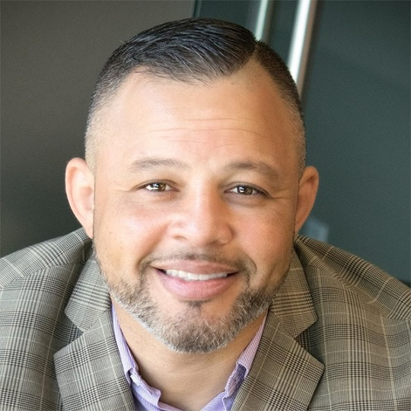
Opening Remarks
Monty Burks
Director of Faith-Based Initiatives for the Tennessee Department of Mental Health and Substance Abuse Services

Slide 3

Become a member today!
Scan to visit our membership page!

Slide 4
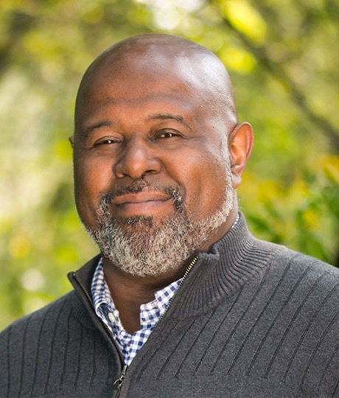
Opening Remarks
Philip Rutherford
Chief Operating Officer,
Faces & Voices of Recovery

Slide 5
Housekeeping Notes
Upcoming events
International Recovery Day, September 30
Recovery Month Luncheon Event - September 7th at Union Station
Ocarta is our 2023 Rally for Recovery host! Join us September 16, 2023 in Oklahoma City Oklahoma
2024 Rally For Recovery will be hosted by NRICO and CRCC in Chicago, Illinois.

Slide 6


Join us Next Year!
June 2 - June 5, 2024 – Denver, CO

Slide 7
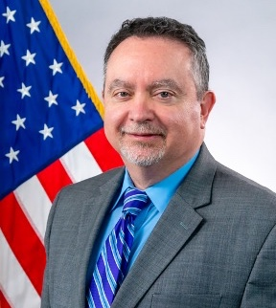
Opening Remarks
Paolo del Vecchio, M.S.W.
Director of the Office of Management, Technology, and Operations (OMTO), Director of the Office of Recovery (OR), SAMHSA

Slide 8
SAMHSA’s Focus on Advancing Recovery Across the Nation
Paolo del Vecchio, MSW
Director, Office of Recovery
Substance Abuse and Mental Health Services Administration
U.S. Department of Health and Human Services
Faces and Voices of Recovery, Recovery Leadership Summit
June 6, 2023

Slide 9


57.8 million adults (22.8% of the population) 18+ had any mental illness
1 in 3 adults aged 18 to 25
1 in 4 adults 18+
Overdose remains a leading cause of injury-related deaths
More than 107,000 lives lost
Approximately one death by suicide every 11 minutes
Leading cause of death for people aged 10 to 14
Teenagers are experiencing high levels of sadness, anxiety, and substance misuse

Slide 10

2 in 3 adults who had a
mental health issue
considered themselves
to be in recovery or recovering.
7 in 10 adults who had a
substance use problem
considered themselves
to be in recovery or recovering.

Slide 11

Policy Changes Presenting New Opportunities
Supported Block Grant Name Change – Substance Use Prevention, Treatment and Recovery Support Block Grant.
Grantees required to account for and report how funds are used to support recovery.
Establishment of SAMHSA’s Office of Recovery

Slide 12
SAMHSA National Recovery Agenda Aim & Purpose
Advancing Recovery Across the Nation
To forge partnerships to support all people, families and communities impacted by mental health and/or substance use conditions to
pursue recovery,
build resilience and
achieve wellness.

Slide 13
SAMHSA National Recovery Agenda Goals
Inclusion
Equity
Peer Services
Social Determinants
Wellness

Slide 14

Goal #1: Inclusion Nothing About Us Without Us
To foster the meaningful involvement of a wide array of people with lived experience to improve behavioral health practice & policy and to foster the social inclusion of people with behavioral health conditions.

Slide 15

Public awareness promoting evidence-based treatment and recovery practices.
Collaboration with public and private entities to celebrate individuals in recovery.
Highlighting the emergence of a strong and proud recovery community and the dedication of service providers and community members across the Nation.

Slide 16

Goal #2: Equity Recovery for All
To increase opportunities for recovery for underserved and under-resourced populations and communities including people of color, youth, older adults, LGBTQI+, rural, veterans and people with disabilities.

Slide 17
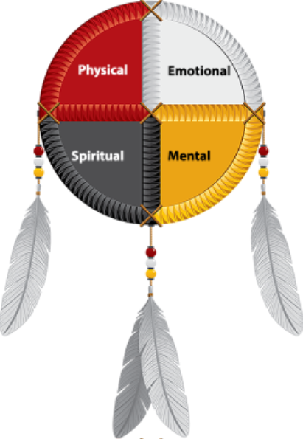
Tribal Recovery Summit

Slide 18

Goal #3: Peer Services Peers Helping Peers
To expand peer-provided services within every community.

Slide 19
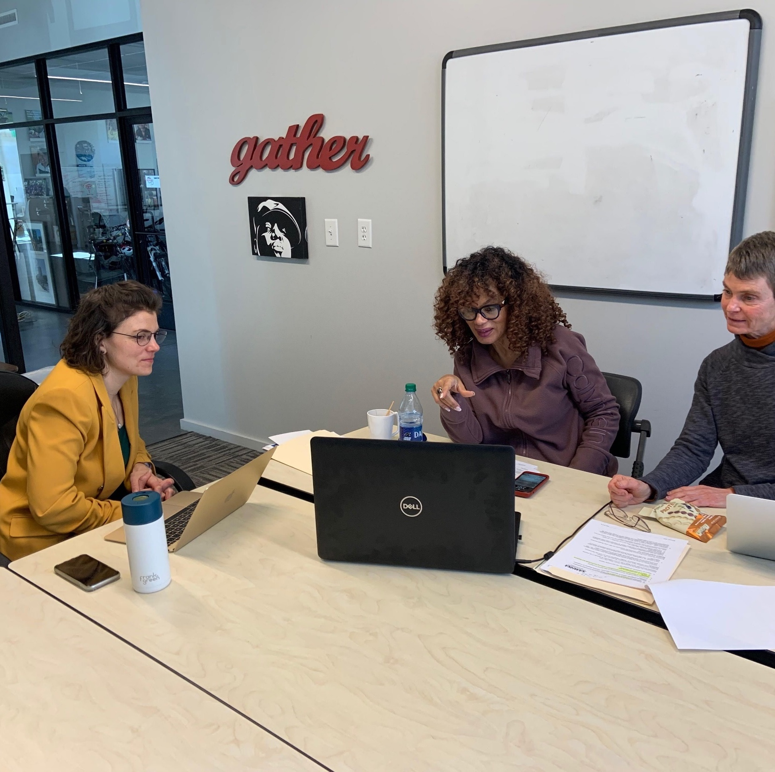
Building Peer Provided Services
Building Communities of Recovery - $5.4 million
Recovery Community Services Program - $1.2 million
Peer Recovery Center of Excellence

Slide 20
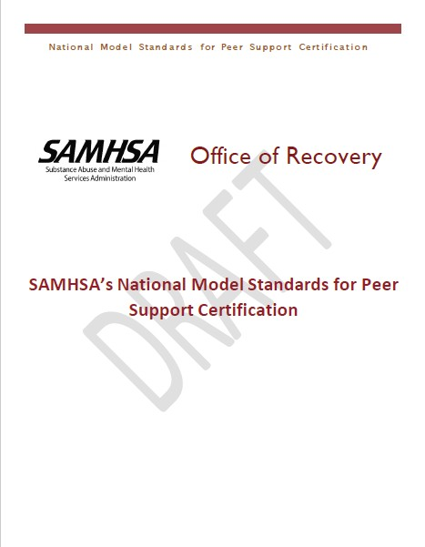
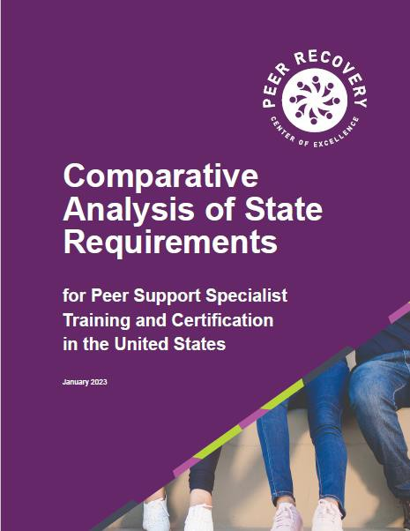

National Model Standards for Peer Support Specialist Certification
Updated as part of the standards
development
February: Technical Expert Panel
March-April: Public comment period
10

Slide 21
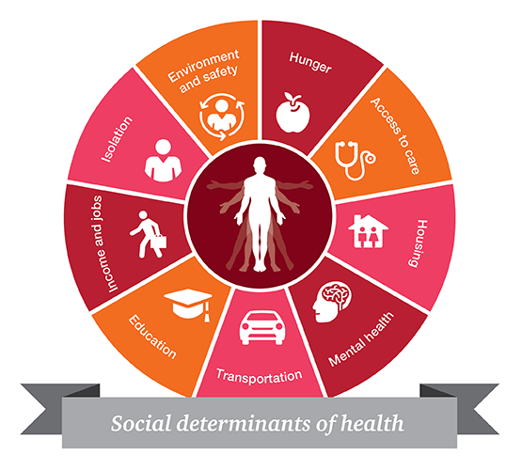
Goal #4: Social Determinants of Recovery Whole Health Care
To address key social determinants that support recovery including access to housing, education, social supports, and employment.

Slide 22

Support for Recovery Housing
SAMHSA’s Best Practices & Suggested Guidelines for Recovery Housing are being revised.
Guidelines are based on the 2018 SUPPORT law that called for Best Practices for operating recovery housing.
SUPPORT legislation defined ‘recovery housing’ as a shared living environment free from alcohol and illicit drug use and centered upon peer supports and connection to services that promote sustained recovery from SUDs.
This ensures that the recovery housing facility adheres to and promotes the use of evidence-based practices.
Notes:
We know that recovery housing is an intervention that is considered a recovery support service.
It is specifically designed to address the recovering person’s need for a safe and healthy living environment while also providing the necessary recovery and peer supports.
SAMHSA’s Best Practices & Suggested Guidelines for Recovery Housing have recently been revised and updated and are currently under review.
Now, all of SAMHSA’s treatment and recovery grants support the use of recovery housing as well as the State Block Grants.
We support and promote the certification of recovery housing through the National Association of Recovery Residences (NARR) through their state affiliates and or state certification.
This is to ensure that recovery housing facilities adhere to and promote the use of evidence-based practices.
A shout out to Ohio Recovery Housing. As a NARR affiliate, ORH creates and maintains standards of excellence for recovery housing in Ohio providing opportunities for peer reviews that regularly document an ongoing commitment to ORH quality recovery housing standards.

Slide 23

Goal #5: Wellness Individual, Family & Community Wellness
To expand holistic, self-care strategies to improve heath and behavioral health outcomes - including the reduction of early mortality and impact of co-morbid chronic health conditions – and to integrate recovery-oriented practices and systemic reform into the full continuum of health and behavioral healthcare including prevention, harm reduction, treatment, crisis care, and recovery support

Slide 24
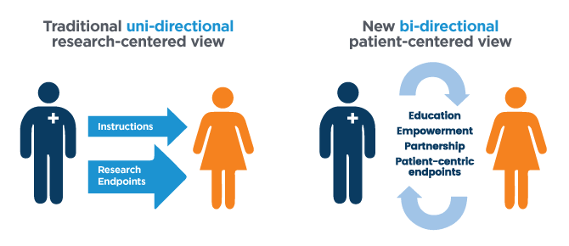
Shared Decision Making

Slide 25



Office of Recovery Core Principles
Data and evidence
To increase the collection, analysis & reporting of data on recovery and expand the identification & use of evidence and practice-based policies and approaches.
Trauma-informed
To embed trauma-informed practices and approaches in recovery efforts.
Rights Protection
To protect the human and civil rights of people with lived experience.

Slide 26

Looking Forward Requested 10% Set-Aside in Substance Use Block Grants Reviewing Recovery Oriented Systems of Care Engaging with Recovery Leaders

Slide 27



Thank You!
SAMHSA’s mission is to lead public health and service delivery efforts that promote mental health, prevent substance misuse, and provide treatments and supports to foster recovery while ensuring equitable access and better outcomes.
Grant Opportunities
www.samhsa.gov/grants
www.grants.gov/web/grants
988 Suicide and Crisis Lifeline Toolkit
www.samhsa.gov/find-help/988/partner-toolkit
@samhsagov @samhsa_leader
/samhsa
/samhsa

Slide 28

Keynote Speaker
Dr. Felecia Pullen
Dr. Felecia Pullen is a qualitative researcher exploring structural racism's impact on attaining recovery capital for people of color with a history of drug use. Her findings have been used to develop Racial Justice and Equity in Healthcare workshops and have resulted in the creation of the MRCAT, an assessment tool for professionals who develop recovery plans with their clients. Through multi-tiered approaches, she believes we can mitigate the harms associated with use and increase the attainment of recovery capital for POCWUD.
Dr. P.'s policy advocacy and activism have been widely recognized. She has delivered numerous workshops in Culturally Responsive Recovery for SAMHSA; has been twice appointed by former NYC Mayor Bill DeBlasio to NYC's Municipal Drug Strategy Council; has produced media campaigns for the State and currently sits on the FOR-NY board of directors.
Through her strong partnerships with NYPD, The NYC Dept of Health & Mental Hygiene, colleges and Universities, public and private healthcare systems, and political stakeholders, Dr. P has delivered programs and services to over 20,000 individuals free of charge.
Her work is inspired by the vision of a caring and compassionate world where every adult and child thrives.

Slide 29

Using a Recovery Capital Framework to Understand the Impact of Structural Racism on POCWUD
Dr. Felecia Pullen Ph.D
June 6, 2023
Faces & Voices of Recovery Leadership Summit
Notes:
Felecia Pullen LMSW Ph.D
Fordham University

Slide 30
Learning Objectives
Increase understanding of the negative impacts of systematic racism on POCWUD
Build knowledge of the 6 Tenets of Recovery Capital, including Negative Recovery Capital
Enhance our knowledge of Importance of assessing for recovery capital and how to use the most effective tool (MRCAT)
Gain knowledge of, and how to use, an anti-racist framework to support the recovery of PoCWUD
Notes:
In 2021, there were 2,668 overdose deaths in NYC, compared to 2,103 in 2020 and the rate per 100,000 increased from 31.6 to 39.4

Slide 31
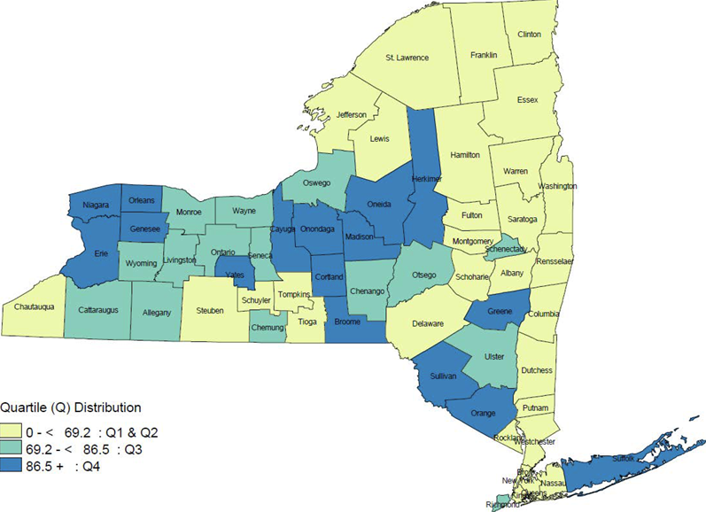
Overdose in New York State
More New Yorkers die of drug overdoses than homicides, suicides and motor vehicle crashes combined.
Quartile (Q) Distribution
0 - < 69.2 : Q1 &Q2
69.2 - < 86.5 : Q3
86.5 + : Q4
Notes:
In 2021, there were 2,668 overdose deaths in NYC, compared to 2,103 in 2020 and the rate per 100,000 increased from 31.6 to 39.4

Slide 32
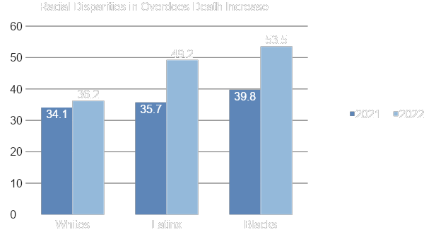
Racial Indicators
(NYC Health, 2022)
Notes:
Rates of overdoses death increased across all racial/ethnic groups from 2020 to
2021. The highest rate in 2021 and largest increase from 2020 was among Black males 55-64, who are our community’s patriarchs!
Black New Yorkers had the highest rate of overdose death, and the largest absolute increase in rate from 2020 to 2021 (39.8 vs.
53.5 per 100,000 residents). In 2021, the rate of overdose death among male New Yorkers (62.1 per 100,000
males) was over three times as high as the rate among female New Yorkers (18.9
per 100,000 females). In 2021, New Yorkers ages 55 to 64 years had the highest rate of overdose death
(81.4 per 100,000 residents) and the largest absolute increase from 2020 (an
increase of 27.9 per 100,000) compared with other age groups.

Slide 33
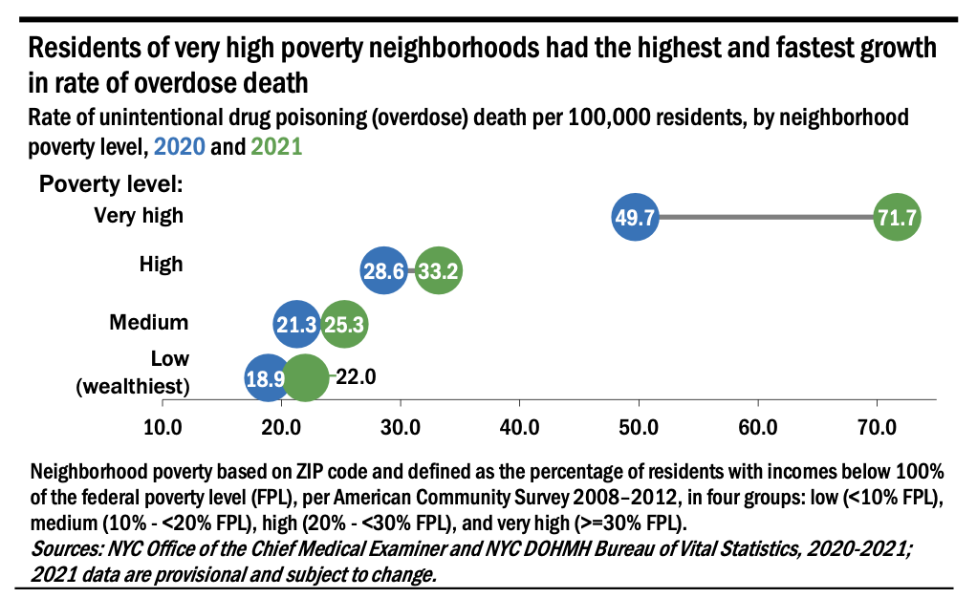
Poverty Indicators
Notes:
Community indicators further contributed to rates of overdose deaths. The neighborhoods with the highest rates of overdose death were those with the highest rates of poverty

Slide 34
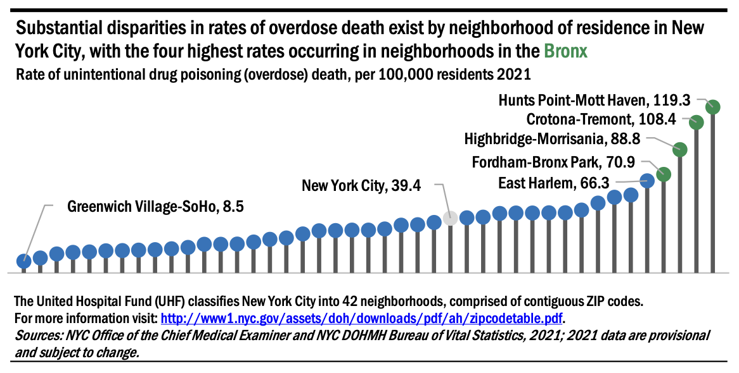
Substantial Disparities in Rates of Overdose Death
Notes:
From 2020 to 2021, rates of overdose death increased the most among residents of the Bronx (from 50.3 to
70.6 per 100,000) which is 42.47 square miles; followed by residents of Brooklyn (from 21.4 to 28.8 per 100,000) which is 69.5 square miles, Manhattan (from 26.3 to
32.8 per 100,000) 22.8 square miles (CONCENTRATION IN OD deaths are in HARLEM 3 square miles) , Staten Island (from 37.7 to 39.3 per 100,000), and Queens (from 20.6 to 21.4 per 100,000).

Slide 35
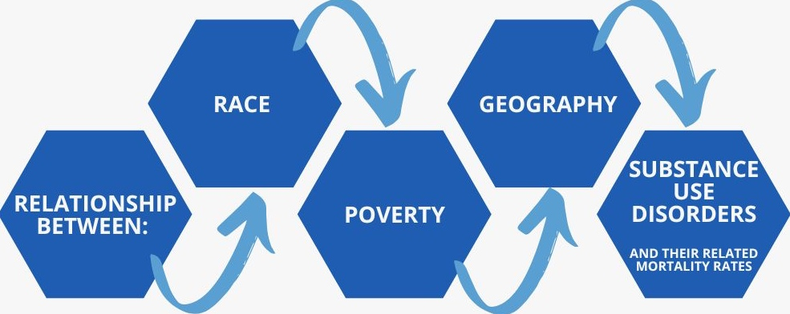
Intersection: Race, Poverty, Geography, Addiction
Blacks in low income neighborhoods experienced the greatest increases in absolute number and rate per 100,000. (NYC Health, 2021)
Notes:
Health equity research suggested a consistent relationship between race, poverty, geography, substance use disorders and their related mortality rates (NYC Health, 2021)
Overdose mortality data illustrate an increase in racial, economic, age, and place-based disparities in overdose deaths, with the largest increases occurring among older New Yorkers, Black New Yorkers,
The intersection of race, poverty, & geography is one of the greatest contributing factors to racial, economic, health, and community-based disparities impacting Blacks (NYC Health, 2021).
Compared to Whites in New York City, Blacks were historically more likely to be: racially segregated in communities at or below 100% of the Federal poverty line, educationally segregated, impacted by chronic diseases, unemployed and justice involved-These factors are also referred to as structural racism (NYC Health, 2021; Bureau of Justice Statistics, 2019).

Slide 36
Structural Racism is a Public Health Crisis
October 2021 the New York City Board of Health declared that “the service and care received by Black New Yorkers reflected long standing structural racism, which impacted their health and wellbeing”, thus defining it as a public health crisis.
(NYC Health, 2021)
Notes:
Structural racism is also at the intersection of race, poverty, addiction and drug enforcement policies
indicate
The intersect between race, poverty, addiction and drug enforcement policies appears punitive for Blacks and to have contributed to their negative recovery capital (Lim, 2018).

Slide 37
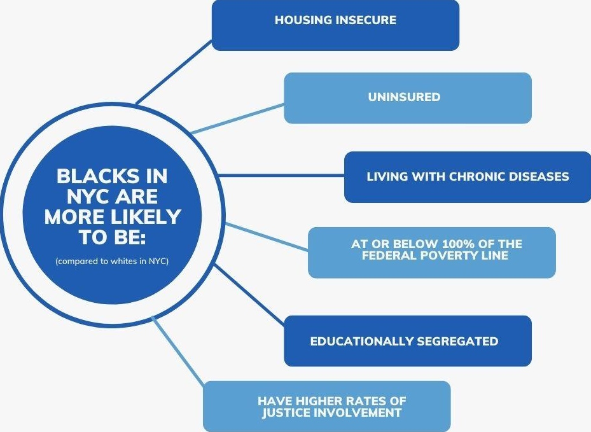
Negative Impact of Structural Racism on POC in NYC
(NYC Health, 2021)
Notes:
Bi-products of negative recovery capital are: homelessness, unemployment, chronic diseases, and poverty
The most prominent inequity in overdose mortality rates in New York City continues to be by geography, reflecting a highly segregated city. As in prior years, these geographic patterns reflect inequities in income, wealth, employment, education, criminal legal system involvement, and housing. All of these factors have been linked to an increased risk of overdose death and are the result of structural racism and disinvestment in communities.

Slide 38
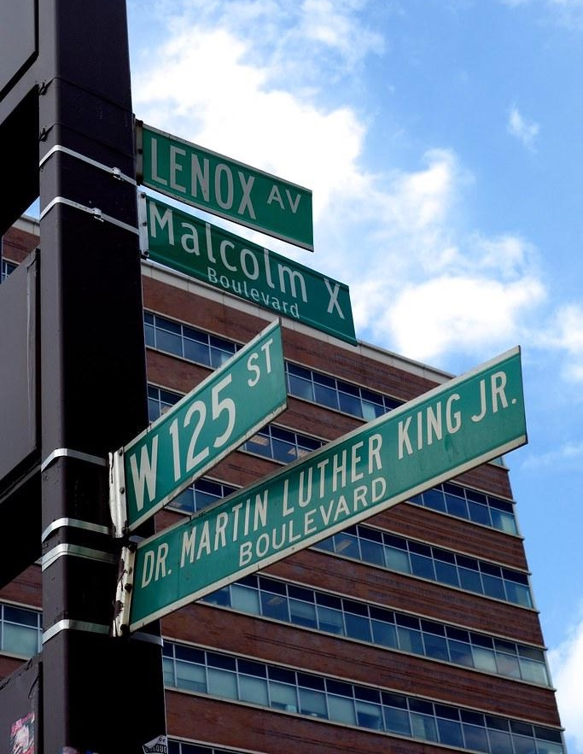
Framing Structural Racism: Critical Race Theory
Structural racism maintained racial superiority of the dominant group while marginalizing the minority group (Kim et al., 2020).
(Lim, 2018) Race-based policies are often used for profit, and labor supply to advance the social interests of Whites
(Delgado & Stefancic, 2017) Power through politics can result in structural racism in the forms of biological racism, intentional racism, implicit bias, microaggressions, racial hierarchies, White privilege, and intersectional racism
Racial attitudes influenced systems of politics, such as drug policies, and are one of the most powerful predictors of policy opinions and implementations (Caputo, 2014).
Crenshaw (1995) economic threat is often met with social control policies to reduce Blacks’ participation in the economic sphere and lessen competition for financial resources.
Notes:
In 2021, there were 2,668 overdose deaths in NYC, compared to 2,103 in 2020 and the rate per 100,000 increased from 31.6 to 39.4

Slide 39
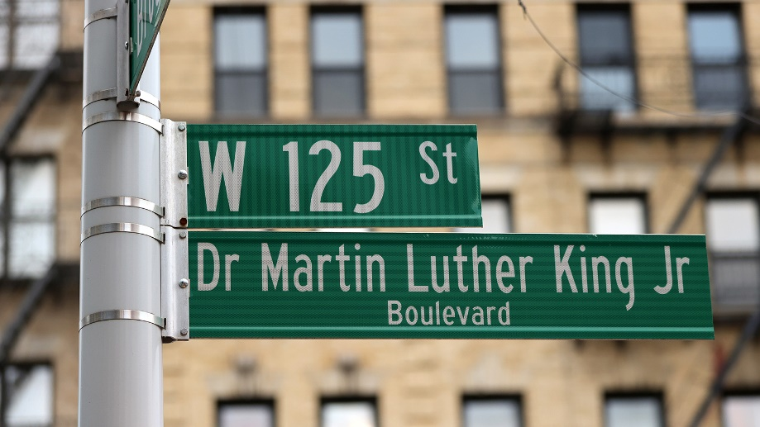
Impact of Systemic Racism on Health Care
Our healthcare system is rooted and based on racist ideology given the work of so many scientists and physicians in USA history
From exclusions of people of color in life-saving research to the exploitation of people of color in research, racism has left a mark on the medical system and strained the relationship between people of color and the healthcare system
Race-based medicine: Tuskegee experiment hundreds of Black men living in poverty in Alabama were used as test subjects; Dr. James Marion Sims, “the father of modern gynecology.” performed experiments on enslaved women in Alabama; HeLa cells were harvested from an African American woman (Henrietta Lacks) without consent and have been widely shared to benefit cancer research
Notes:
In 2021, there were 2,668 overdose deaths in NYC, compared to 2,103 in 2020 and the rate per 100,000 increased from 31.6 to 39.4

Slide 40
Impact of Drug Policies on PoCWUD
The US Black male incarceration rate increased nearly five-fold from 1 per 500 Black men entering into the justice system to about 1 per 100 (Alexander & West, 2010).
Not only were Blacks more likely than Whites to be arrested, but once arrested they were six-times more likely to be convicted; and once convicted, Blacks were more likely to face harsher sentencing due to racialized drug enforcement policies (Kim et al., 2020; Lim, 2018).
Blacks who experienced structural racism may also have been disproportionately impacted by the attainment of negative recovery capital (Granfield & Cloud, 2001; Nguyen & Reuter, 2012)
Notes:
In 2021, there were 2,668 overdose deaths in NYC, compared to 2,103 in 2020 and the rate per 100,000 increased from 31.6 to 39.4

Slide 41
“None of us need to suffer; please tell Albany and DC that we’re all human beings.” - Freda
“Tell policymakers to look at the ramifications of policies on our second and third generation of children... Until we are in positions of power, nothing will change..”
- Bruce
“We've been left behind economically, in the media, educationally, legally, and politically…we need them (government) to focus on those areas to help our people build.”
- Solomon
“Distribute enough resources to support our ability to organize our own communities. These are things that I think are important in recovery.”
- Douglas
“What I would want for [Blacks] is for somebody to actually speak up against the government who is responsible for these political and financial inequities.”
- Monique
Nothing is stable or sacred today. If they (government) choose to change the laws, which they are trying to do with voting, We can’t do nothing.”
- Nina
“Tell [the government] we want preventative measures…so we don't have to heal because more of us have been prevented from the illness.”
- Jazzi Granni
Notes:
Although participants were able to attain recovery capital, they also felt that 30 years of racialized drug enforcement policies still have ramifications for the Black family. They articulated that the lack of political representation and advocacy from the 80’s and 90’s still leaves them feeling unstable financially, politically voiceless, psychologically wounded, and marginalized by structural racism.

Slide 42
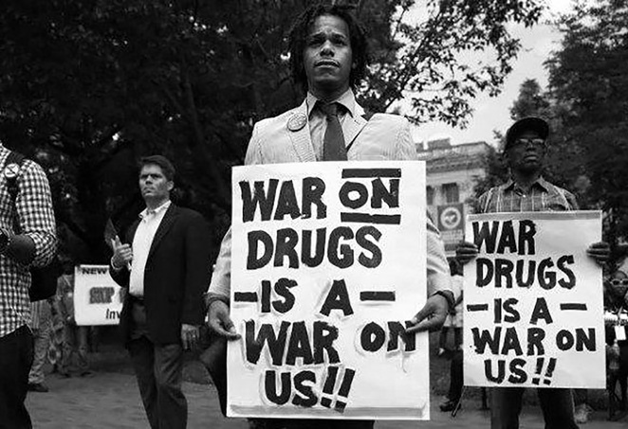
“
The Harms of Drug User are Not Necessarily from the Drugs Themselves
“You want to know what this was really all about? Nixon had two enemies: The antiwar left, and Black people. We knew we couldn’t make it illegal to be either against the war or Black. But by getting the public to associate the hippies with marijuana and the Blacks with heroin, and then criminalizing both heavily, we could disrupt those communities. Did we know we were lying about the drugs? Of course we did.”
~ John Ehrlichman, Counsel and Assistant to US President Nixon
Notes:
In 2021, there were 2,668 overdose deaths in NYC, compared to 2,103 in 2020 and the rate per 100,000 increased from 31.6 to 39.4

Slide 43
“
The war on drugs was power and privilege and African Americans had no power.” ~ Monique
Media’s portrayal of Blacks contributed to their attainment of negative recovery capital.
Douglas
Monique
Solomon
“If every time I look at a commercial and all the successful people are White and smart and all the people that are having problems and are criminals are Black, you begin to believe it and ask yourself the question “Are they smarter than us?” By the end of the day, after dealing with the racist imaging and the microaggressions, you're exhausted.”
“I looked at a treatment and recovery presentation and all of the people who were addicts were Black, but all of the people who were talking about the beautiful life of recovery were White. I just said to myself “Where am I represented on this panel?”
“There’s this certain thing called White privilege. And even the poorest of White person feels that they're better off than the richest Black person because the system supports them to think that way.”
Notes:
In 2021, there were 2,668 overdose deaths in NYC, compared to 2,103 in 2020 and the rate per 100,000 increased from 31.6 to 39.4

Slide 44
“
The war on drugs was power and privilege and African Americans had no power.” ~ Monique
Media’s portrayal of Blacks contributed to their attainment of negative recovery capital.
Bruce
Jazzi Granni
Freda
“In my opinion, if you're White and addicted to heroin there is a need to preserve your Whiteness. And therefore, we're going to do everything we can to save your life. You’re Black and addicted to crack cocaine then you're a problem and we're going to lock you up.”
“The design is to annihilate this race and by any means necessary. So, yeah, they say, “We're going to hook you on drugs. We're going to make sure it is plentiful coming into your community. We're going to send your children to jail so that they cannot procreate; and the ones that are out here, we're gonna make sure they don't prosper.”
“They eliminated their competition. The [Government] had to get rid of us. That way the White community can thrive.”
Notes:
In 2021, there were 2,668 overdose deaths in NYC, compared to 2,103 in 2020 and the rate per 100,000 increased from 31.6 to 39.4

Slide 45
Utilizing an Anti Racist Framework for Assessing the Recovery Capital of PoCWUD
Dr. Felecia Pullen

Slide 46
What is Antiracism?
“In a racist society, it is not enough to be non-racist. We must be antiracist.” ~ Angela Davis
Anti-racism is defined as the work of actively opposing racism by advocating for changes in political, economic, and social life. Anti-racism tends to be an individualized approach and set up in opposition to individual racist behaviors and impacts.
~ Harm Reduction Coalition

Slide 47
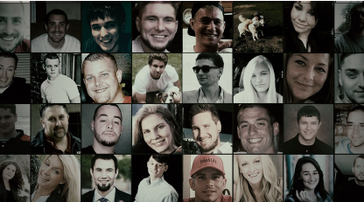
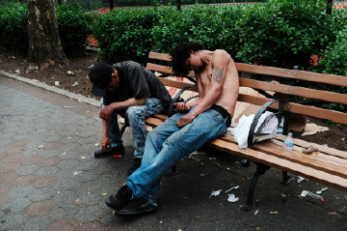

Race-based Stigma of Drug Use is Framed by Politics and Media
Depictions of drug use vary by race/ethnicity, gender, class and geography
STAT (2016)
(2018)

Slide 48

Stigma Prevents PoCWUD from Accessing Care
Stigma is a major barrier to help-seeking behavior and discourages people from seeking additional help
Stigma does not discourage substance use but feelings of worthlessness/ hopelessness can trigger ongoing, continuous use

Slide 49
What is Harm Reduction?
“Harm reduction is a set of practical strategies and ideas aimed at reducing negative consequences associated with drug use.
Harm reduction is also a movement for social justice built on a belief in, and respect for, the rights of people who use drugs.
~ Harm Reduction Coalition

Slide 50
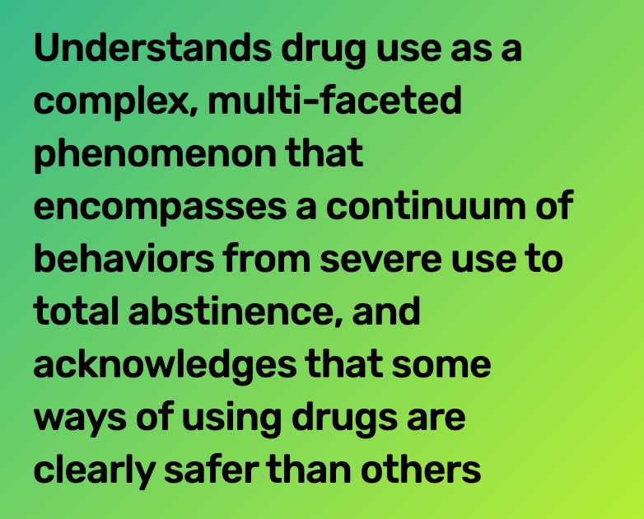
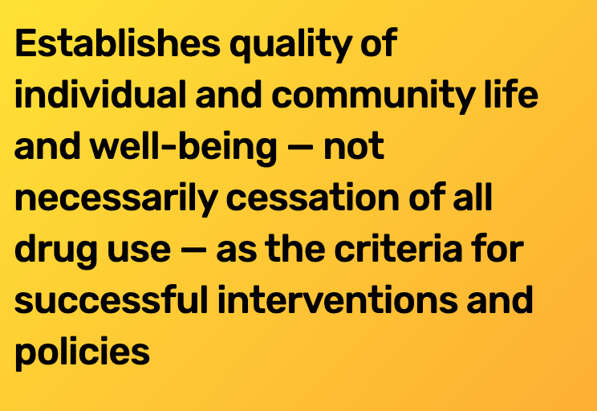
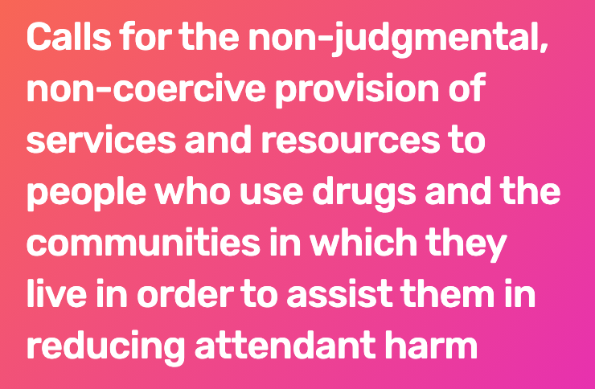
Principles of Anti Racist Framework for RC

Slide 51
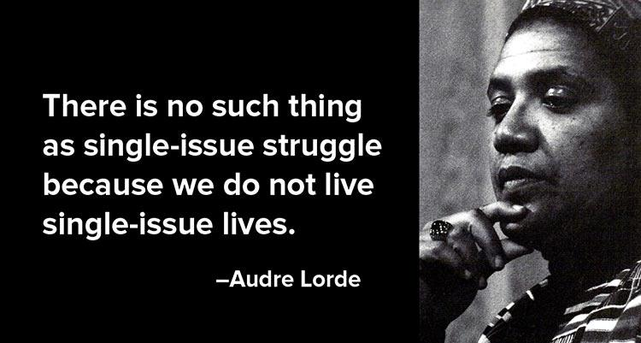

Harm Reduction + Antiracism
Intersection of criminal justice, drug policy and public health
Recognize history and present movements
Recognize that drug control and drug policies have been used to uphold colonial power structures in the US (going back to the role and purpose of race, racism, systemic racism)
Drug policies have contributed to the injustices we see affecting people who use drugs (like overdose deaths and other drug-related deaths)

Slide 52
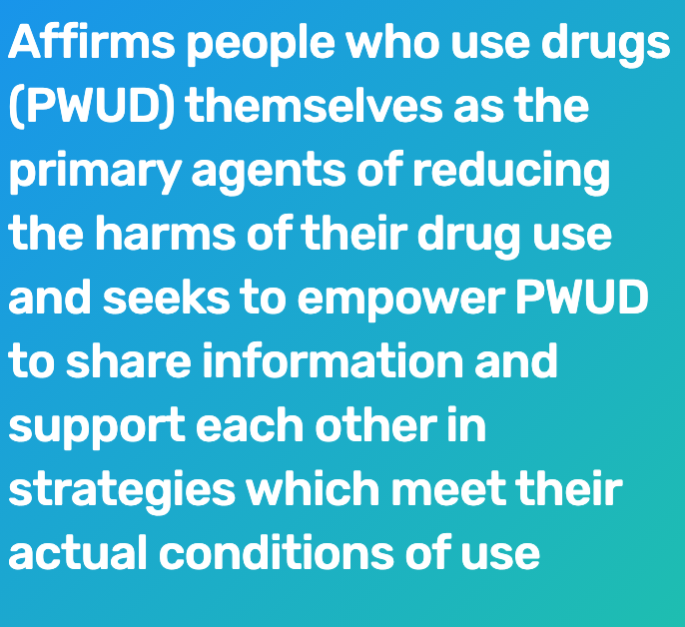
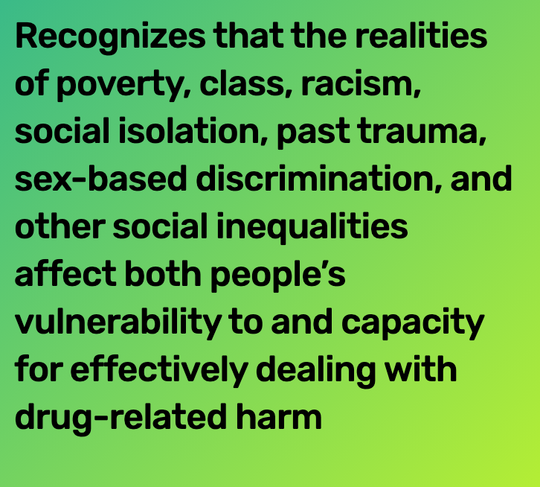
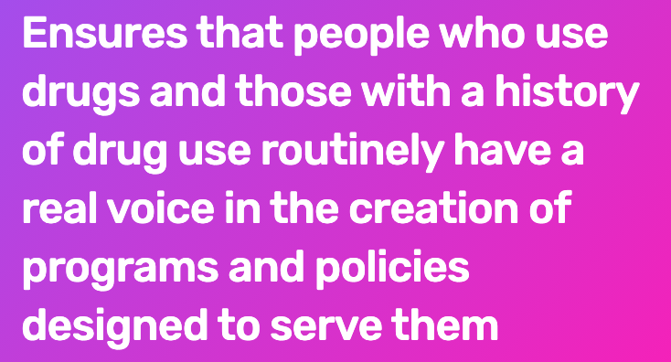
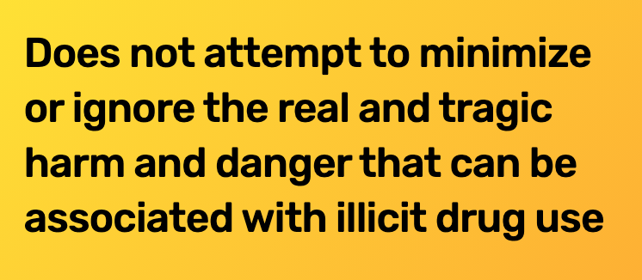
Principles of Anti Racist Framework for RC

Slide 53

Integrating an Antiracist Framework
Institutional leadership must support the work for the work to happen
Ensure that the community is leading the work
Cross sector collaborate to reach community members
Build social connections, advocate for a more just social order
This also means looking at drug policy and getting involved in advocacy
Ask for the decriminalization of drugs and their use; end to mass incarceration of people who use drugs; and redirection of funding away from ineffective and punitive drug control programs towards harm reduction and treatment programs

Slide 54
TENETS OF RECOVERY CAPITAL
Human
Capital
Physical Capital
Spiritual Capital
Social
Capital
Cultural
Capital
Education
Skills
Internal Resources
Emotional/Mental Wellbeing
Housing
Employment
Money
Bank Account
Motor Vehicle
Connection to a Higher Power
Faith-Based Membership
Improved and Healthy Relationships
Community Norms
Cultural Beliefs
Race
Low Educational Attainment, Depression, Anxiety, Low self-esteem
Unemployed, Uninsured,
Housing Insecure, Living at or below federal poverty line
Spiritual Disconnection
Social Isolation
Dysfunctional Relationships
Living in neighborhood with high rates of use/OD
(Laudet & White, 2008 & NYC Health, 2021) (Alexander & West, 2019; Bureau of Justice Statistics, 1988)
Notes:
Recovery after addiction is often measured by the attainment of recovery capital
human, cultural, social and physical capital were crucial components of sustained recovery.
access to improving their physical health (human), pro-social norms (cultural), healthy relationships (social), and housing (physical) could positively contribute to an individual’s integration and reintegration into self, family, community, and society during recovery
Negative recovery capital referred to relapse (human), engagement with norms of substance use (cultural), isolation (social), homelessness and incarceration (physical) (Laudet & White, 2008). The attainment of negative RC in the form of incarceration appeared to most frequently intersect with race, poverty, geography and drug enforcement policies for Blacks (Alexander & West, 2010; Bureau of Justice Statistics, 1988)

Slide 55
Reasons to Assess for Recovery Capital
“Recovery” should be defined and experienced by individuals engaged in the process.
(Laudet, 2020; Timpson et al. 2016)
The attainment of Recovery Capital helps to sustain recovery goals
(Laudet & White, 2008; Cloud and Granfrield, 2004)

Slide 56
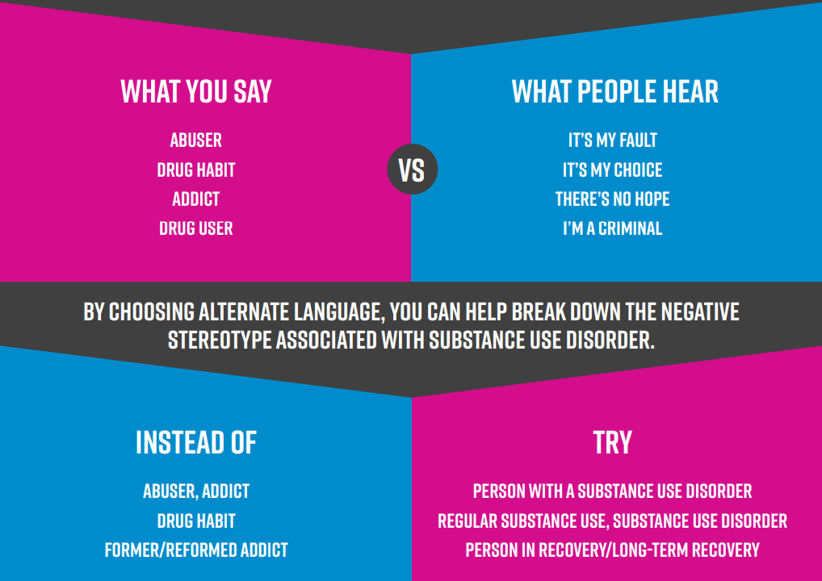
Anti Racist Framework: Person-first Language
Language is powerful, especially when talking about substance use
Labels such as “addict” and even “substance use disorder” may land heavily on people
Stigmatizing language perpetuates negative perceptions
“Person first” language focuses on the individual, not the disorder – don’t let drug use be the defining factor of the patient

Slide 57
Tools for Peers to Assess for Recovery Capital?
Brief Assessment of Recovery Capital (BACR-10) (Vilsaint et. al, 2017)
Instructions: On a scale of 1 (Strongly disagree) to 6 (Strongly agree), please indicate your level of agreement with the following statements.
1. There are more important things to me in life than using substances.
2. In general I am happy with my life.
3. I have enough energy to complete the tasks I set myself.
4. I am proud of the community I live in and feel part of it.
5. I get lots of support from friends.
6. I regard my life as challenging and fulfilling without the need for using drugs or alcohol.
7. My living space has helped to drive my recovery journey.
8. I take full responsibility for my actions.
9. I am happy dealing with a range of professional people.
10. I am making good progress on my recovery journey.
Notes:
Questions Generally guiding toward assessment of happiness and fulfillment
What do you do AFTER these questions are answered?

Slide 58
Tools for Peers to Assess for Recovery Capital?
Assessment of Recovery Capital- ARC (Groshkova et al., 2013)
Instructions for participants. Please tick if you agree with any of the following statements.
Having a sense of purpose in life is important to my recovery journey
2. I am able to concentrate when I need to
3. I am actively involved in leisure and sport activities
4. I am coping with the stresses in my life
5. I am currently completely sober
6. I am free from worries about money
7. I am actively engaged in efforts to improve myself (training, education and/or self-awareness
8. I am happy dealing with a range of professional people
9. I am happy with my personal life
10. I am making good progress on my recovery journey
11.I am proud of my home
12. I am proud of the community I live in and feel a part of it
13. I am satisfied with my involvement with my family
14. I cope well with everyday tasks
15. I do not let other people down
16. I am free of threat or harm when I am at home
17. I am happy with my appearance
18. I engage in activities and events that support my recovery
19. I eat regularly and have a balanced diet
20. I engage in activities that I find enjoyable and fulfilling
21. I feel physically well enough to work
22. I feel safe and protected where I live
23. I feel that I am in control of my substance use
24. I feel that I am free to shape my own destiny
25. I get lots of support from friends
26. I get the emotional help and support I need from my family
27. I have a special person that I can share my joys and sorrows with
28. I have access to opportunities for career development (job opportunities, volunteering or apprenticeships)
29. I have enough energy to complete the tasks I set myself
30. I have had no ‘near things’ about relapsing
Notes:
More detailed assessment.
What happens of they do not agree with any of the statements “free from worries”, “cope Well everyday”, “have access to support” What do you do then?
more importantly notice that sobriety the focus of recovery. “I am CURRENTLY COMPLETELY SOBER”. This tool is not congruent with current definitions of recovery or aligned with multiple pathways to recovery

Slide 59
Mixed-Method Recovery Capital Assessment Tool (MRCAT) (Pullen, 2022)
Instructions: On a scale of 1 (Strongly disagree) to 5 (Strongly agree), please indicate your level of agreement with the following statements.
Quantitative Scoring: The sum of the Likert-items should inform the recovery plan. The items are weighted 5-Strongly Disagree; 4-Disagree; 3-Neither Disagree nor Agree; 2-Agree; 1-Strongly Agree. Items with a score of 4 & 5 are RC measures in most need of improvement. Items scored 1 & 2 are stronger areas of capital.
Qualitative Follow-up: After completion of the quantitative section, any items with a score of 4, 5, or 3 should be followed-up with an in-depth questionnaire to gain a deeper understanding of their initial responses. Findings from the follow-up questions can be used to design a recovery plan
Utilization: The MRCAT is designed to assess the existence of Recovery Capita (RC) and to measure where the client’s RC is strongest; and which measures need additional support. Additionally, the impact of Negative Recovery Capital can help to determine other areas to support the individual. Implications can be used to inform recovery planning in partnership with the participant. The MRCAT should be utilized as an ongoing tool, and revisited to support the individual’s self-defined recovery goals.
Notes:
MRCAT 5-point Likert vs . Responses include Strongly Disagree; Disagree; Neither Disagree nor Agree; Agree; Strongly Agree).
BARC-10 6 Pt LIKERT: 1=Strongly Disagree, 2=Disagree, 3=Somewhat Disagree, 4=Somewhat Agree, 5=Agree, 6=Strongly Agree
ARC check with what you agree with…no rating scale to indicate level of agreement

Slide 60
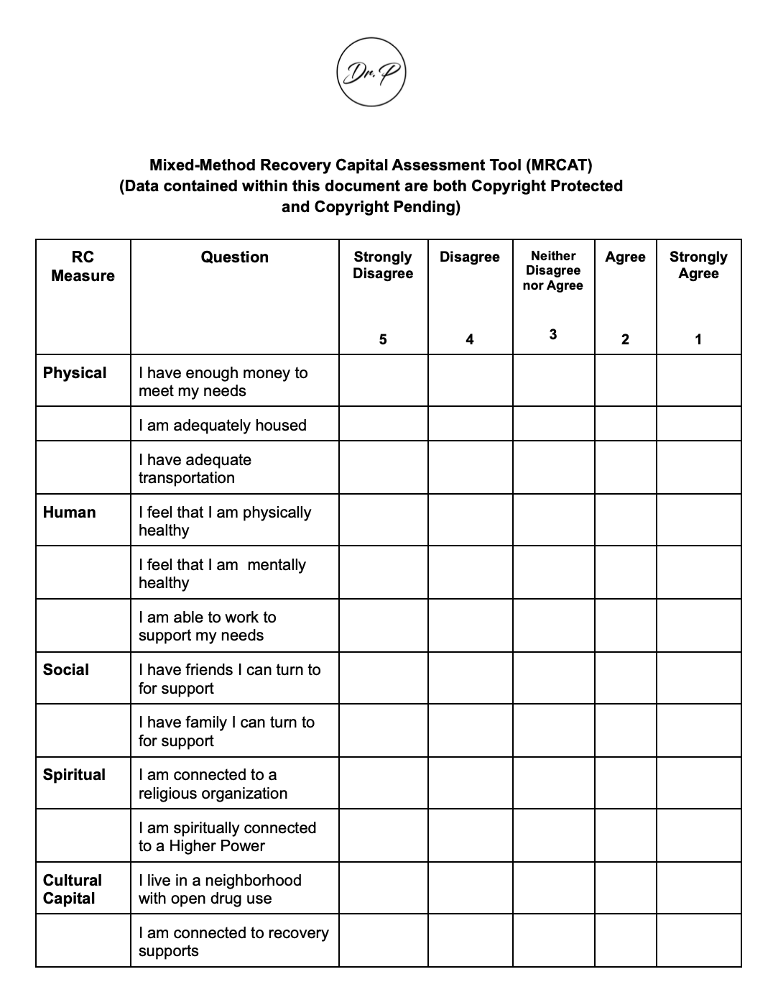
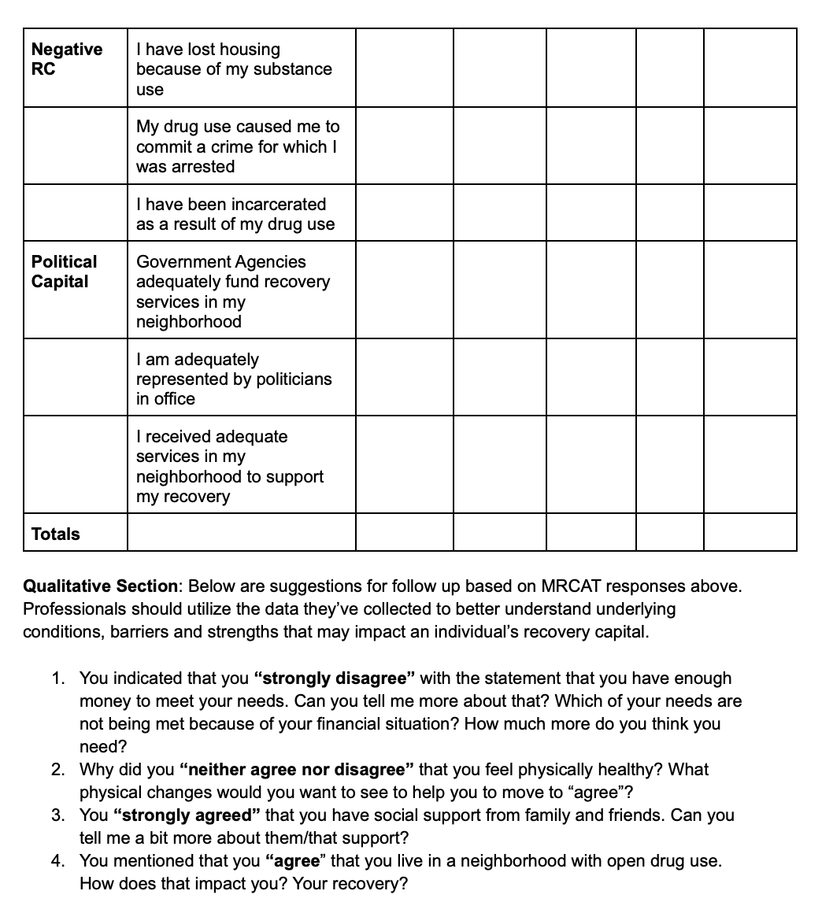
Mixed-Method Recovery Capital Assessment Tool
Notes:
SUD counselors, CCAR, CPRA, CASAC, SAPIS, LMSW, LCSW, CPP, CPS, and MHP may use the Mixed Method Recovery Capital Assessment Tool (MRCAT) to assess RC and to explore the perspectives and experiences of clients with the goal of understanding if, and how, their attainment of recovery capital has been impacted.
After completion of the quantitative section, any items with a score of 4, 5, or 3 should be followed-up with an in-depth questionnaire to gain a deeper understanding of their initial responses. Findings from the follow-up questions can be used to design a recovery plan

Slide 61
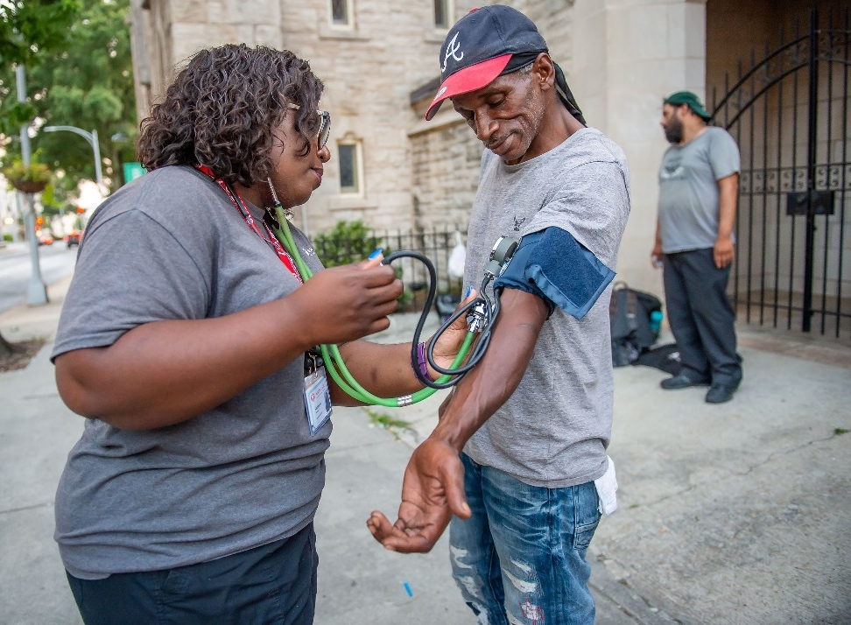
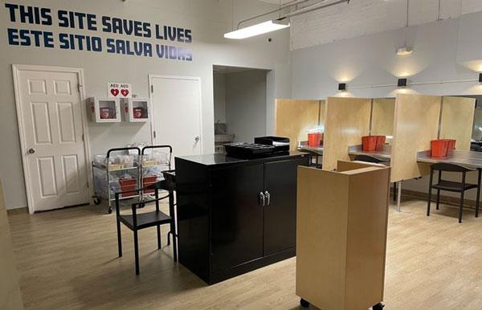
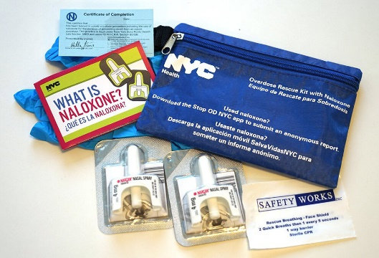
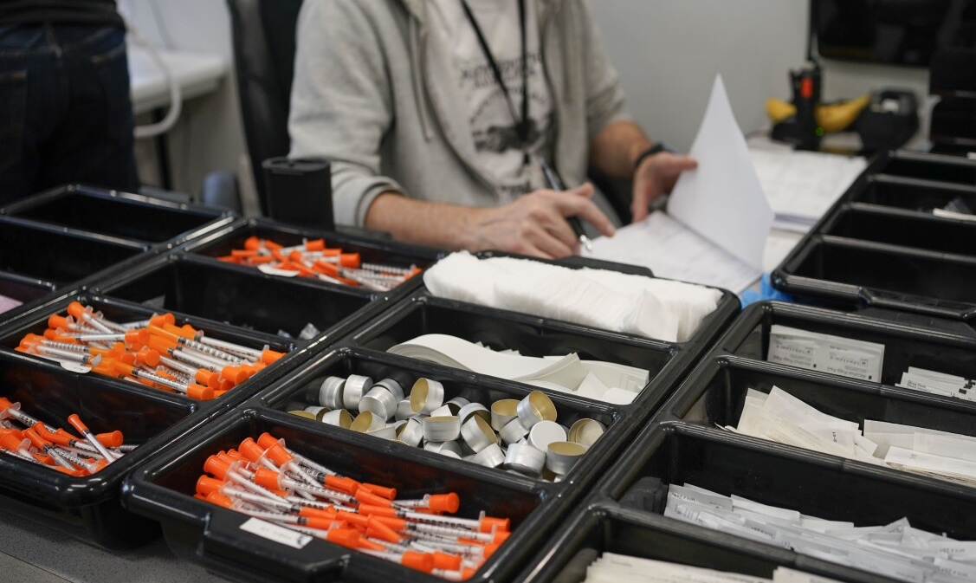
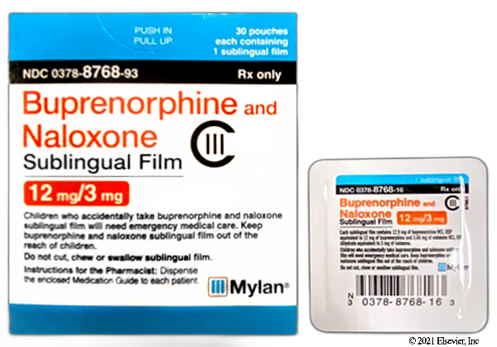
Principles In Action

Slide 62
Anti Racist Health Care for PoCWUD
LEARN ABOUT OOPCs-“Since the opening of the Overdose Prevention Center in Harlem, so much has changed in my life for the better,” said Armando Ortiz, a member with VOCAL-NY’s Users Union and OnPoint participant. “I no longer make neighbors feel afraid or unsafe by using in the streets. I no longer am afraid of overdosing with no one to help me. I now feel hopeful about my future. Governor Hochul: We need Overdose Prevention Centers everywhere, and you can do that with an executive action.”
RECOMMEND AN OOPC-“If Overdose Prevention Centers were open, more people would be interacting with case managers and program assistants educating them about what their options are if they’re at all interested in Medication-Assisted Treatment or other forms of support,” said Tanner Milazzo, a leader with Albany VOCAL-NY’s Users Union. “A lot of the time people don’t access resources – not because we’re not interested, but because we don’t know what’s available. Governor Hochul: You have the power, with the wave of your pen, to grant an executive order authorizing Overdose Prevention Centers throughout New York State right now.”

Slide 63
Opportunities for Racial Equity in HealthCare
Create advisory councils inclusive of Black voices
Listen to understand the impact of structural racism
Research and develop best practices for health equity
Target funding to underserved communities

Slide 64
Conclusion
The intersection of Race, Poverty, Geography and Addiction is a bi-product of structural racism which negatively impacts the attainment of recovery capital for Blacks
1
Commitment to reducing harms associated with structural racism (housing insecurity/homelessness, mass incarceration, high rates of unemployment, substandard education) is a prerequisite to improved and equitable outcomes for Blacks.
2
Parity in research comprehensive training, and targeted funding are necessary to support the attainment of recovery capital for Blacks
3
Notes:
Commitment to reducing harms associated with racialized drug enforcement policies and the residual effects of the attainment of negative recovery capital is a prerequisite to improved and equitable outcomes for Blacks in recovery and for Blacks who are still using drugs.
The purpose of this study was to frame how racially equitable applications of drug enforcement policies can contribute to the attainment of negative recovery capital for Blacks.
Changing structural racism, which preserves White privilege, and contributes to the attainment of negative recovery capital for Blacks requires long-term, focused efforts and institutional policy changes.
The goals of these changes are to deconstruct policies which uphold systems of White supremacy and marginalize Blacks. Racial attitudes, social teachings, intentional and unintentional bias and microaggressions must be corrected if we are to create parity among White and Black participants in treatment, prevention, recovery and harm reduction.

Slide 65
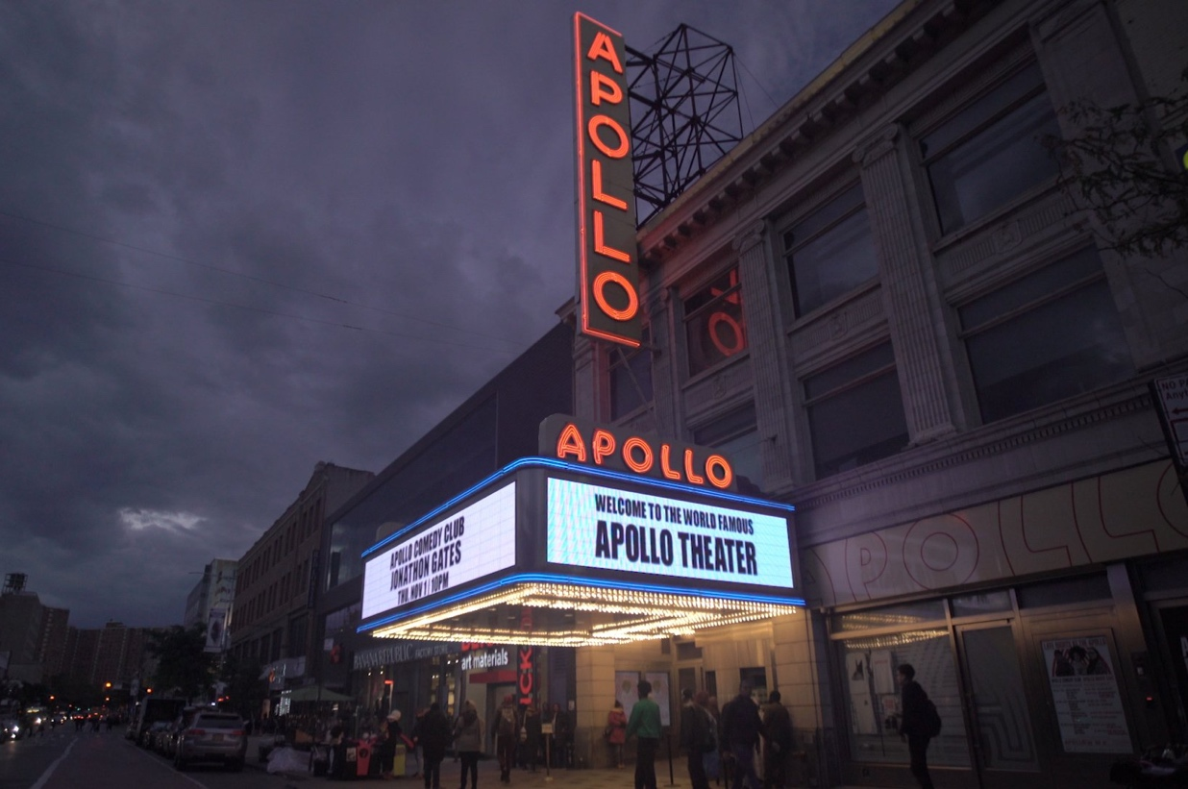

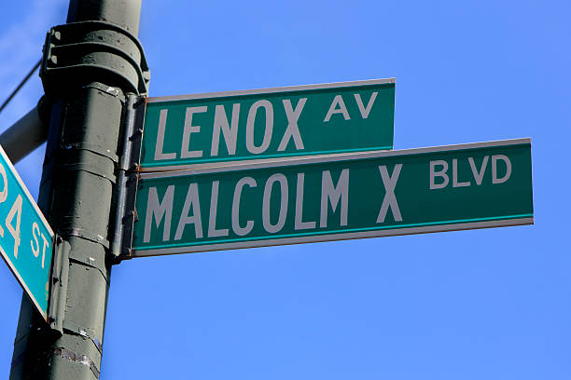
Questions?

Slide 66
Housekeeping Notes
AM Breakout Sessions 11:00 AM – 12:00 PM
Lunch served at noon in the Presidential Ballroom
Digital Recovery Solutions General Session begins at 1:15 PM
Afternoon Breakout Sessions 2:45 PM – 3:45 PM
Hill Day Informational Session at 4:00 PM
Please join us this evening at 7:00 PM for Movie Night! Choose from one of three inspiring films:
Love in the Time of Fentanyl
Our American Family
Recovery Café with Q&A
No dinner provided this evening, please plan accordingly

Slide 67
Break & Breakouts Return to Presidential Ballroom by 1:15 PM

Slide 68
Welcome Back

Slide 69

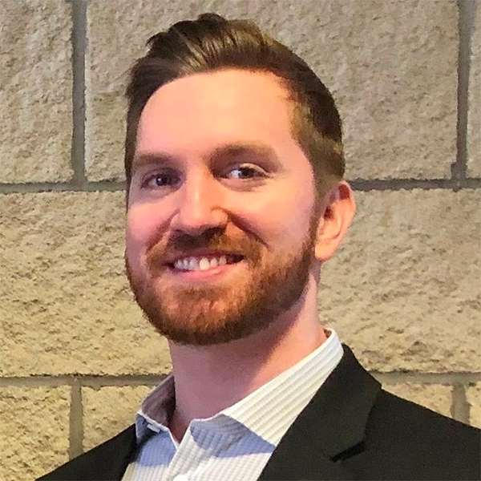
General Session
Advancing Digital Recovery Solutions
Presented by Jon Picard & Nelson Spence

Slide 70


A digital application for peer support specialists and those who employ them to connect, learn, and grow.

Slide 71

RecoveryNet: The Why
Workforce
Career Development
Continuing Education
Accessibility to Other Peers
Providers
Tools and Resources
Capacity
Authenticity of Services
Data and Reporting

Slide 72
RecoveryNet: Who is it for?
Peer Specialists
Networking
Continuing Education
Meet with Participants Virtually
Providers
Fidelity
Enhanced Data Capture
Organizational Support
Empower Staff
State Agencies
Build and Enhance Recovery Infrastructure
Workforce Development
Data, Data, Data
Reduce Hesitancy in Peer Adoption

Slide 73
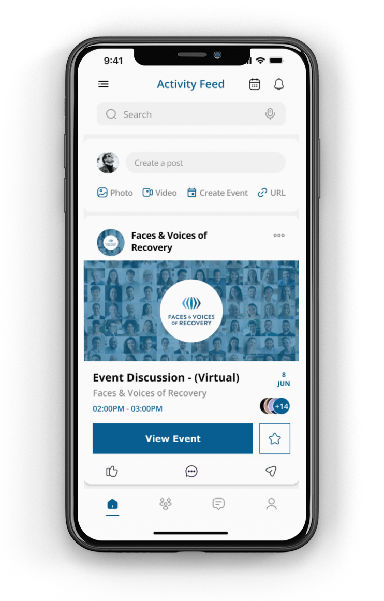
RecoveryNet: Connect
Peer Specialists
Dedicated space for networking
Professional Development
Resource exchange
Events
Timely and relevant advocacy updates
Providers
Build Community
Workforce Retention

Slide 74

RecoveryNet: Learn
Peer Specialists
Continuing Education
Resources and Tools
Share and attend Events
See upcoming Peer Interactions
Share achievements
Providers
PRSS Best Practices
Supervision

Slide 75
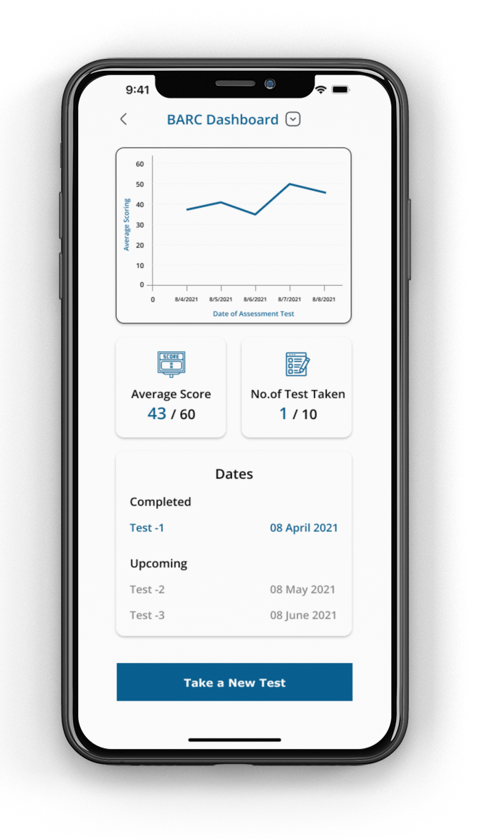
RecoveryNet: Grow
Peer Specialists
Operationalize Self-Care
Providers
BARC-10 Assessments for Peer Specialists
Create Custom Assessments to support your Peer Workforce
Integration with RDP 2.0

Slide 76
Advancing Digital Recovery Solutions
Showcasing RecoveryNet and Recovery Data Platform 2.0 to enhance Peer Specialists and Recovery Community Organizations with tools to further connection and data analytics

Slide 77

Key Principles
•Recovery Changes LIVES
•We have all seen powerful personal recovery stories
•Data tells the story of recovery in people, communities, and nationally
•We must inform the Recovery Movement through all aspects of data analytics

Slide 78
Trends & Responses
Increasing Data needs
More required elements
Increasing Mechanisms
Mobile Applications
Improvements
Robust Reporting
Additional Tools
Variations in Programs
Participant Portals
Customizations
Flexibility
National Data Sets
Research Projects
Informed Systems
Streamlined Capture
Assessment Creation
Record Type Requirements
Scheduling
Responsive
Quick Views
Standardization
Top-Down Deployments
Flexibility

Slide 79
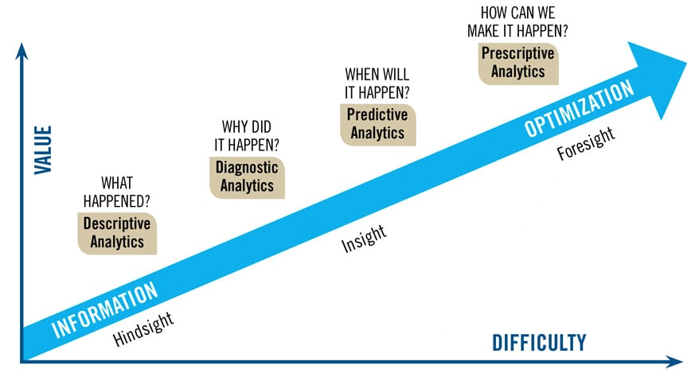
Data Analytics

Slide 80
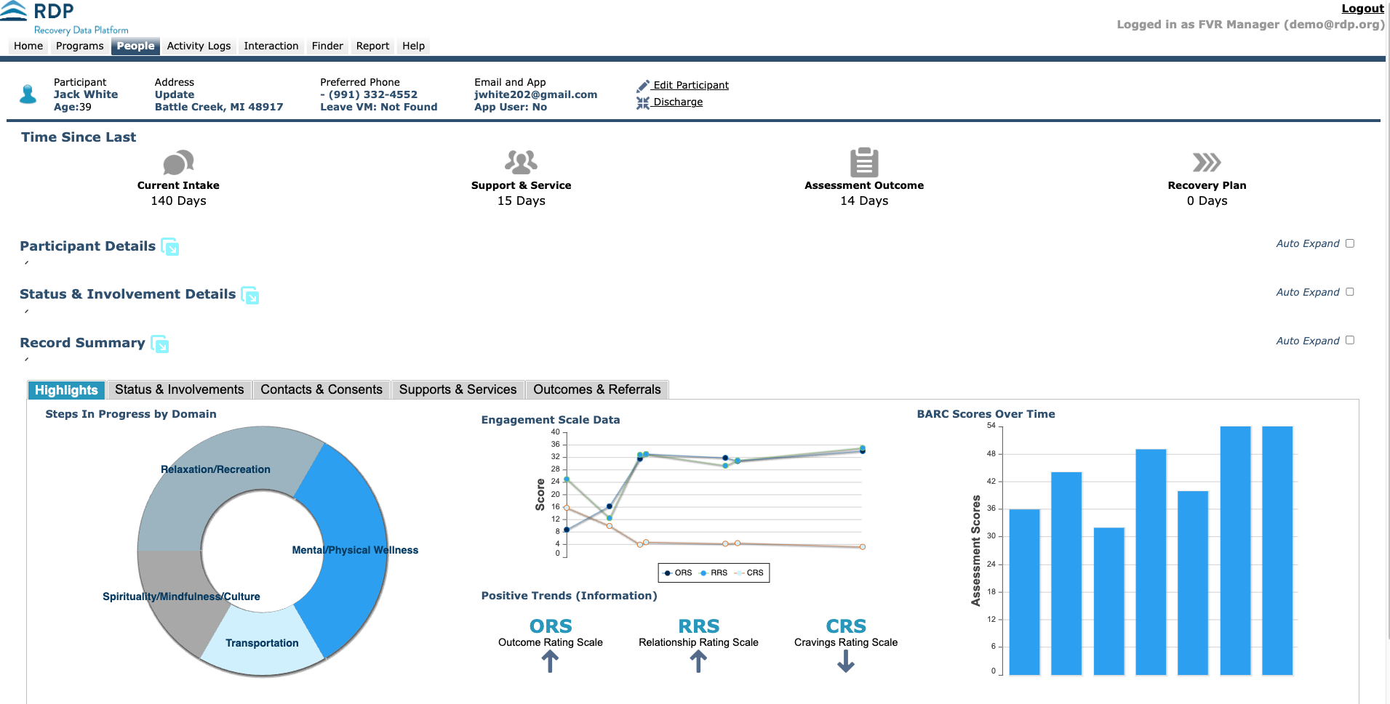
Participant Analytics

Slide 81
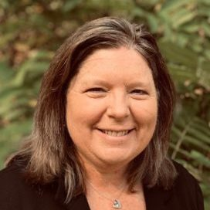
News & Updates
Patty McCarthy
Chief Executive Officer
Faces & Voices of Recovery

Slide 82

International Recovery Day

Slide 83

Save the Date: Recovery Month Luncheon
Luncheon Event
September 7th
at Union Station
Head to rm.facesandvoicesofrecovery.org
And stay up to date with all the details

Slide 84

2023 Hub Event
Congratulations to OCARTA
our 2023 Rally for Recovery Host!
September 16, 2023
900 North Portland Ave Oklahoma City, Oklahoma 73017
Oklahoma Citizens’ Advocates for Recovery and Transformation Association

Slide 85


2024 Hub Event
Congratulations to NIRCO & CRCC
our 2024 Rally for Recovery Host!
September 2024
Chicago, Illinois

Slide 86
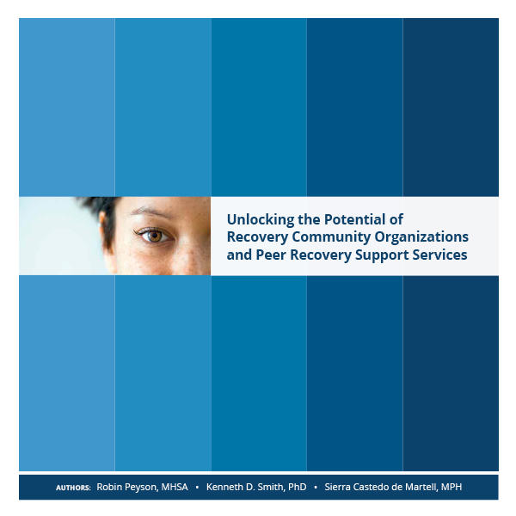

Position Paper Available Now!
Scan the QR Code faces.ly/position-paper

Slide 87


Slide 88

Alliance of Recovery Centered Organizations

Slide 89
Housekeeping Notes
Afternoon Breakout Sessions 2:45 PM – 3:45 PM
Headshot Lounge open from 4:00 PM – 5:00 PM
Mandatory Hill Day Informational Session at 4:00 PM
Wellness Activities and All Recovery Meetings begin at 7:00 AM
Breakfast begins at 7:00 AM tomorrow
Join us at 8:30 AM tomorrow morning in the Presidential Ballroom for Hill Day Kickoff!

Slide 90
Break & Breakouts Return to Presidential Ballroom by 4:00 PM for the Hill Day Informational Session & Movie Night at 7:00 PM

Slide 91
Hill Day Informational Session

Slide 92
Turning Stories into Results: Effectively Using Advocacy to Create Legislative Change In Congress
Ryan Greenstein
Overdose Prevention Initiative
Global Health Advocacy Incubator
Libby Jones
Overdose Prevention Initiative
Global Health Advocacy Incubator

Slide 93
Why is now the time for overdose prevention legislation?
Consensus that we’ve reached a crisis moment
Bipartisan support for increasing access to treatment
Urban and rural regions are being impacted
Synthesis between public health and public safety on policy solutions

Slide 94
Personal stories inspire and are a powerful tool to help move policy forward.

Slide 95
Case Study: Mainstreaming Addiction Treatment (MAT) Act
Eliminated outdated waiver (x-waiver) required for prescribing medication to treat opioid use disorder
Why was Congress passing the MAT Act important?
Signed into law on December 29 as part of the Consolidated Appropriations Act of 2022

Slide 96
Strategies and Tactics
Build a diverse coalition
Take advantage of networks
Find unexpected champions
Own your expertise
Bring stories to Congress

Slide 97
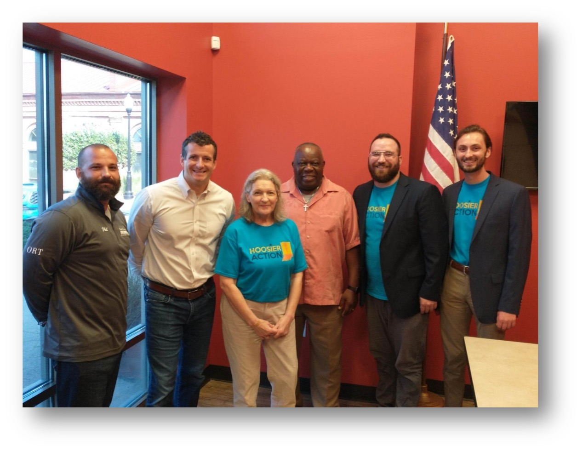
Tools You Have
Lived experience
Constituent meetings
District visits
Social media

Slide 98
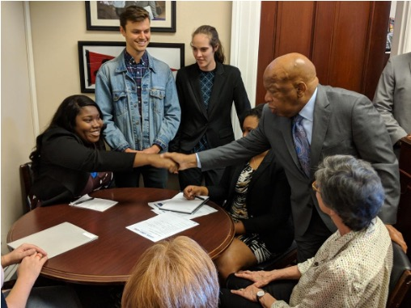
Tips for a Successful Congressional Meeting
Tell Your Story
Have A Clear Ask
Be Concise
Staff Matter
Be Respectful
Follow Up
Photo Credit: Jose Woss/FCNL

Slide 99








Earned Media

Slide 100
Why is now the time for overdose prevention legislation?
Consensus that we’ve reached a crisis moment
Bipartisan support for increasing access to treatment
Urban and rural regions are being impacted
Synthesis between public health and public safety on policy solutions

Slide 101
Stay in Touch
Libby Jones, Project Director
LJones@ AdvocacyIncubator.org
Ryan Greenstein, Associate Director of Advocacy
Rgreenstein@AdvocacyIncubator.org
@ActionForOD
www.ActionForOverdose.org

Slide 102
Discussion

Slide 104



Join us this evening!
Movie Night - 7:00 PM
Kick off your business casual attire, throw on some comfy clothes, and join us for Tuesday Night Movie Night! We'll be sharing beverages and popcorn while watching recovery-related documentaries. View one of these 3 inspiring films!

