Slide 1

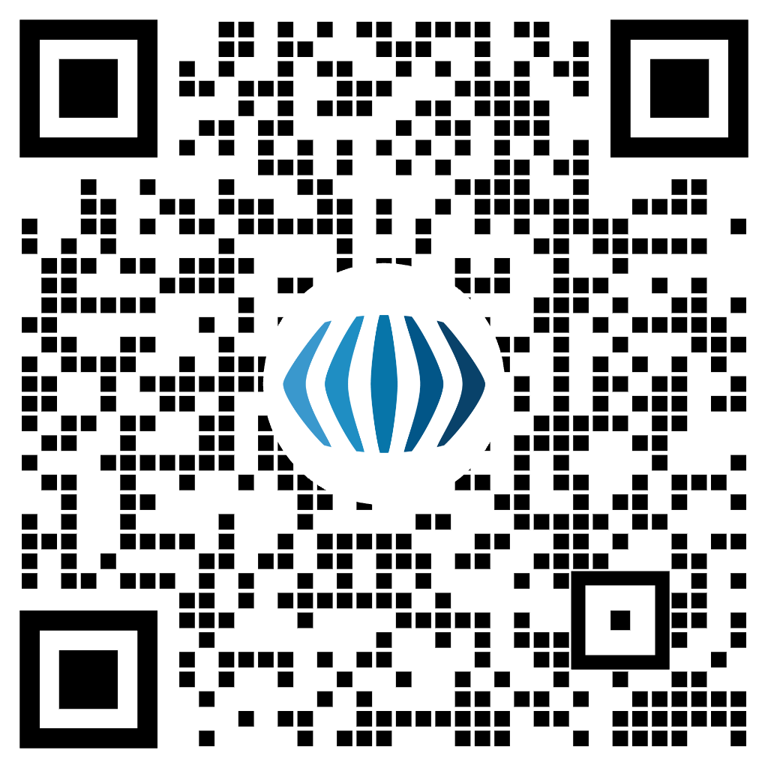
Recovery Leadership Summit | Denver, CO | June 2-5
KEY | DATES
February 22, 2024 | Early Bird Registration Opens
February 22, 2024 | Call for Presentations Opens
March 15, 2024 | Call for Presentations Closes
March 22, 2024 | Early Bird Registration Closes
March 23, 2024 | Regular Registration Opens
May 2, 2024 | Discounted Hotel Room Block Closes
May 17, 2024 | Regular Registration Closes
May 18, 2024 | Late Registration Opens
May 31, 2024 | Late Registration Closes
Scan and Buy Your Ticket
Buy Your Ticket: rls.facesandvoicesofrecovery.org

